Slide 1
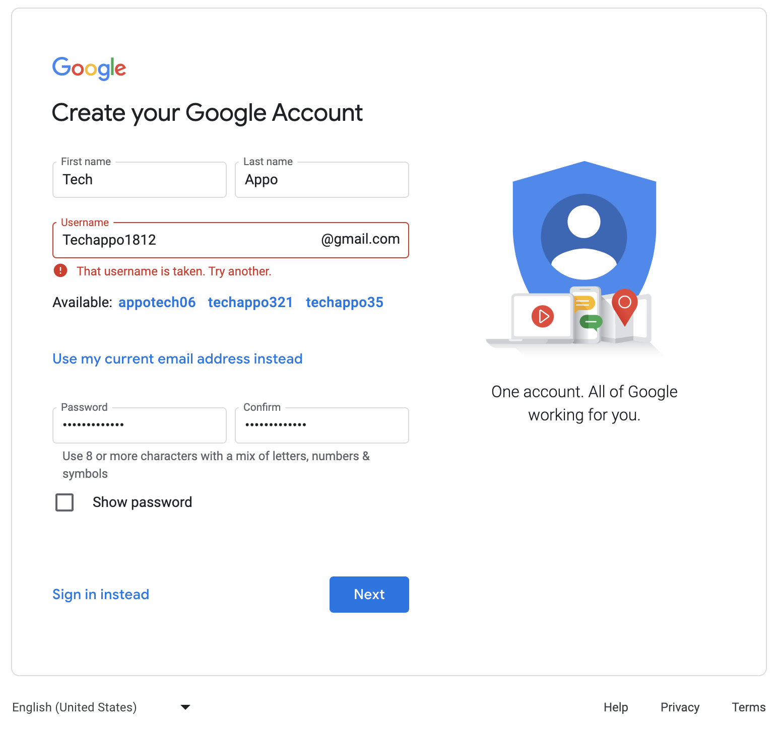
Creating Website’s Email Id by developer for mail….

Slide 2
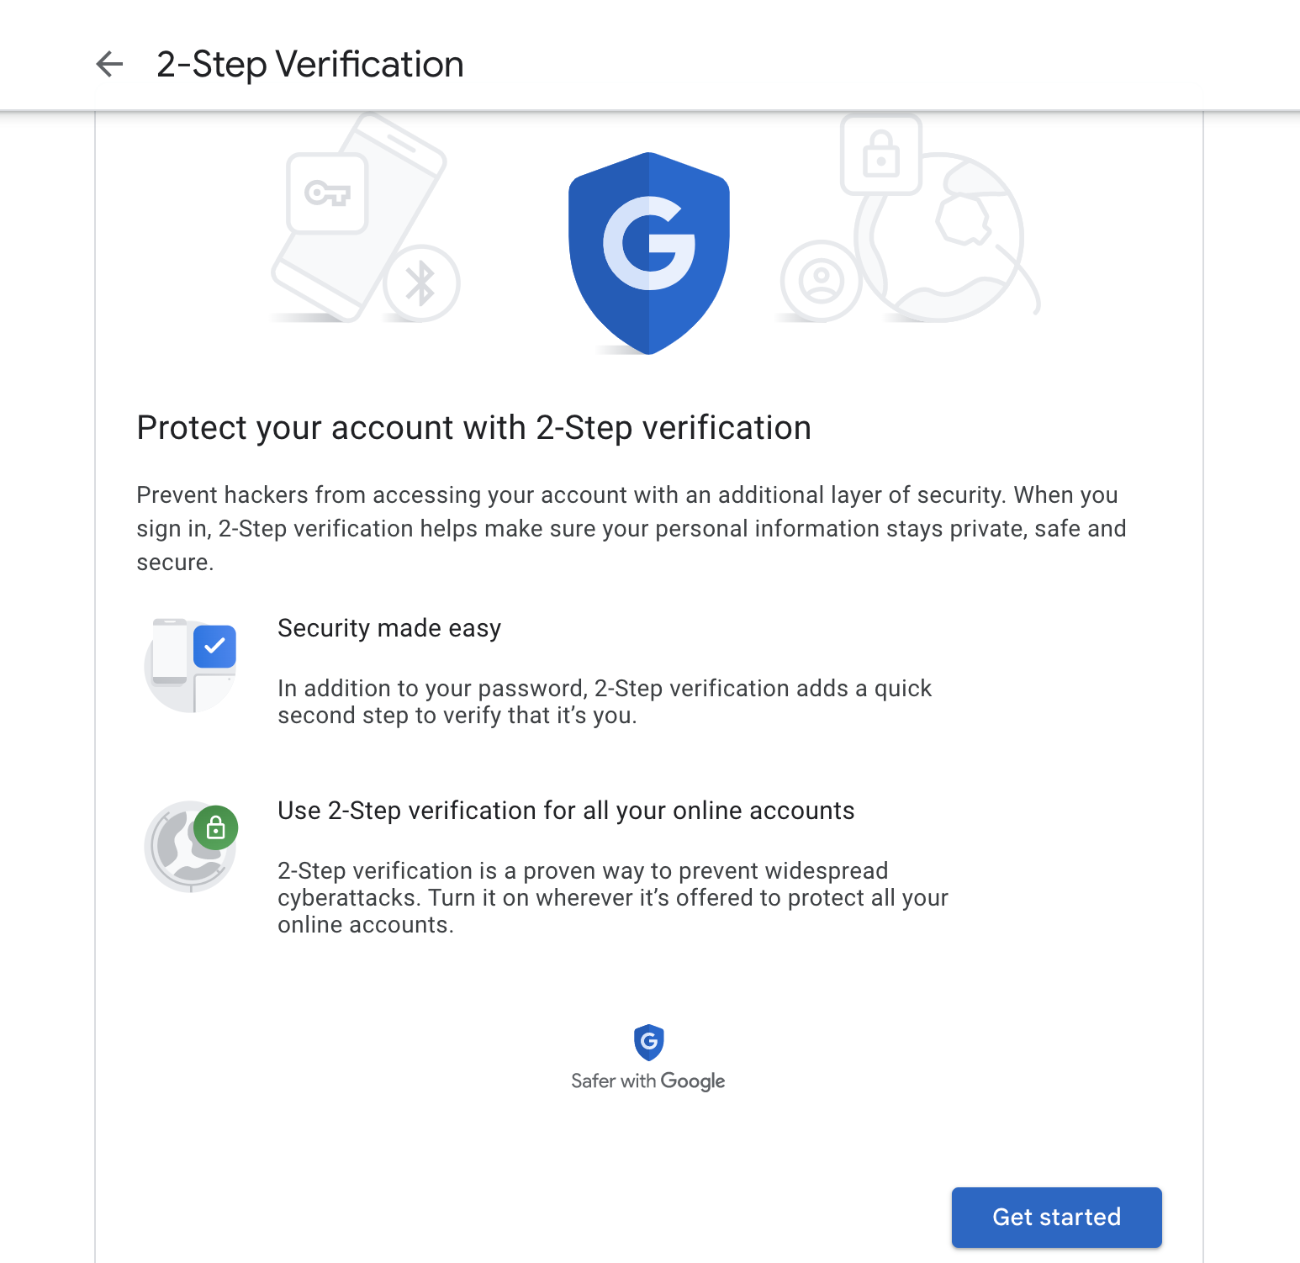
Enabling 2-Step Verification
.

Slide 3
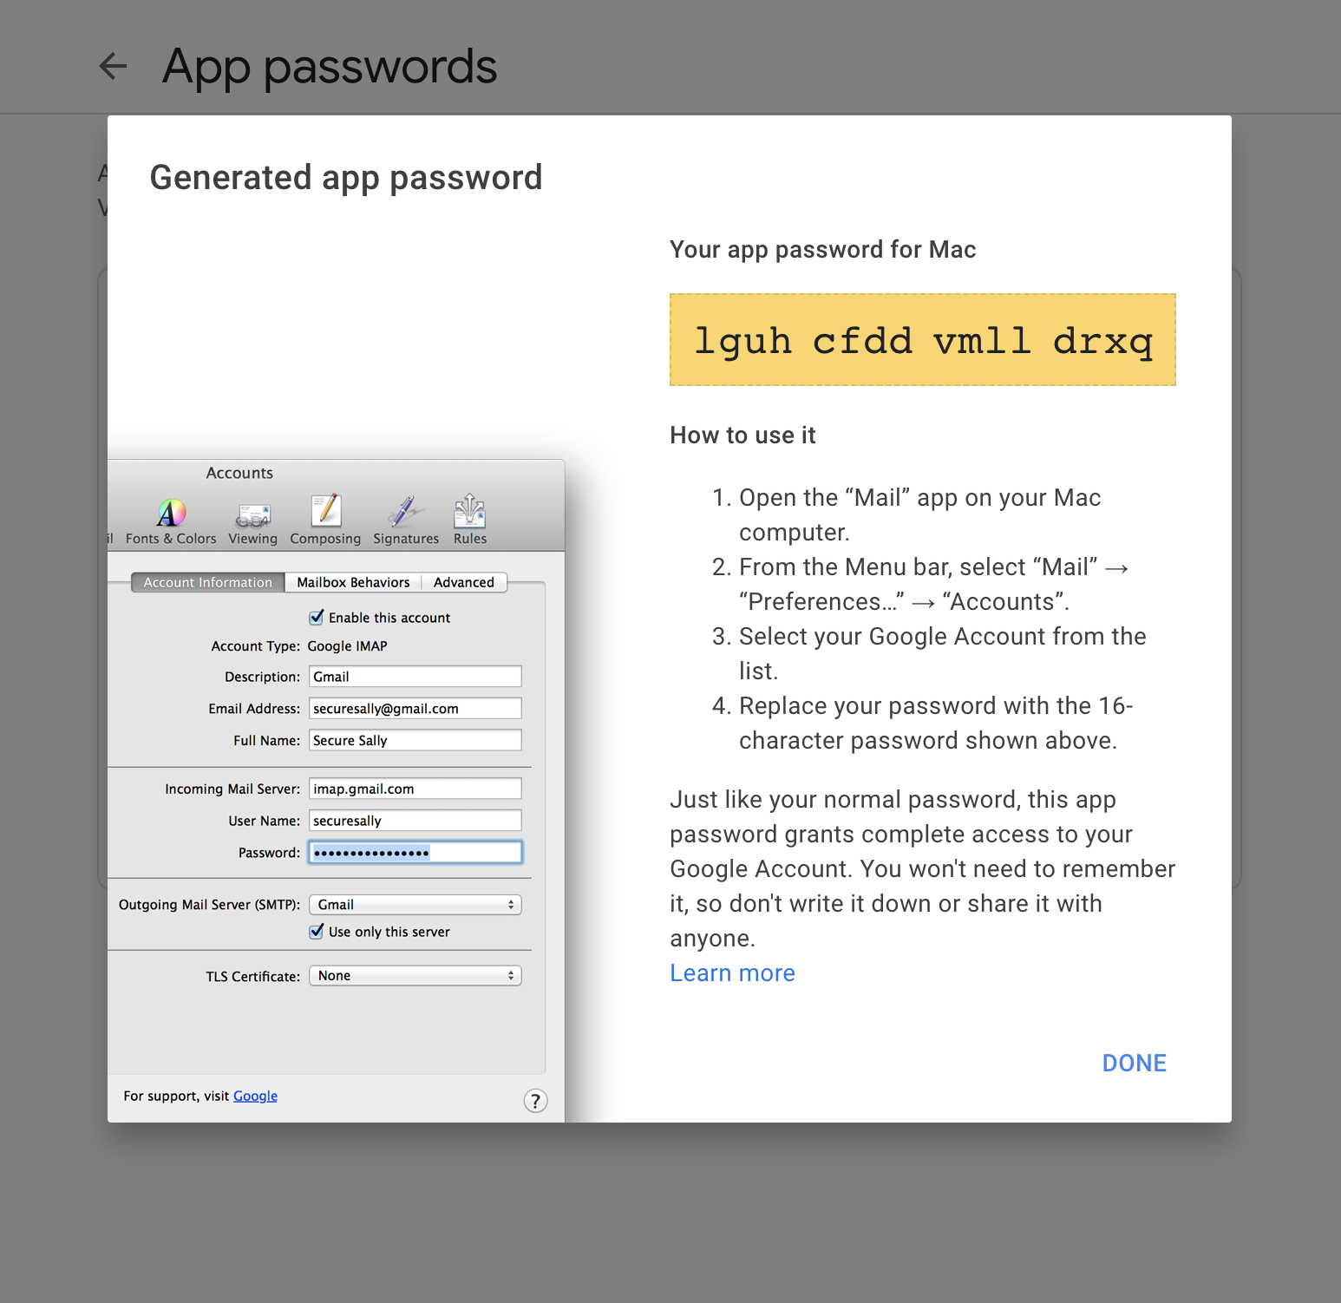
Creating App-Password

Slide 4
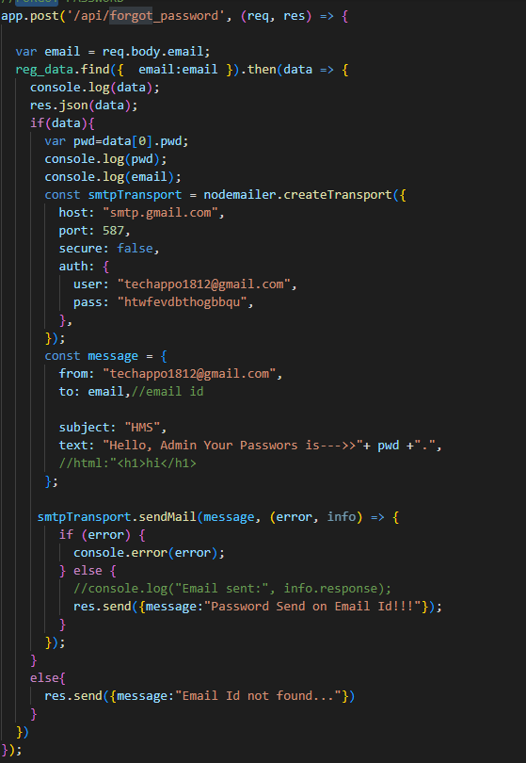
Email-ID
“lguhcfddvmlldrxq”
Code for email Notification for forgot password…

Slide 5
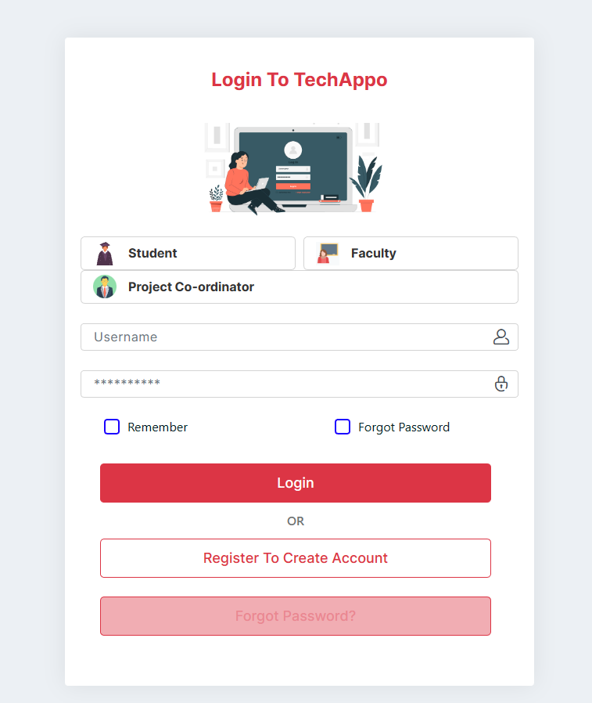
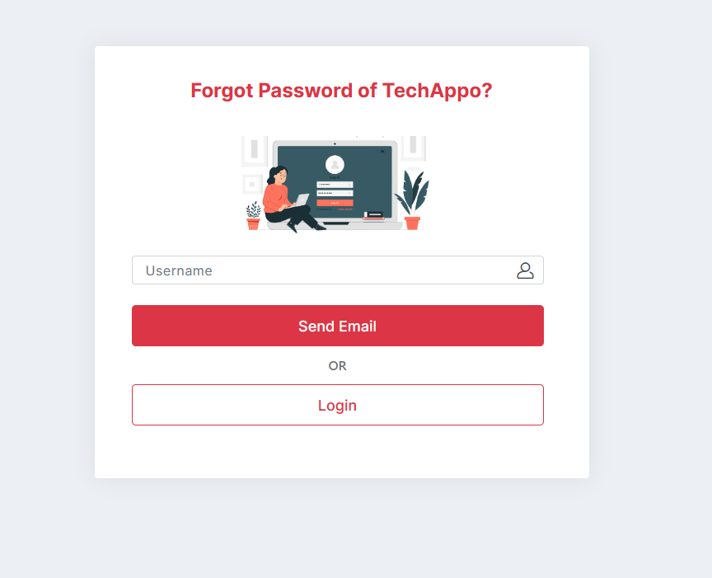
Forgot Password

Slide 6
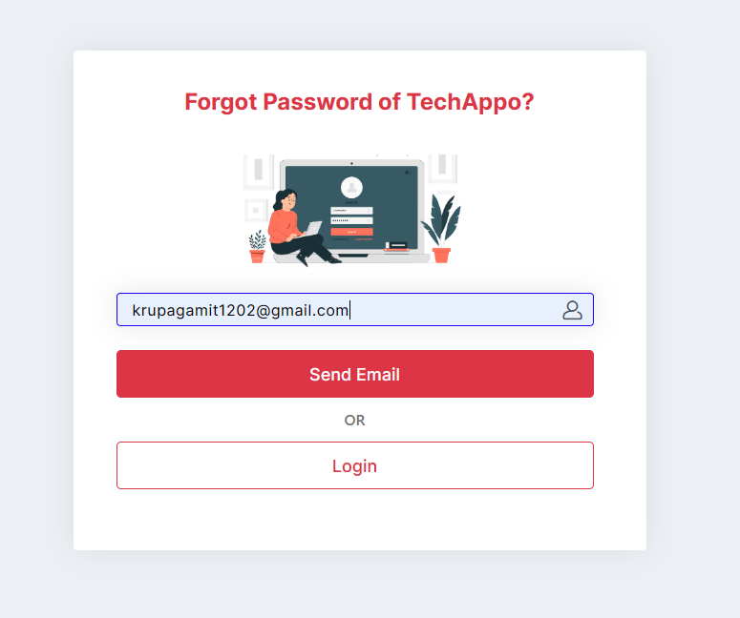
User Email Id

Slide 7
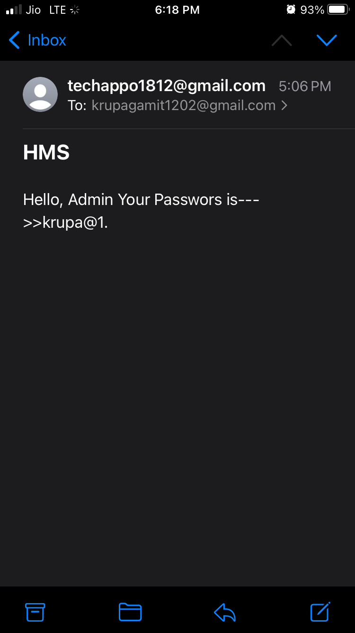
Mail to the user for password.

