Slide 1





CIPHATHON 26’
Problem Statement: Personal Digital Privacy and Exposure Intelligence Engine
Team Name: Datayoddhas
Team Members: Khushi Tiwari, Yashika Raj, Tanushree Dharmavaram, Vanshika Kaushal

Slide 2

Persona Trace: Identity Exposure Detector
Idea / Prototype
Detects scattered digital identity fragments across the internet.
Input: email, username, phone number.
Collects data from breach databases, social platforms, and OSINT sources.
Correlates fragments to build a digital identity footprint.
How It Addresses the Problem
Identifies exposed identity fragments before attacker exploitation.
Uses identity correlation and similarity matching across platforms.
Generates a Cyber Exposure Risk Score.
Displays results via graph-based identity visualization showing attack paths.
Innovation & Uniqueness
Integrates breach detection, username enumeration, and OSINT analysis.
Performs identity reconstruction risk assessment.
Combines automated risk scoring with network visualization to reduce identity attack surface.

Slide 3
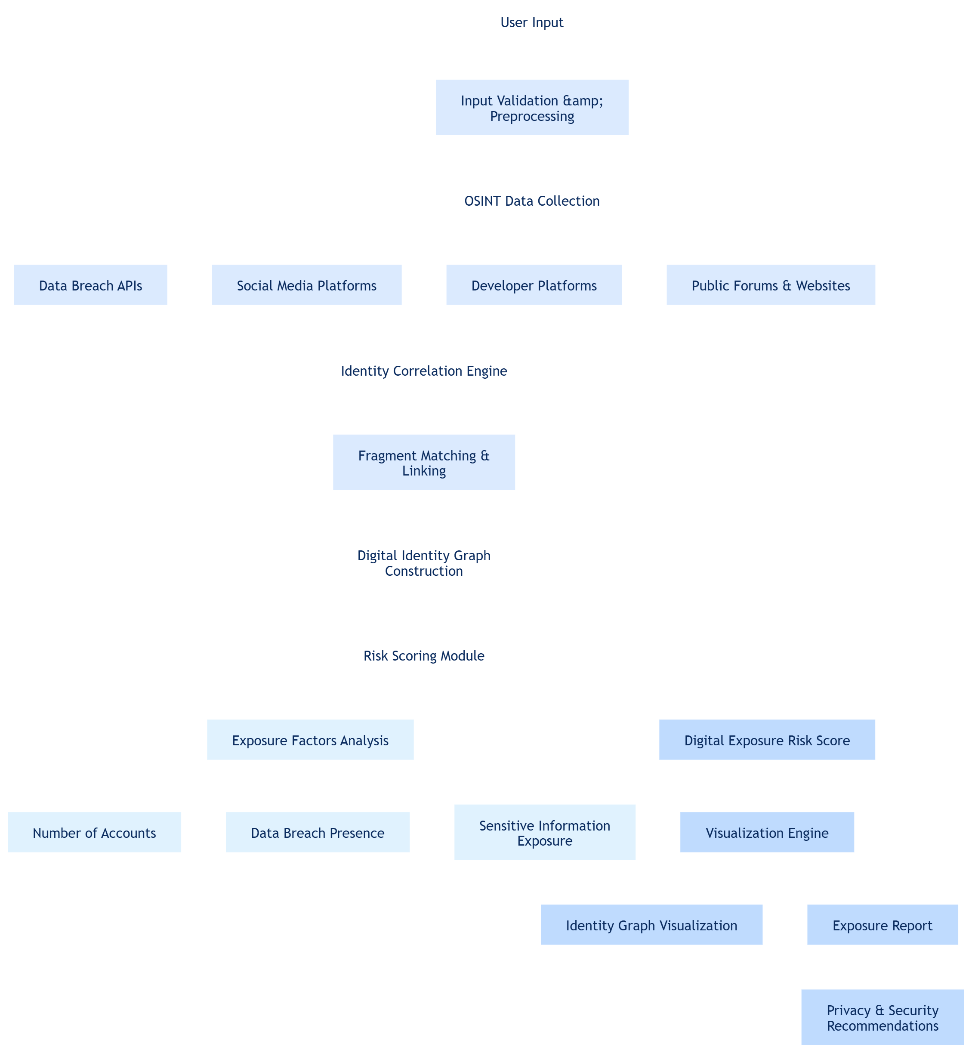
Technical Approach
Technologies Used
Frontend: React.js, Tailwind CSS
Backend: Python (FastAPI)
Languages: Python, JavaScript, HTML, CSS
APIs / Tools:
XposedOrNot (breach detection)
GitHub API (profile lookup)
Sherlock (username search)
Visualization: Cytoscape.js
Methodology / Implementation
User Input: Email, username, phone number collected via UI.
Data Collection: APIs & OSINT tools scan platforms for identity fragments.
Identity Correlation: Similarity matching links accounts across sources.
Risk Scoring: Calculates Cyber Exposure Score based on detected data.
Visualization: Graph network shows identity connections and attack paths.

Slide 4



FEASIBILITY AND VIABILITY
Feasibility of the Idea
Uses OSINT to collect public identity fragments.
Integrates APIs like XposedOrNot and GitHub API.
Built using React, FastAPI/Python, and graph visualization tools.
Prototype targets limited platforms with basic risk scoring.
Potential Challenges & Risks
API rate limits.
False matches from similar usernames.
Privacy concerns.
Incomplete OSINT data.
Strategies to Overcome Challenges
Use official APIs.
Apply similarity matching for identity correlation.
Process only public data.
Use confidence scoring and optimized API calls.

Slide 5
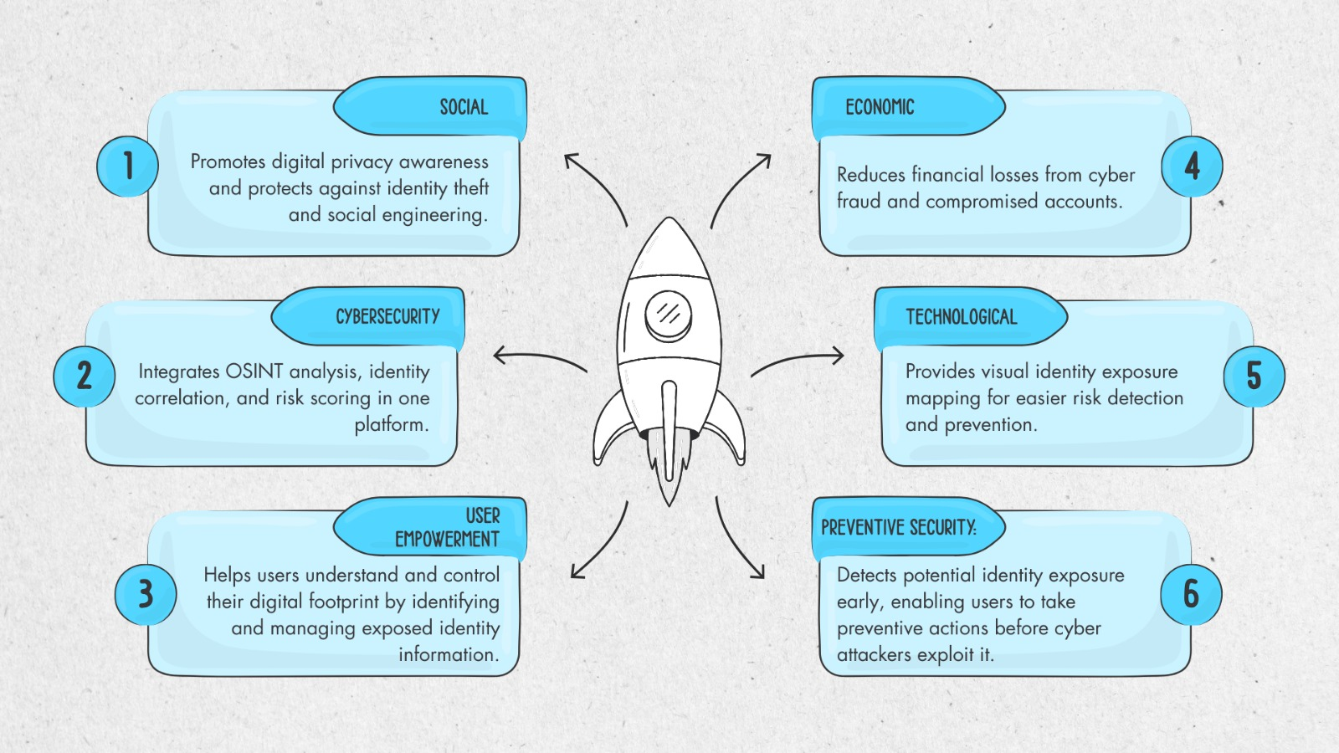
IMPACT AND BENEFITS
BENEFITS
Potential Impact on Target Audience
Helps users monitor and understand their digital identity exposure online.
Supports cybersecurity professionals in identifying identity-based attack vectors using OSINT.
Increases awareness of digital footprint risks and promotes safer online behavior.
Enables early detection of identity reconstruction threats (phishing, impersonation, account takeover).

Slide 6
Conclusion
The Digital Shadow Mapper provides an innovative approach to understanding and managing personal digital exposure by identifying fragmented identity information available across public online platforms. By leveraging OSINT techniques, identity correlation, and risk scoring, the system helps users visualize their digital footprint and understand potential security risks.
The solution promotes cybersecurity awareness and proactive privacy protection by enabling users to detect vulnerabilities in their online presence before they can be exploited by malicious actors. With its scalable architecture and practical implementation, the platform demonstrates how data aggregation, analysis, and visualization can be used to enhance digital safety in an increasingly connected world.
Overall, this project highlights the importance of digital identity management and contributes toward building a more secure and privacy-aware online ecosystem.

Slide 7
REFERENCES
APIs & Data Sources
PublicAPI.dev – https://publicapi.dev/have-i-been-pwned-api
OSINT Tools
Sherlock (GitHub) – https://github.com/sherlock-project/sherlock
Bellingcat Toolkit Entry – https://bellingcat.gitbook.io/toolkit/more/all-tools/sherlock
Sherlock OSINT Manual (2025) – https://github.com/ContactAlexey/Sherlock-OSINT-Manual-2025
GoSearch – https://github.com/ibnaleem/gosearch
Visualization Tools
Cytoscape.js – https://js.cytoscape.org/
GitHub Repository – https://github.com/cytoscape/cytoscape.js
Tutorial – https://blog.js.cytoscape.org/2016/05/24/getting-started/
npm Package – https://www.npmjs.com/package/cytoscape
OSINT Research & Methodology
Awesome OSINT List – https://github.com/jivoi/awesome-osint
APIs for OSINT – https://github.com/cipher387/API-s-for-OSINT
Digital Footprint OSINT Tool – https://github.com/Hamed233/Digital-Footprint-OSINT-Tool
GitHub OSINT Methodology Guide – https://preciousvincentct.medium.com/github-osint-the-ultimate-reconnaissance-methodology-guide-e896ff162f63
XposedOrNot API – https://api.xposedornot.com
XposedOrNot Official Website – https://xposedornot.com

