Slide 1
SMART LOW COST IOT DEVICE FOR MONITORING NOISE POLLUTION IN VEHICLES
Lab Based Project -ECN 300
Project Supervisor
Dr.Sanjeev Manhas
Professor (ECE Department)
Project Members
Khushi Vishwakarma (18116038)
Nunsavath Prashanth (18116056)

Slide 2
NOISE POLLUTION
What is Noise pollution?
Any excessive or unwanted noise that lead to harmful effects on humans or wildlife.
Regular exposure to elevated sound levels can lead to :
Permanent hearing loss (reduced hearing sensitivity)
Increased blood pressure
Cardiovascular effects
Lack of concentration, stress, and fatigue
Sleep disturbance (Insomnia)
Source-https://www.iberdrola.com/environment/what-is-noise-pollution-causes-effects-solutions

Slide 3
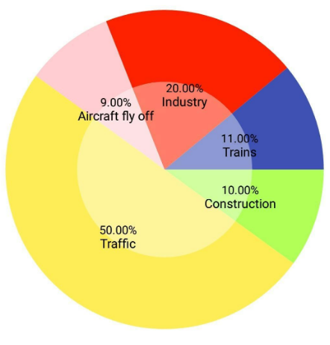
CAUSES OF NOISE POLLUTION
Road traffic is the major source of noise pollution - 50%
Contributing factors in vehicular noise:
The horn noise
The engine noise
Loud music played inside the vehicle
High bass music played inside the vehicle
Fig 1: Contributing factors in noise pollution
Source:https://thetablebar.blogspot.com/2020/07/bar-graph-of-noise-pollution-in-india.html
Notes:
Traffic noise is due to vehicular pollution

Slide 4
CONTENTS
Introduction
Loudness measurement
Vibration (Bass) measurement
Frequency measurement
Location tracking
Working of the device
Circuit connections
Demo video
Comparison table
Conclusion

Slide 5
INTRODUCTION
A device is developed to control the noise pollution levels.
This device is used to measure :
Loudness level in the vehicle
Frequency of the source
Bass (Vibration)
An interface, created through Blink App (open source) is used to display these values.
The vehicle's location data is also displayed in the application.
Notes:
A device is developed to control the noise pollution levels.

Slide 6
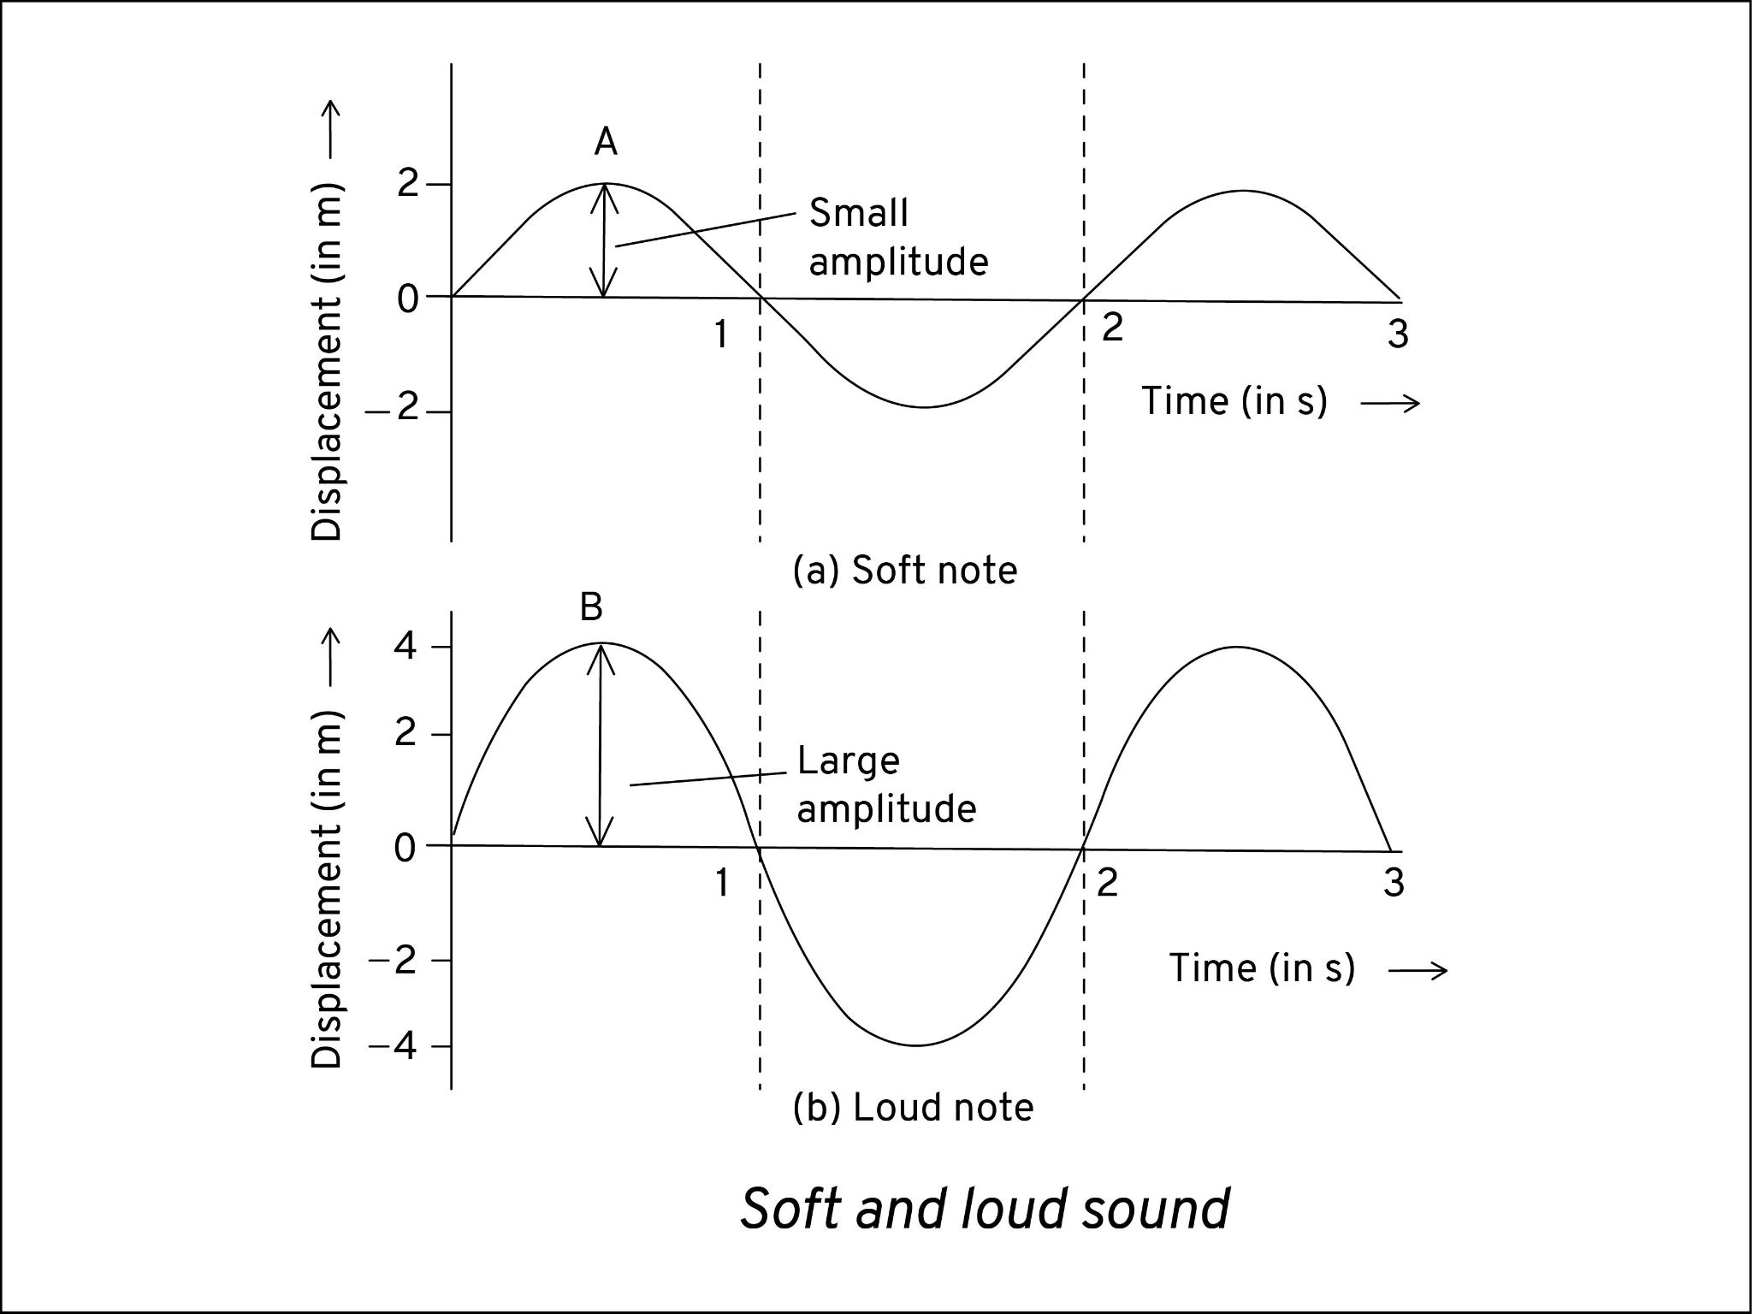
LOUDNESS MEASUREMENT
The Loudness is the gap between the maximum and minimum amplitude levels of the input signal over a defined period of time.
A _{p-p} = A _{max} – A _{min}
This value of loudness is calculated using MAX4466 sound sensor,which takes analog sound signals as input.
The sound sensor measures the amplitude of every sample for a period of time and after processing, outputs the loudness value in dB.
Source : https://www.lidolearning.com/questions/ph-bb-selina8-ch7-exsa-q8/q8-how-is-loudness-related-to-/
Fig 2: low and high loudness levels

Slide 7
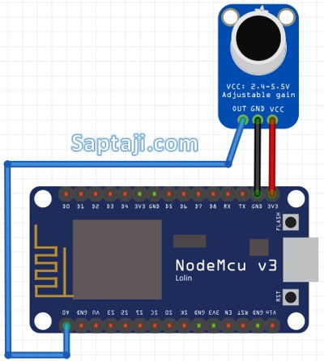
LOUDNESS MEASUREMENT
The NodeMCU (ESP8266), a WIFi enabled microcontroller is used.
The difference between the maximum and the minimum amplitude levels is calculated-Peak to peak value
This value is converted into decibels using the map function.
maps one particular range of values to other range of values.
The Loudness value (in dB) is communicated to the App via Internet connectivity
If loudness > threshold (90 dB)
Alert / Warning notification sent to the user
Fig 3 : Circuit connection of NodeMCU with sound sensor

Slide 8
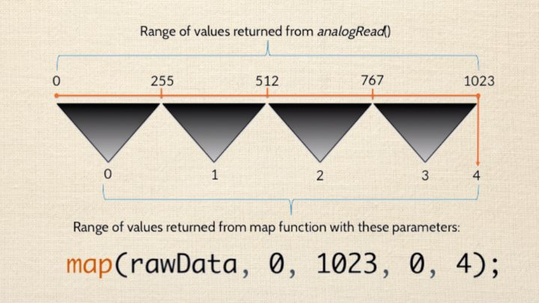

LOUDNESS MEASUREMENT: MAP FUNCTION
peaktoPeak is the gap between max and min amplitudes of the signal.
Int db is the db value of peaktoPeak converted using map function
The map function implementation - The map function divides the analog range into equal intervals and assigns a value to each interval.
Source : https://www.arduino.cc/reference/en/language/functions/math/map/

Slide 9
LOUDNESS MEASUREMENT : FLOW CHART
Data collected using MAX4466 sound sensor.
Data transfered to NodeMCU ,Max and Min values are stored.
Peak to peak value -’p’ is calculated.
‘p’ is mapped to the dB scale using map function.
If L > 90dB, an alert sent to the user.
This value transferred to app and displayed as Loudness on the Blynk App.
Fig 4: Explaining the flow chart of loudness measurement

Slide 10

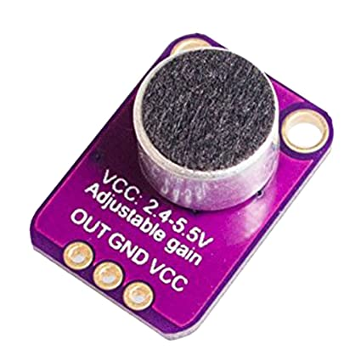
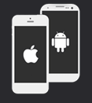
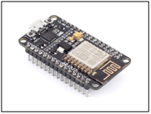

LOUDNESS MEASUREMENT : FLOW CHART
MAX4466 sound sensor
NodeMCU
Blynk App
Measures the amplitude of input sound signals.
The peak to peak value is calculated, converted to db and then communicated to the app.
The Loudness value is displayed in the app.If value>90 db,alerts the user.

Slide 11
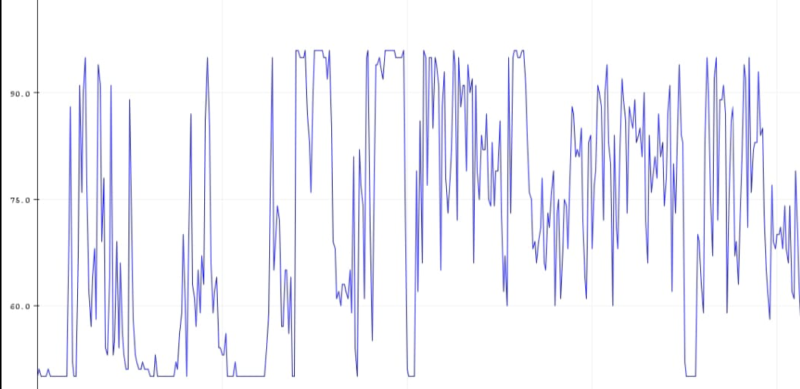
LOUDNESS MEASUREMENT : RESULTS
Fig : Graph showing the loudness value(in db) on y-axis and time in x-axis

Slide 12
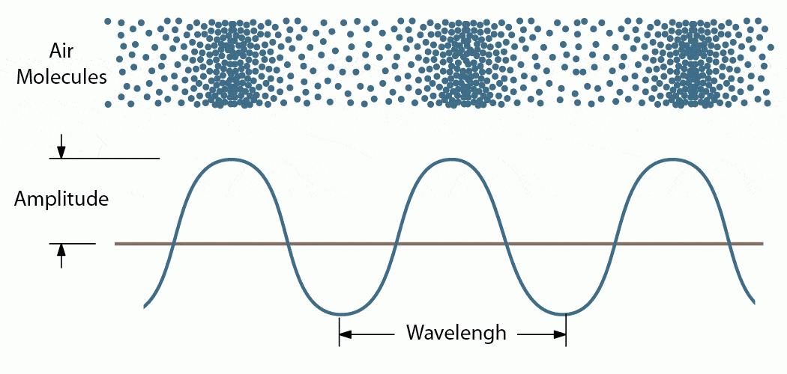
VIBRATION (BASS) MEASUREMENT
Vibration means quickly moving back and forth about a point of equilibrium. If molecules vibrate in air, this generates a sound wave.
High vibration levels for a continuous period is dangerous for heart patients.
The vibration is measured using SW420 vibration sensor with the help of NodeMCU.
Vibration can be measured using displacement (amplitude), velocity and acceleration.
Amplitude measurement of vibration is suited for this application.
Fig 8 :: Vibrating air molecules
Source : http://w3.ric.edu/faculty/PSCI103/waves/waves_notes.pdf

Slide 13
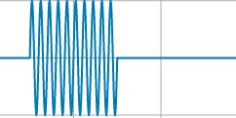
VIBRATION (BASS) MEASUREMENT
The first half has high vibration - the signal is high for a long time
The other half has low vibration (nearly zero) – the signal is high for significantly lesser time
The pulsein function is used to calculate the total time for which the input signal is high.
If this pulsein function output value is higher than the threshold, then the app will alert the user by sending a warning notification.
Fig 9: Vibration in a signal
Data is collected using Vibration sensor.
Time for which the signal is high is calculated using pulsein() function
If this value crosses the threshold limit, an alert is sent to the user.
Source : https://scikit-dsp-comm.readthedocs.io/en/latest/_images/nb_examples_Continuous

Slide 14
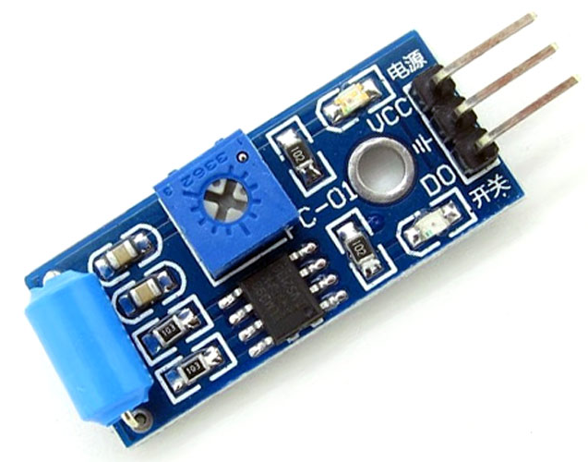
VIBRATION MEASUREMENT : FLOW CHART
SW420 vibration sensor
NodeMCU
Blynk App
Detects whether input signal is high or low.
Measures the time for which input signal is HIGH using pulsein function.
If this value is higher than threshold,app alerts the user.

Slide 15
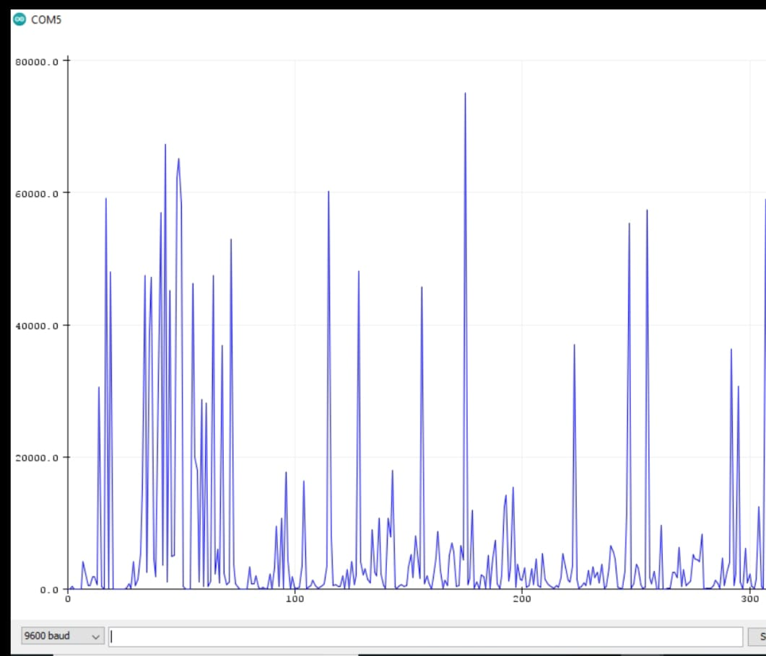
VIBRATION MEASUREMENT : RESULTS
Fig : Graph showing the time for which the input is high (on y-axis) vs time (on x-axis)

Slide 16
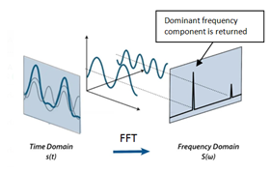
FREQUENCY MEASUREMENT
Frequency analysis is done to identify the source responsible for producing maximum loudness.eg. the horn.
Input data - sound sensor values at a sampling rate of 1/5000 s
Nyquist Sampling theorem - f _{s} >= 2*f _{max}
f _{max} = 2500 Hz
Sapling frequency f _{s}= 5000 Hz
Fast Fourier Transform (FFT) is used in the analysis.
Fig 5: Working of FFT: Time domain data converted to Frequency domain to find out the dominant frequency component
Source : https://leightonzhang.com/2016/11/08/nyquist-shannon-sampling-theory/

Slide 17
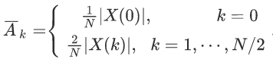

FREQUENCY COMPUTATION
64 input samples are collected each at 0.0002s
N=64
Windowing (Hamming Window) - reduce error
Time domain signal transformed to frequency domain
DFT coefficients X(k) computed via Fast Fourier Transform (FFT) algorithm
Magnitude value for each of the bin k is computed
Frequency corresponding to the bin k :
Dominant frequency - frequency having maximum amplitude is returned
Collection of 64 samples of raw data
Windowing
Time domain-> frequency domain
Magnitude Calculation
Dominant frequency returned
Fig 6: Algorithm for frequency computation
Notes:
Windowing is done to reduce the effects of leakage and enhance the ability of FFT to extract spectral data. HAMMING Window is used here.
Freq resolutio = 5000/64 =78 lower is good

Slide 18
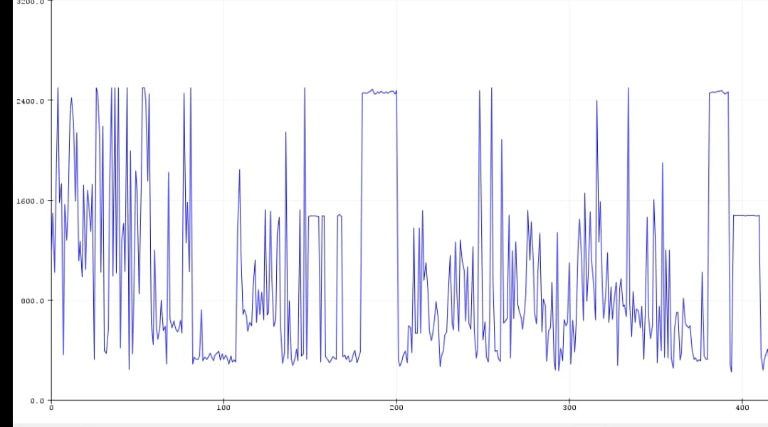
FREQUENCY MEASUREMENT : RESULTS
Fig : Plot showing the different frequency values on y-axis and time on x axis

Slide 19
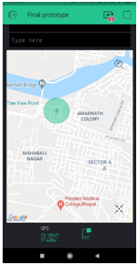
LOCATION OF THE VEHICLE
The Google Maps API for tracking the location of the vehicle.
The GPS sensor of the mobile phone is used.
In the successive prototype, the location data will be used for alerting/notifying the user if any red alerting places like hospitals, nursing homes are present nearby.
Fig 10: Location data -map and coordinates displayed on the app

Slide 20
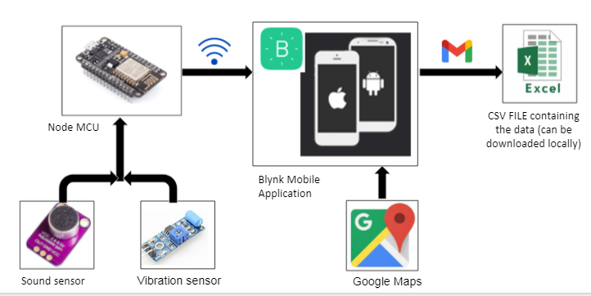
WORKING OF THE DEVICE
The sensors collects the Loudness, Frequency, Vibration data.
NodeMCU collects the data and process it as per the program written in the Arduino IDE.
NodeMCU is connected to the Blynk Application over the Internet, and the data is stored on the Blynk server.
Fig 11: Flow of working of the project

Slide 21
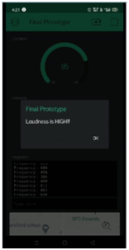
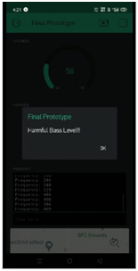
WORKING OF THE DEVICE
The Blynk app will display the real-time data stored in the Blynk server.
The app will also display the location data of the vehicle using Google Maps API.
The Blynk app will notify the user if the loudness or bass value exceeds a certain threshold.
The data is stored on the Blynk server and can be accessed and downloaded as a CSV (excel) file format
Fig 12: Notification sent to alert the user
Notes:
(the request can be sent from the Blynk app, and the CSV file will be sent over mail to the registered user).

Slide 22
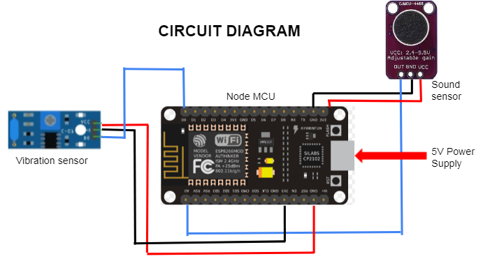
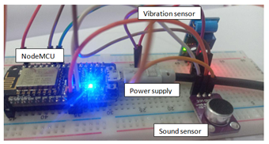
CIRCUIT CONNECTIONS
(a)
(b)
Fig 13 (a) & (b) Circuit connections for the device
CODE : https://github.com/Khushi38/IoT_based_Noise_Monitoring_System/blob/main/Combined_Code

Slide 23

DEMO VIDEO
Demo video link : https://drive.google.com/file/d/1Xs5gQI1cUHFWI_DuNe8GxeqBEThEBrwz/view?usp=sharing

Slide 24
EXPECTED VALUES vs MEASURED VALUES
Sound source | Sound Parameter | Expected Value | Measured Value
Normal Conversation | Loudness | 50-60 db | 55 db
Car Engine | Loudness | 70-75 db | 72 db
Car Horn | Loudness | 85-95 db | 90 db
High bass Music | Vibration | High Vibration | High Vibration
Car Horn | Frequency | 400-600 Hz | 500-600 Hz
Fire alarm | Frequency | 500-550 Hz | 530-560 Hz
Table 1 : Comparison between expected data and measured data
Source : https://in.pinterest.com/pin/323766660702134412/
https://www.gcaudio.com/tips-tricks/decibel-loudness-comparison-chart/

Slide 25
CONCLUSION
This device is used for controlling noise pollution by alerting the user when harmful noise levels are observed.
The project (device) can be used as a base to develop a complete prototype.
The future work of this prototype can includes
Alerting/notifying the user if any red alerting places like hospitals, nursing homes are present nearby.
The frequency data measured could be used to identify the source, like the horn or the engine producing the loud sound levels.
PCB designed sensors
gives more accurate results
specific to the application.

Slide 26
REFERENCES
[1] Malchaire.J : “Sound Measuring Instruments” (Université Catholique de Louvain, B-1200 Bruxelles, Belgium).
[2] “Noise Sources and their measurements” [online] https://www.who.int/docstore/peh/noise/Comnoise-2.pdf]
[3] “NodeMCU datasheet” by Components101/NodeMCU (22 April 2020) [online] https://components101.com/development-boards/nodemcuesp8266-pinout-features-and-datasheet
[4] “Vibration Technical guide” by IMV Corporation (Japan). https://www.imv.co.jp/e/pr/vibration_measuring/chapter03/
[5] Mads Aasvik , “What Is FFT and How Can You Implement It on an Arduino ” (Norwegian Creations) by (10 Aug,2017) https://www.norwegiancreations.com/2017/08/what -is -fft -and - how -can -you -implement -it -on -an -arduino/
[6] ”MAX4466 with adjustable gain” by Adafruit [online] https://www.adafruit.com/product/1063
[7] “Vibration Sensor datasheet” by Components101 (29 April 2020) [online] https://components101.com/sensors/sw-420-vibration-sensormodule
[8] “Blynk Official ” [online] https://blynk.io/
[9] “Frequency resolution” by science Direct https://www.sciencedirect.com/topics/computer-science/frequency-resolution

