Slide 1

Customer Shopping Behavior Analysis
Uncovering spending patterns, customer segments, and product preferences from 3,900 transactions to guide strategic business decisions.

Slide 2
Dataset at a Glance
3,900
18
Purchases
Columns
Transactional records across all product categories
Demographics, purchase details & shopping behavior
37
$59.76
Missing Values
Avg Purchase
In Review Rating — imputed by category median
Average transaction value across the dataset
Key features include customer demographics (Age, Gender, Location, Subscription Status), purchase details (Item, Category, Amount, Season), and shopping behavior (Discount, Promo Code, Frequency, Review Rating, Shipping Type).

Slide 3


Data Preparation in Python
Cleaning & Standardization
Loaded via pandas, explored with df.info() and describe(). Missing Review_Rating values imputed by category median. Columns renamed to snake_case.
Feature Engineering
Created age_group by binning customer ages and purchase_frequency_days from purchase data. Dropped redundant promo_code_used column.
Database Integration
Cleaned DataFrame loaded into PostgreSQL for structured SQL analysis.

Slide 4
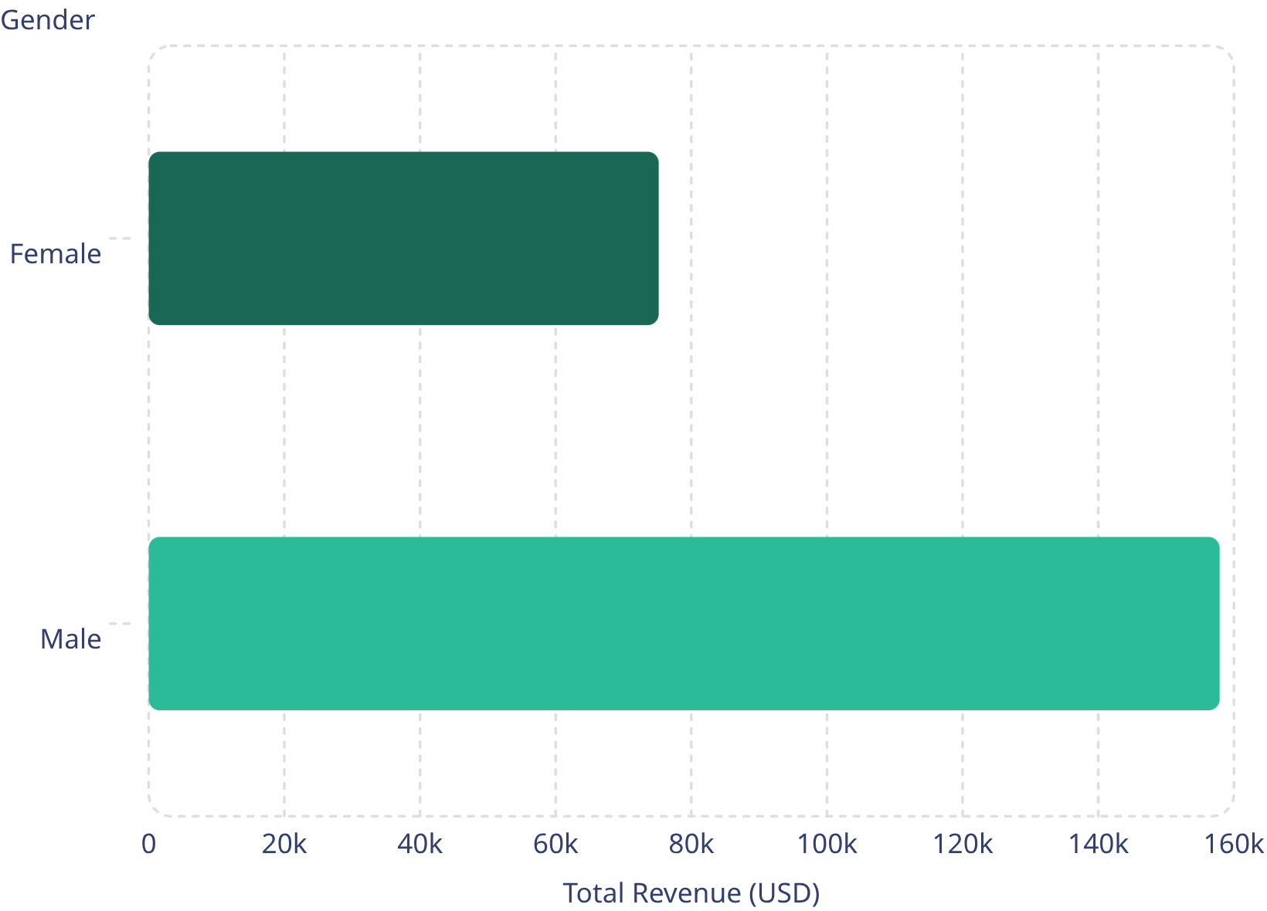
Revenue & Spending Insights
Revenue by Gender
Male customers generated over 2x the revenue of female customers ($157,890 vs. $75,191).
Shipping Type Comparison
Express shipping averaged $60.48 vs. Standard at $58.46 — a modest but consistent premium.
High-Spending Discount Users
839 customers used discounts yet still spent above the average purchase amount.

Slide 5
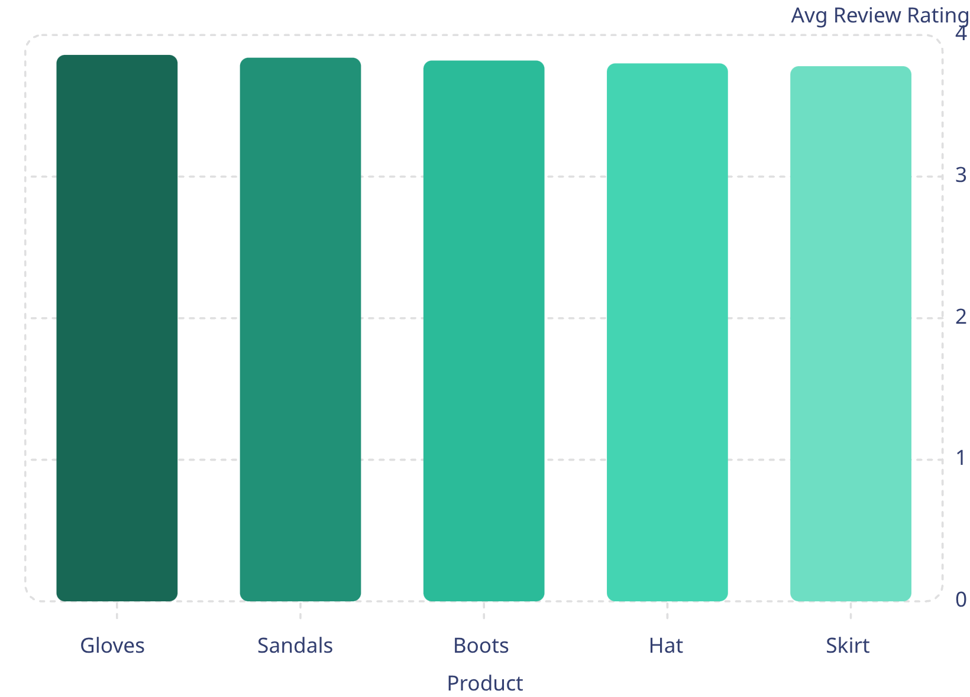
Top Products & Categories
Top 5 by Rating
Gloves lead with a 3.86 average rating. Overall dataset average is 3.75.
Top Products per Category
Accessories: Jewelry (171), Sunglasses (161), Belt (161)
Clothing: Blouse (171), Pants (171), Shirt (169)
Footwear: Sandals (160), Shoes (150), Sneakers (145)
Outerwear: Jacket (163), Coat (161)

Slide 6
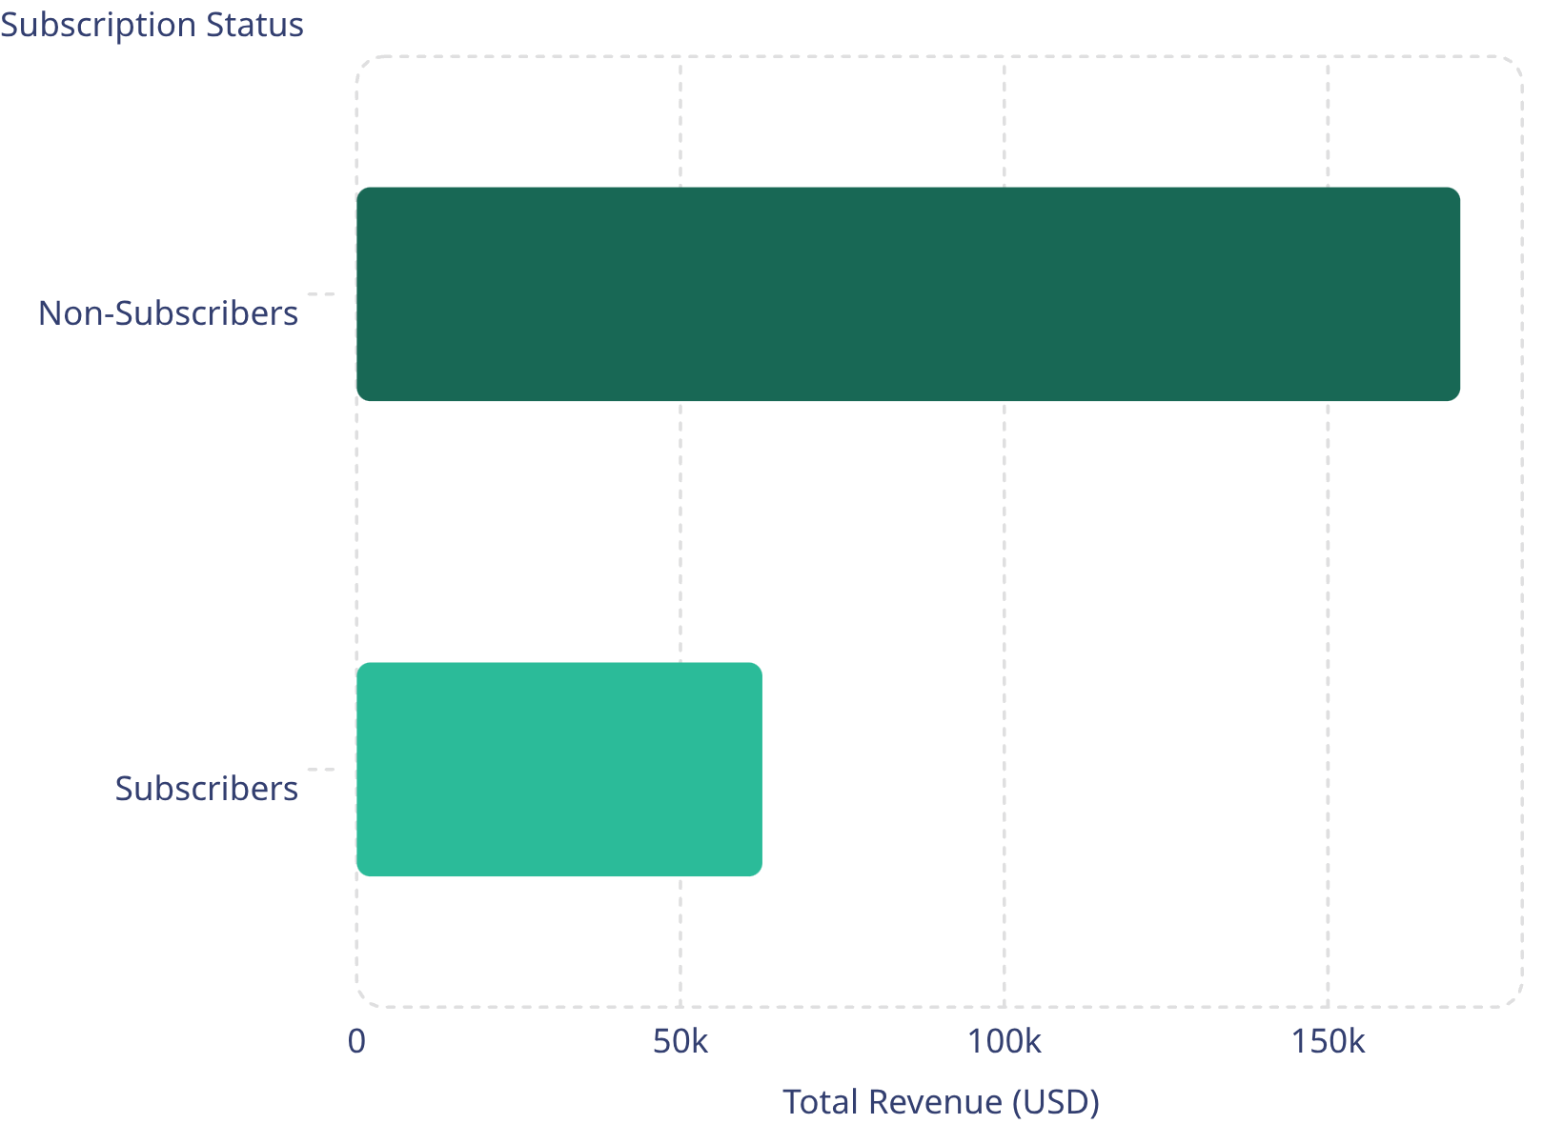
Subscription Behavior
Subscribers vs. Non-Subscribers
Non-subscribers drive 73% of revenue ($170,436) despite nearly identical average spend (~$59.50). Subscribers represent only 27% of customers (1,053 of 3,900).
Repeat Buyers & Subscriptions
Among customers with 5+ purchases, 958 are subscribers vs. 2,518 non-subscribers — suggesting subscription adoption lags among repeat buyers.

Slide 7
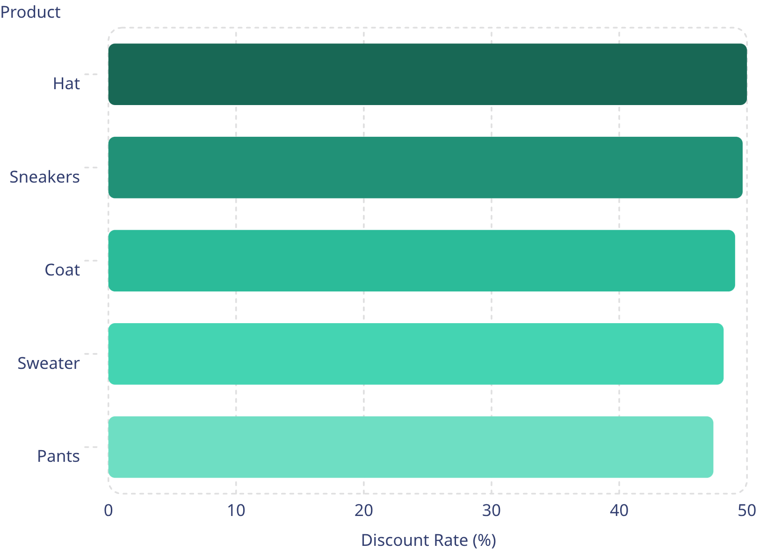

Discount-Dependent Products
Products Most Reliant on Discounts
The top 5 discount-dependent products all show ~47–50% of purchases made with a discount applied.
Hats are the most discount-sensitive product — half of all hat purchases involve a discount. This signals potential margin risk and pricing sensitivity in these categories.

Slide 8

Customer Segmentation
🏆 Loyal
🔄 Returning
3,116 customers — the dominant segment, representing the core repeat-purchase base.
701 customers — engaged but not yet at loyal frequency. Prime targets for loyalty programs.
🆕 New
83 customers — smallest segment. Opportunity to convert through onboarding incentives.

Slide 9
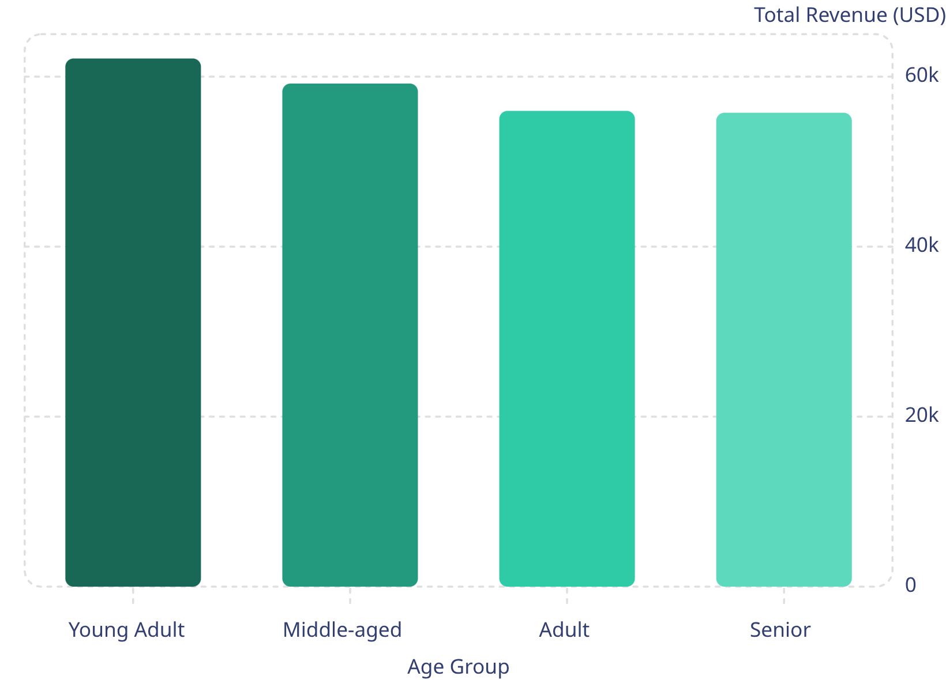
Revenue by Age Group
Age Group Revenue Contribution
Revenue is relatively evenly distributed across age groups. Young Adults lead at $62,143, while Seniors contribute the least at $55,763 — a difference of only ~11%.
This suggests broad product appeal across demographics, with slight opportunity to deepen engagement with older segments.

Slide 10

Business Recommendations
Boost Subscriptions
Promote exclusive subscriber benefits to grow the 27% base and capture more recurring revenue.
Loyalty Programs
Reward the 701 Returning customers to accelerate conversion into the Loyal segment.
Review Discount Policy
Balance sales boosts with margin control — nearly 50% of top products rely heavily on discounts.
Targeted Marketing
Focus campaigns on high-revenue age groups, express-shipping users, and top-rated products.

