Slide 1
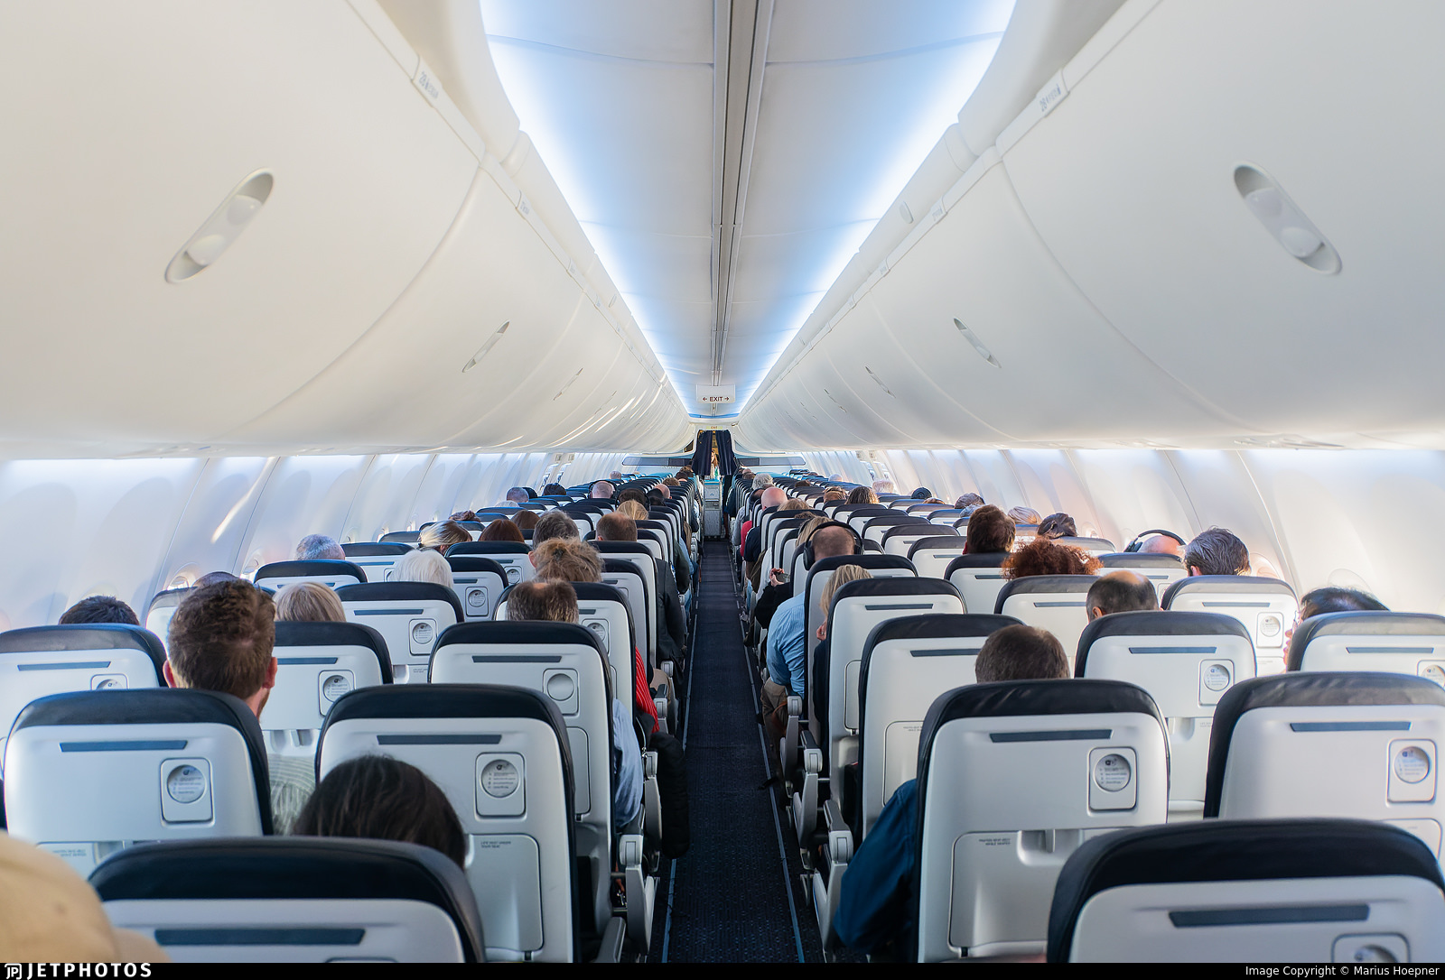
Airline Passenger Satisfaction Prediction
This project analyzes airline passenger data to predict whether a passenger is satisfied or not based on their travel experience. I explored the dataset, performed EDA, applied preprocessing steps, and trained machine learning models to identify key drivers of satisfaction.

Slide 2

Data Overview
1
Dataset Size 129,880 rows and 24 columns containing passenger information and service ratings.
Key Features Age, Gender, Class, Type of Travel, Flight Distance, Service Ratings (e.g., In-flight ,Wifi , Cleanliness)
Target Variable Passenger Satisfaction (Satisfied / Neutral or Dissatisfied)
2
3

Slide 3

Data Preprocessing
Handling Missing Values Filled missing values in "Arrival Delay" using the median. Dropped remaining rows with null values (e.g., in Flight Distance).
Outlier Treatment Visualized using boxplots; handled using IQR method where necessary.
Feature Scaling Standardized numerical features using StandardScaler

Slide 4
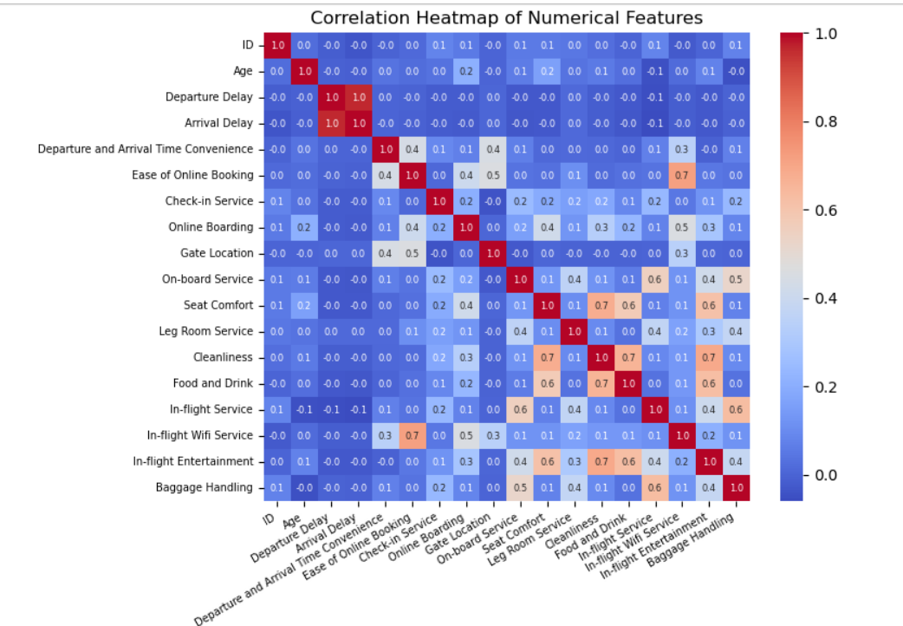
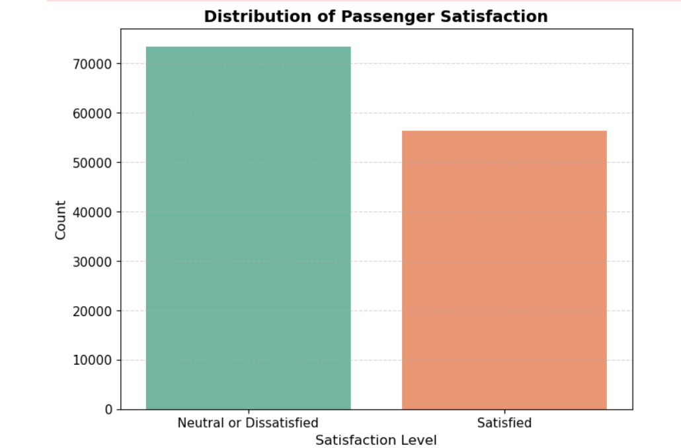
Exploratory Data Analysis
Correlation Analysis
Correlation heatmap showed strong relationships between several service-related features
Distribution Plots
Histograms showed balanced target distribution and reasonable data spread

Slide 5
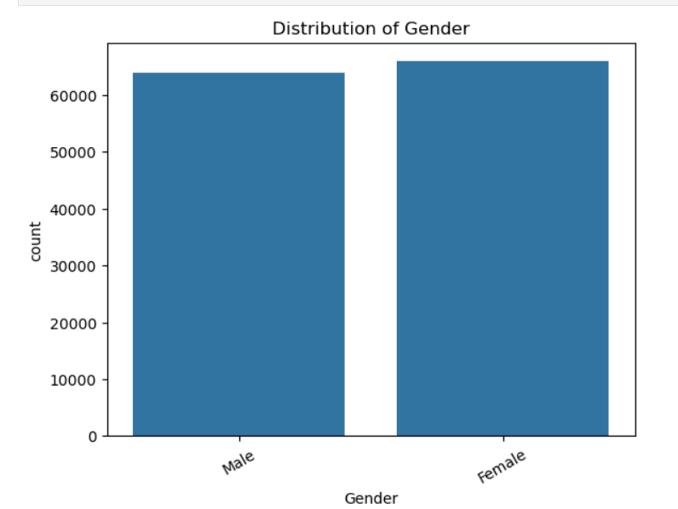
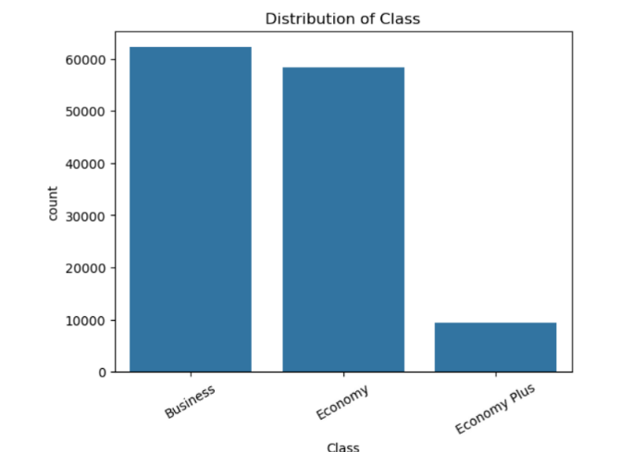
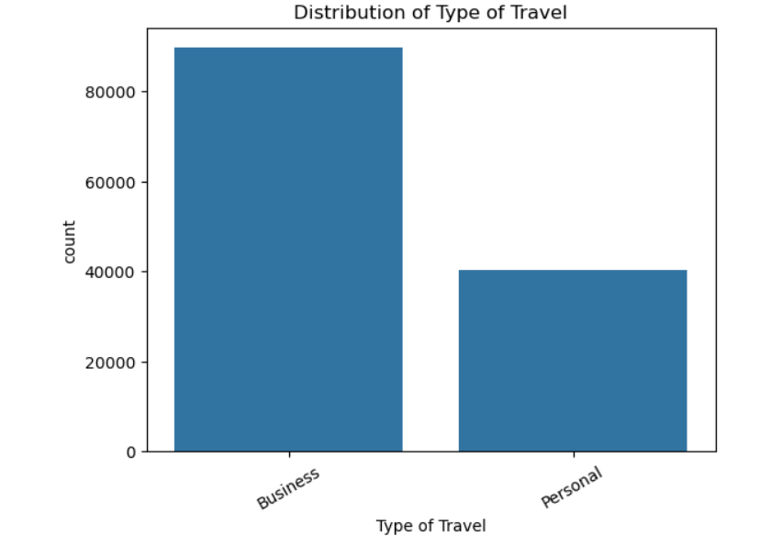
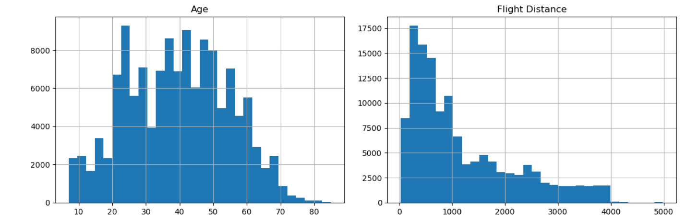
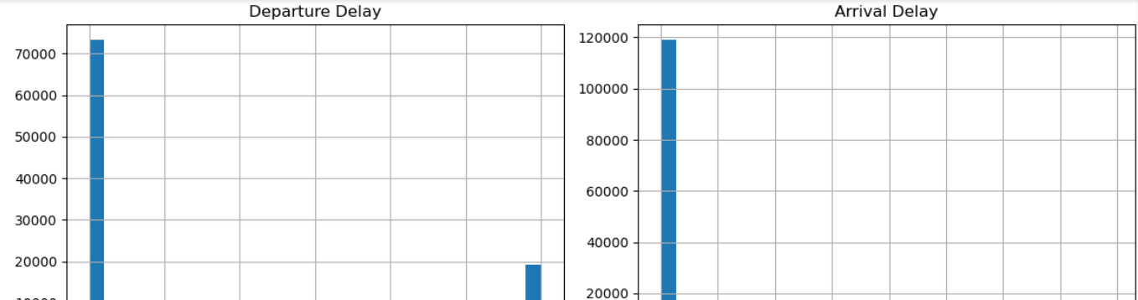
Categorical Analysis
Count plots revealed trends by class, travel type, and gender.
Numerical Analysis
Numerical analysis using histograms revealed skewness and spread in features like Age, Departure Delay, and Flight Distance.

Slide 6
Model Training and Evaluation
Data Splitting Train-test split: 80% training,
20% testing.
Performance Metrics Evaluated using Accuracy, Precision, Recall, F1-Score, and Confusion Matrix.
1
2
3
Model Training Logistic Regression, Random Forest, XGBoost models trained.

Slide 7
MODEL SELECTION
Tree-based Models
XGBoost Model
Linear Models
Logistic Regression for baseline classification performance
Random Forest used to capture non-linear relationships.
XGBoost used for advanced boosting-based classification with highest accuracy

Slide 8
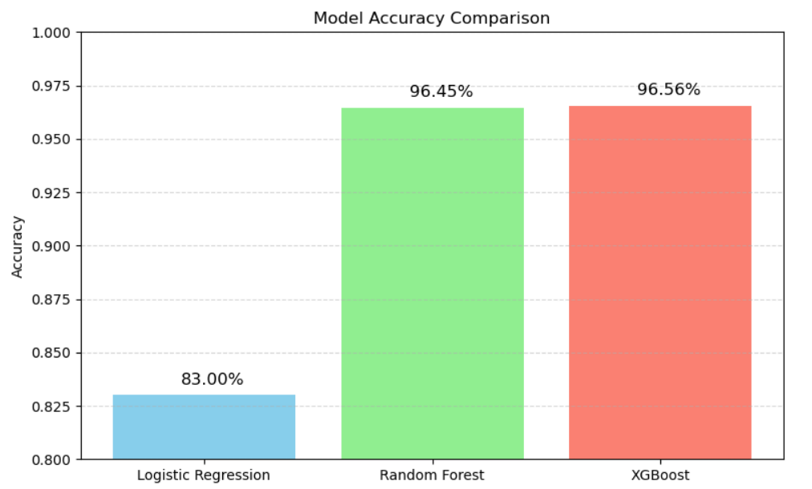
MODEL PERFORMANCE COMPARISON
Best Performer XGBoost Classifier performed best with 96.56% accuracy.
Runner-up Random Forest Classifier achieved an accuracy of 96%, securing the second-best performance.
Conclusion XGBoost provided the highest classification performance with 96.5% accuracy, followed by Random Forest at 96%. Logistic Regression served as a strong baseline with 83% accuracy.

Slide 9
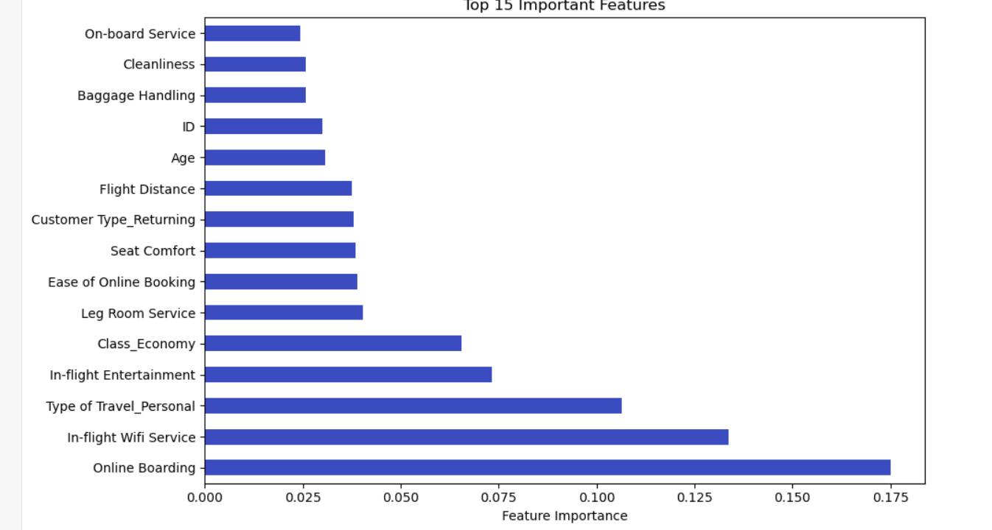
Feature Importance
1
Online Boarding
Top feature influencing passenger satisfaction.
2
In-flight ,Wifi Service & Type of Travel
Also played a major role in satisfaction prediction.
3
Other Services like Entertainment, Seat Comfort, and Class
Had noticeable but moderate influence.

Slide 10

Key Findings
1
Best Model XGBoost Classifier performed best with 96.56% accuracy.
2
Satisfaction Drivers Service quality features, especially in-flight Wi-Fi, strongly influenced satisfaction.
3
Business Insight While most passengers are satisfied, areas like Wi-Fi, boarding process, and seat comfort still need improvement.

Slide 11
THANK YOU

