Slide 1

(Call Centre Domain)
Banking Business
Banking Business (Call Centre Domain)
This project analyzes banking call center data to predict customer subscription to term deposits. We explored the dataset, applied preprocessing techniques, and evaluated multiple machine learning models to identify the most accurate predictor
I analyzed banking call center data to predict customer subscription to term deposits by exploring the dataset, applying preprocessing techniques, and evaluating multiple machine learning models to identify the most accurate predictor.

Slide 2

Dataset Overview
Dataset Size
45,211 rows × 17 Columns of Bank Marketing Call Centre Data
Key Features
age, job, marital status, education, contact method, duration, campaign info, etc.
Target Variable
y (subscribed: yes/no)
Data Overview

Slide 3

Data Pre-processing
No missing values
Clean dataset ensured smoother model training without imputation
Converts to numerical format required by ML models
Prevents ordinal misinterpretation of categories (like `job`, `month`, `outcome`)
Preserved important business signals like high `balance` or `duration`
Normalized value ranges to improve algorithm performance (especially for distance-based models)
Label Encoding for binary categorical features (`yes`/`no`)
One-Hot Encoding for multi-category columns
Outliers were visualized but not forcefully removed to preserve
important data patterns
Scaled numerical columns using StandardScaler

Slide 4
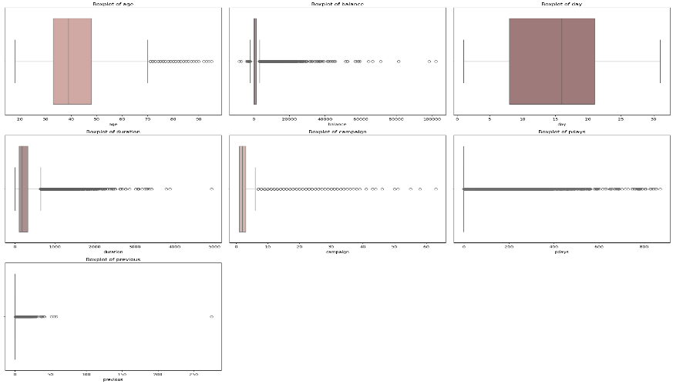
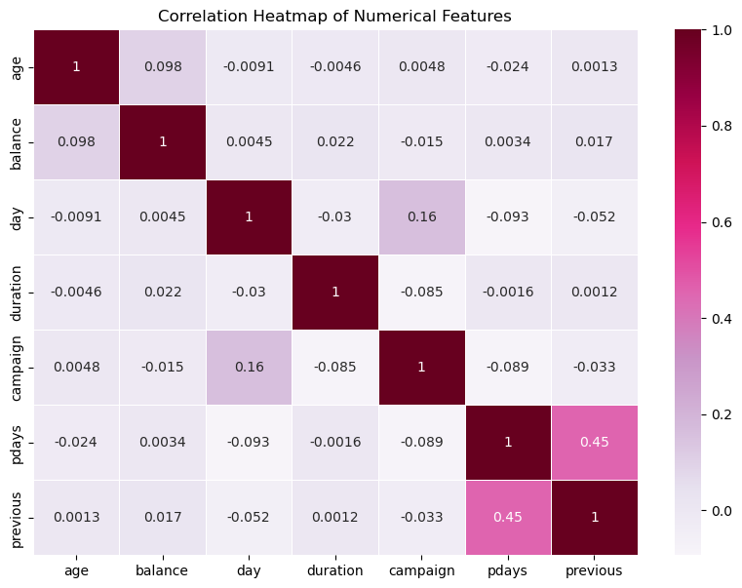
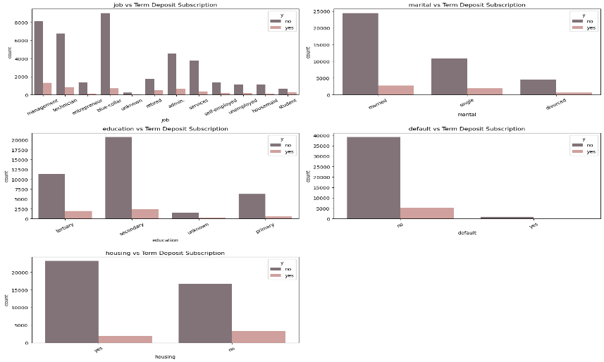
Exploratory Data Analysis (EDA)
Boxplots
Correlation Heatmap
Countplots
Boxplots highlighted outliers in features like balance duration and pdays helping data spread and skewness
The heatmap revealed relationships between numerical variables, helping guide feature selection and avoid multicollinearity
Countplots showed how subscription rates (yes/no) vary across categorical features such as job, marital status, and education

Slide 5
Model Training and Evaluation
Data Splitting
Hyperparameter Tuning
Applied GridSearchCV to optimize Random Forest parameters:
Dataset was split into 80% training and 20% testing for model evaluation
n_estimators, max_depth, min_samples_split
XGBoost was tuned using:
SMOTE was applied only on the training set to avoid data leakage.
scale_pos_weight to handle class imbalance
Early stopping to prevent overfitting
Performance Metrics
Evaluated models using:
Accuracy for overall performance
Recall to measure ability to detect “yes” subscriptions (minority class)
Precision & F1-score to balance false positives and false negatives
Confusion matrix and classification report were used for detailed analysis.

Slide 6
Model Selection
Baseline Model
Tree-based Models
Logistic Regression Used as a baseline classifier for binary prediction with simple linear decision boundary
Decision Tree Captures non-linear relationships with simple rule-based splits.
Advanced Models
Random Forest Ensemble of decision trees used with GridSearchCV to improve generalization and reduce overfitting.
XgBoost
Gradient boosting algorithm tuned for imbalanced data using
scale_pos_weight parameter improved recall for the minority class.

Slide 7
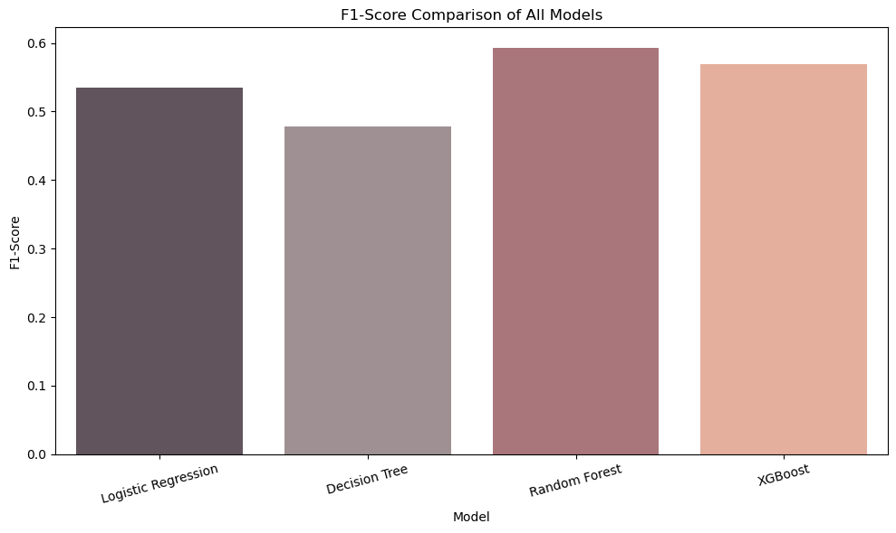
Model Performance
Best Recall (Subscriber Catcher)
XGBoost achieved the highest recall (0.85) ideal when the goal is to catch as many "yes" subscribers as possible, even at the cost of some false positives.
Best Precision & F1-Score
Random Forest
delivered strong balance with a high precision and F1-score (0.59), making it the most stable and business-friendly performer.
Baseline Classifier
Logistic Regression
showed 89% accuracy but with low recall (0.33) not suitable when the positive class is rare but important.
Simple Tree-Based Model
Decision Tree
performed reasonably well with 0.48 F1-score and recall of 0.40 good for interpretability but not optimal.

Slide 8
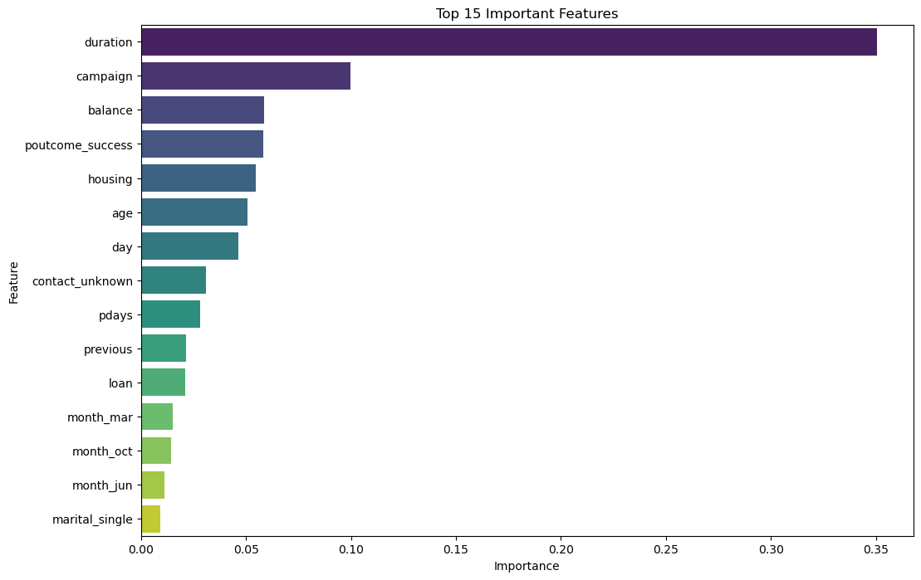
Feature Importance
Duration
Most important feature (46.37%)
Campaign
Second most important (10.12%)
Balance
Third most important (5.87%).
Poutcome_success, housing, and age followed with
moderate influence

Slide 9

Key Findings
The dataset was highly imbalanced (88% “no” vs. 12% “yes”), requiring SMOTE for fair model training.
Clients with higher account balances showed slightly higher subscription rates.
Random Forest achieved the highest F1-score (0.59), offering balanced performance.
XGBoost achieved the highest recall (0.85), making it the best model for identifying potential subscribers.
Call duration was the most influential factor — longer calls strongly correlated with term deposit subscriptions.
Customers who previously responded positively to campaigns were more likely to subscribe again
Subscriptions peaked in months like March, October, and December, indicating seasonal trends
Top features included duration, campaign, poutcome_success, balance, age, and housing

