Slide 1

RevOps360
Salesforce-Inspired Revenue Intelligence Platform
Power BI | DAX | Data Modeling | Business Intelligence
Interactive business intelligence solution for revenue, churn, customer engagement, and operational analytics
Created by Khushi

Slide 2

Business Challenge
Businesses often struggle to monitor revenue performance, customer churn, operational efficiency, and customer engagement within a centralized analytics environment. Data is frequently spread across multiple systems, making it difficult to track KPIs, identify risks, and generate actionable insights. Inspired by Salesforce-style business intelligence platforms, RevOps360 was developed to provide interactive dashboards and executive-level reporting for data-driven decision-making.

Slide 3
RevOps360 Solution Framework
PROBLEM
SOLUTION
Revenue performance
KPI Monitoring
Operational efficiency
Actionable Insights
Customer engagement
Data-driven Decisions
Customer churn
Interactive Reporting

Slide 4
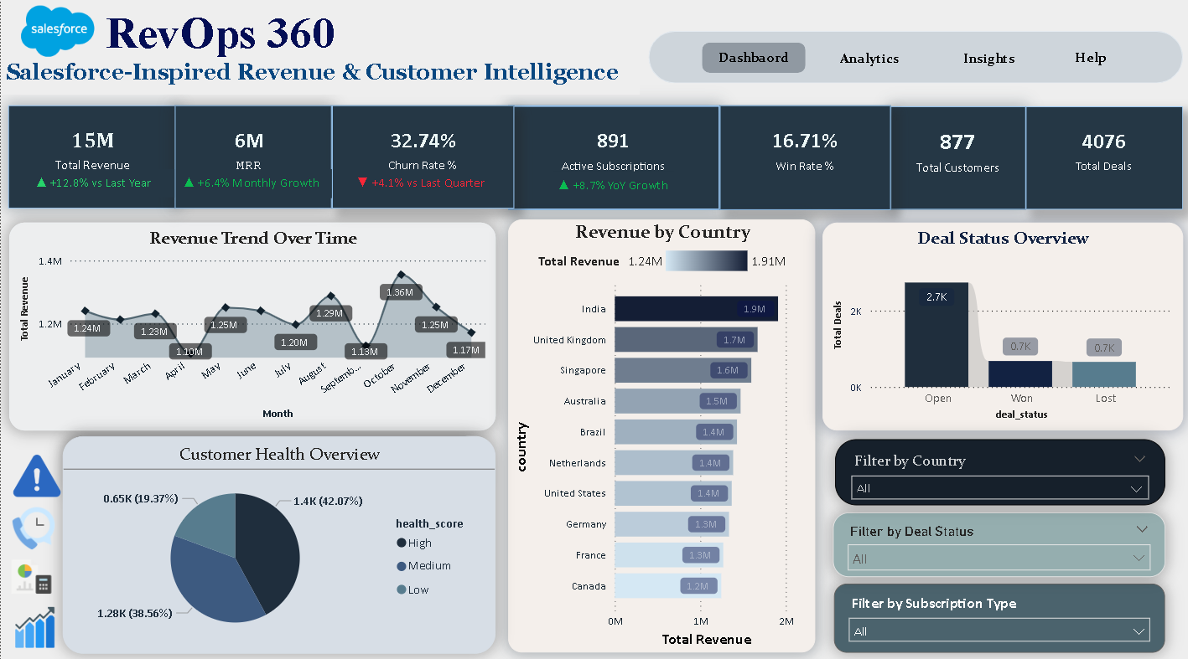
Dashboard Overview :
KPI Monitoring & Business Performance Tracking
Interactive dashboard for revenue, customer retention, and subscription monitoring
Executive KPI tracking with revenue, churn, and operational metrics
Dynamic chart switching and contextual filtering for focused analysis
Regional revenue and support ticket analysis for business insights
Salesforce-inspired design with multi-page navigation and interactive reporting

Slide 5
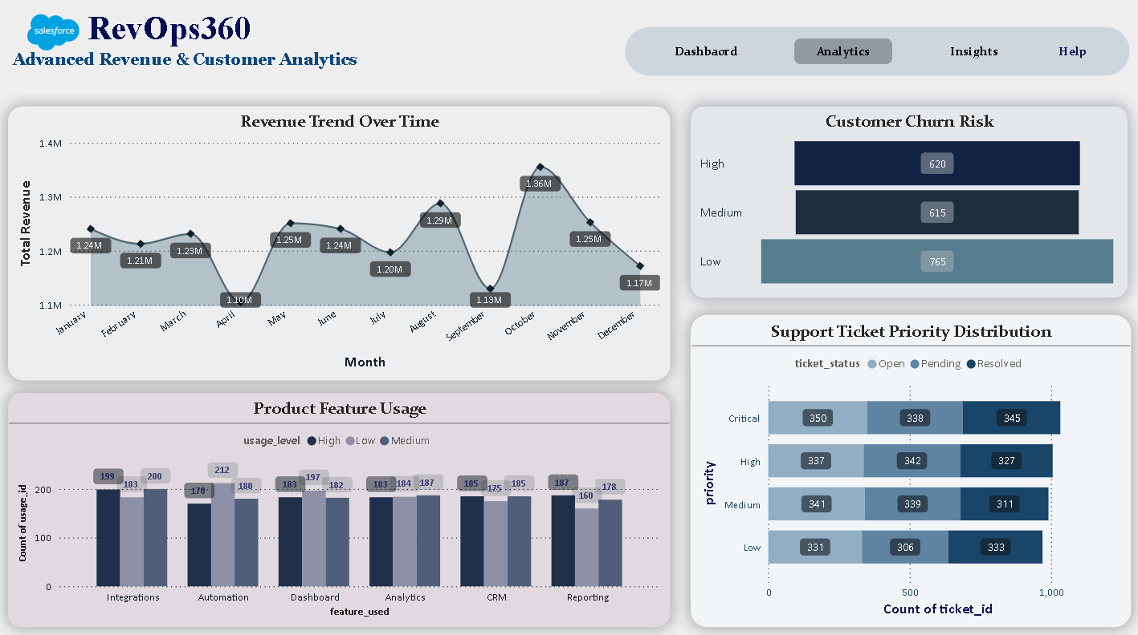
Analytics Insights
Revenue trends revealed key business performance patterns.
Customer churn analysis identified retention opportunities.
Product usage insights highlighted feature adoption trends.
Support ticket analysis uncovered operational workload patterns.
Interactive analytics enabled data-driven decision-making.

Slide 6
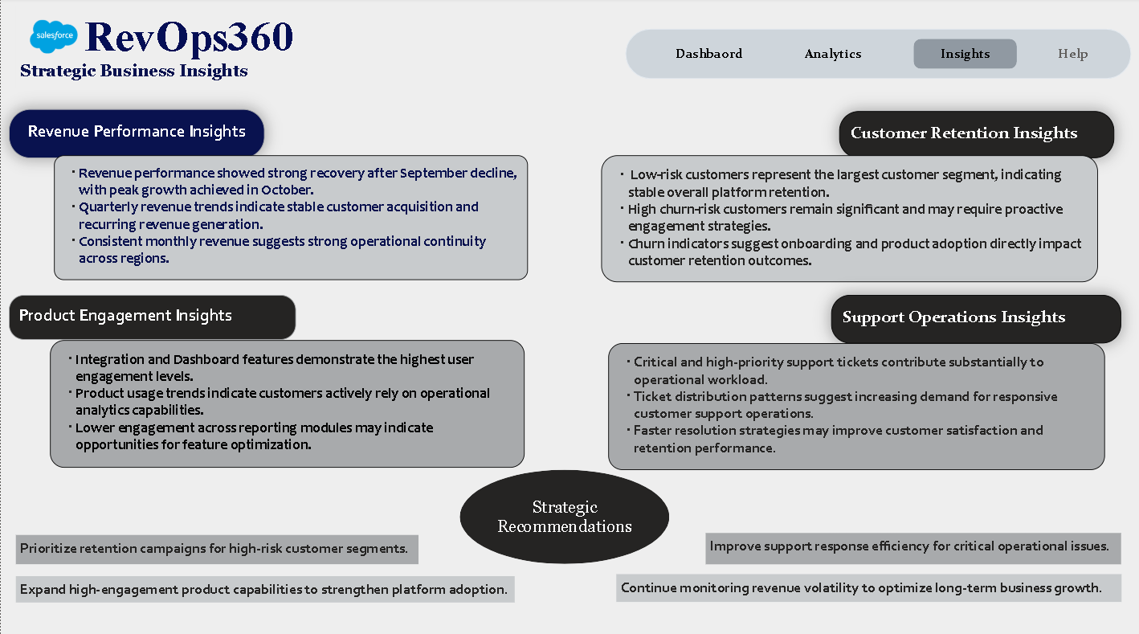
Key Insights & Recommendations:
Strong revenue growth indicated positive business performance
High-risk customer segments require proactive retention efforts.
Highly used features contributed to stronger customer engagement and platform adoption.
Support analytics revealed operational workload and improvement opportunities.
Key focus areas include customer retention, support efficiency, and feature adoption.

Slide 7

Key Learnings & Conclusion
0 1
Developed a Salesforce-inspired business intelligence platform using Power BI, DAX, and interactive dashboard design principles
0 2
Gained hands-on experience in KPI tracking, revenue analytics, customer churn analysis, and operational reporting
0 3
Implemented advanced Power BI features including bookmarks, dynamic visual switching, contextual filtering, and multi-page navigation
0 4
Improved understanding of analytical storytelling, dashboard UX design, and business-focused data visualization
0 5
Learned how data-driven insights can support strategic business decisions and operational performance monitoring
0 6
RevOps360 demonstrates the integration of business intelligence, interactive analytics, and executive reporting.

Slide 8
Thank You
This project demonstrates the application of Power BI, DAX, data modeling, KPI monitoring, and business intelligence principles to solve real-world business challenges through interactive analytics and data-driven insights. I appreciate your time and feedback.

