Slide 1
IBM University Engagement Project Submission
AI-Powered Startup Business Planning Assistant using IBM Granite & IBM Business Automation Open Edition (BOB)

Slide 2

Project Tile –Startup Blueprint AI Agent
Domain of Project – Artificial Intelligence (AI), Generative AI, Entrepreneurship & Startup Planning, Business Strategy and Decision Support
Student Name | Recent Passport Photo | Email ID | Mobile number [WhatsApp]
KHUSHI AGARWAL |  | khushiagarwal16923@gmail.com | 9389840824

Slide 3
Problem Statement -
Problem Statement: Startup Blueprint AI
The Challenge
Many aspiring entrepreneurs have innovative startup ideas but struggle to transform them into structured business plans. Developing a complete startup blueprint requires expertise in market research, business strategy, financial planning, competitor analysis, and investment readiness. Existing resources are often fragmented, time-consuming, or require expensive consultancy services. As a result, many promising ideas fail to progress beyond the concept stage due to the lack of accessible, AI-driven business guidance.
The Objective
Build an AI-powered Startup Blueprint Agent that helps entrepreneurs convert raw business ideas into comprehensive startup blueprints using IBM watsonx.ai Granite foundation models and IBM Bob. The solution should:
Idea Validation – Analyze startup ideas for feasibility, market potential, innovation, scalability, and business readiness.
AI Blueprint Generation – Generate a complete startup blueprint including executive summary, business model, revenue strategy, SWOT analysis, competitor analysis, funding suggestions, marketing strategy, and growth roadmap.
Business Readiness Scoring – Evaluate startup ideas and assign a readiness score with actionable recommendations for improvement.
AI-Powered Business Assistance – Provide intelligent insights, investment suggestions, government startup schemes, and legal guidance tailored to the proposed business.
Document Generation – Allow users to download professionally formatted startup blueprints as PDF reports.
Interactive Web Application – Provide an intuitive Flask-based web interface with blueprint history, dashboard, and real-time AI-generated responses.

Slide 4
Proposed Solution -
Proposed Solution: AI-Powered Startup Blueprint Agent
The proposed solution is an AI-powered Startup Blueprint Agent built using IBM watsonx.ai, IBM Bob, Granite Foundation Models, and Flask to help aspiring entrepreneurs transform business ideas into structured, investment-ready startup blueprints. The system addresses the challenges of business planning by providing intelligent idea validation, market analysis, financial planning, and strategic recommendations through an interactive AI-powered web application.
At its core, the solution leverages IBM watsonx.ai Granite Models to analyze user-provided startup ideas and generate comprehensive business blueprints. The AI processes the input using carefully designed system prompts and produces structured outputs, including business strategy, revenue models, market opportunities, SWOT analysis, funding suggestions, legal guidance, and growth roadmaps. The application also evaluates the startup concept and assigns a Business Readiness Score to help entrepreneurs understand the viability of their ideas.
The system consists of four key AI modules:
Idea Validation Module analyzes startup ideas for feasibility, innovation, market demand, scalability, and monetization potential before generating a blueprint.
Blueprint Generation Module creates a detailed startup blueprint covering executive summary, target audience, business model, competitor analysis, marketing strategy, funding recommendations, and investor pitch.
Business Insights Module provides AI-generated recommendations for government startup schemes, legal considerations, risk analysis, and business growth strategies.
Report Generation Module converts the generated blueprint into a professionally formatted PDF report that users can download and share with investors or mentors.
The solution includes a user-friendly Flask-based web application with an interactive chat interface, blueprint history dashboard, startup readiness scoring, and PDF export functionality. The application communicates with IBM watsonx.ai through secure APIs to generate high-quality AI responses powered by Granite Foundation Models.

Slide 5
Technology Used
IBM Business Automation Open Edition (BOB)
Used as the cloud-based development environment to build, test, and manage the Startup Blueprint AI application.
IBM watsonx.ai
Used to securely access and deploy IBM Granite Foundation Models for AI-powered startup blueprint generation.
IBM Granite 4-h small Model ( ibm/granite-4-h-small)
Used for natural language understanding, reasoning, idea validation, business strategy generation, and personalized startup recommendations.
Python Flask
Used to develop the backend APIs, application logic, and manage communication between the frontend and IBM watsonx.ai.
HTML, CSS, JavaScript & Bootstrap
Used to build a responsive and interactive web interface for users to submit startup ideas and view generated blueprints.
ReportLab / PDF Generation
Used to generate downloadable PDF reports of the AI-generated startup blueprint.
Git & GitHub
Used for version control, project management, and source code hosting.

Slide 6
Project Components Used-
1. User Interface (HTML, CSS, JavaScript, Bootstrap)
Provides an interactive and responsive interface where users can enter startup ideas, view AI-generated business blueprints, and download reports.
2. Flask Backend (Python)
Handles user requests, validates input, communicates with IBM watsonx.ai, manages application logic, and processes blueprint generation.
3. IBM Business Automation Open Edition (BOB)
Used as the development environment to build, test, and manage the Startup Blueprint AI application efficiently.
4. IBM watsonx.ai
Provides secure access to IBM Granite foundation models and processes AI requests to generate intelligent startup business recommendations.
5. IBM Granite 3.3 4B Instruct Model
Performs natural language understanding, startup idea analysis, business reasoning, and generates comprehensive startup blueprints.
6. Prompt Engineering
Uses predefined system instructions to guide the AI in generating structured, relevant, and consistent business plans.
7. PDF Report Generator
Converts the generated startup blueprint into a professional PDF document that users can download and share.
8. Session History
Maintains previously generated startup blueprints during the user session for quick access and comparison.

Slide 7
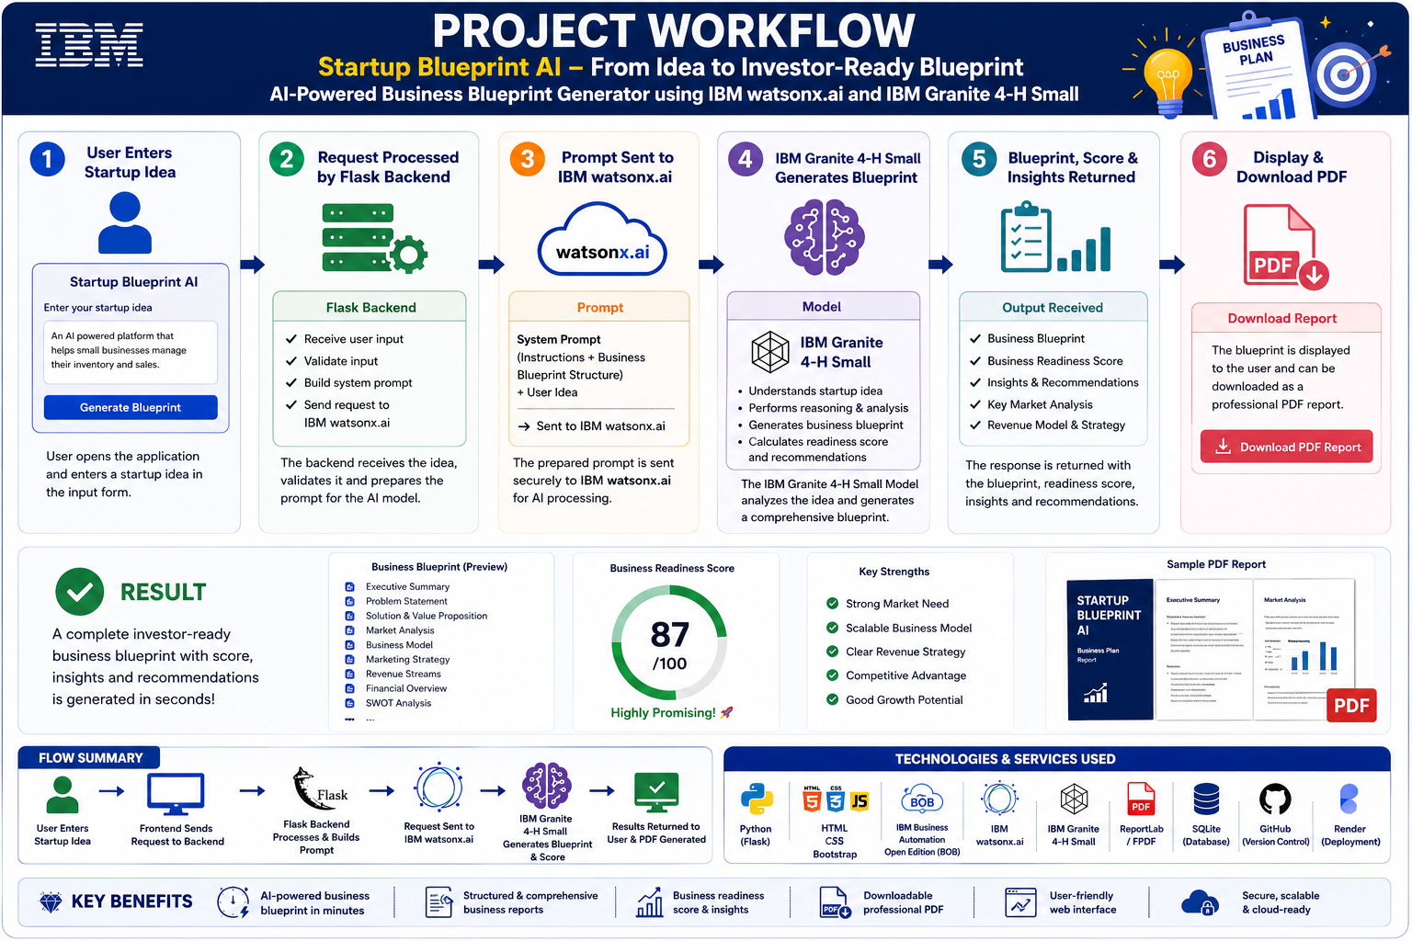
Project workflow -

Slide 8
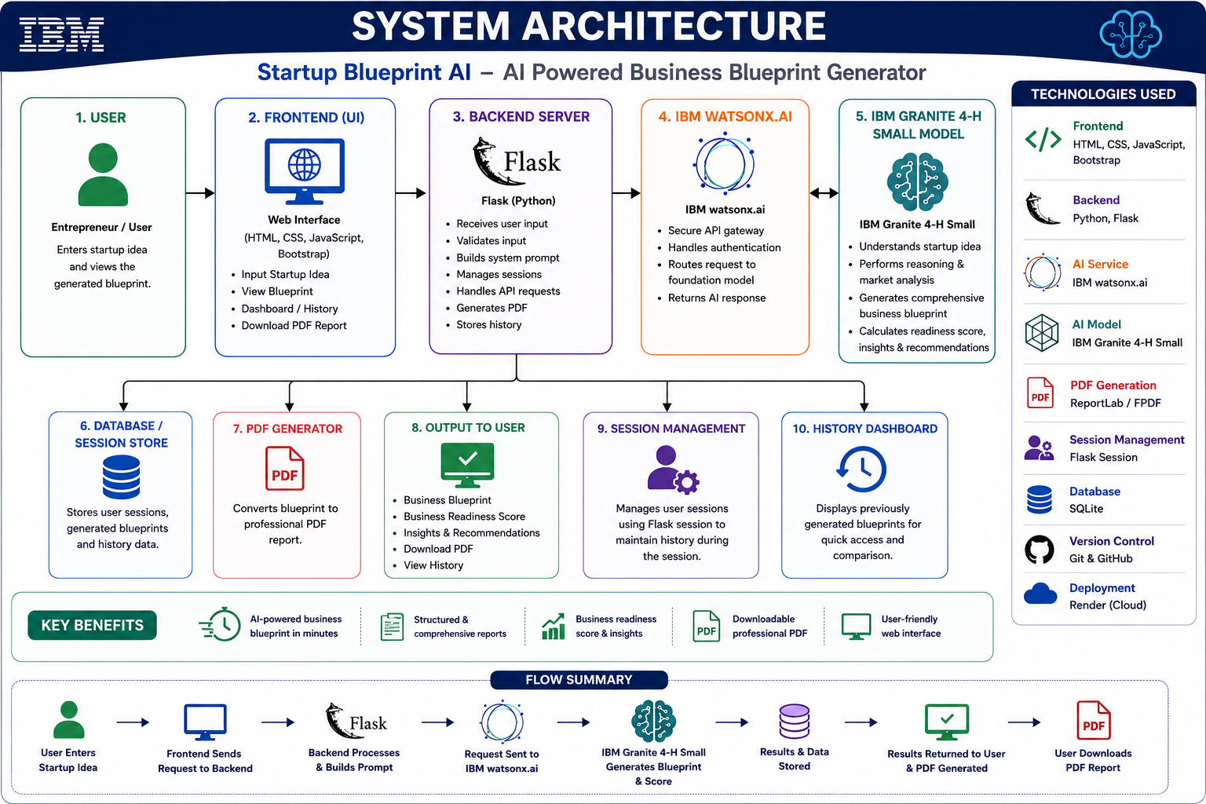
System Architecture

Slide 9

Role of AI in the Solution
The Startup Blueprint AI platform leverages Agentic AI to assist aspiring entrepreneurs in transforming a startup idea into a structured business blueprint. Instead of providing generic responses, the AI acts as an intelligent business consultant by analyzing user input and generating personalized recommendations.
The solution uses the IBM Granite 4-H Small Instruct Model hosted on IBM watsonx.ai for natural language understanding, reasoning, and business content generation. Based on the startup idea entered by the user, the AI creates a comprehensive blueprint containing business strategy, market analysis, revenue model, funding suggestions, risk assessment, and implementation roadmap.
The AI performs the following key functions:
Idea Understanding: Interprets the startup concept using natural language processing.
Idea Validation: Evaluates feasibility, innovation, scalability, and business potential.
Blueprint Generation: Produces a detailed startup plan with structured sections.
Business Readiness Scoring: Calculates a readiness score based on the overall quality and viability of the idea.
Personalized Recommendations: Suggests suitable business models, marketing strategies, funding options, and growth plans tailored to the startup.
Report Generation: Generates a professional blueprint that can be downloaded as pdf.

Slide 10
IBM Granite Model Usage & Prompt Flow
Model Used: IBM Granite 4-H Small Instruct (via IBM watsonx.ai)
Prompt Flow:
User Startup Idea
│
▼
System Prompt
(AI Business Consultant Instructions)
│
▼
User Prompt
(Startup Idea)
│
▼
IBM Granite 4-H Small Model
│
▼
AI Processing & Reasoning
│
▼
Generated Startup Blueprint
│
▼
Business Readiness Score + PDF Report
·
·
·

Slide 11
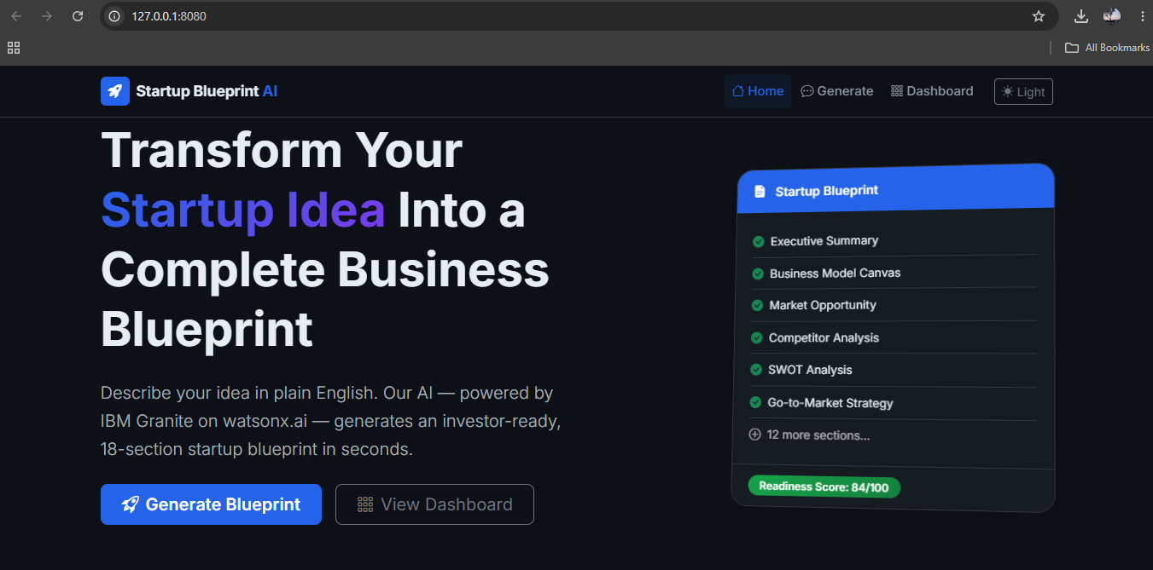

Slide 12
Novelty and Uniqueness
1. AI-Driven Startup Planning: Converts a simple startup idea into a complete business blueprint within minutes using IBM Granite 4-H Small.
2. Comprehensive Business Analysis: Automatically generates market analysis, SWOT analysis, revenue model, funding suggestions, legal guidance, and growth roadmap in one platform.
3. Business Readiness Score: Evaluates the feasibility and potential of a startup idea with AI-generated insights and recommendations.
4. Professional PDF Export: Allows users to download investor-ready business blueprints as a formatted PDF.
5. User-Friendly Web Application: Built with Flask and integrated with IBM watsonx.ai to provide an intuitive and responsive experience.
6. Supports First-Time Entrepreneurs: Reduces the need for extensive business expertise by offering AI-powered planning and decision support.
This content is concise, presentation-friendly, and highlights what makes your project different.

Slide 13
Git Hub Link
Github URL – https://github.com/KhushiAgarwal10/AI-Startup-Blueprint-Agent
·
·
·

Slide 14
Future Scope
1. Multi-Agent Business Assistance
Enhance the system by introducing specialized AI agents for finance, legal compliance, marketing, and investment advisory, enabling entrepreneurs to receive more comprehensive and domain-specific business guidance.
2. Real-Time Market Intelligence
Integrate live market data, startup trends, competitor information, and government schemes to generate more accurate, up-to-date, and data-driven business blueprints and recommendations.
3. Cloud Deployment & Collaboration
Deploy the application on IBM Cloud with secure user authentication, project storage, and collaboration features, allowing multiple users to create, manage, and share startup blueprints efficiently.
·
·
·

Slide 15
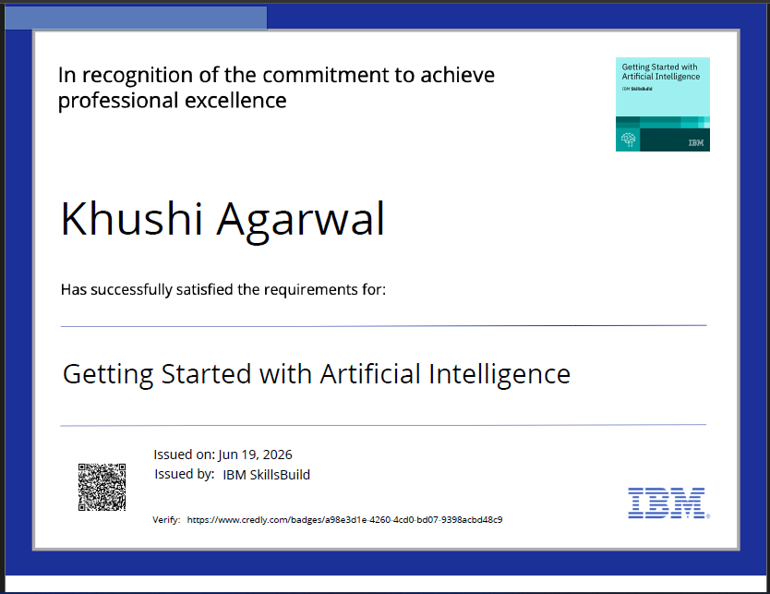
Certificates Earned:
Please add your credly certificate

Slide 16
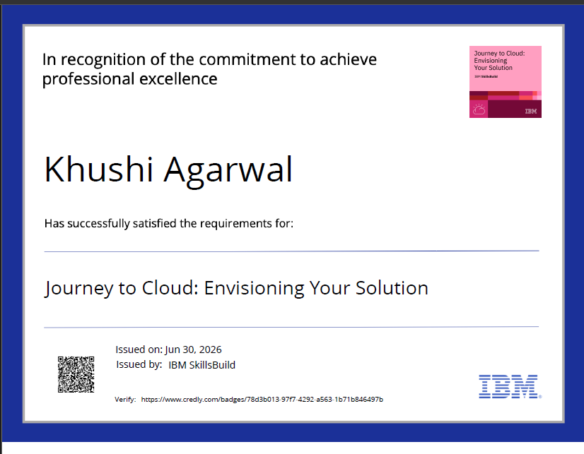

Slide 17
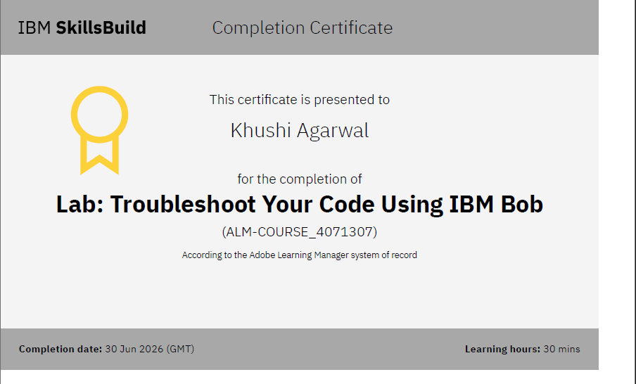
Certificates Earned:​
Add your IBM BOB Certificate

Slide 18


