Slide 1


Bookstagram
“Why just read when you can create!”
(MERN Social AI Authoring Platform)
Presented By: Khushi Bhatt & Aditi Aditi
CSIS 4495 – Applied Research Project

Slide 2

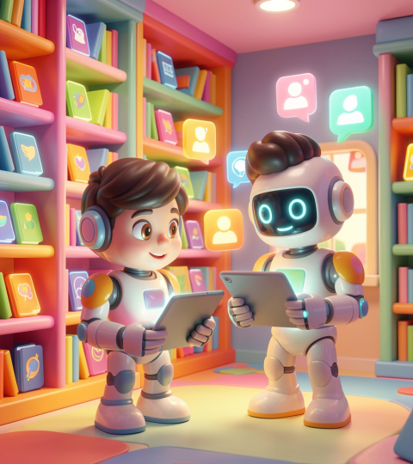
01
Product Overview

Slide 3
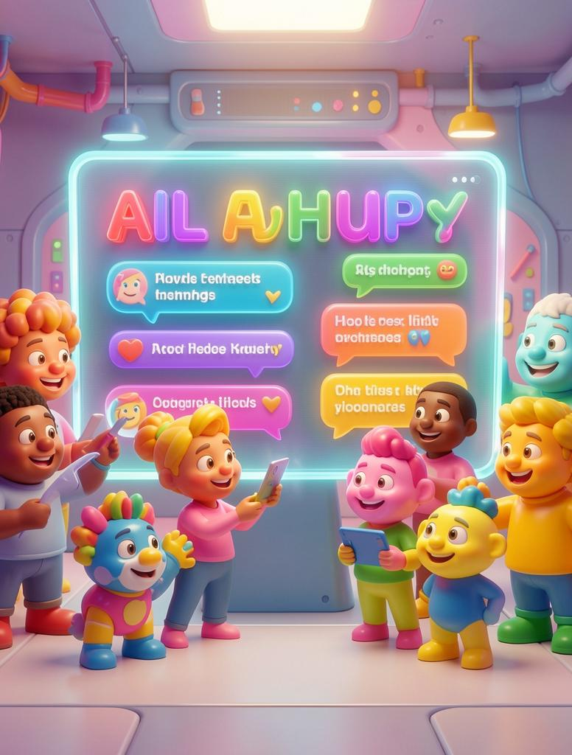
Introduction
Bookstagram is a MERN-stack social writing platform combining AI authoring with social features for collaborative storytelling.
Designed to showcase AI-assisted eBook creation, real-time social interactions, and export capabilities for reader and author workflows.

Slide 4
Problem & Solution
Problems:
Writers struggle with:
Generating ideas
Maintaining motivation
Completing eBooks
AI tools:
Help generate content but lack engagement
Social platforms:
Provide engagement but no structured writing support
This creates the “Social Authoring Gap.”
Solution: Bookstagram
Combines:
AI-assisted writing (Gemini)
Social features (likes, follows, feed)
Unique features:
AI + Social in one platform
3 writing modes (Human + AI collaboration)
Full authoring – publishing workflow
Novelty: Hybrid of AI writing + social engagement

Slide 5
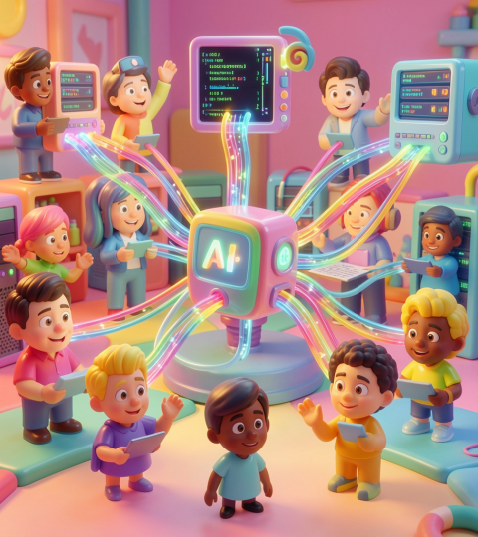
02
Technical Details

Slide 6
Technology Stack
Frontend: React + Vite, Tailwind CSS, React Router, Axios for requests.
Backend: Node.js + Express, MongoDB, JWT authentication, Socket.io for real-time messaging.
Deployment: Cloud storage (Cloudinary), CI/CD pipelines.

Slide 7
AI Integration
Google Gemini handles outlines, chapter generation, and the BookBot chatbot.
Hugging Face provides story image and avatar generation for covers and content visuals.
Hybrid workflows allow iterative user-AI collaboration and in-app AI suggestions for threads.

Slide 8
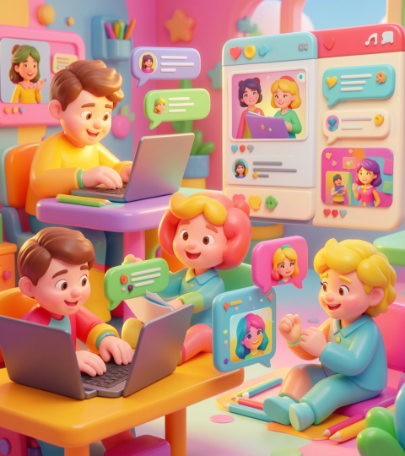
Key Features
AI eBook creation (outline + chapters)
Chapter editor with 3 writing modes
AI-generated images & covers
Social feed (like, follow, explore)
Threads (posts + comments)
Real-time messaging + AI Bookbot
PDF & DOCX export

Slide 9
User Flow
Start
Onboarding Profile Setup with avatar creation and preferences.
Compose
Choose writing mode (manual, AI, hybrid) and generate outlines or chapters.
Publish
Export eBook (PDF/DOCX) or share to feed for discovery.

Slide 10
Implementation Approach
Agile Development (Sprint-Based)
Followed an iterative Agile SDLC approach
Timeline: January – April 2026
Development Phases
Backend architecture & secure authentication (JWT)
AI integration (Gemini for text, HuggingFace for images)
Core feature development (eBook creation, chapter editor, social features)
Real-time messaging & AI Bookbot (Socket.io)
User analytics & performance tracking
Testing & Optimization
Continuous testing and debugging after each sprint
Regular improvements for performance and user experience

Slide 11
Challenges Faced
Gemini API changes (breaking updates)
Avatar generation from prompts was difficult
Re-generating avatars with changes (e.g., expressions like wink) was inconsistent
Used Gemini + Flux + HuggingFace APIs for image generation
Profile picture update not reflecting across pages (Profile & Dashboard)
Cloudinary integration vs local storage
Real-time messaging setup (Socket.io)
Markdown to PDF/DOCX conversion
Merge conflicts in Git
Resolved through debugging, testing, and improvements

Slide 12
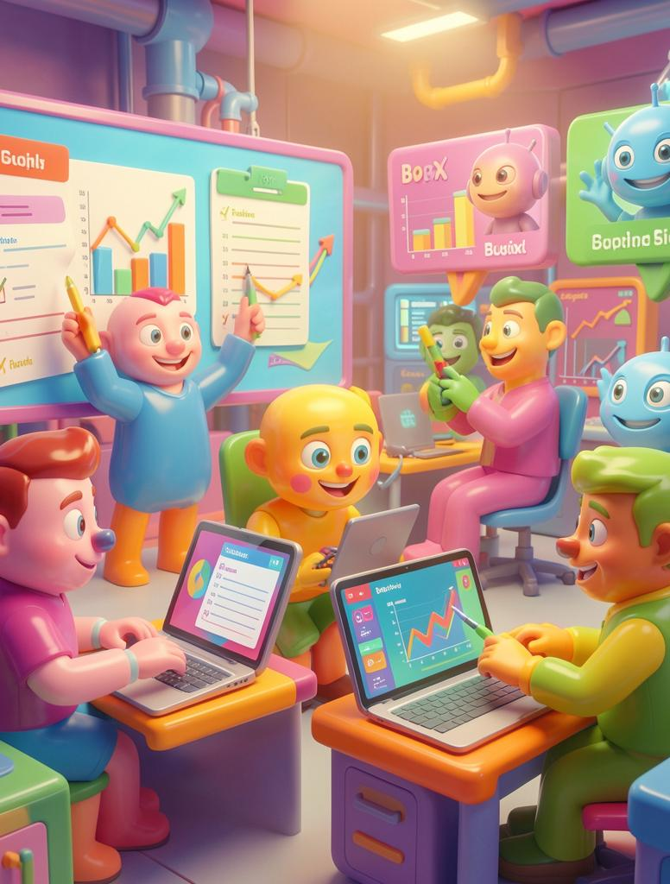
Evaluation & Testing
Functional testing for all features
End-to-end user testing
Survey system implemented
Results:
AI improved writing productivity
Social features increased motivation
Users showed high satisfaction

Slide 13
Learning & Impact
Learnings
• Gained hands-on experience with AI integration (Gemini API) • Explored AI image generation (Gemini, Flux, HuggingFace) • Built an AI-powered messaging bot • Learned full-stack development using MERN stack • Improved debugging and problem-solving skills • Understood importance of testing and iteration
Impact • AI support improved writing productivity • Social features increased user engagement • User feedback helped enhance the platform • Developed a complete end-to-end working product • Built confidence in real-world project development

Slide 14
Conclusions
Bookstagram demonstrates a cohesive MERN + AI platform that bridges structured writing and social engagement.
Result: improved author productivity, richer social discovery, and export-ready eBook outputs.

Slide 15
Thank You
Let’s move on to the live demo of Bookstagram.

