Slide 1

UNIFIED MENTOR
Analyzing Amazon Sales Data
Khushi Daga

Slide 2
Problem Statement
Fields Used
About Data
Extract, Transform and Load
Index
Output of ETL
Python Code
Output
Tableau
Output Of Tableau
Required Links

Slide 3

Problem Statement
Sales management has gained importance to meet increasing competition and the
need for improved methods of distribution to reduce cost and to increase profits.
Sales management today is the most important function in a commercial and business enterprise.

Slide 4
Fields Used
Project Difficulties Level
Technologies Used
Technologies
Domain
Data Science
E-commerce
Advanced
Python and Tableau

Slide 5
About Data
No Missing Values Found
Data
Rows: 93
Columns: 19
Start Date: 31/03/2022
Data Range
End Date:
29/06/2022

Slide 6
Variables | Data Type
Region, Country, Item Type, Sales Channel and Order Priority | Object
Order Date and Ship Date | datetime64[ns]
Order ID, Units Sold and Shipping Duration | int 64
Unit Price, Unit Cost, Total Revenue, Total Cost, Total Profit and Profit Margin | float 64
Order Day, Order Month and Order Year | int 32

Slide 7
Extract, Transfrom and Load
Extract
Retrieve raw data from multiple sources such as databases or files.
Transform
Modify and structure the data to meet analysis or storage requirements.
Load
Store the transformed data into a target system like a database or data warehouse for use

Slide 8
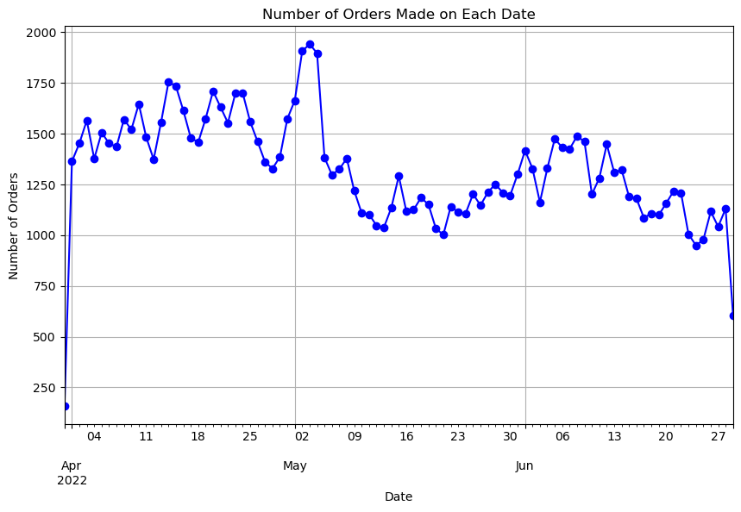
Output of ETL

Slide 9
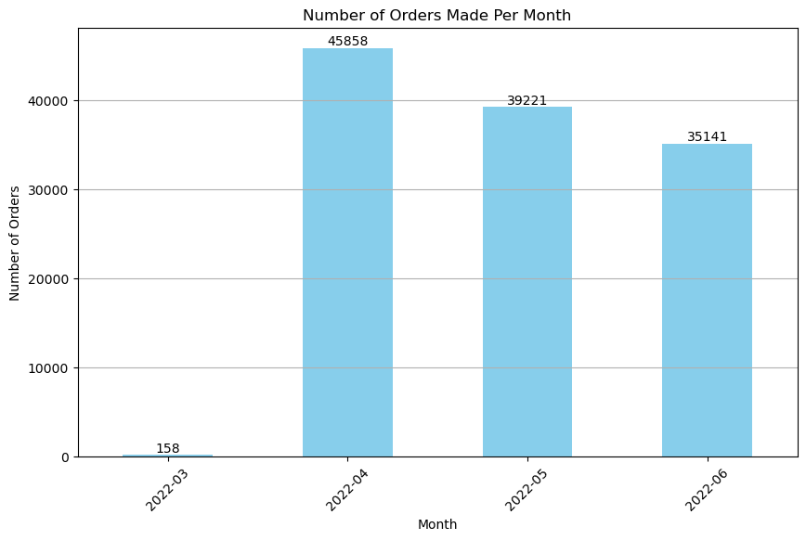
Output of ETL

Slide 10
Python
Libraries used are following:
pandas as pd
matplotlib.pyplot as plt
seaborn as sns
These libraries were used for various observations and visualisations.

Slide 11
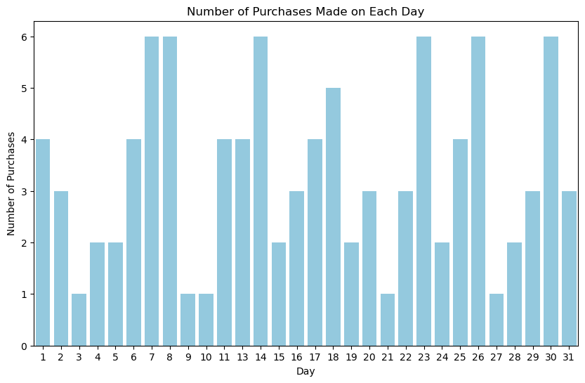
Output

Slide 12
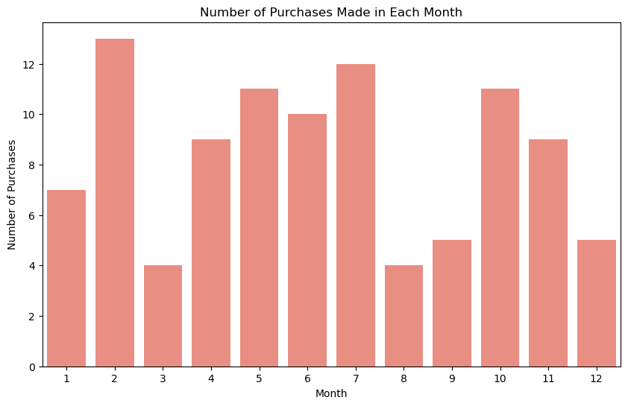
Output

Slide 13
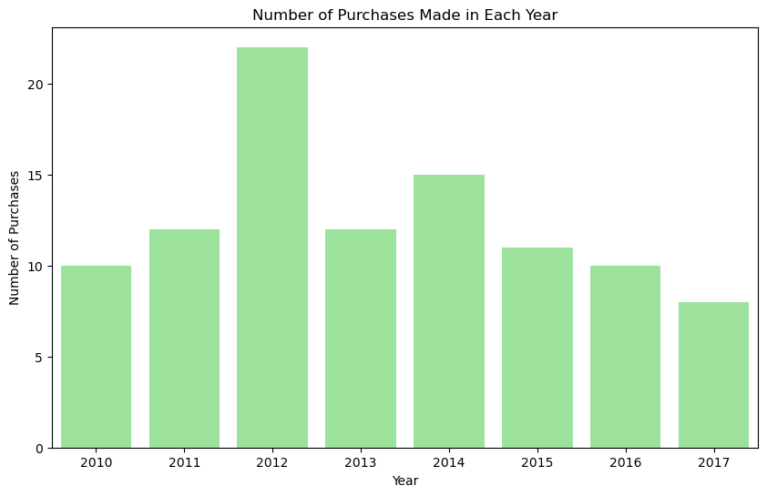
Output

Slide 14
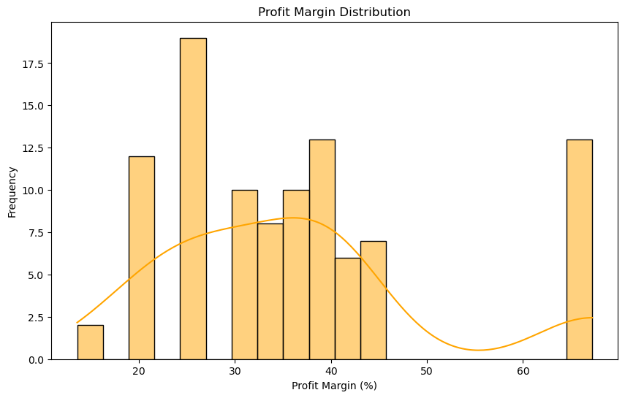
Output

Slide 15
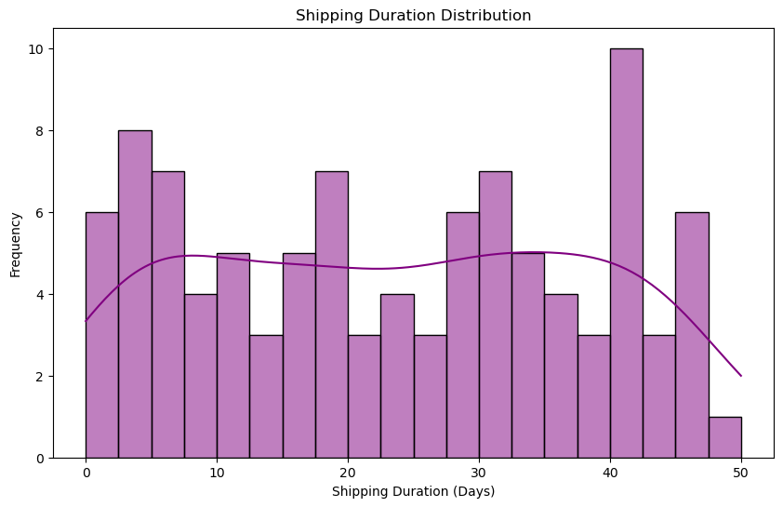
Output

Slide 16
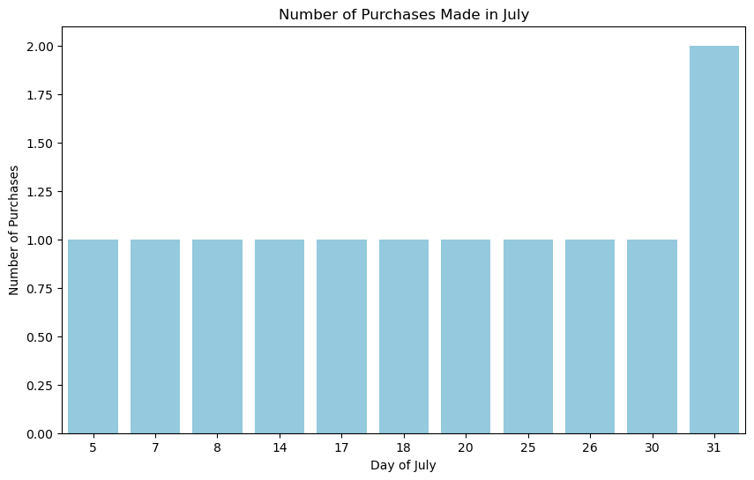
Output

Slide 17
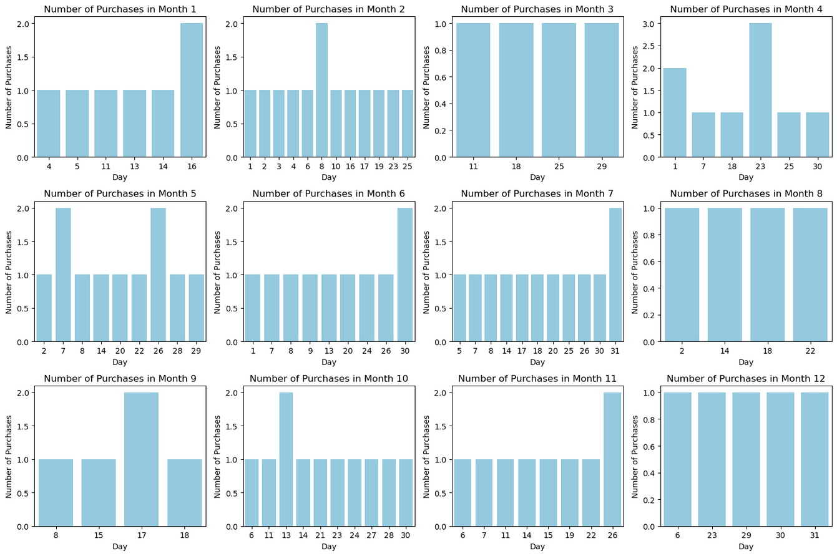
Output
Output

Slide 18
Output
Top Selling Item Types by Total Revenue:
Item Type
Cosmetics 36601509.60
Office Supplies 30585380.07
Household 29889712.29
Baby Food 10350327.60
Clothes 7787292.80
Name: Total Revenue,
dtype: float64
Order Priority Analysis
Order Total Total
Priority Profit Revenue
C 6748328.46 18855063.05
H 16891599.58 48749546.05
L 10858727.86 36628127.46
M 9669542.50 33116031.75
Sales Channel Analysis:
Sales Channel
Offline 79094809.20
Online 58253959.11
Name: Total Revenue,
dtype: float64

Slide 19
Tableau
Tableau is a data visualization and analytics tool that helps to create interactive dashboards and visualizations from various data sources.
It connect you with your data, create visualizations using a drag-and-drop interface, build interactive dashboards, and share your insights with everyone.
For my Amazon Sales Survey , I have used Tableau to visualize sales trends, regional distribution, product performance, and more, making it easier to understand and analyze your data effectively.

Slide 20
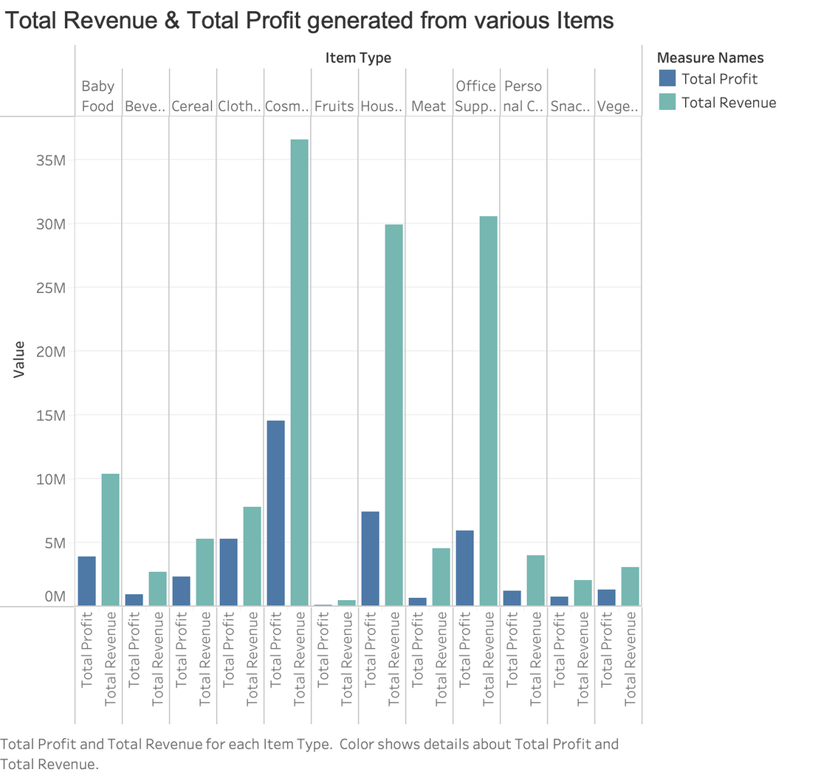
Output

Slide 21
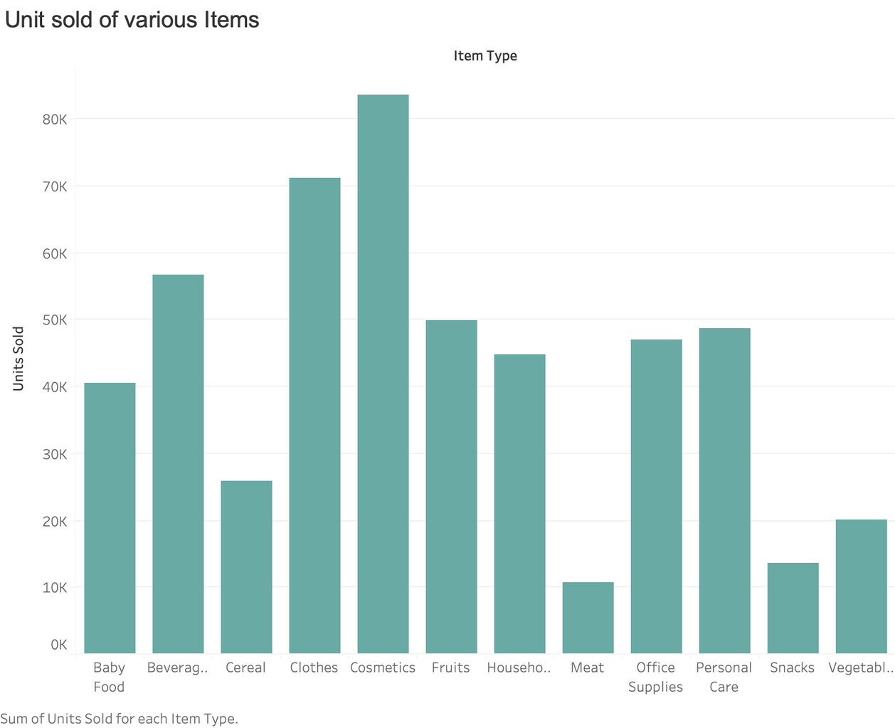
Output

Slide 22
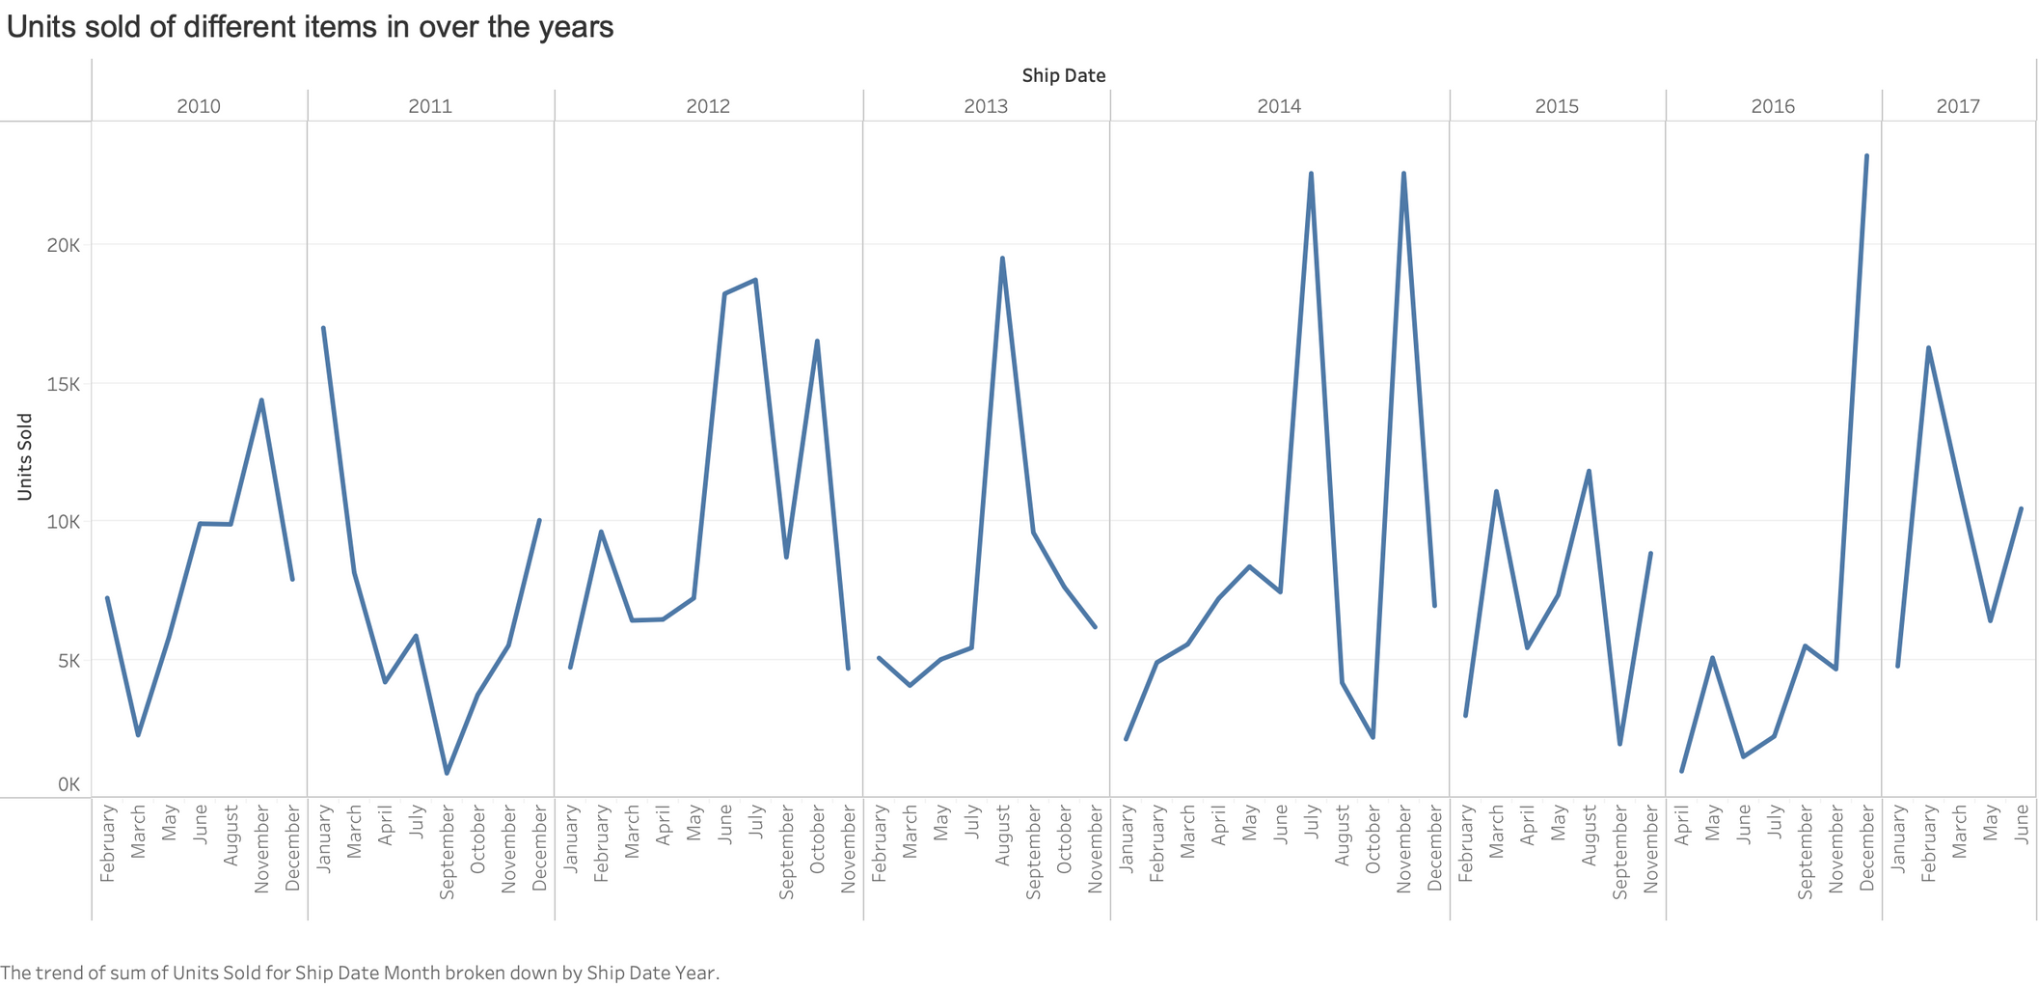
Output

Slide 23
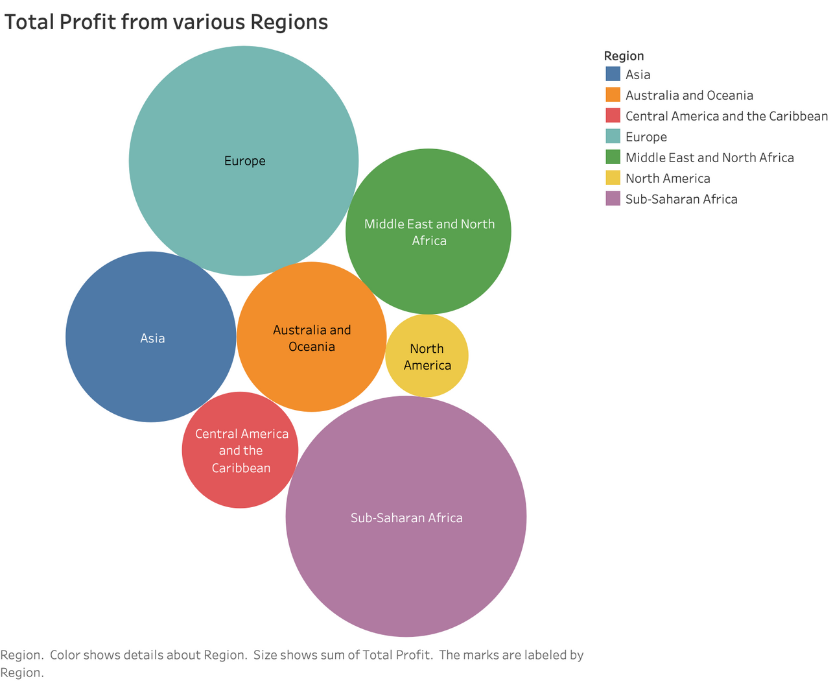
Output

Slide 24
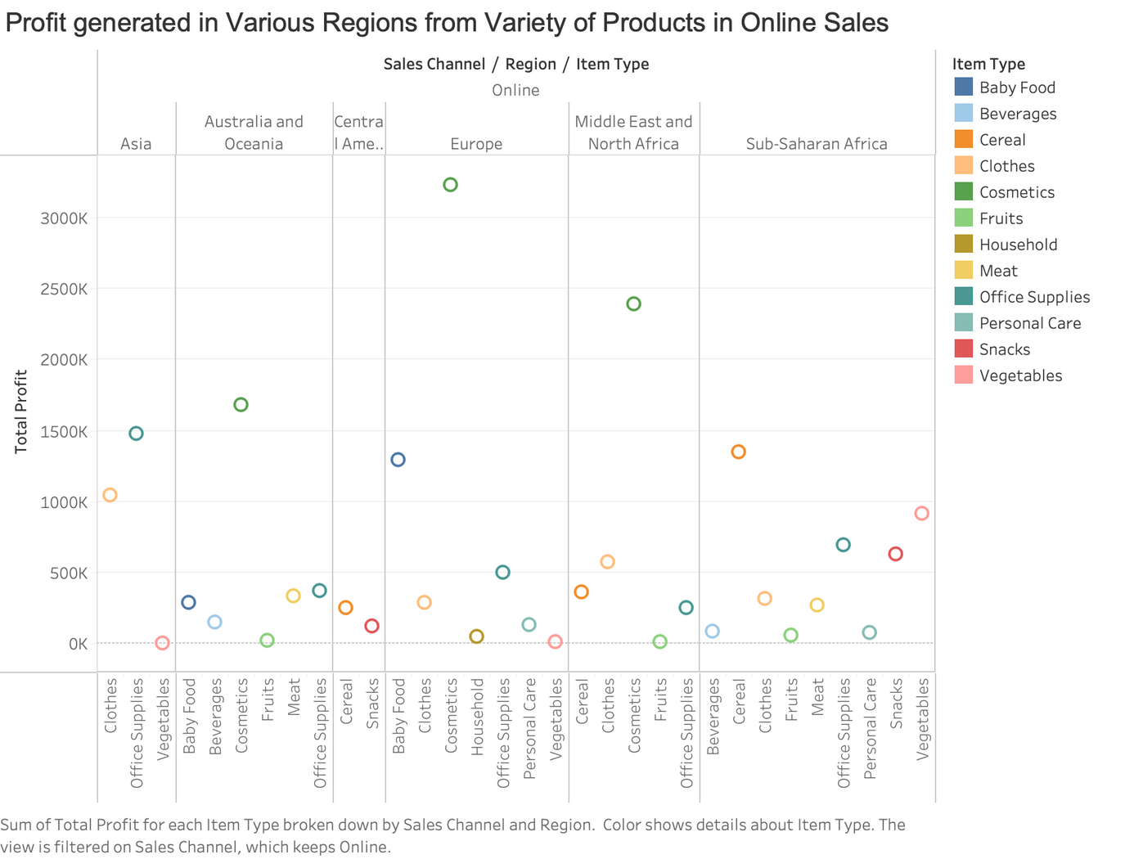
Output

Slide 25
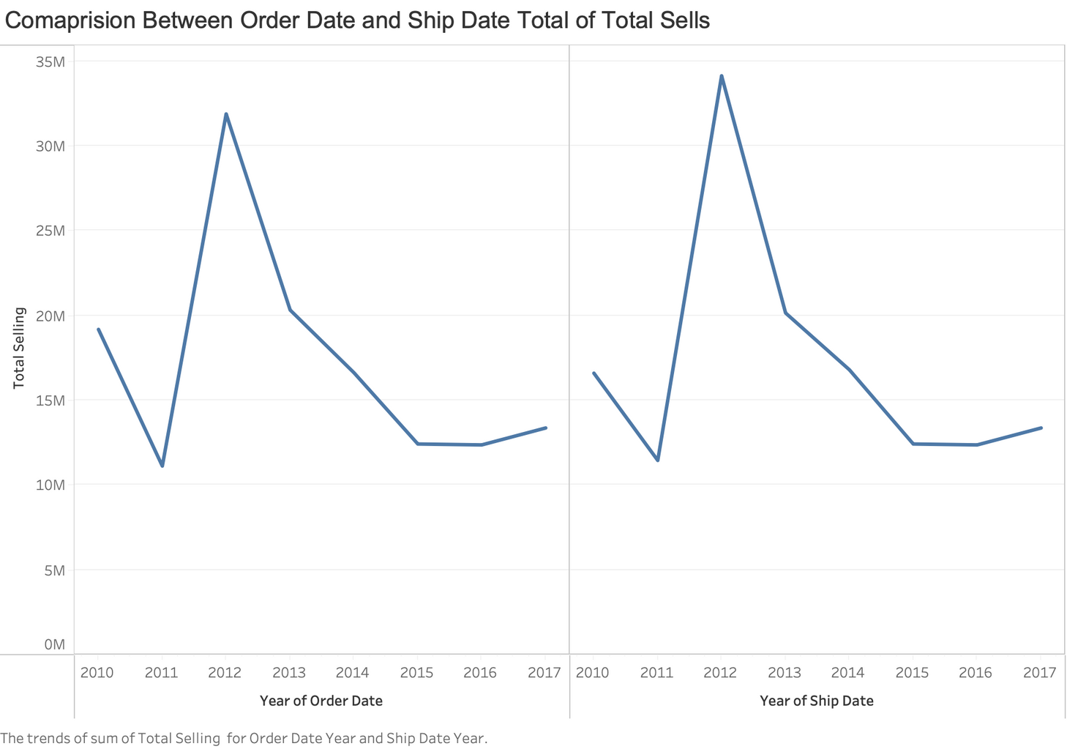
Output

Slide 26

Required Links
Khushi Daga
GitHub
https://github.com/KhushiDaga/Khushi_AmazonSales

Slide 27
Thank You

