Slide 1
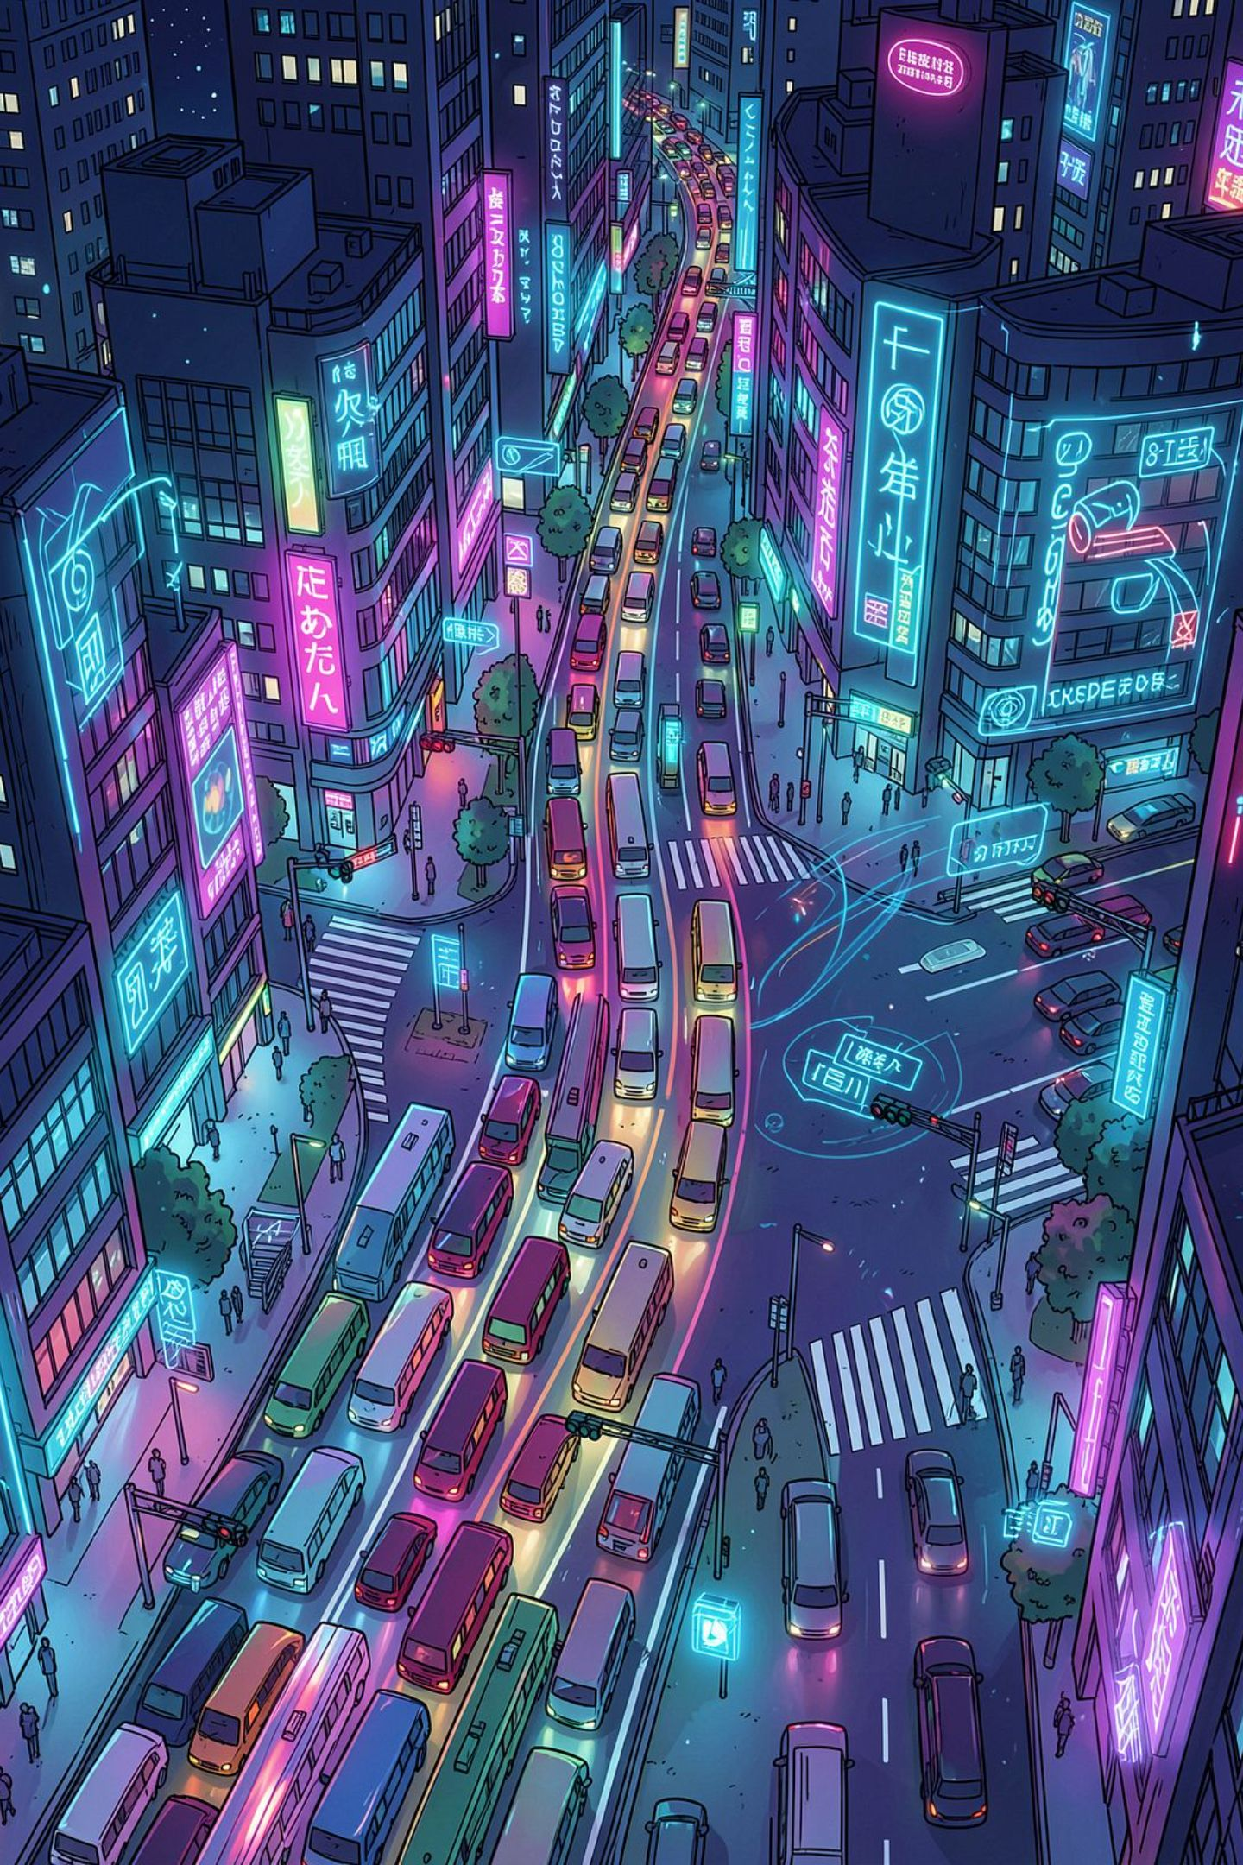
“The City Moves. The Signals Don’t.”
Urban traffic is dynamic; signals are not. Fixed timers give equal green time to unequal demand.
Consequences
Core Problem
Long waits and stop‑start traffic
Fuel wastage and higher emissions
Delayed emergency response
Congestion cascades across nearby intersections
We don't lack traffic signals. We lack traffic intelligence.

Slide 2
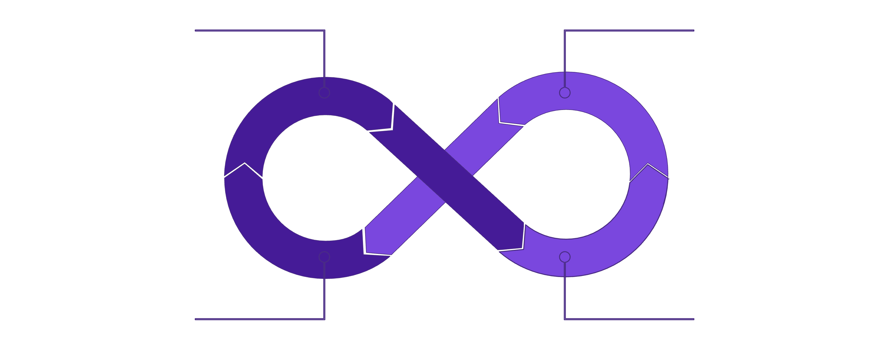
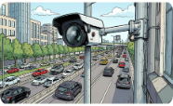
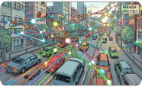
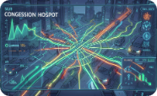
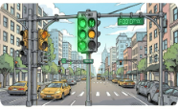
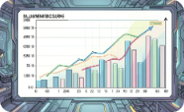
Meet Raahi — Traffic That Thinks Ahead.
Camera Feed
AI Detection
Signal Optimization
Traffic Analysis
Don't just detect traffic. Understand it. Predict it. Act on it. Learn from every intersection.
01 — SEE
02 — UNDERSTAND
03 — PREDICT
AI cameras detect and count vehicles in real time.
Analyze density, flow vectors and intersection state.
Identify emerging jams
before they form.
04 — ACT
05 — LEARN
Dynamically optimize signal timings to demand.
Historical patterns refine
future decisions.

Slide 3

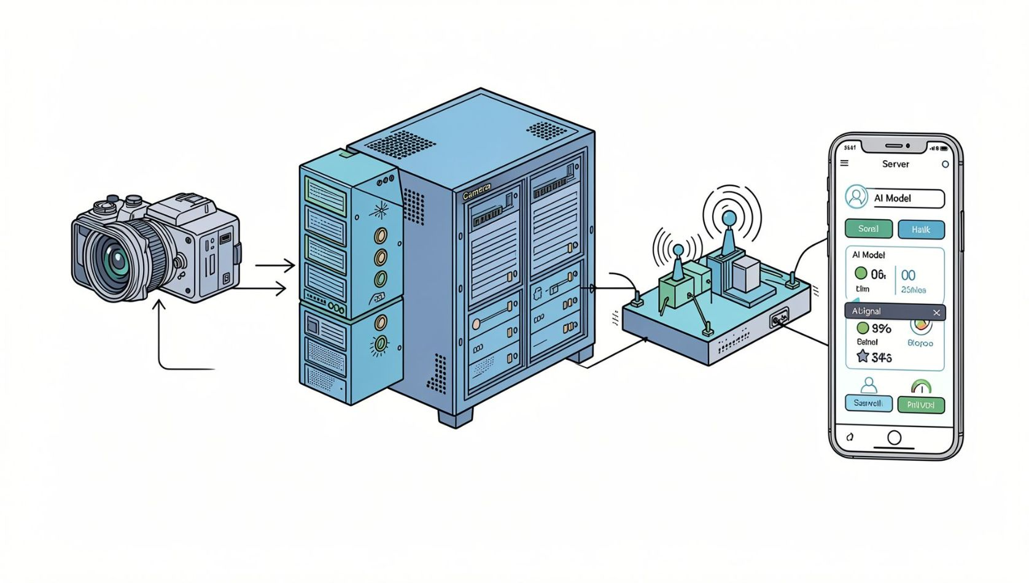
The Intelligence Behind Raahi
Data Layer
Computer Vision
AI Engine
Decision Engine
Tech Highlights
Computer vision: YOLO + OpenCV for robust multi-vehicle detection
AI models: real‑time prediction of congestion hotspots
Decision engine: optimization loop for signal timings and priority
Infrastructure: FastAPI for edge control, Firebase for telemetry, Flutter/React for dashboards
Computer Vision + AI Prediction + Adaptive Control = Intelligent Traffic Management

Slide 4
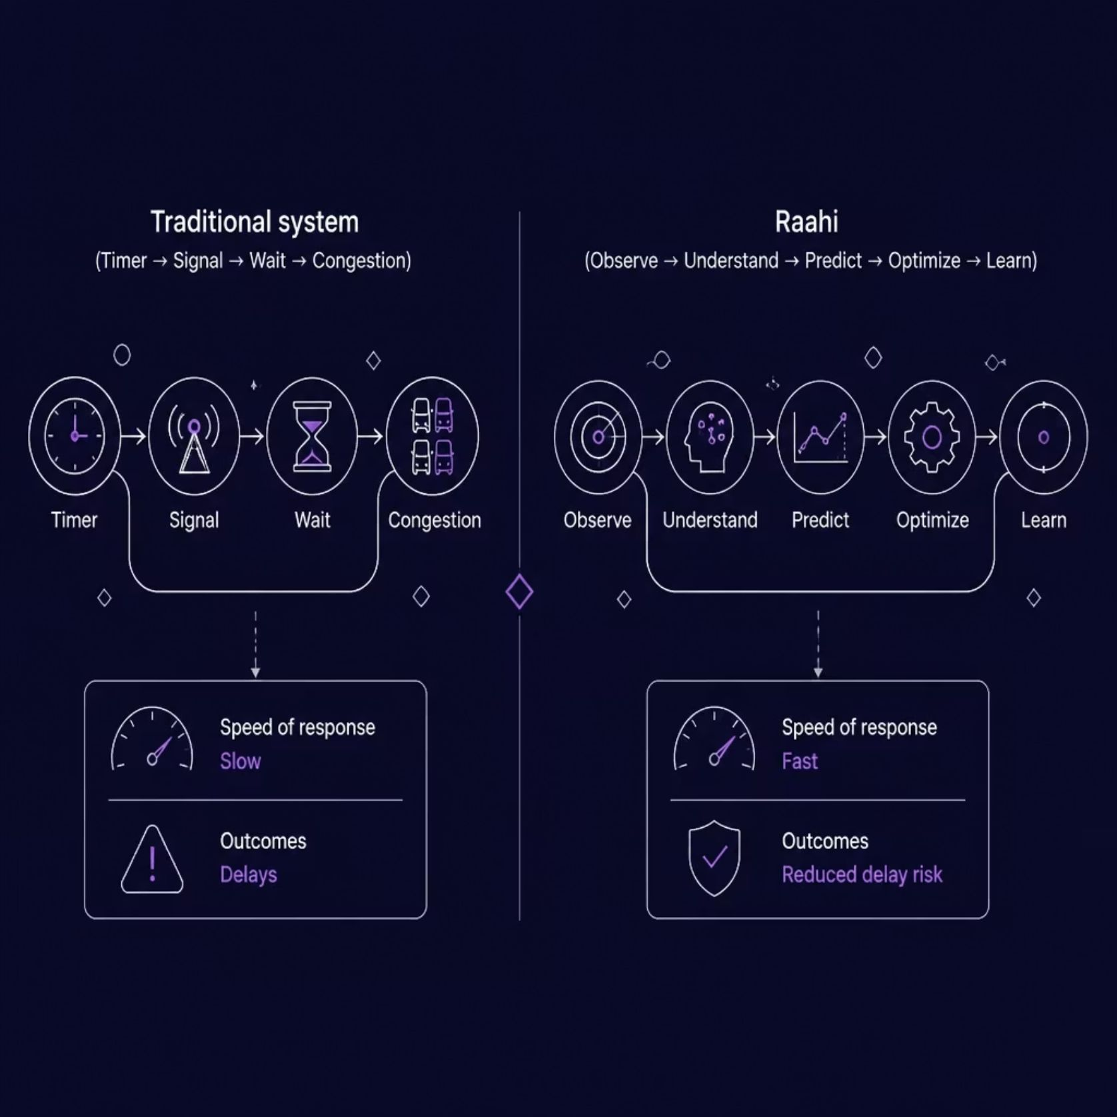
From Reactive Signals to Predictive Intersections
1
2
Demand‑Based Signals
Predict Before the Jam
Green time allocated by measured vehicle demand, not preset timers.
Early detection of congestion build-up enables preemptive adjustments.
3
4
Intersection Intelligence
Continuous Learning
Local decisions with network-level
coordination.
Models improve from historical and
edge data.
5
Emergency‑Ready
Priority routing for ambulances and first responders.
“We are not replacing traffic lights.
We are giving them intelligence.”

Slide 5
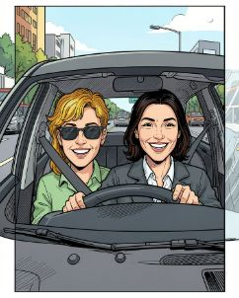
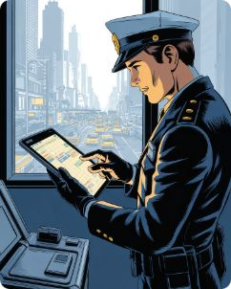
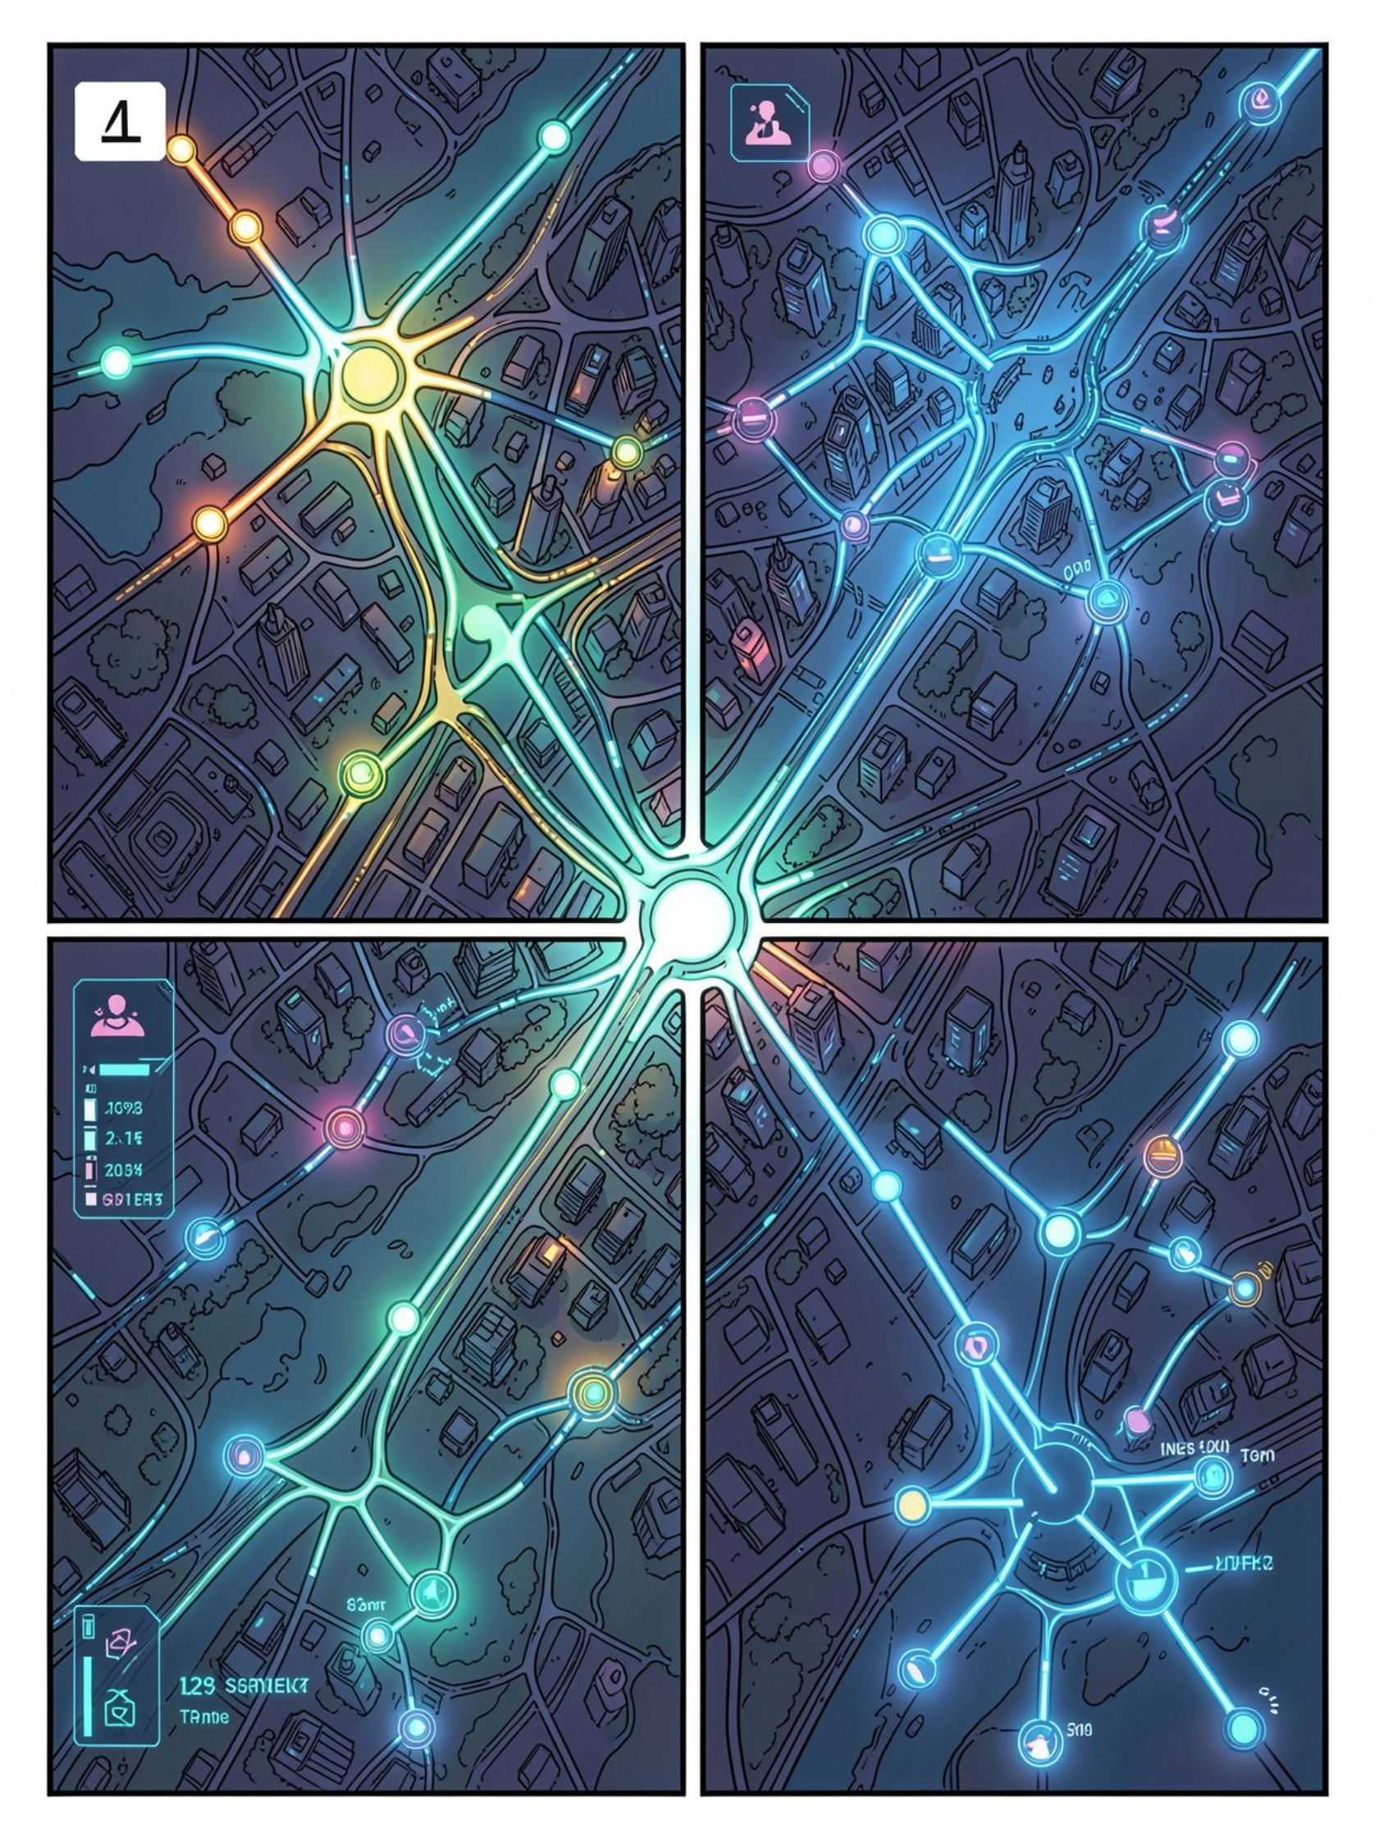
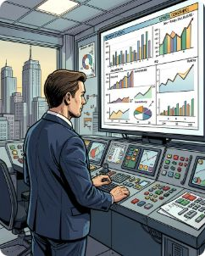
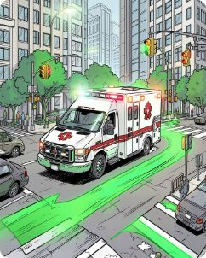
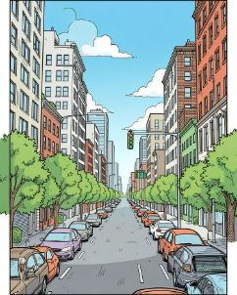
One Smart Intersection Can Influence an Entire City
Commuters
Traffic Police
Scalability
Prototype → Single Junction → Multiple Junctions → City‑Wide AI Network
Less waiting,
Smoother
journeys.
Real‑time
intelligence for
faster decisions.
City Authorities
Emergency
Services
Data-driven
planning and
policy.
Reduced intersection delays for critical response.
Environment
Less idling — lower fuel waste and emissions (potential impact).
Raahi turns daily firefight management into
proactive, data-driven traffic strategy.

Slide 6
From Smart Signals to a Self‑Learning Traffic Network
Prototype
1
Edge AI at one intersection — verify detection and control loop.
Emergency Corridor Intelligence
2
Single Junction
Dynamic priority for life‑critical vehicles.
Deploy, measure KPIs (delay, queue length, priority success).
Multiple Junctions
3
Context‑Aware AI
Coordinate neighboring intersections for corridor optimization.
Integrate weather, accidents, events for better predictions.
4
City‑Wide Network
Digital twin, cross‑intersection learning, context‑aware predictions.
IoT‑Powered Intersections
Cameras + sensors + signals + AI for richer inputs.
Traffic Digital Twin
Simulate strategies and evaluate city‑scale impacts before rollout.
“Raahi doesn't just manage traffic. It teaches the city how to move.”

