Slide 1







STACK OVERFLOW DEVELOPER SURVEY 2019
Khushi Goosari
13-08-2024

Slide 2



OUTLINE
Executive Summary
Introduction
Methodology
Results
Visualization – Charts
Dashboard
Discussion
Findings & Implications
Conclusion
Appendix

Slide 3

EXECUTIVE SUMMARY
Data contextualization and analysis goal
Methodology description.
Data Gathering
Data Analysis
Data Visualization
Results presentation supported with graphs and trends.
Discussion of overall findings and implications regarding the results previously exposed.
Final conclusions of the carried out research

Slide 4

INTRODUCTION
Stack Overflow’s annual Developer Survey is the largest and most comprehensive survey of people who code around the world.
Results don’t represent everyone in the developer community evenly.
Nearly 90,000 developers
Trends to predict where the developers are going
Characterization of developers around the globe

Slide 5

METHODOLOGY
Data Collection
Data Wrangling
Exploratory Data Analysis
Data Visualization
Dashboard Creation
Presenting of Findings

Slide 6
RESULTS
The collected data is first pre processed and cleaned.
Used Visualization to Analyze the data find preset the findings.

Slide 7
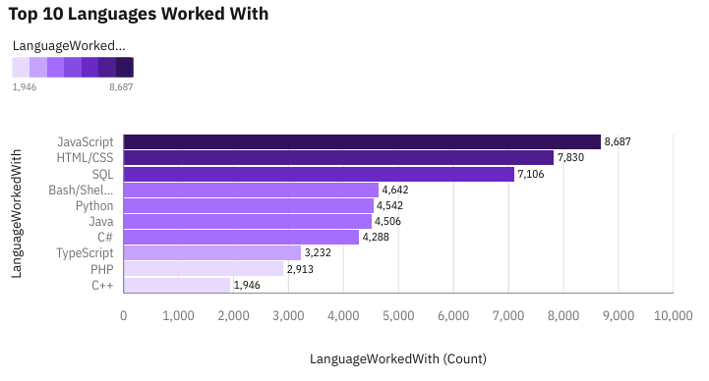
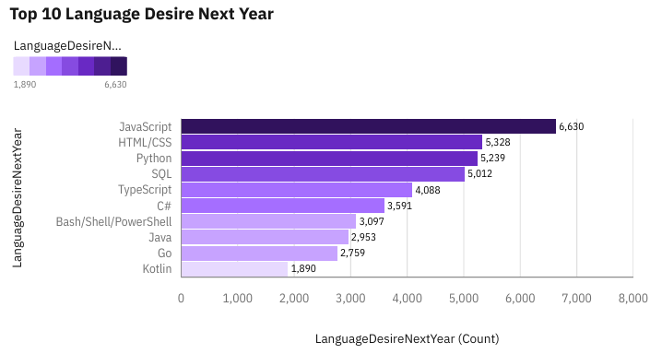
PROGRAMMING LANGUAGE TRENDS
Current Year
Next Year

Slide 8
PROGRAMMING LANGUAGE TRENDS - FINDINGS & IMPLICATIONS
Findings
JavaScript seems to keep as leading language.
Python fastest-growing
Great interest in TypeScript
Implications
Possible developers migration from JavaScript to TypeScript.
More people are interested in Python

Slide 9
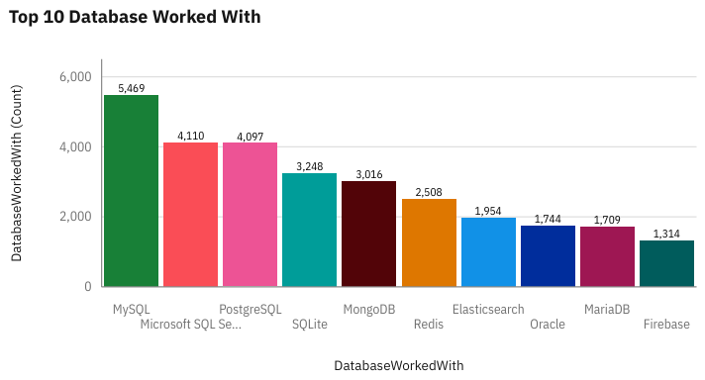
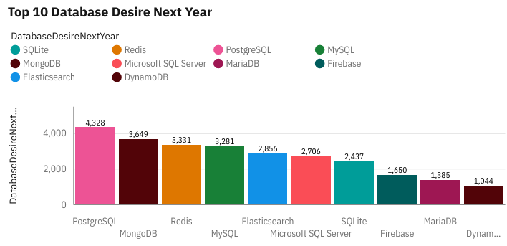
DATABASE TRENDS
Current Year
Next Year

Slide 10
DATABASE TRENDS - FINDINGS & IMPLICATIONS
Findings
Lack of interest in Microsoft SQL Server and SQLite.
Increasing interest in PostgreSQL and MongoDB.
Implications
Microsoft SQL Server and SQLite losing ground in the market.
PostgreSQL and MongoDB establishment in the market.

Slide 11

DASHBOARD
IBM-Capstone-Project/Dashboards/Project Dashboard.pdf at main · KhushiGK/IBM-Capstone-Project (github.com)

Slide 12
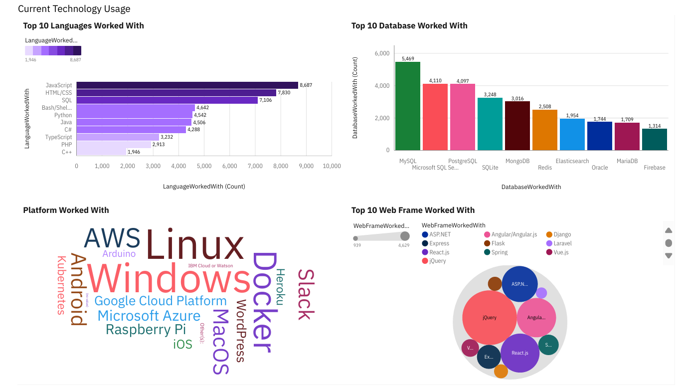
DASHBOARD TAB 1

Slide 13
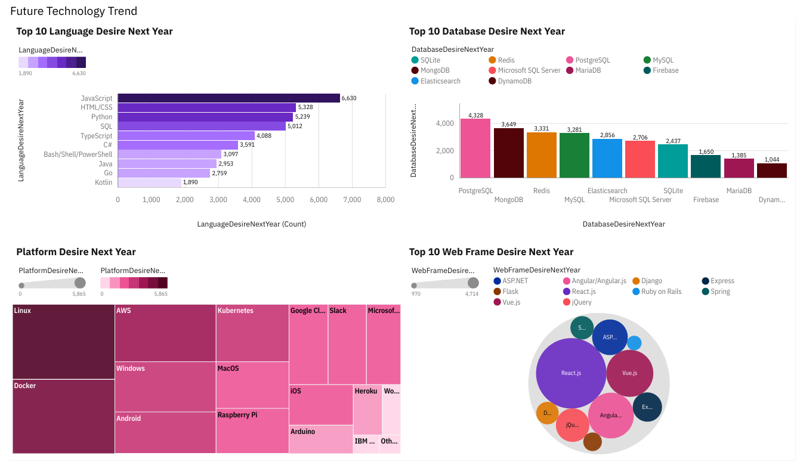
DASHBOARD TAB 2

Slide 14
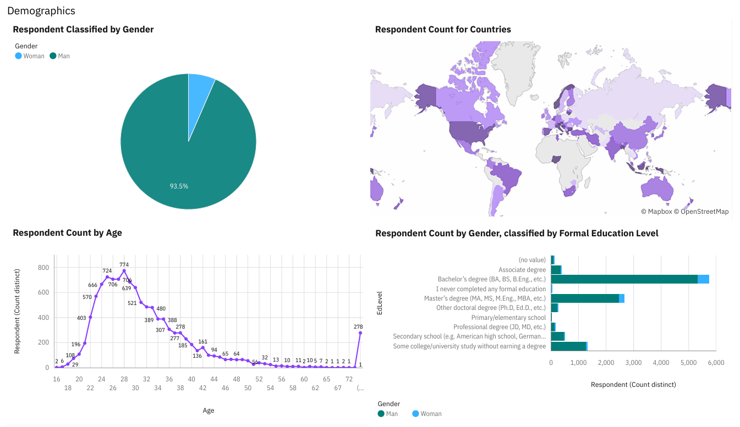
DASHBOARD TAB 3

Slide 15
DISCUSSION
Women places in global IT areas
Why the SQL servers are remained the most interest in the future?
What is the key value of HTML/CSS to be still required?

Slide 16
OVERALL FINDINGS & IMPLICATIONS
Findings
JavaScript widely used and TypeScript getting popular.
Over 90% young male developers.
Developers mostly located in developed countries.
Implications
JavaScript and TypeScript web frames gaining followers.
Global polarization of developers location and gender.
Young developers without postgrad studies on its majority.

Slide 17

CONCLUSION
Developers are people with very marked characteristics.
A good idea of popularity trends of different tools, platforms and languages can be obtained.
There is a job to be done to spread accessibility of this labor market to countries in development.

Slide 18

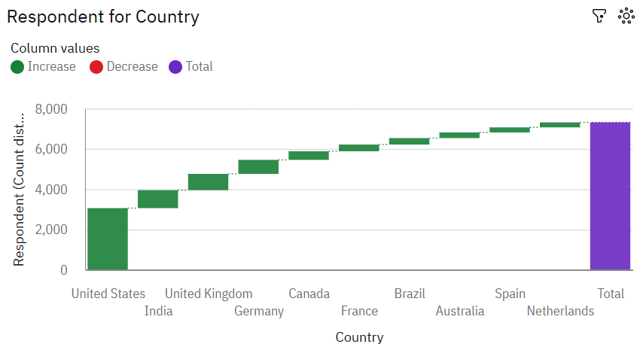
APPENDIX

Slide 19
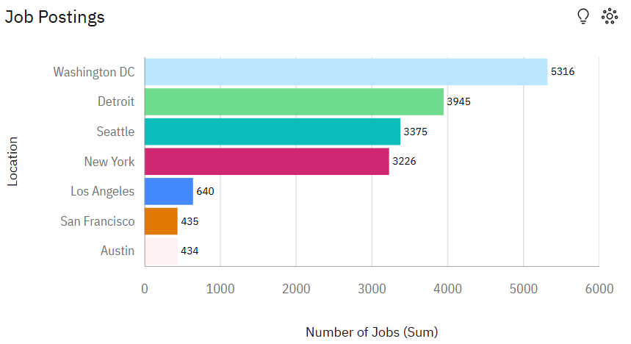
JOB POSTINGS

Slide 20
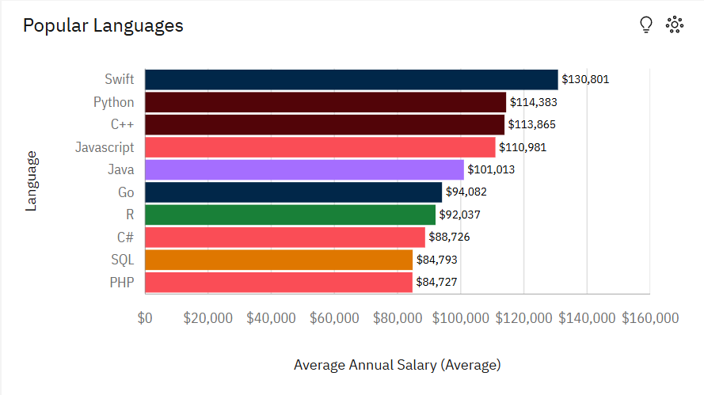
POPULAR LANGUAGES

