Slide 1

AgroBot: Universal AI-Based Multilingual Agricultural Assistant
A revolutionary AI-powered solution bringing expert agricultural guidance to farmers worldwide through real-time crop disease diagnosis and multilingual support.

Slide 2
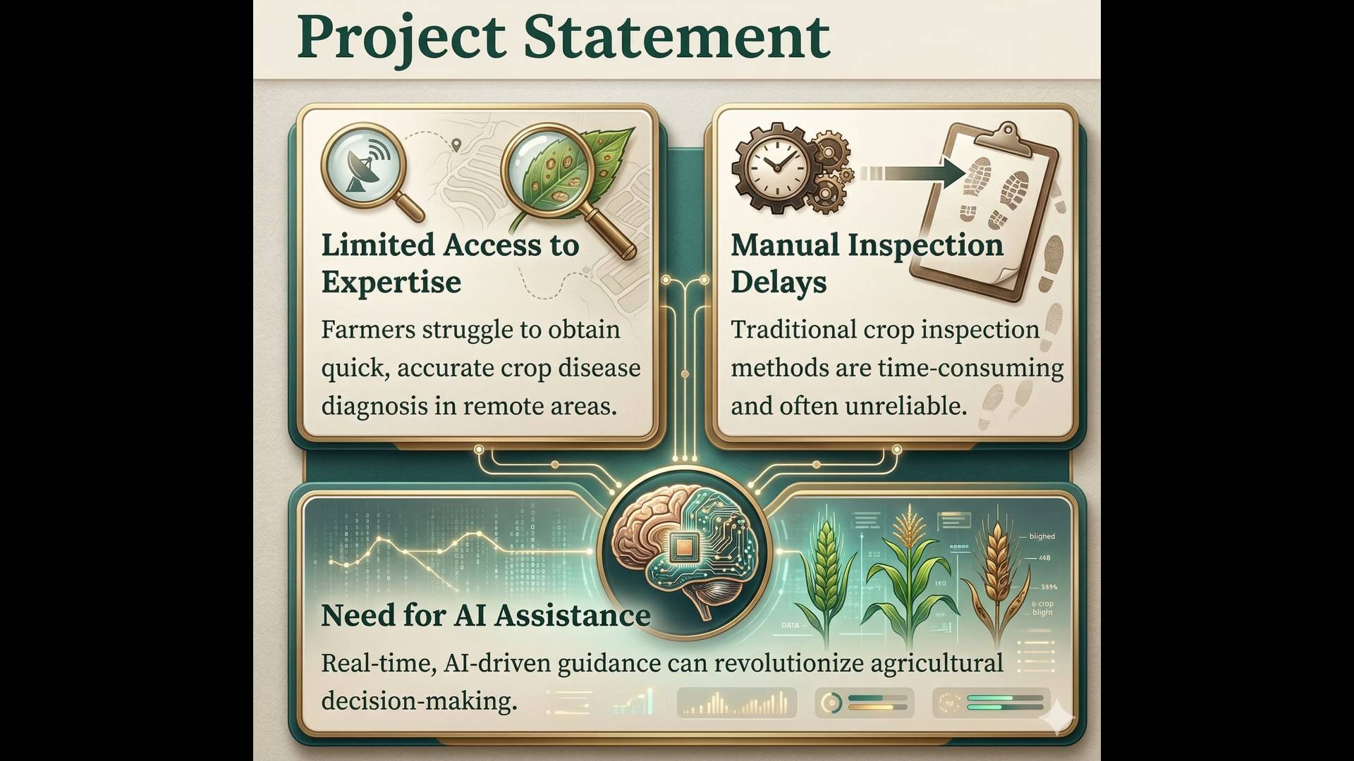

Slide 3
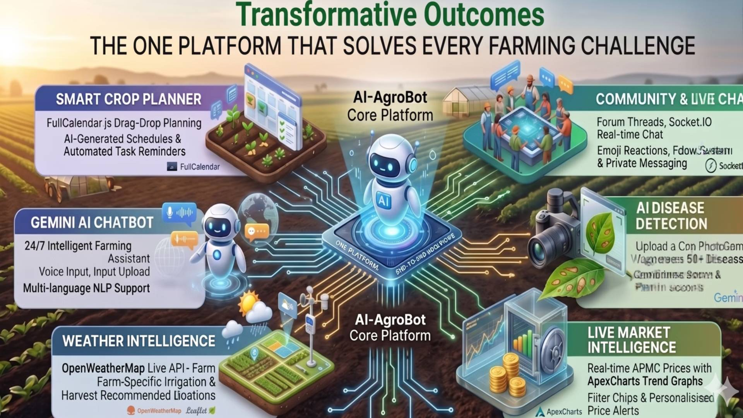

Slide 4
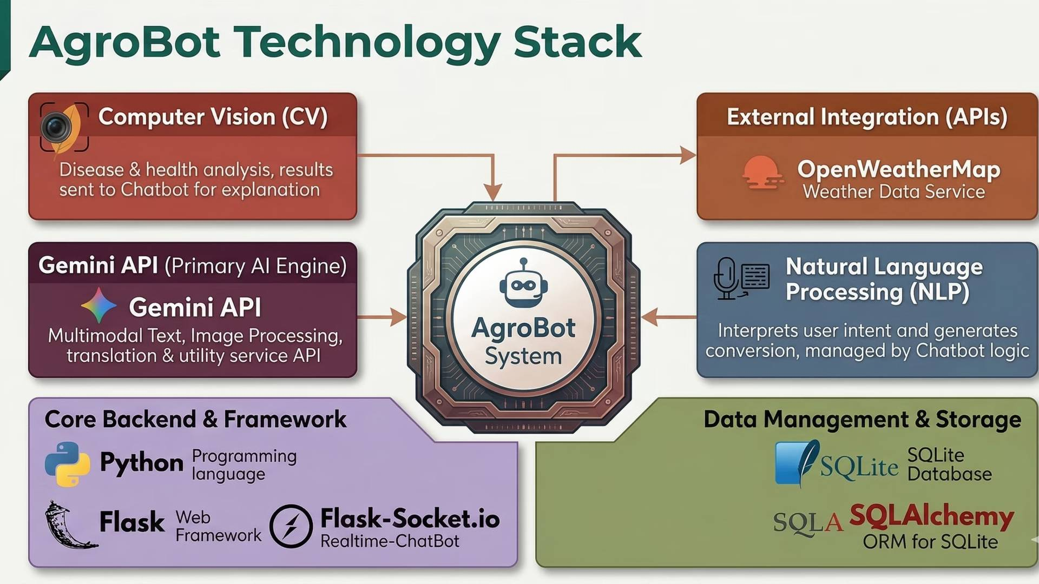

Slide 5
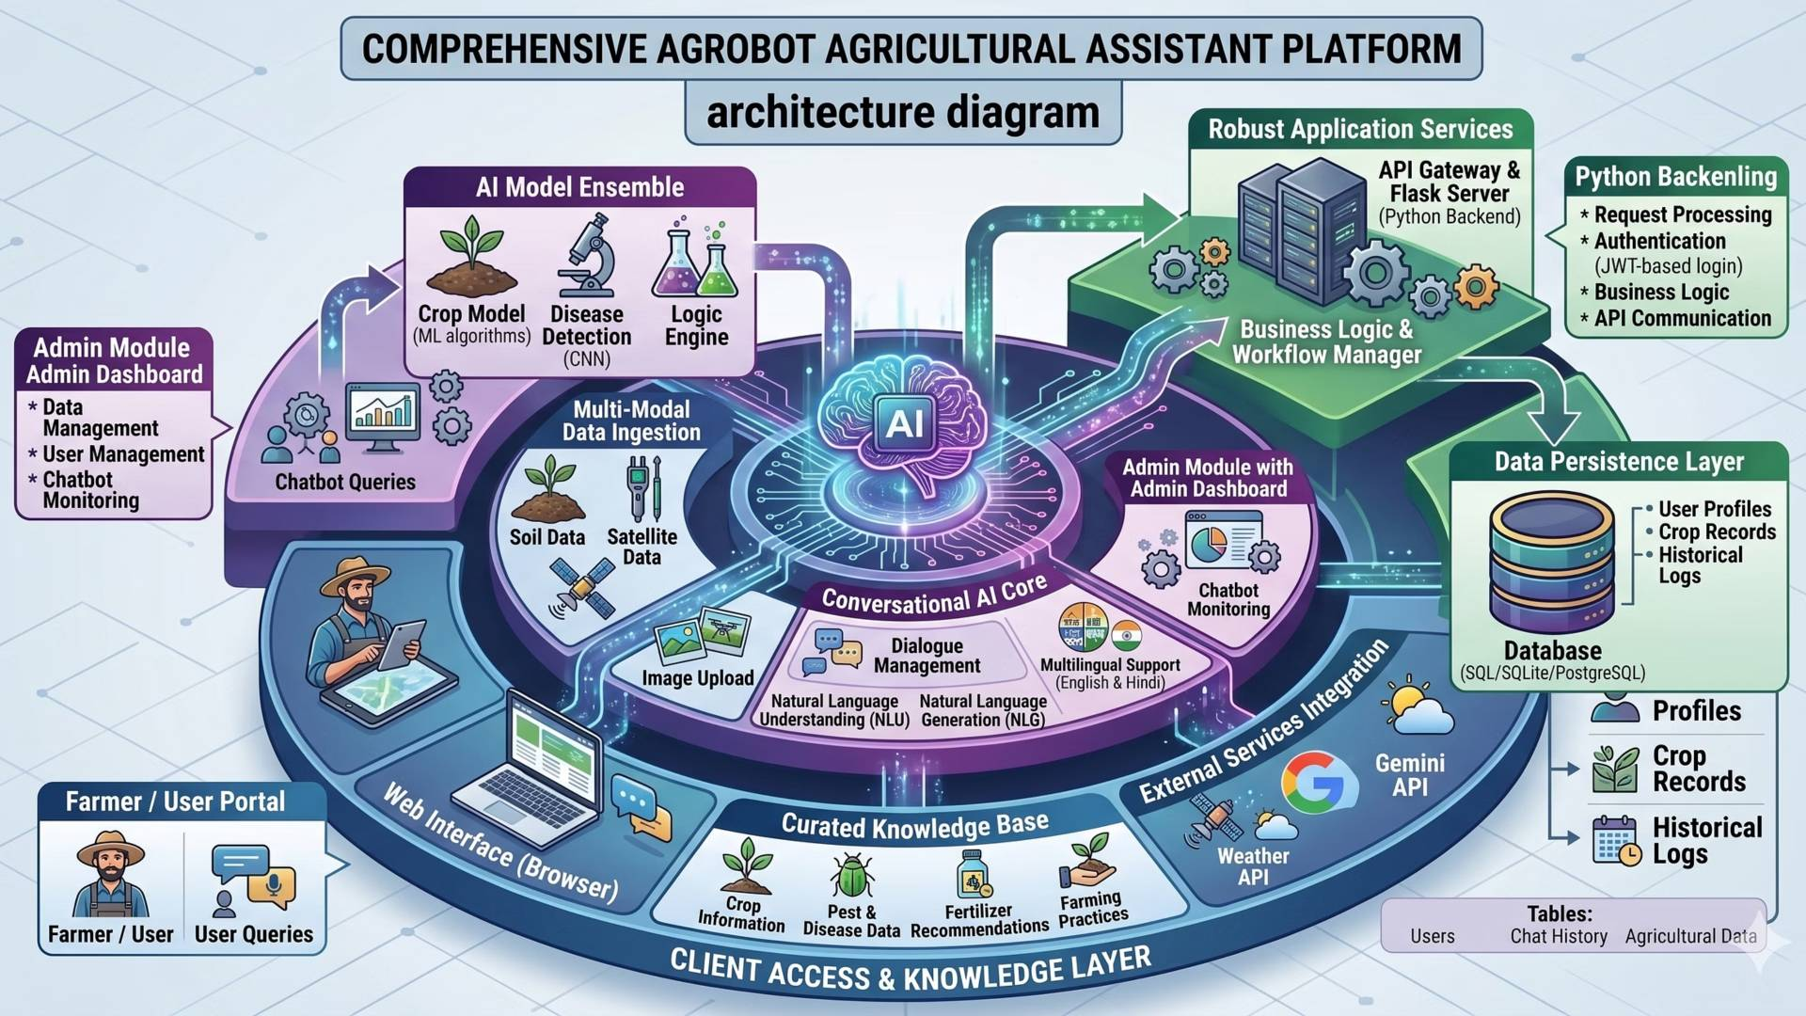

Slide 6
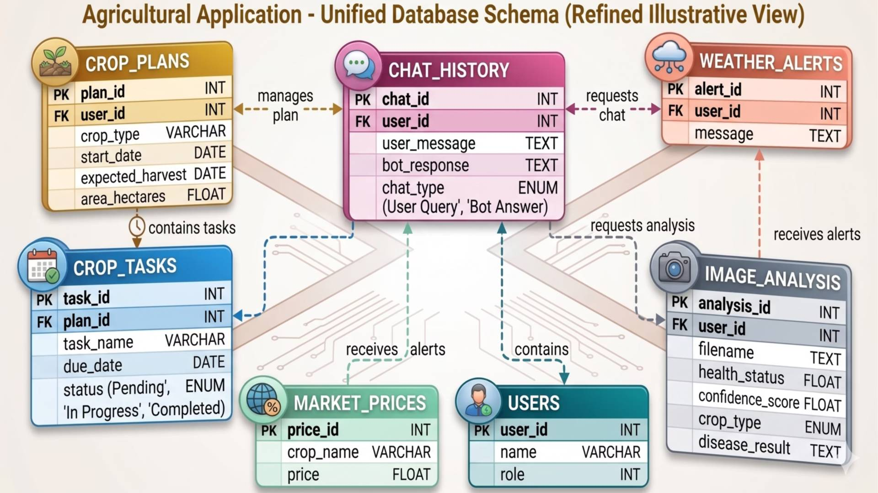

Slide 7
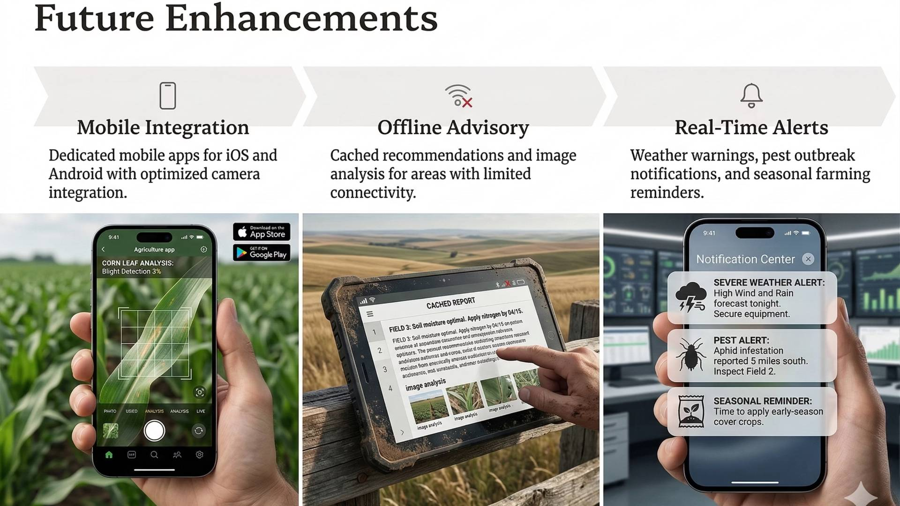

Slide 8


Conclusion
AgroBot bridges the gap between traditional farming practices and modern AI technology, delivering expert agricultural insights directly to farmers' fingertips.
Key Benefits:
Reduced crop losses through early disease detection
Lower dependency on manual diagnosis and external consultants
Improved productivity through data-driven decision-making
Scalable solution for small and large farming operations

Slide 9
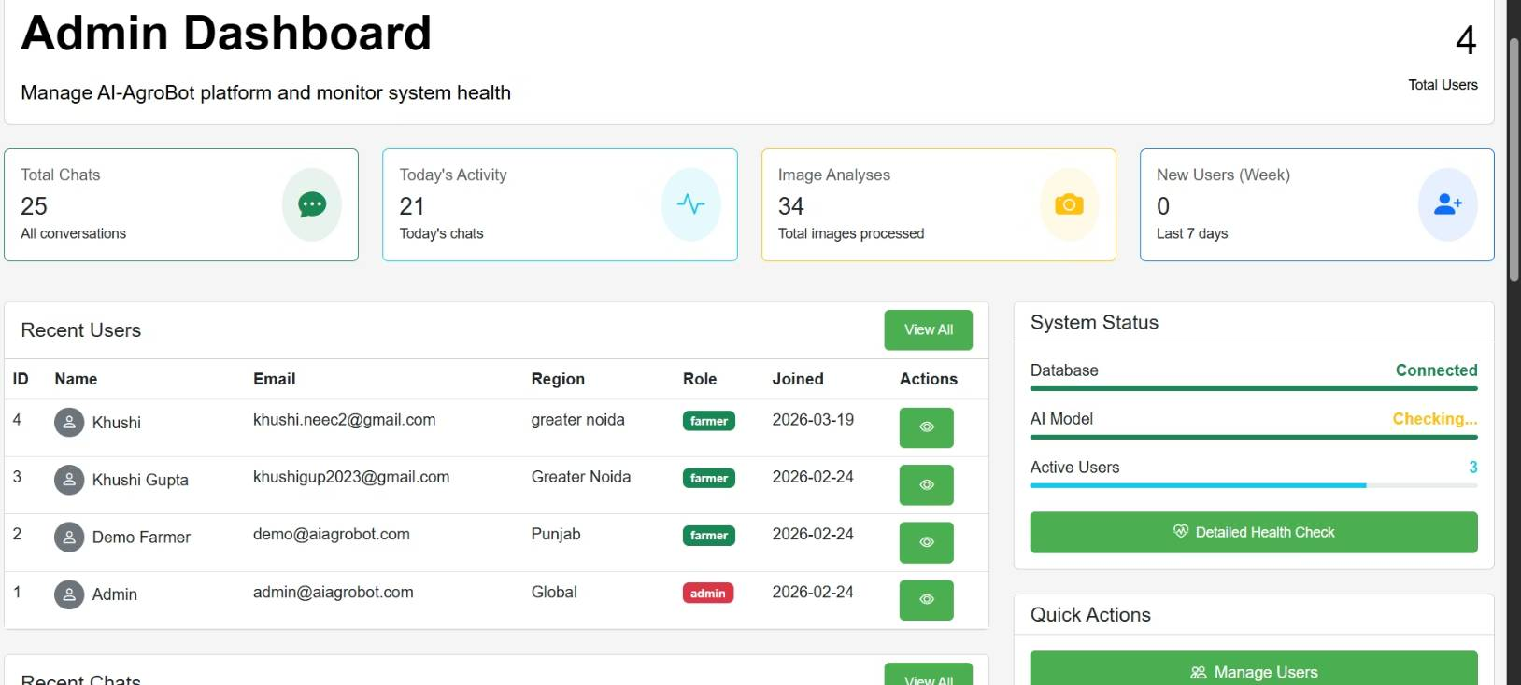
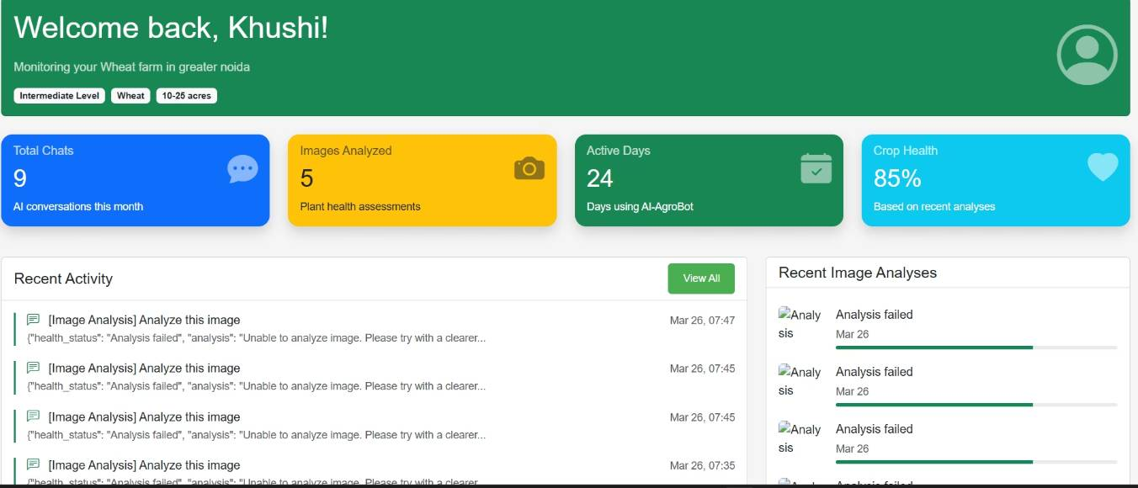
Sample Output

