Slide 1
Vehicle Detection, Classification & Counting using YOLOv8
Khushi Jaiswal
AI & Computer Vision Assignment – 2025

Slide 2
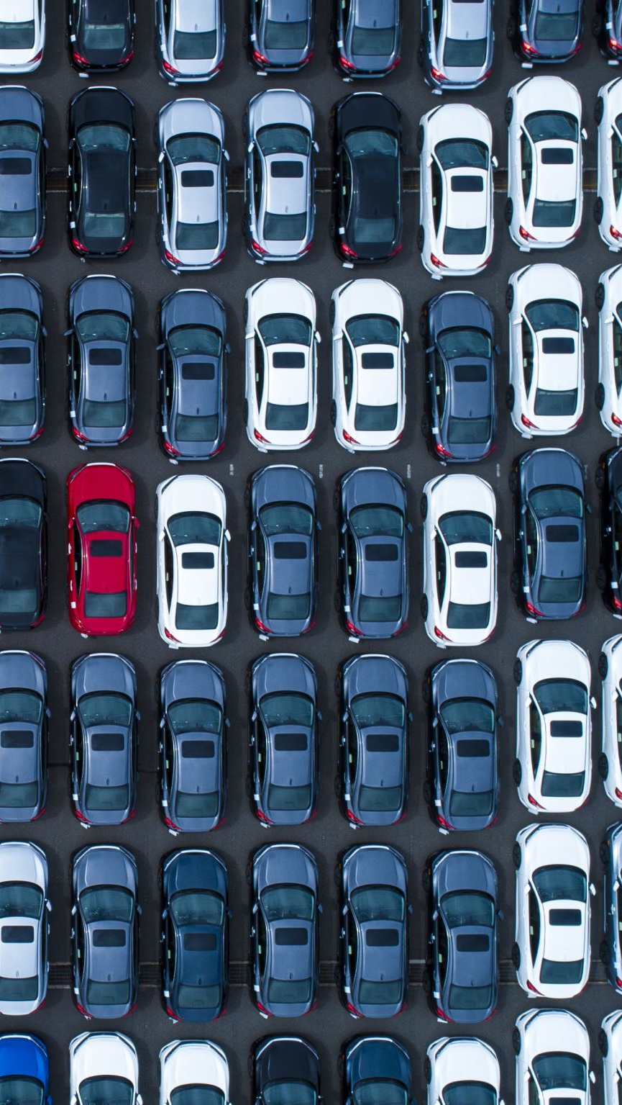
Problem Statement
• Detect, classify, and count vehicles (cars, trucks, motorcycles)
• Display bounding boxes and confidence scores
• Summarize total count by type
• Save annotated output images

Slide 3
Dataset and Vehicle Classes
• Input: 10 traffic images (640x640)
• Pretrained on COCO dataset
• Used classes:
- Car (ID: 2)
- Motorcycle (ID: 3)
- Truck (ID: 7)

Slide 4
Technology Stack
• Language: Python 3.8+
• Libraries: OpenCV, NumPy, Matplotlib
• Framework: YOLOv8 (Ultralytics)
• Development: Jupyter Notebook

Slide 5

Why YOLOv8?
• Latest and most accurate YOLO version
• Improved detection of small/occluded objects
• Fast and lightweight
• Easy to integrate with Python

Slide 6
System Workflow
Load
Load image
Load
Load YOLOv8 model
Run
Run inference
Filter
Filter vehicle classes (IDs: 2, 3, 7)
Draw
Draw bounding boxes and labels
Count
Count vehicle types
Save
Save annotated output

Slide 7
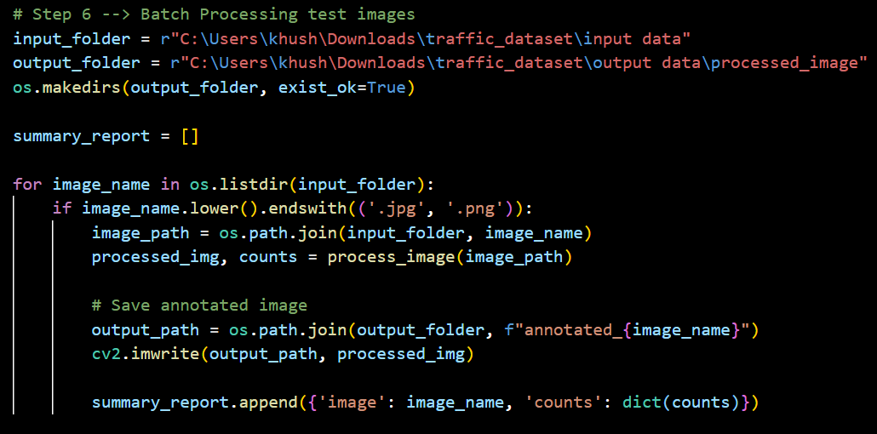
Sample Code

Slide 8
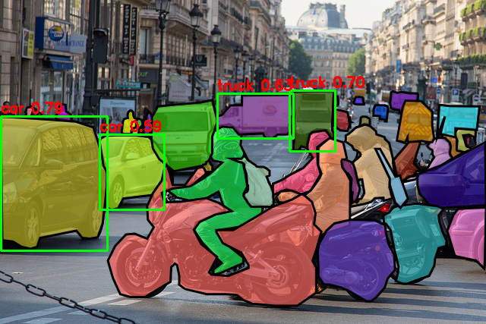
Visual Output Example
• Annotated images show:
Bounding boxes
Outputs saved in /output/processed_images/
Labels with class name and confidence
Category-wise counts

Slide 9

Results Summary
• Accuracy: ~90%
• Inference time: <1 sec/image
• Detected:
- Cars: 20
- Trucks: 5
- Motorcycles: 4

Slide 10
Challenges & Solutions
• Missed small motorcycles → Lowered confidence threshold
• Overlapping vehicles → Applied NMS
• Irrelevant detections → Filtered class IDs

Slide 11
Future Improvements
• Real-time detection (webcam/CCTV)
• Train on local traffic data
• Use YOLOv8m/l for better accuracy
• Deploy web UI using Flask/Streamlit

Slide 12
Conclusion
• YOLOv8 effectively detected, classified, and counted vehicles
• Achieved high accuracy on real-world images
• Future work includes real-time processing and deployment

Slide 13
Thank You!
• GitHub: https://github.com/KhushiJaiswal2904
• Email: khushijai23@gmail.com

