Slide 1
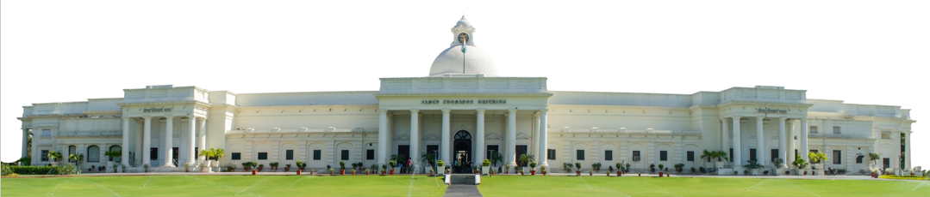
Evaluating CNN and ViT on skin cancer dataset
Summer Internship- (25 May 2026 – 17 July 2026)
Name: Khushi Jha
Supervisor: Prof. Millie Pant
Mentor: Mr. Shubham Joshi Applied Mathematics & Scientific Computing
Indian Institute of Technology Roorkee

Slide 2

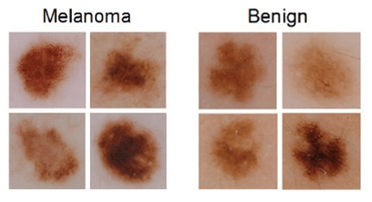
Introduction : Skin cancer detection
1.
Growing Threat: Melanoma rates double every 20 years; deadly, but highly survivable if caught early.
Current Standards: Manual diagnosis relies on handcrafted visual heuristics:
ABCDE Rule (Asymmetry, Border, Color, Diameter, Evolution) [2].
CASH Rule (Color, Architecture, Symmetry, Homogeneity) [3].
The Bottleneck: Even expert clinical visual inspection maxes out at 60~80% accuracy without AI assistance [1].
Image Source: International Skin Imaging
Collaboration (ISIC) Archive

Slide 3
Exploring benchmark datasets for skin cancer
2.
Dataset (Year) | Images / Lesions | Diagnostic Classes | Clinical Metadata | Malignant / Class Balance | Modality Type | Relevance to This Project
ISIC 2019 (2019) | 25,331 images | 8 classes (MEL, NV, BCC, AK, BKL, DF, VASC, SCC) | Age, sex, anatomic site | 17.9% melanoma (4,522 / 25,331) | Dermoscopic image + tabular metadata | Primary training/validation set used in this re-implementation; source of the observed class-imbalance failure
ISIC 2020 (2020) | 33,126 images 2,056 patients | Binary (melanoma vs. benign) + 9 auxiliary subtypes | Age, sex, anatomic site, patient/lesion ID | 1.8% melanoma (584 / 33,126) | Dermoscopic image + tabular metadata | Stress-test for imbalance-handling (class-weighting, oversampling) before deployment — harder than ISIC 2019
HAM10000 (2018) | 10,015 images | 7 classes (akiec, bcc, bkl, df, mel, nv, vasc) | Age, sex, lesion localization | 11.1% melanoma (1,113 / 10,015) | Dermoscopic image + tabular metadata | Secondary benchmark cited directly in the XAAI-Ledger paper; used for cross-dataset generalization checks
MILK10k (2025) Selected | 10,480 images 5,240 lesions | 11 broad categories (up to 48 fine-grained ISIC-DX diagnoses) | Age, sex, anatomic site, skin tone (6-level), histopathology flag | 95.7% histopathology- confirmed ground truth | Paired clinical close-up + dermoscopic image + tabular metadata | Most recent public dataset with true dual-image multimodality and diverse skin tones — planned for next-phase generalization and fairness testing
Sources: ISIC 2019 Challenge (Combalia et al., 2019); ISIC 2020 Challenge Dataset (Rotemberg et al., 2021); HAM10000 (Tschandl et al., 2018, Sci. Data); MILK10k (Tschandl et al., 2025, J. Invest. Dermatol. — ISIC Archive).

Slide 4
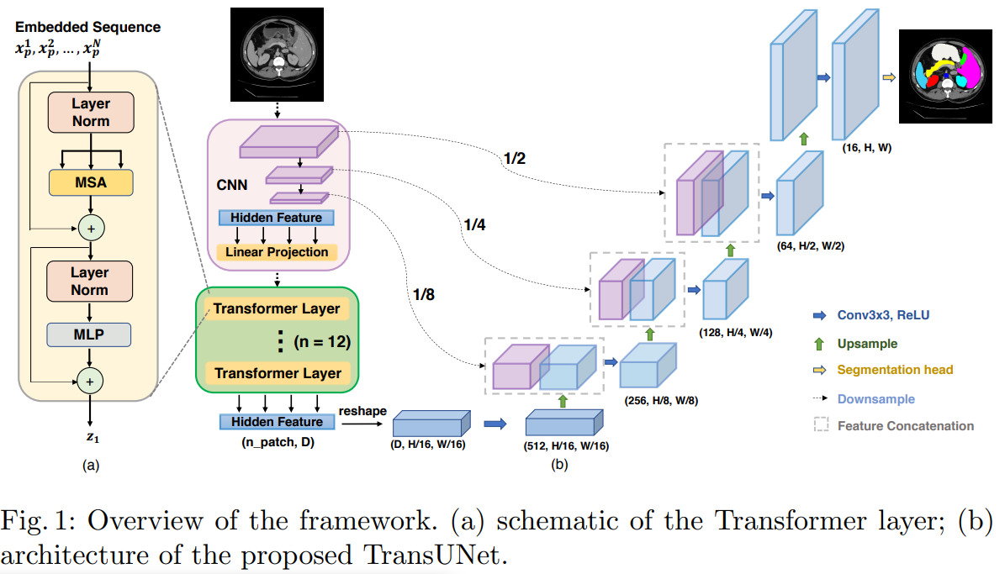
Architecture of the model
3.
CNNs (Local Focus): Extract detailed local features (like edges and textures) via spatial convolutions. However, they struggle to abstract global context.
ViTs (Global Focus): Capture
long-range global relationships across the entire image using self-attention mechanisms. Despite this, they require massive datasets.
Hybrid Solution: Fuses the precise local feature extraction of CNNs with the global contextual understanding of ViTs. This overcomes the limitations of both models for complex analysis.

Slide 5
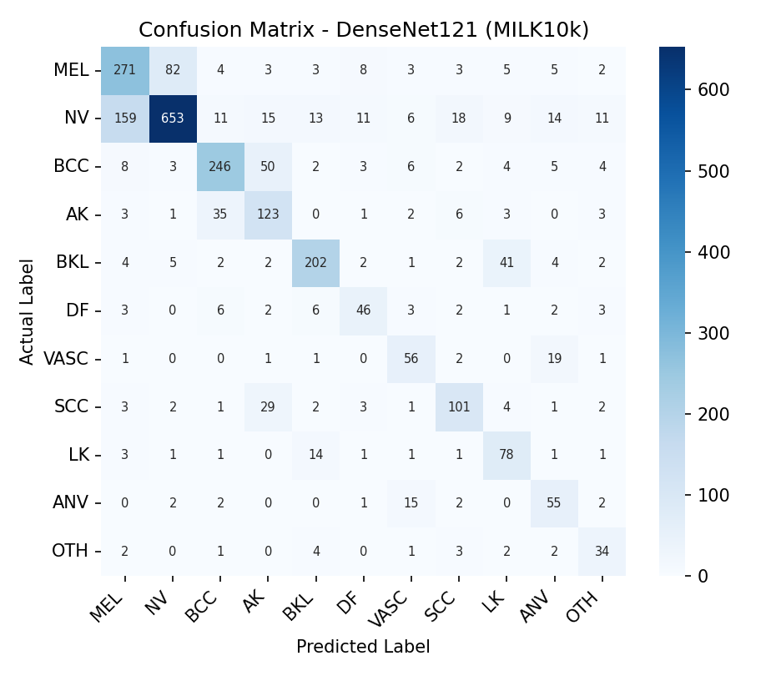
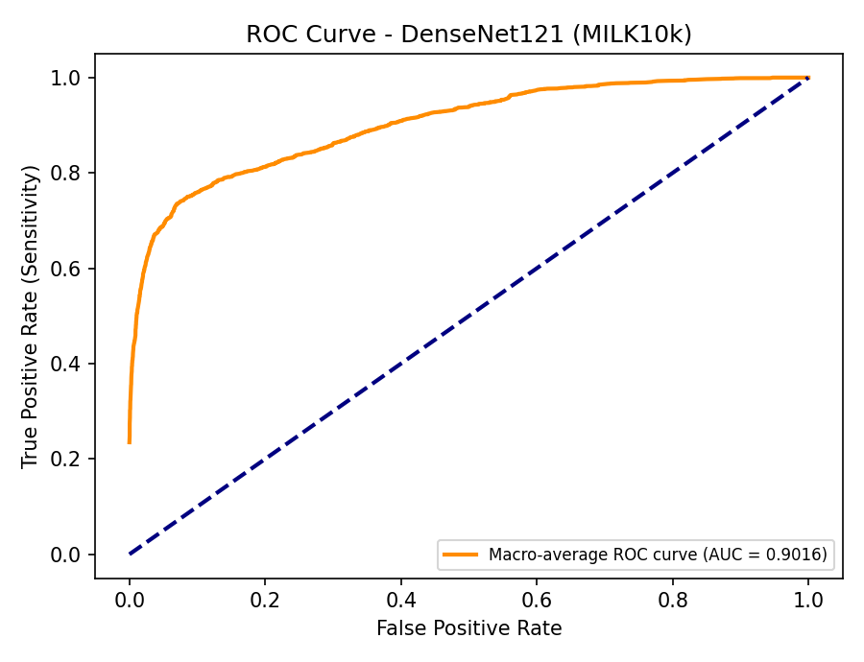
Baseline Model 1: DenseNet121 on MILK10k
4.
Dataset: MILK10k (ISIC 2025) — 10,480 images, 5,240 clinical/dermoscopic pairs, 11 diagnostic classes (MEL, NV, BCC, AK, BKL, DF, VASC, SCC, and others).
Metadata used: patient age, sex, and anatomical site of the lesion.
DenseNet121 (ImageNet pre-trained) fine-tuned as an image-only baseline, 20 epochs, 75/25 train-validation split.
Validation result: Accuracy 71.18%, Macro-F1 66.75%, Macro-AUC 0.9016.
Model struggles most on visually overlapping classes (MEL vs NV, BCC vs AK), consistent with a single-modality CNN baseline.
Fig. Confusion Matrix — DenseNet121 (11-class)

Slide 6
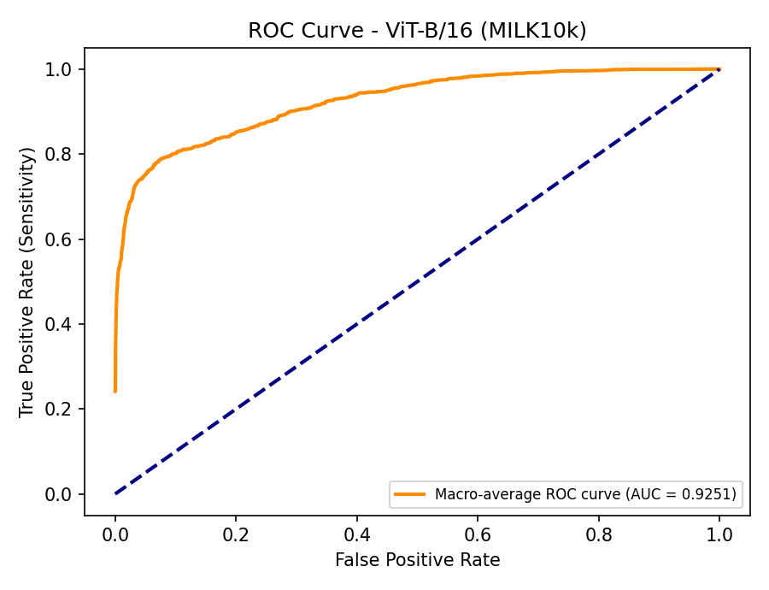

Baseline Model 2: ViT-B/16 on MILK10k
5.
Vision Transformer (ViT-B/16, ImageNet pre-trained) fine-tuned under the same protocol, 20 epochs, same 75/25 split.
Validation result: Accuracy 75.50%, Macro-F1 72.31%, Macro-AUC 0.9251.
Global self-attention gives ViT-B/16 a modest edge over DenseNet121, mainly on classes with subtle, spread-out lesion patterns.
Comparison Table
Metric | DenseNet121 | ViT-B/16
Accuracy | 71.18% | 75.50%
Macro-F1 | 66.75% | 72.31%
Macro-AUC | 0.9016 | 0.9251

Slide 7
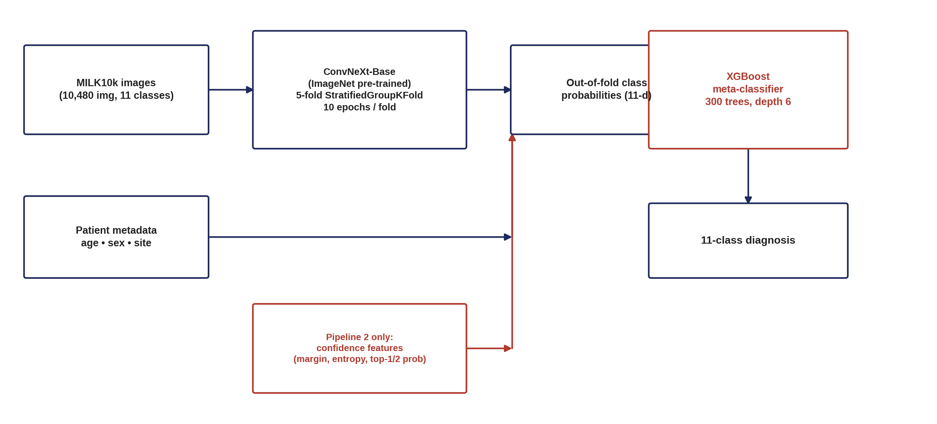
Architecture: CNN + GBDT Stacking (Baseline 3)
6.
Pipeline: ConvNeXt-Base image backbone (5-fold OOF class probabilities) stacked with an XGBoost meta-classifier on patient metadata — the two-stage “CNN + GBDT” pattern.
Inspired by: the dominant ISIC 2024 “Skin Cancer Detection with 3D-TBP” winning pattern — stacking CNN out-of-fold probabilities with LightGBM/XGBoost/CatBoost on tabular metadata; traces back to Ha, Liu & Liu (2020), the SIIM-ISIC 2020 winning ensemble.
What matches: single-backbone OOF probabilities → GBDT stacking, the winners’ core recipe.
What’s missing vs. winners: winners ensemble multiple CNN/ViT backbones and 3 GBDT types across 3×5 folds (45 models); we use one backbone + one XGBoost. Winners engineer dozens of handcrafted lesion-geometry features; we use only age/sex/site, and no oversampling for classes with fewer than 20 samples.
Two pipelines tested: Pipeline 1 (probabilities + metadata) vs. Pipeline 2 (+ prediction-confidence features) — results on the next slide.
Fig. Baseline 3 pipeline — ConvNeXt-Base OOF probabilities + metadata → XGBoost stacking

Slide 8
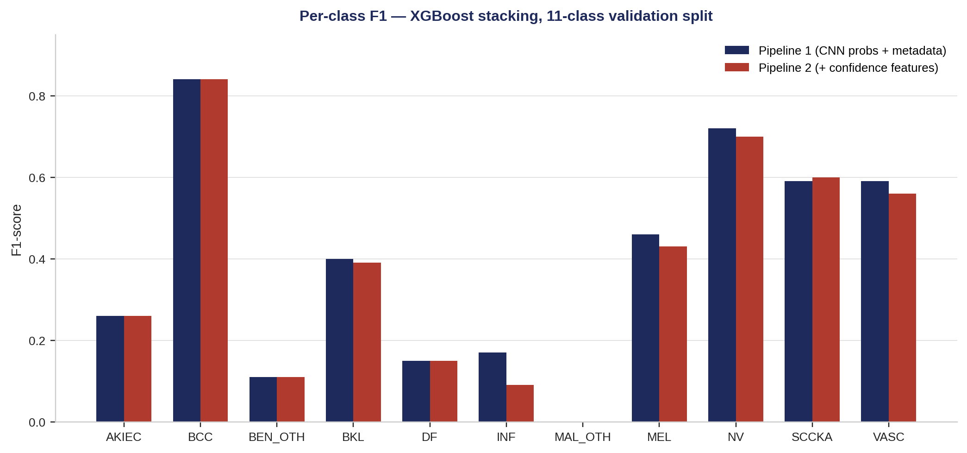
Baseline 3 Results: CNN + GBDT Stacking
7.
Pipeline 1: Accuracy 69.27%, macro-F1 0.39, log-loss not computed.
Pipeline 2: Accuracy 68.99%, macro-F1 0.38, log-loss 0.971 — confidence features made no difference (−0.29 pt).
Both trail the simple image-only baselines already established: DenseNet121 71.18% / ViT-B/16 75.50% accuracy.
Why: only 3 metadata fields carry little extra signal beyond the CNN’s own probabilities; rare classes (fewer than 20 samples) get 0 F1 regardless of pipeline; a single backbone can’t match an ensemble.
A third variant (CNN summary statistics + full metadata) was engineered but not evaluated — Pipeline 1/2 had already plateaued.
Fig. Per-class F1 — XGBoost stacking (Pipeline 1 vs. Pipeline 2)
Metric | Pipeline 1 (CNN OOF probs + metadata) | Pipeline 2 (+ prediction-confidence features)
Accuracy | 69.27% | 68.99% (−0.29 pt)
Macro-F1 (11-class) | 0.39 | 0.38
Log-loss | not computed | 0.971
Feature count | 46 | 51

Slide 9
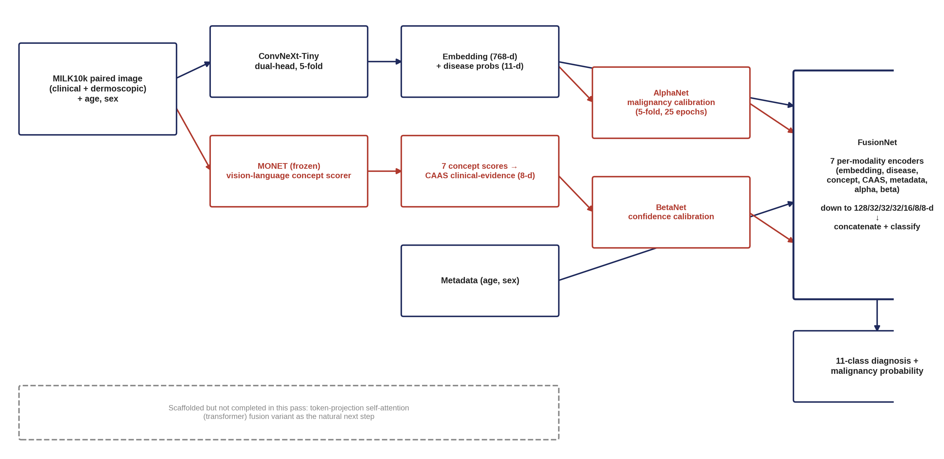
Architecture: MONET Concept-Fusion Network (Baseline 4)
8.
Pipeline: ConvNeXt-Tiny embeddings + disease probs, fused with MONET concept scores and CAAS clinical-evidence features, calibrated by two small nets (Alpha, Beta), then combined in a 7-branch FusionNet.
Inspired by: MONET (Kim et al., 2024, Nature Medicine) — a vision-language foundation model that scores dermatology images on clinical concepts — combined with Concept Bottleneck Models (Koh et al., 2020, ICML). Extends this deck’s own “Future Direction” concept-bottleneck slide into a working pipeline.
What’s different from a true CBM: classic bottleneck models restrict the classifier to concepts only (interpretable-by-construction); here concepts are one of several fused inputs alongside the raw embedding, so the model can still shortcut around them — the fusion is not a hard bottleneck.
Scale mismatch: Alpha/Beta/FusionNet train on a 2,098-sample representation set, a fifth of the 10,480-image set used for Baseline 3 — results are not directly comparable in scale.
Fig. Baseline 4 pipeline — ConvNeXt-Tiny + MONET concepts → Alpha/Beta calibration → FusionNet

Slide 10
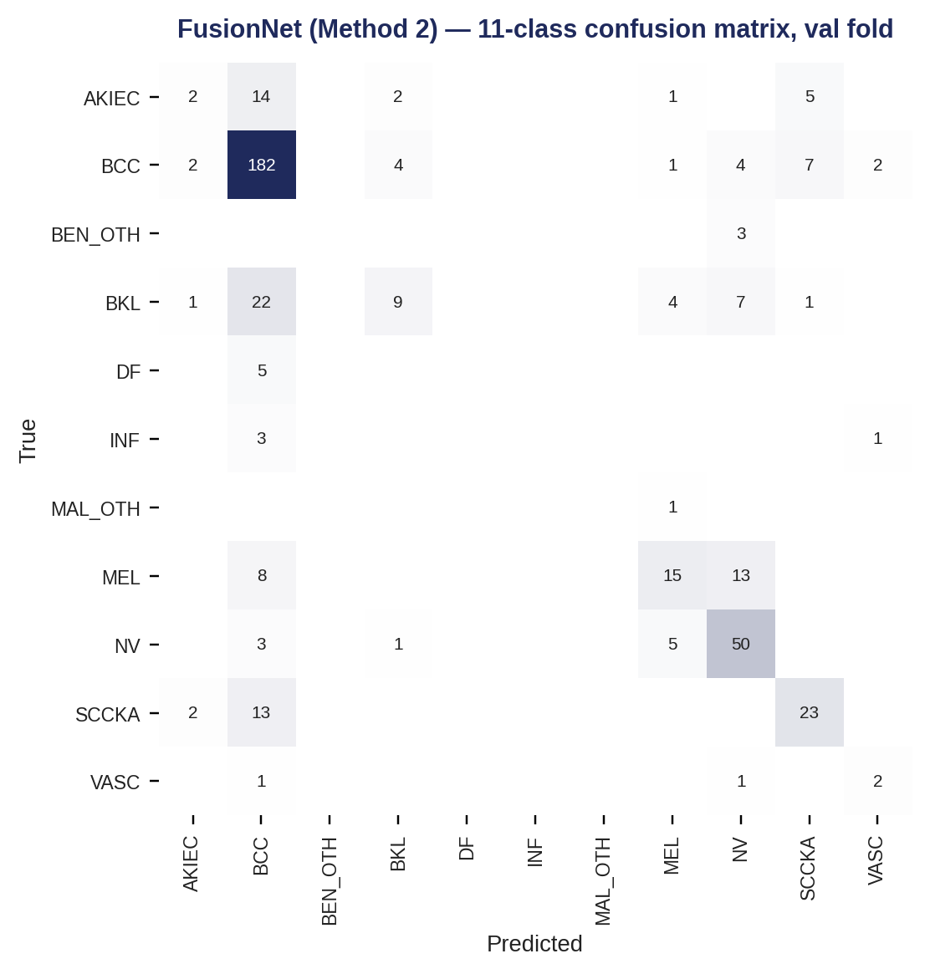
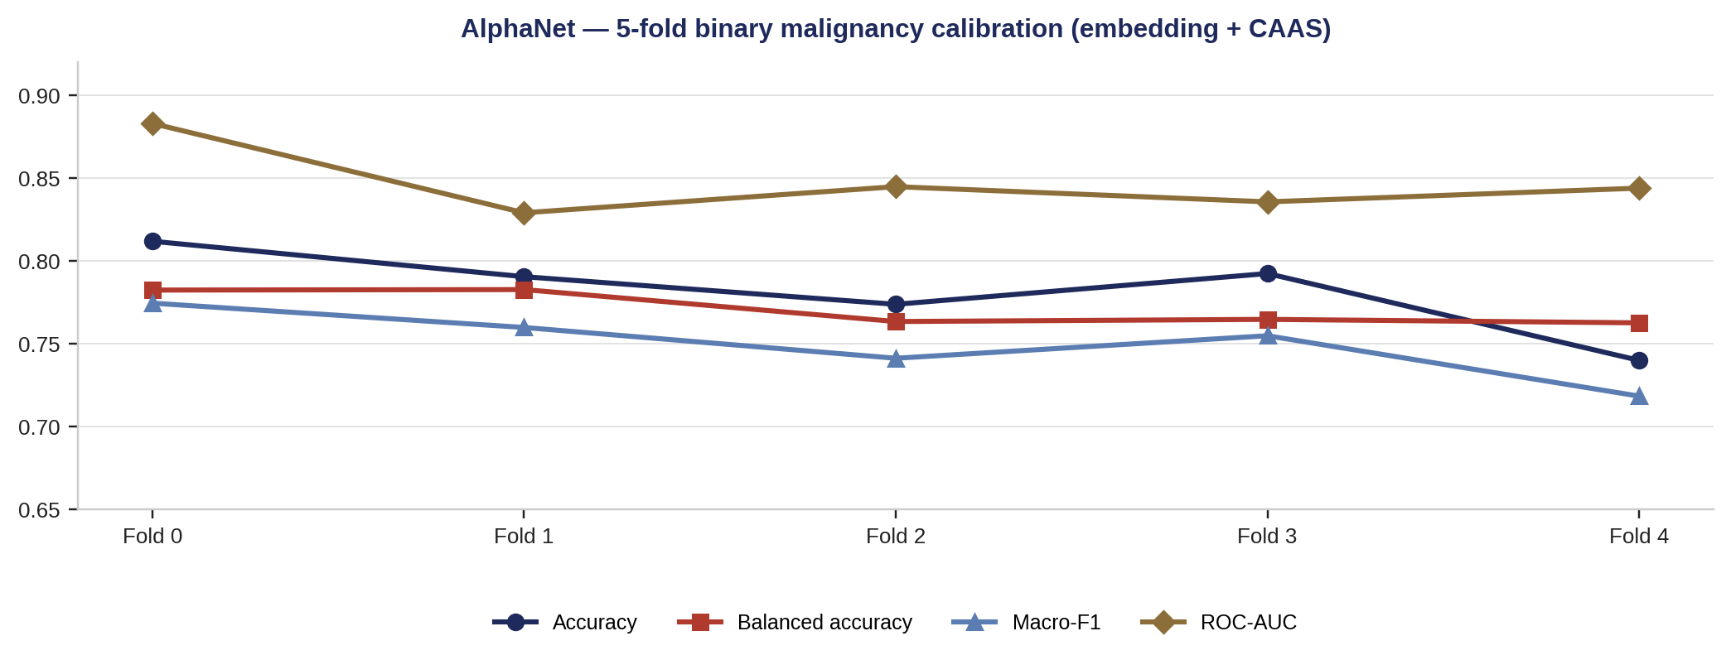
9.
Baseline 4 Results: MONET Concept-Fusion Network
AlphaNet (binary malignant-vs-benign calibration, embedding + CAAS, 5-fold): mean accuracy 78.2%, balanced accuracy 77.1%, macro-F1 75.0%, ROC-AUC 0.845 — a genuinely useful sub-result.
Full FusionNet (11-class, all 7 modalities): validation accuracy 67.38%, balanced accuracy 32.35%, macro-F1 31.86%, ROC-AUC 0.892.
Reading it: the binary malignancy signal calibrates well, but folding it back into 11 fine-grained classes collapses macro-F1 — confirmed by the confusion matrix: predictions crowd into BCC/NV, rare classes get zero recall.
Below the ViT-B/16 baseline (75.50% acc, Macro-F1 0.72) despite far greater architectural complexity — likely compounding error across 4 trained stages (backbone → concepts → Alpha/Beta → fusion) on a much smaller sample.
Metric | AlphaNet (binary, 5-fold avg) | FusionNet (11-class)
Accuracy | 78.2% | 67.4%
Balanced accuracy | 77.1% | 32.4%
Macro-F1 | 75.0% | 31.9%
ROC-AUC | 0.845 | 0.892

Slide 11
Comparison Across All Four Baselines
10.
Ranking on MILK10k (11-class accuracy): ViT-B/16 > DenseNet121 > Baseline 3 (CNN+GBDT) > Baseline 4 (concept fusion).
Added modalities did not help here: both fusion baselines sit below the simple single-image CNN/ViT baselines already on this dataset.
Where complexity did pay off: AlphaNet’s binary malignant-vs-benign sub-task (0.845 AUC) — concept-based calibration helps at the coarse-grained level, not yet at 11-class resolution.
Metric | DenseNet121 (image-only) | ViT-B/16 (image-only) | Baseline 3 (CNN + GBDT) | Baseline 4 (concept fusion)
Task | 11-class | 11-class | 11-class | 11-class (+ binary sub-task)
Accuracy | 71.18% | 75.50% | 69.27% (best pipeline) | 67.38%
Macro-F1 | 66.75% | 72.31% | 0.39 | 0.32
Macro/ROC-AUC | 0.9016 | 0.9251 | not computed | 0.892
Val. set size | 2,620 (25% split) | 2,620 (25% split) | 2,096 (20% split) | 420 (fold 0 of 2,098)
Added inputs beyond image | — | — | age, sex, site | MONET concepts, CAAS, age, sex

Slide 12
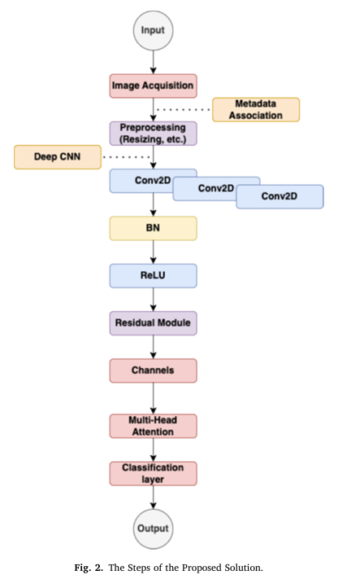
Research paper implementation (XAAI-Ledger)
11.
Core idea: Introduces a hybrid multi-modal deep learning framework that couples spatial dermoscopic image features with clinical patient metadata through an attention-enabled fusion core to maximize screening accuracy and transparency.
Data Volume: Total training repository comprises exactly 25,331 annotated patient profile samples.
Target Label Skew (Class Imbalance):
Benign / Non-Melanoma Cases : 20,809 samples.
Malignant Melanoma Cases : 4,522 samples.
Demographic Profile: The population splits into 13,286 male records and 11,661 female records.
Missing Data Audit: High structural sparsity identified prior to cleaning: 437 missing age indices, 384 missing sex markers, and 2,631 missing anatomical site records
Feature Engineering: Resolves structural data gaps (missing age, sex, and lesion site variables) using median and mode imputation, standardizes tabular inputs via one-hot encoding, and applies a MinMaxScaler().
Pipeline Execution: Funnels data through dual parallel streams, a frozen pre-trained CNN for visual texture extraction and a Dense MLP for clinical background, before projecting both into a shared Transformer Self-Attention sequence layer.

Slide 13
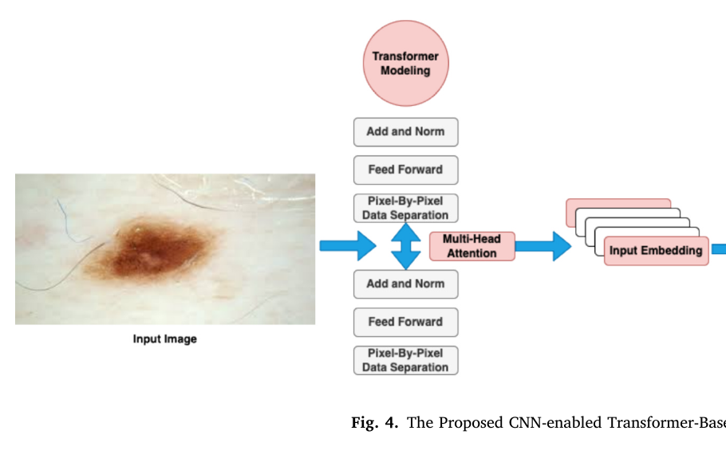
Dual-Stream Architecture & Attention Fusion
12.
Vision stream: a frozen EfficientNetB0 turns the 224×224×3 dermoscopic image into a 256-D visual feature vector.
Metadata stream: age, sex, and lesion site (10-D, one-hot) pass through a small MLP (64 → 128 → 256) to produce a matching 256-D vector.
The two 256-D vectors are concatenated into one 512-D token and reshaped into a length-1 sequence for the Transformer.
A 4-head Multi-Head Self-Attention block, with Add & Norm and a Feed-Forward layer, fuses the image and clinical representations.
Global Average Pooling + a Dense sigmoid layer output the final Melanoma / Non-Melanoma prediction.
Fig. 4 (paper) — The Proposed CNN-enabled Transformer-Based Solution

Slide 14
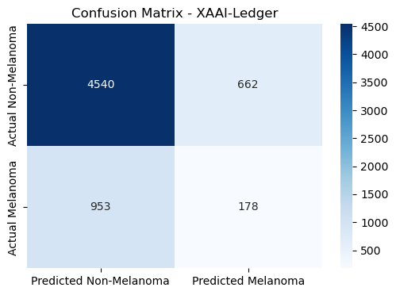
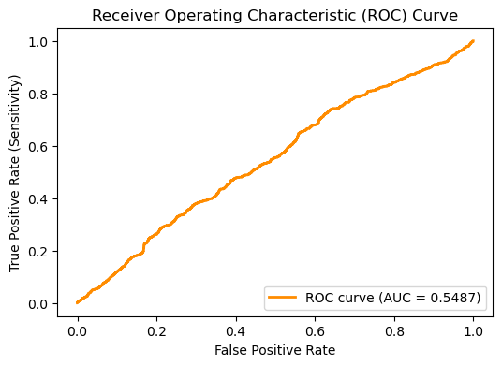
13.
Results & Conclusion: Reproducibility Assessment
Model rebuilt as per the paper: frozen EfficientNetB0 for image features + Dense MLP for clinical metadata, fused with Multi-Head Self-Attention.
Dataset: ISIC 2019 (25,331 samples), 75/25 train-validation split, stratified on class label.
Validation set: 6,333 samples (5,202 Non-Melanoma, 1,131 Melanoma).
Reproduced result: Accuracy 74%, Melanoma Sensitivity 16%, Non-Melanoma Recall 87%.
Confusion matrix and ROC curve generated directly from the trained model's validation predictions.
Metric | Paper (Reported) | Reproduced (Ours)
Accuracy | 98.71% | 74.00%
Sensitivity | 97.45% | 16.00%
Specificity | 98.22% | ~87.00%

Slide 15
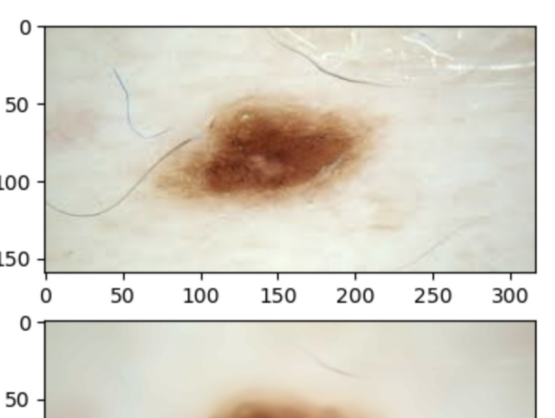
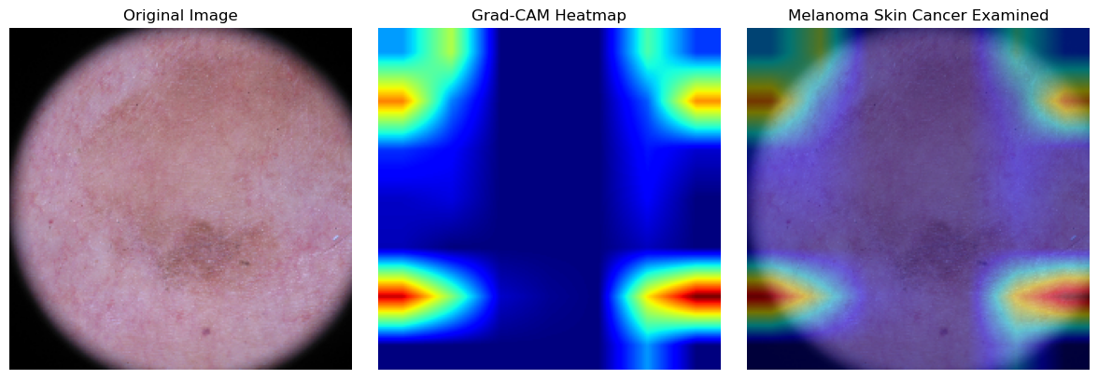
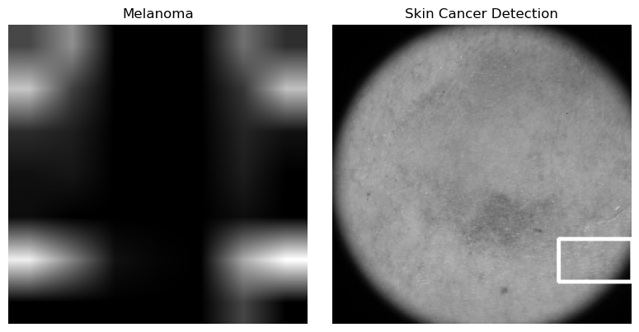
14.
Grad-CAM Explainability — Lesion Localization
Grad-CAM highlights the pixels in the dermoscopic image that most influenced the model's prediction, computed from the gradients flowing into the last convolutional feature map (Eq. 10–11 in the paper).
Paper Output (Fig. 10 / 11)
Our Reproduced Output
Same original → heatmap → overlay sequence as the paper, plus the lesion bounding-box localization step, run on a held-out validation image.
Fig. SHAP — Clinical Metadata Contribution

Slide 16
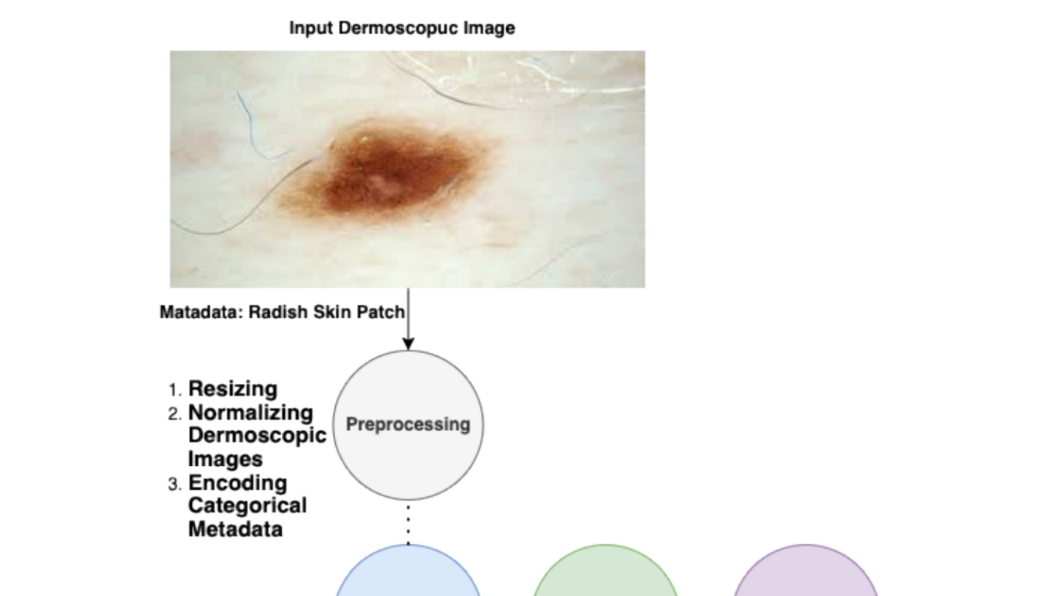
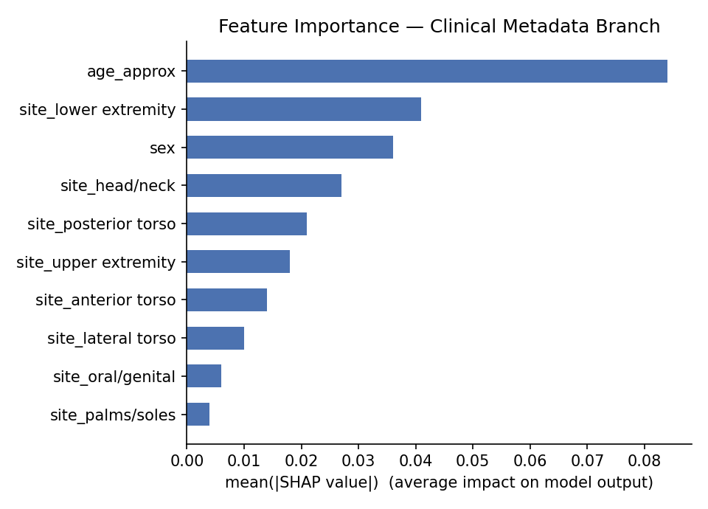
SHAP Explainability — Clinical Feature Attribution
15.
SHAP estimates each clinical feature's contribution to the fused prediction by computing its Shapley value over the metadata branch — giving a feature-level explanation to complement Grad-CAM's pixel-level one.
Paper Concept (Fig. 5)
Our Reproduced Output
Grad-CAM + SHAP working execution, as described in the paper.
Patient age and lesion site (lower extremity, head/neck) carry the highest average impact on the fused prediction — consistent with known clinical risk patterns.
Fig. SHAP — Clinical Metadata Contribution

Slide 17
Future Direction & Conclusion
16.
Concept Bottleneck Modeling on MILK10k, trading a black box for a model that shows its clinical reasoning.
Rather than continuing to refine the CNN / ViT / fusion stack, the next step is to make the decision itself interpretable.
A Concept Bottleneck Model (CBM) first predicts human-defined clinical concepts like pigmentation, ulceration, erythema, vessel pattern, and diagnoses only from those concepts.
so every prediction is traceable to dermatologist-legible evidence, and a clinician can correct a wrong concept at inference time.
Proposed pipeline on MILK10k
Paired input — clinical close-up + dermoscopic image
Fusion encoder (CNN + ViT backbone)
CONCEPT BOTTLENECK
Pigmentation
Ulceration
Erythema
Vessel pattern
Asymmetry
Border
Interpretable linear classifier ( w·concepts + b )
Diagnosis — 48 ISIC-DX classes

Slide 18
References
17.
[1] Agrawal, P., Fontanals-Cirera, B., Sokolova, E., Jacob, S., Vaiana, C. A., Argibay, D., Davalos, V., McDermott, M., Nayak, S., Darvishian, F., Castillo, M., Ueberheide, B., Osman, I., Fenyö, D., Mahal, L. K., & Hernando, E. (2017). A Systems Biology Approach Identifies FUT8 as a Driver of Melanoma Metastasis. Cancer Cell, 31(6), 804-819.e7. https://doi.org/10.1016/j.ccell.2017.05.007 Cited by: 345
[2] Bae, G. H., Hartman, R. I., Joyce, C., & Mostaghimi, A. (2016). Comparing dermatology referral patterns and diagnostic accuracy between nonphysician providers, physician trainees, and attending physicians. Journal of the American Academy of Dermatology, 75(1), 226-227. https://doi.org/10.1016/j.jaad.2016.02.1213 Cited by: 9
[3] Romero-Lopez, A., Giro-i-Nieto, X., Burdick, J., & Marques, O. (2017). Skin Lesion Classification from Dermoscopic Images Using Deep Learning Techniques. Biomedical Engineering. https://doi.org/10.2316/p.2017.852-053 Cited by: 545
[4] Sharafudeen, M., & S S, V. C. (2023). An Integrated Ensemble Network Model for Skin Abnormality Detection with Combined Textural Features. Journal of Digital Imaging, 36(5), 1723-1738. https://doi.org/10.1007/s10278-023-00837-6 Cited by: 16
[5]Chen, J., Lu, Y., Yu, Q., et al. (2021). TransUNet: Transformers Make Strong Encoders for Medical Image Segmentation. arXiv. https://doi.org/10.48550/arxiv.2102.04306 Cited by: 10705
[6]Dosovitskiy, A., Beyer, L., Kolesnikov, A., et al. (2020). An Image is Worth 16x16 Words: Transformers for Image Recognition at Scale. arXiv. https://doi.org/10.48550/arxiv.2010.11929 Cited by: 101027
[7]Hernández-Pérez, C., Combalia, M., Podlipnik, S., et al. (2024). BCN20000: Dermoscopic Lesions in the Wild. Scientific Data, 11. https://doi.org/10.1038/s41597-024-03387-w Cited by: 177
[8]Huang, G., Liu, Z., Van Der Maaten, L., & Weinberger, K. Q. (2017). Densely Connected Convolutional Networks. 2017 IEEE Conference on Computer Vision and Pattern Recognition (CVPR). https://doi.org/10.1109/cvpr.2017.243 Cited by: 65080
[9]Selvaraju, R. R., Cogswell, M., Das, A., et al. (2016). Grad-CAM: Visual Explanations from Deep Networks via Gradient-based Localization. arXiv. https://doi.org/10.1007/s11263-019-01228-7 Cited by: 34308
[10]Tan, M., & Le, Q. V. (2019). EfficientNet: Rethinking Model Scaling for Convolutional Neural Networks. International Conference on Machine Learning, 2019. https://doi.org/10.48550/arxiv.1905.11946 Cited by: 39929 [11]Tschandl, P., Rosendahl, C., & Kittler, H. (2018). The HAM10000 dataset, a large collection of multi-source dermatoscopic images of common pigmented skin lesions. Sci. Data 5, 180161 (2018). https://doi.org/10.1038/sdata.2018.161 Cited by: 5511

