Slide 1
Face Mask Detection
Team ML5
By-
Sanskar Verma
Parth Bhore
Atharva Mohite
Nishchay Shroff

Slide 2

Introduction to the problem statement
The World has been fighting the pandemic in great spirit, with the unlocking phases in motion.This is the time to be more proactive than ever. Governments all around the world have recognised the power of Artificial Intelligence and Machine Learning in order to battle the virus.
As a response to the COVID-19 pandemic, we open-sourced a face mask detection project that uses ML to detect whether a person is wearing mask or not.
Face Mask Detection using Deep Learning CNN model

Slide 3
Binary Classification
Binary classification is the task of classifying the elements of a set into two groups on the basis of a classification rule. It is type of supervised learning.
Here we classify images as ‘Mask’ or ‘No Mask’
Face Mask Detection using Deep Learning CNN model

Slide 4
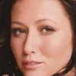
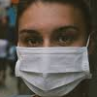
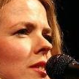
About the dataset
We used Face-mask-detection-12k-images dataset for training and testing.
It is a standard dataset which includes 12,000 images.
We used 10,000 images for training, 2000 for testing and 1000 for validation, therefore the test train ratio is 83.33% and 16.67%.
It is equally divided into ‘Mask’ and ‘No Mask’ categories.
It is a pre-augmented dataset.
The images are of various sizes, the faces are real as well as animated and the pictures are taken at different angles.
Face Mask Detection using Deep Learning CNN model

Slide 5





Libraries Used
Numpy: To convert images into numpy array and feed it to model
Pandas: Handling dataset
OpenCV: Reading,displaying and writing to images, and for face recognition.
Keras: Our deep learning model is based on Keras and uses Keras layers such as Conv2D, Dense, etc.
Matplotlib: Plotting graphs
Face Mask Detection using Deep Learning CNN model

Slide 6
Preprocessing the data :
Normalization: Each pixel has a RGB value from 0 to 255. We can divide pixel value by 255 to scale it down to 0 to 1. This is called Normalization
Augmentation: In order to overcome overfitting we can flip, rotate and crop the images to modify the limited dataset. This is called Data Augmentation.
Here, we are using a pre-augmented dataset.
Face Mask Detection using Deep Learning CNN model

Slide 7
Method used-Deep Learning CNN
Deep learning is one of the most adaptable state of the art approaches for feature extraction and classification of unstructured and structured data.
It uses multiple layers to progressively extract higher-level features from the raw input.
Deep learning CNN consist of an alternate convolutional layer and a max pooling layer connected to the fully connected layer.
Face Mask Detection using Deep Learning CNN model

Slide 8
Why CNN??
A conventional alternative of CNN is NN
NN | CNN
Backpropagates thousands or even millions of times and produces many parameters | CNN has far less number of parameters, thus saving time and memory
We have to convert the unstructured data to structured before feeding the network | It can directly work on unstructured data like images, videos and sounds and gives high accuracy
Parameters are unique and not shared | Parameters are shared
Face Mask Detection using Deep Learning CNN model

Slide 9
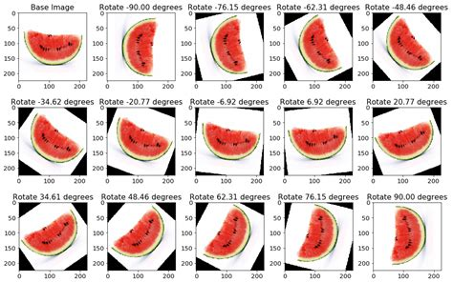
One major disadvantage of CNN is that it needs large training data needed. This can be overcomed by data augmentation.
Face Mask Detection using Deep Learning CNN model

Slide 10
Keras Model
Keras is a high-level neural network in API.
Keras makes it easy to turn models into products.
It supports multiple backend engines and does not lock us into one ecosystem.
Keras has strong GPU support and distributed training support.
It is very easy to code with Keras.
Face Mask Detection using Deep Learning CNN model

Slide 11
Layers in a CNN
Dense layer- It is a fully connected layer,meaning each neuron in a layer receives an input from all the neurons present in the previous layer.
Flatten layer- It does flattening of a tensor. Flattening a tensor means to remove all the dimensions except for one.
Dropout- It prevents overfitting. It randomly selects and removes some nodes at every iteration, along with all of the incoming and outgoing connections.
Face Mask Detection using Deep Learning CNN model

Slide 12
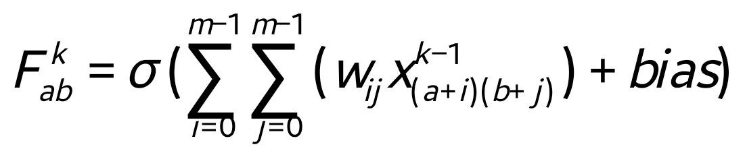
CNN: Conv2D
Input of size n x n is given to the convolutional layer. If we use m x m filter w, our convolutional layer produces an output of size (n−m+1)x(n−m+1).
It is required to sum up the contributions, weighted by the filter components from the previous layer cells, add bias term and then apply the activation function.
Face Mask Detection using Deep Learning CNN model

Slide 13
MaxPooling2D
It simply takes some k x k region and output a single value which is optimized for that section.
For example, if input layer is n x n layer then the output will be computed as a (n / k) x (n / k) layer, where k x k block is compact to present a single value through the max function.
It is primarily used to reduce the number of trainable parameters.
Face Mask Detection using Deep Learning CNN model

Slide 14

Activation functions: Relu, Softmax
The activation function is a non-linear transformation that we do over the input before sending it to the next layer of input or finalizing it as output.
We have used ReLU and Softmax activation functions in our project.
ReLU-It stands for Rectified linear activation function. It is the most commonly used activation function. It is calculated as f(x)=max(0,x)
Softmax - It is an activation function that is used in the output layer of neural network models that predicts multinomial probability distribution. Mathematically, it is
Face Mask Detection using Deep Learning CNN model

Slide 15

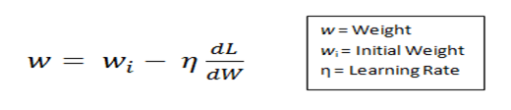
Learning rate
The task of minimizing the loss (Etotal) involves trying to adjust the weights and biases.
Learning rate (η) is a hyper-parameter used to control the rate at which an algorithm updates the parameter estimates or learns the values of the parameters.
Face Mask Detection using Deep Learning CNN model

Slide 16
Optimizer
Optimizers are algorithms used to reduce the loss function and update the weights in backpropagation.
Optimizer is one of the arguments of the model.compile() function of keras.
The different types of optimizers are:-
Adam
Adagrad
SGD
RMSprop
Face Mask Detection using Deep Learning CNN model

Slide 17
Fine tuning the model
We have varied the optimizer keeping the batch size, filter size, learning rate and activation function constant.
Cases | Optimizer | Learning rate | Filter size | Activation function in CNN
(a) | Adam | 0.0001 | 3x3 | ReLU
(b) | Adagrad | 0.0001 | 3x3 | ReLU
(c) | SGD | 0.0001 | 3x3 | ReLU
(d) | RMSprop | 0.0001 | 3x3 | ReLU
Face Mask Detection using Deep Learning CNN model

Slide 18
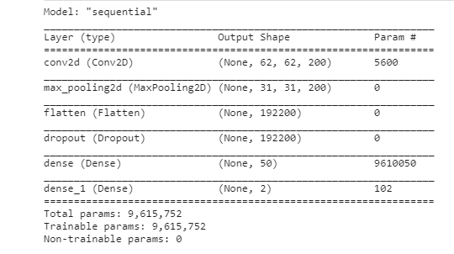
Model architecture
Face Mask Detection using Deep Learning CNN model

Slide 19
Compiling model
After comparing their performances, we concluded that adam is the best optimizer for gradient descent.
We have employed the binary cross entropy method to calculate loss, because it is a binary classification problem.
We have run the model in 10 epochs.
The learning rate is equal to the default learning rate of adam optimizer ie 0.001.
We have used Sequential API because it is very simple and easy to use.
Face Mask Detection using Deep Learning CNN model

Slide 20
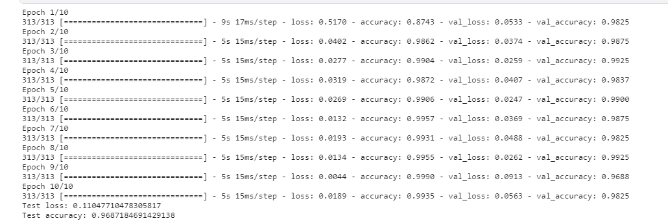
Running the Model
Face Mask Detection using Deep Learning CNN model

Slide 21
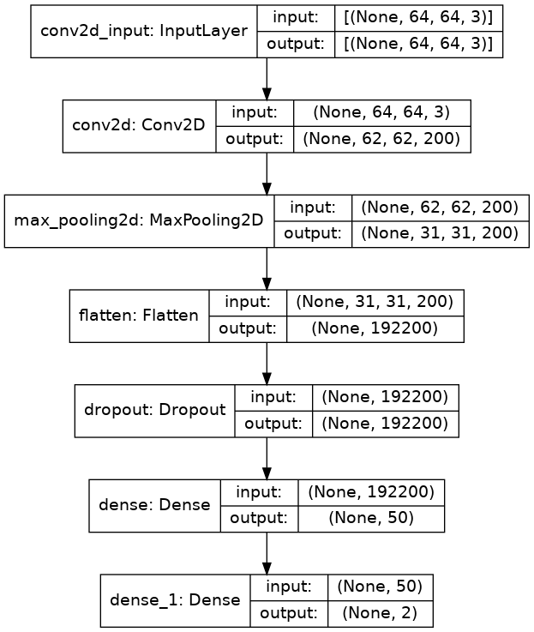
Model summary

Slide 22
Model flowchart
2D color image
Resized size of image 64×64
Image in the form of an array
Normalized image
Augmented image
Batches of training and testing images
Creating a CNN model
Training and testing the model
Performance evaluation
Fine tuning
Face Mask Detection using Deep Learning CNN model
Face Mask Detection using Deep Learning CNN model

Slide 23
Overall Accuracy
Confusion matrix:
 | Predicted values
Actual values |  | Mask | No Mask
 | Mask | TP M (506) | E M NM (2)
 | No Mask | E NM M (8) | TP NM (475)
Face Mask Detection using Deep Learning CNN model

Slide 24
Evaluation parameters
Precision M= (TP M)/ (TP M+E NM M)
Precision NM= (TP NM)/ (TP NM+E M NM)
Recall M= (TP M)/ (TP M+E M NM)
Recall NM= (TP NM)/ (TP NM+E NM M)
 | Precision | Recall | F1-score | Support (Number of test sample)
Mask | 0.98 | 1.00 | 0.99 | 508
No Mask | 1.00 | 0.98 | 0.99 | 483
Face Mask Detection using Deep Learning CNN model

Slide 25
Face detection using OpenCV
Reading the image using cv2.imread() function
Converting the image to grayscale using cv2.cvtColor() function
Implement haar face cascade classifier through cv2.CascadeClassifier() function
Plot the image with a rectangle around the face using plt.imshow() function
Face Mask Detection using Deep Learning CNN model

Slide 26
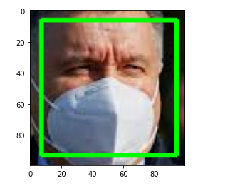
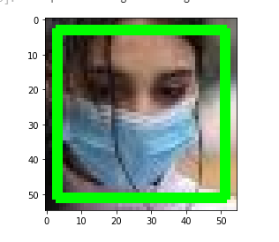
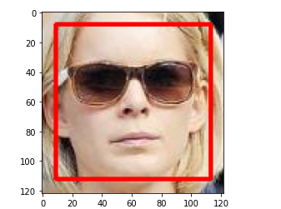
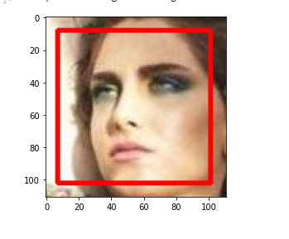
Examples:
Face Mask Detection using Deep Learning CNN model

Slide 27
Conclusion
Deep learning convolutional neural network with batch size 32, filter size 3x3, activation function ReLU and adam optimizer gives the most accurate result on the mentioned dataset.
We achieved a test accuracy of 0.97578
Face Mask Detection using Deep Learning CNN model

Slide 28
Applications
We can tell whether someone a person is wearing a mask or not without being in contact with the person. If converted into an app or exe file, we can implement the model in a stationary camera which can be mounted at public spaces.
The model can be used as a base model in transfer learning.
Our model can work on image with multiple faces.
Face Mask Detection using Deep Learning CNN model

Slide 29
Future scope
Fine tuning the model (transfer learning) to use for other binary classifications.
Training the model with a more vast, robust and varied dataset.
A user friendly front end can be designed using softwares like FLASK
We could build on a pre trained model like Mobile Net V2 for better accuracy.
Face Mask Detection using Deep Learning CNN model

Slide 30
Thank You
Face Mask Detection using Deep Learning CNN model

