Slide 1

WELCOME

Slide 2

Network Topology
BY: NIDHI PARMAR
TY-BCA

Slide 3

INDEX
Network
Point to Point Topology
Bus Topology
Mesh Topology
Star Topology
Ring Topology
Tree Topology
Hybrid Topology

Slide 4

WHAT IS NETWORK?
A network is A group of two or more computers or other electronic devices that are interconnected for the purpose of exchanging data and sharing resources.

Slide 5
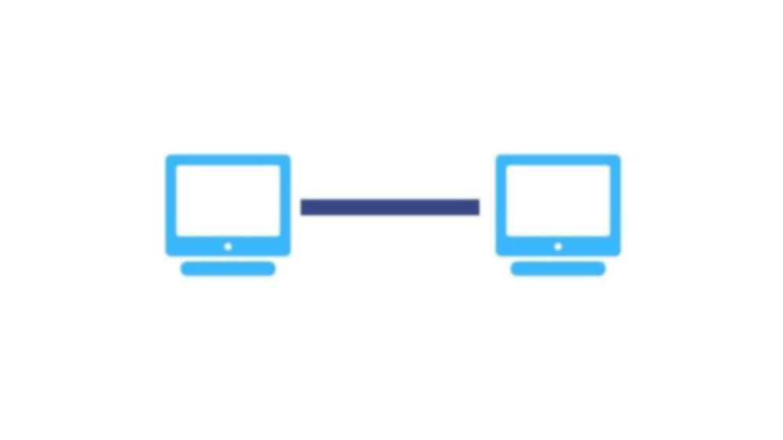
Point-to-Point Topology
Point-to-Point Topology is a type of topology that works on the functionality of the sender and receiver. It is the simplest communication between two nodes, in which one is the sender and the other one is the receiver. Point-to-Point provides high bandwidth.

Slide 6
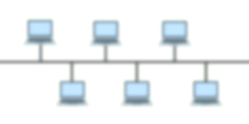
Bus Topology
The bus network topology is also referred to as horizontal topology. This topology is very common among local area networks. In this network, every computer is linked to a single connection line or cable through an interface. Thus each computer can directly communicate with other computer or device in the network.

Slide 7
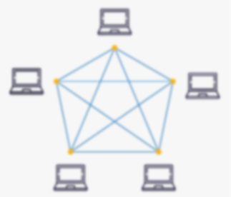
Mesh Topology
A mesh topology is a network setup where each computer and network device is interconnected with one another. This topology setup allows for most transmissions to be distributed even if one of the connections goes down. It is a topology commonly used for wireless networks. Below is a visual example of a simple computer setup on a network using a mesh topology.

Slide 8
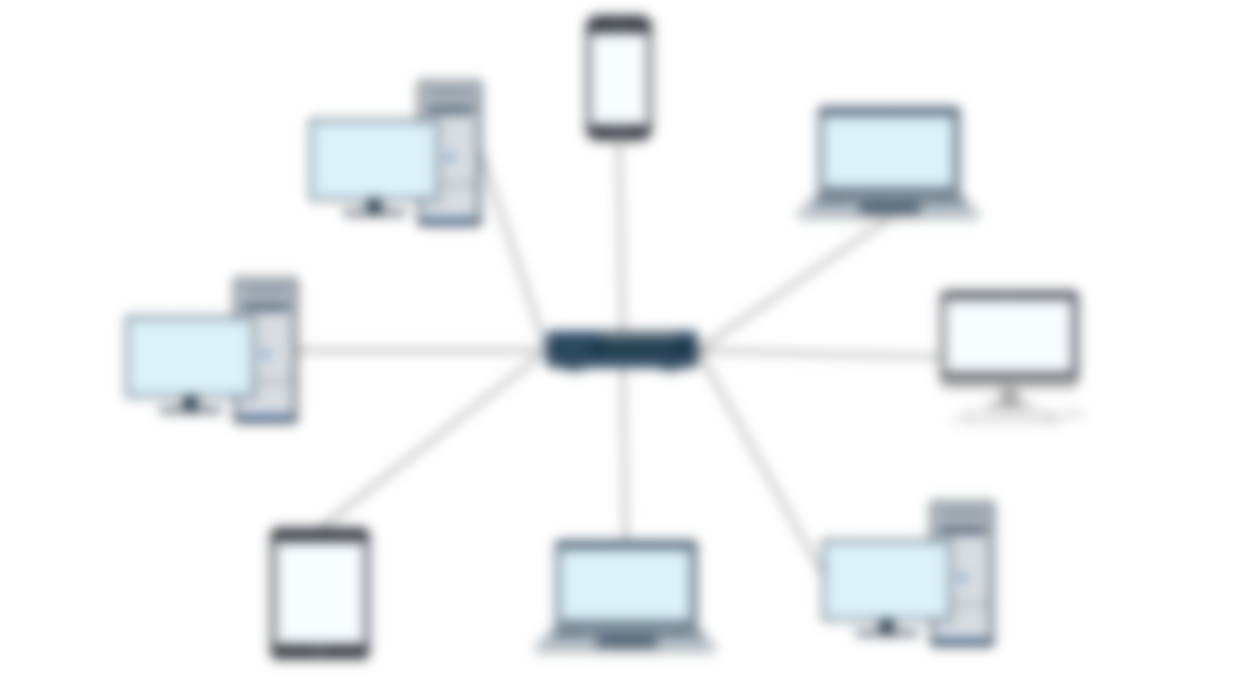
Star Topology
A star topology, sometimes known as a star network, is a network topology in which each device is connected to a central hub. It is one of the most prevalent computer network configurations, and it's by far the most popular Network Topology. In this network arrangement, all devices linked to a central network device are displayed as a star.

Slide 9
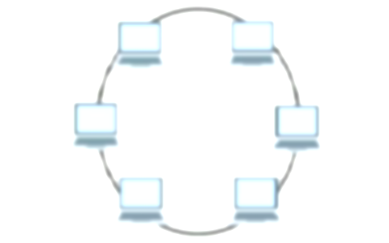
Ring Topology
In computer networking, a ring topology is a network configuration in which each node is connected to two other nodes in the network, building a single continuous pathway for signals through the network. Ring topologies are often used in local area networks (LANs).

Slide 10
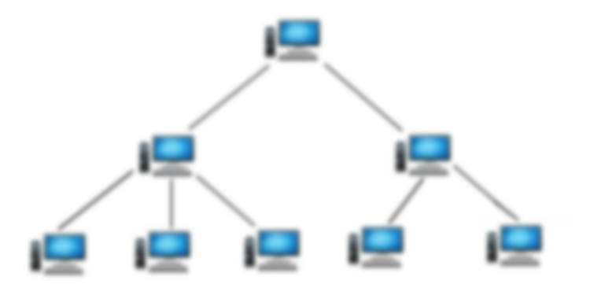
Tree Topology
In computer networking, tree topology is a type of network topology that resembles a tree. In a tree topology, there is one central node (the “trunk”), and each node is connected to the central node through a single path. Nodes can be thought of as branches coming off of the trunk.

Slide 11
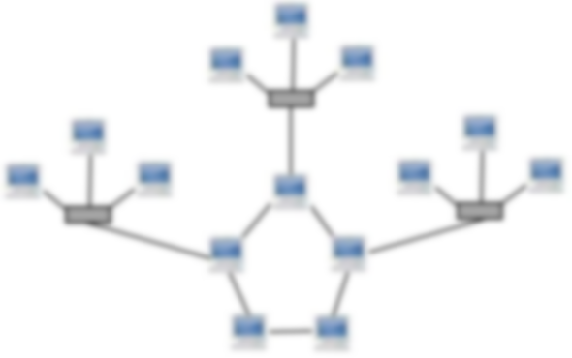
Hybrid Topology
This topological technology is the combination of all the various types of topologies we have studied above. Hybrid Topology is used when the nodes are free to take any form. It means these can be individuals such as Ring or Star topology or can be a combination of various types of topologies seen above. Each individual topology uses the protocol that has been discussed earlier.

Slide 12
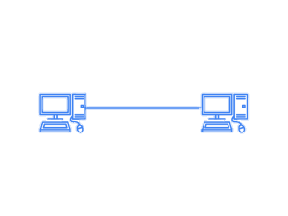
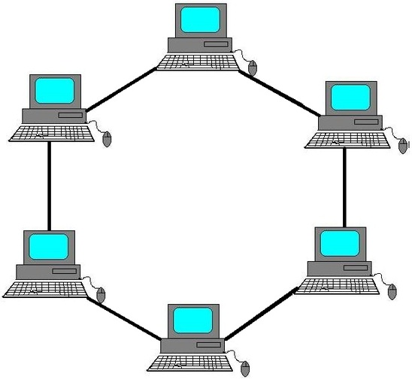
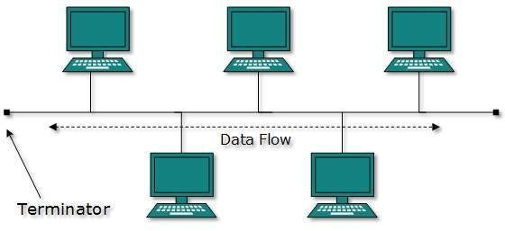
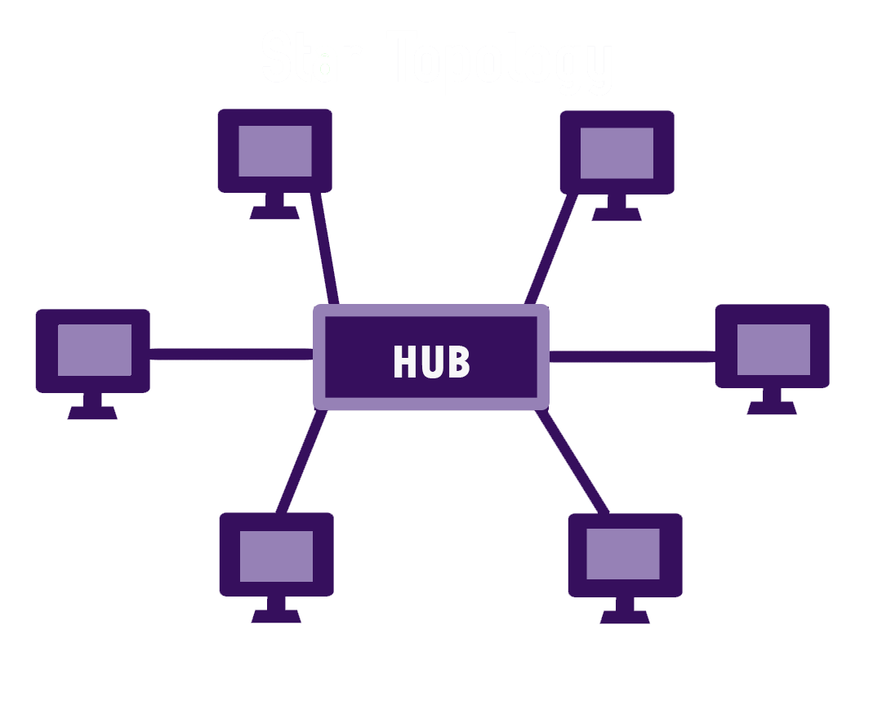
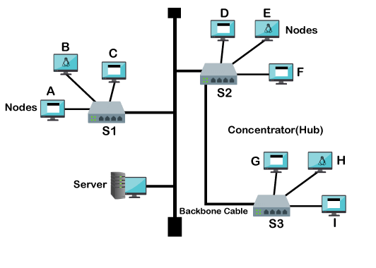
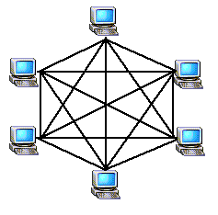
POINT TO POINT
BUS TOPOLOGY
RING TOPOLOGY
MESH TOPOLOGY
STAR TOPOLOGY
TREE TOPOLOGY
STAR TOPOLOGY

Slide 13


