Slide 1

XgBoostEstimator
A Machine Learning Analysis of US Census Salary Data

Slide 2
Motivation
Studying Census data helps economists understand the driving forces behind income patterns.
The goal of my analysis was to regress income levels into two factors: "<= $50K" and "> $50K" and identify critical variables for predicting annual income thresholds.
Marital status, age, and capital gains were among the most effective variables in predicting income levels.
The future applications of this work include generalizing economic health in regions without income data but with available predictor variables.
This allows data scientists to analyze the economic health of entire populations, moving beyond individual components.
One potential downside is the high computing and processing cost associated with working with large datasets, which was tackled by AWS Sage maker Notebook , processing job, inference jobs.

Slide 3
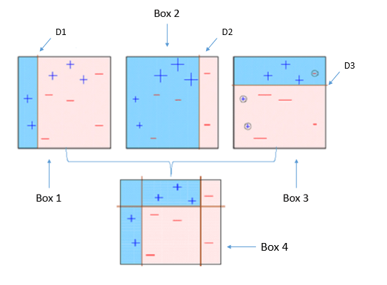
XGBOOST
It stands for "Extreme Gradient Boosting" and is designed to enhance the accuracy and efficiency of predictive models.
XGBoost uses a combination of gradient boosting algorithms and decision tree-based learning to handle both regression and classification problems.
It incorporates parallel computing techniques and tree pruning algorithms to deliver fast and accurate results, making it a popular choice in various data science competitions and industry applications.

Slide 4
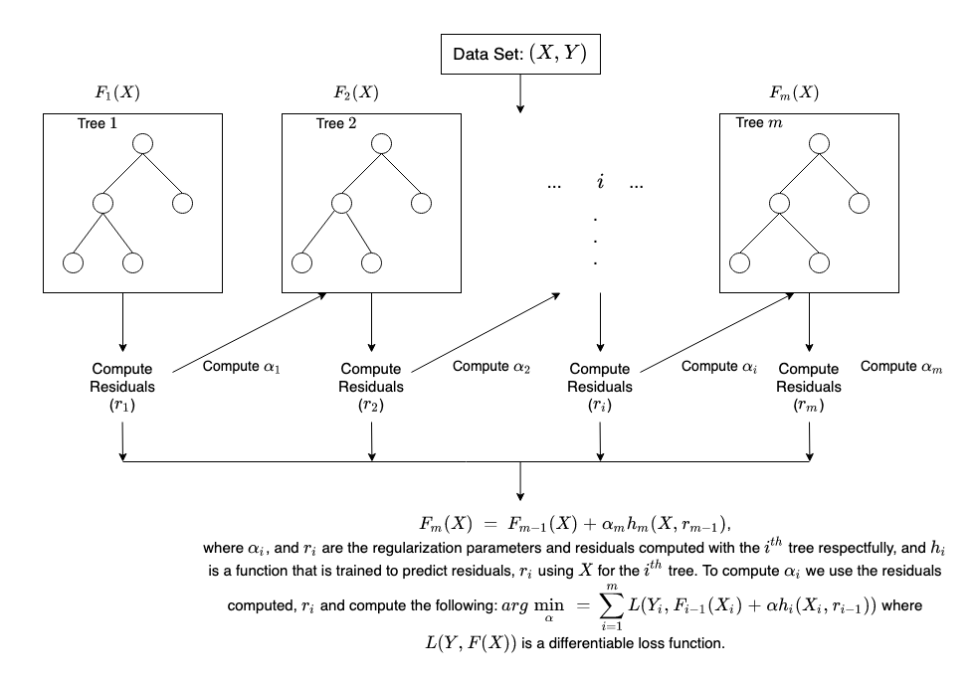
XGBOOST WORKING
XGBoost works by iteratively building a strong predictive model by combining multiple weak models, usually decision trees.
It starts by fitting a base model, typically a shallow decision tree, to the training data.
It then calculates the errors or residuals from the initial model's predictions.
In the subsequent iterations, XGBoost focuses on learning from the errors by constructing new decision trees to capture the patterns missed by previous models.
The new trees are added to the ensemble model, and the process continues until a specified number of trees, or a predefined stopping criterion is reached.
XGBoost incorporates regularization techniques to control overfitting and handle noise and outliers in the data.
The final prediction is made by aggregating the predictions of all the individual trees, weighted by their importance in reducing the overall error.

Slide 5
Critical Hyper tuning Parameters
learning_rate: This parameter controls the step size at each boosting iteration. A lower learning rate can potentially improve generalization, but it may require more boosting iterations to converge.
max_depth: It determines the maximum depth of each decision tree in the boosting process. Increasing the max_depth can lead to a more complex model, but it also increases the risk of overfitting. Finding the right balance is crucial.
n_estimators: This parameter specifies the number of boosting iterations or trees to build. Increasing the number of estimators can improve the model's performance, but it comes at the cost of increased computational complexity. It's important to find an optimal value that balances performance and efficiency.
subsample: It controls the fraction of training instances used for building each tree. A value less than 1.0 introduces stochasticity and can help reduce overfitting. However, setting it too low may result in underfitting, so it's important to find the right value for your specific dataset.

Slide 6
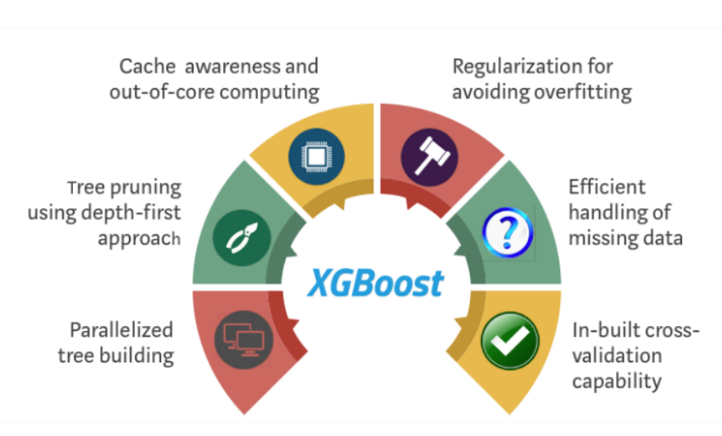
Why XGBoost
High Performance: XGBoost is renowned for its high performance and efficiency.
Capturing Complex Relationships: It effectively captures complex relationships in data, improving accuracy.
Regularization Techniques: XGBoost incorporates regularization to prevent overfitting and enhance generalization.
Feature Importance: It provides insights into feature importance, aiding in decision-making.
Handling Missing Values: XGBoost can handle missing values, reducing preprocessing requirements.
Parallel Processing: It supports parallel processing, enabling faster training and scalability.

Slide 7

Thank You
Santosh

