Slide 1
EXECUTIVE ANALYTICS BRIEFING
Q3 COMMERCIAL READOUT
Customer shopping behavior, in one read
What 3,900 purchases reveal about customer value, product demand, and the next growth levers.
Dataset scope: 3,900 recorded retail transactions · Core customer base: 3,900 accounts
Notes:
Frame the session: 3,900 retail transactions analyzed to evaluate customer retention, category concentration, discounting dynamics, and product catalog performance.

Slide 2
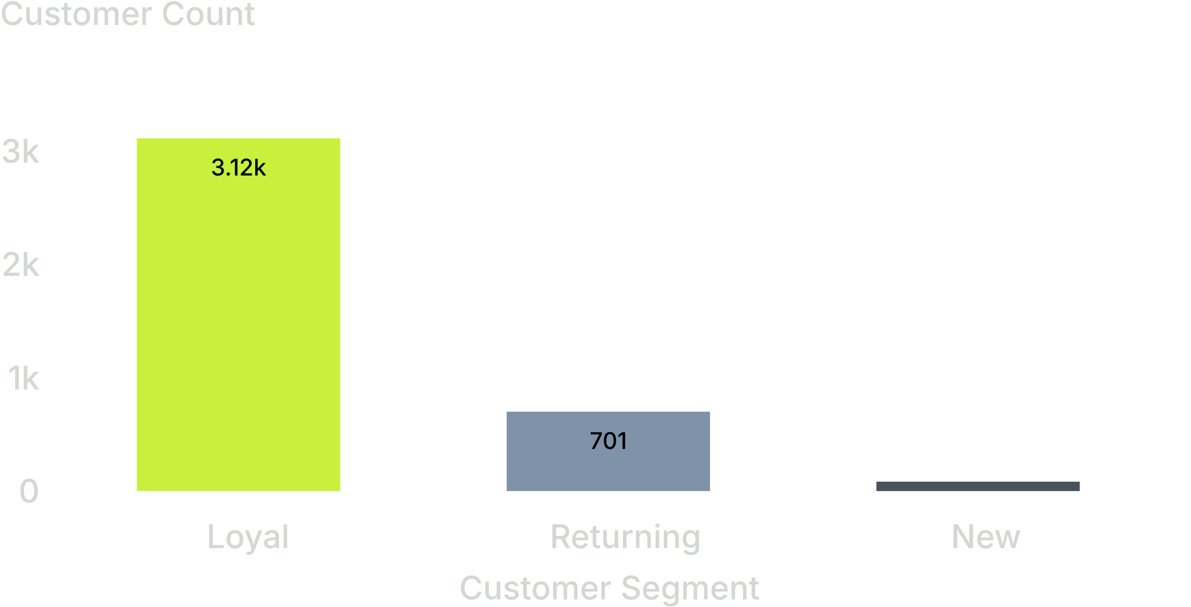
CUSTOMER SEGMENTATION
The business is powered by repeat customers
3,116
Loyal customers
80% of customer base (3,900 total purchases)
Returning
New
701
83
Use loyalty as the foundation for retention and subscription growth.
Repeat customers (loyal + returning) represent 97.9% of all transactions, making retention our primary baseline.
02
Notes:
Point out the sheer concentration in loyalty: 3,116 of 3,900 customers are already loyal. New acquisition is only 83 accounts, meaning growth must come from expanding wallet share and recurring models.

Slide 3
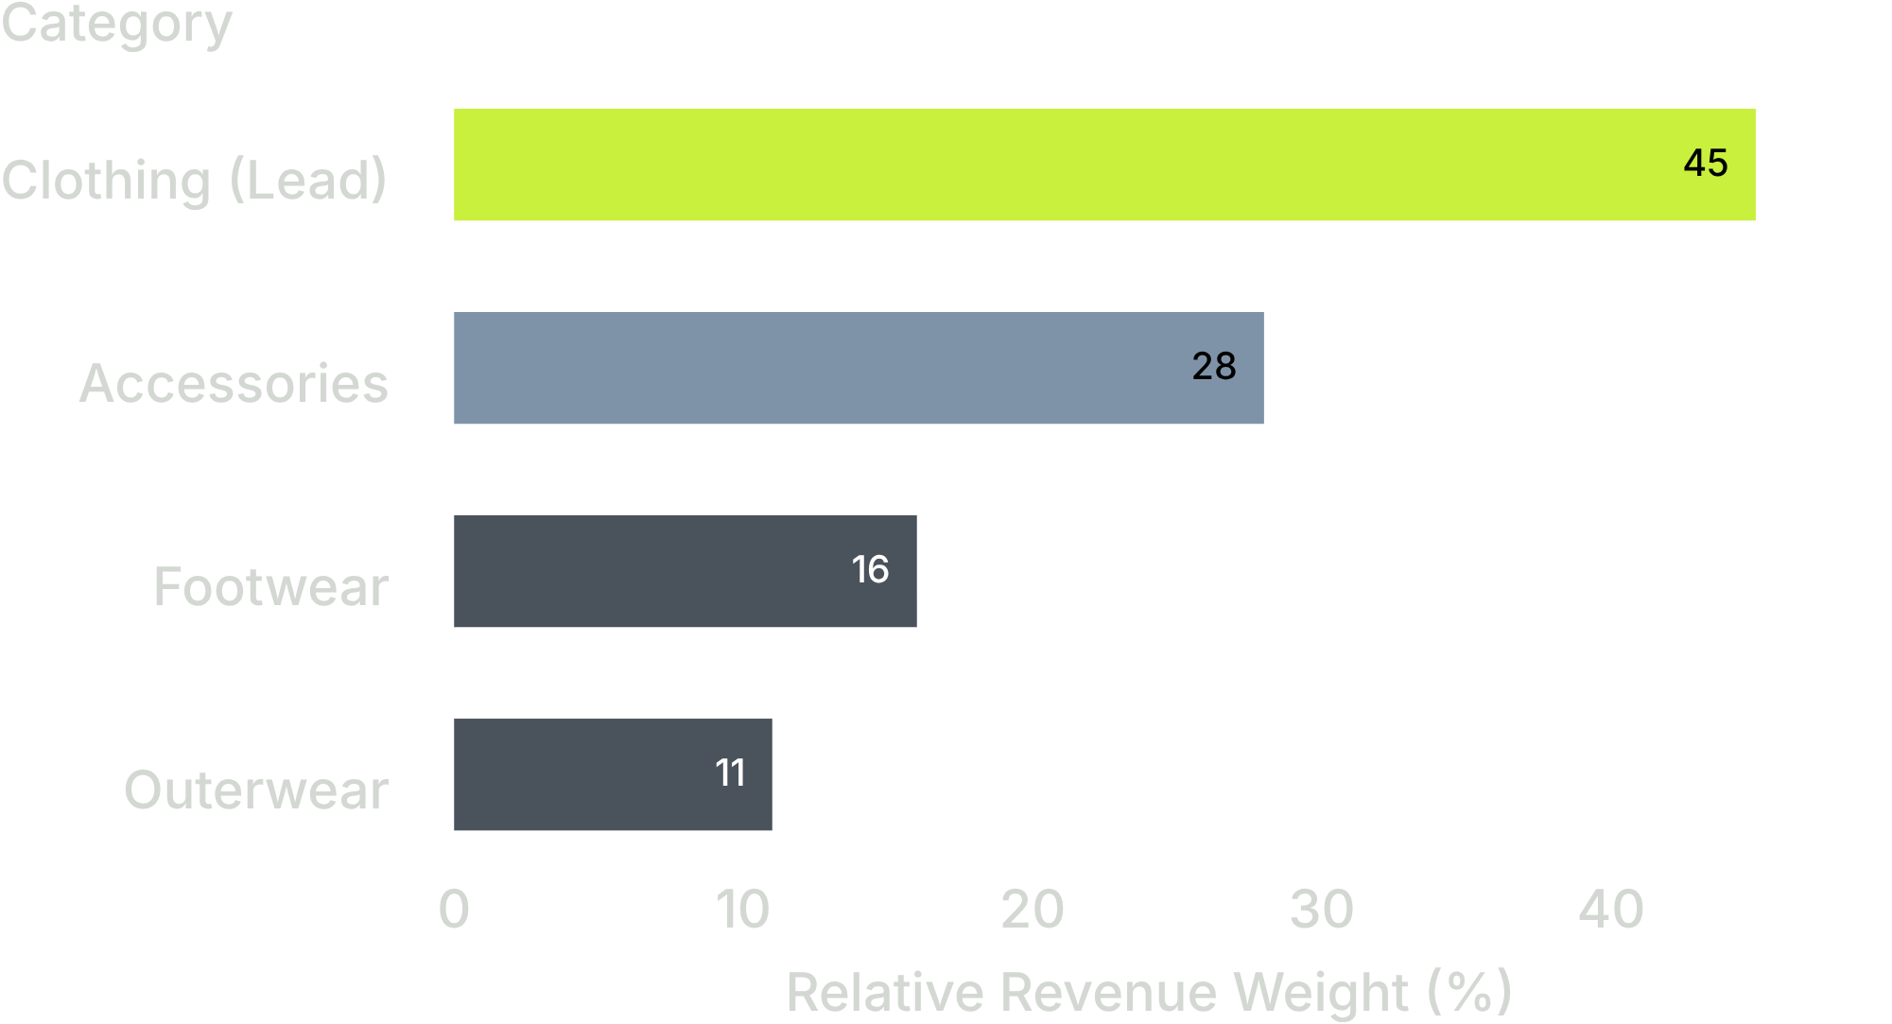
CATEGORY & COHORT CONTRIBUTION
Revenue is concentrated in a few customer and category patterns
TRANSACTION BASELINE
$59.76
Average purchase across all 3,900 orders
CUSTOMER SENTIMENT
3.75 / 5.0
Average review score across catalog
Young adults contribute the highest revenue among age groups.
Clothing leads total revenue and overall transaction count, followed by accessories as the primary attach category.
03
Notes:
Clothing and accessories dominate the transaction volume. Young adults are the core economic engine, while the overall order basket averages $59.76 with steady 3.75 customer satisfaction.

Slide 4
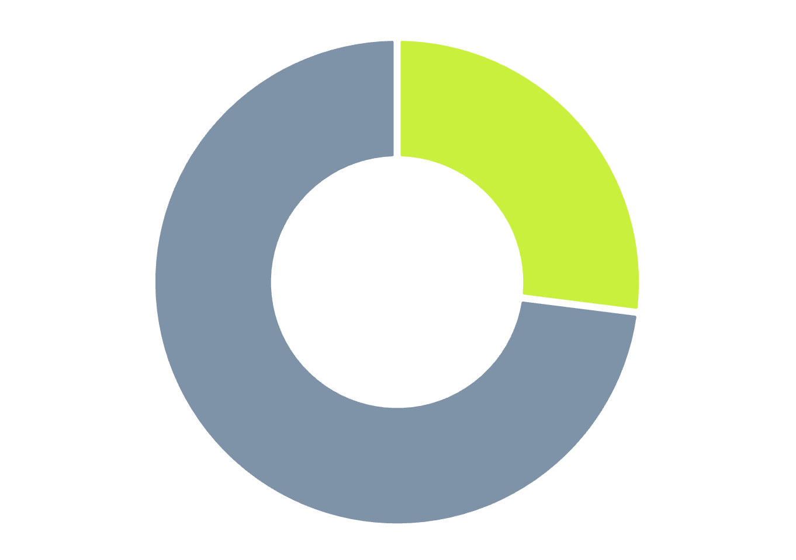
RECURRING REVENUE OPPORTUNITY
Subscription adoption is the clearest gap
METRIC | SUBSCRIBERS | NON-SUBSCRIBERS
Customer share | 27% | 73%
Total revenue generated | $62,645 | $170,436
Average purchase amount | $59.49 | $59.87
Key takeaway: Average spend is nearly identical ($59.49 vs $59.87). The subscription program currently functions as a billing status, not a basket-expansion engine.
73% of customers transact on one-off orders, leaving recurring subscriptions underutilized.
04
Notes:
Emphasize that subscribers and non-subscribers spend the exact same per basket (~$59.50). The growth upside is expanding frequency or adding subscription perks, converting the 73% non-subscribers.

Slide 5
PROMOTION & MARGIN TRADE-OFFS
Discounts can lift conversion without guaranteeing bigger baskets
HIGH-SPEND PROMOS
CATEGORIES WITH HIGHEST DISCOUNT DEPENDENCE
839
Category / Item
Hats
Sneakers
Coats
Sweaters
Pants
Customers
Used discounts while spending above the $59.76 average purchase amount
Revisit discount depth and targeting to protect margin while preserving demand.
05
Notes:
839 customers used discounts while spending above the average purchase amount. Discount dependence is highest for hats, sneakers, coats, sweaters, and pants. Revisit discount depth and targeting to protect margin while preserving demand.

Slide 6
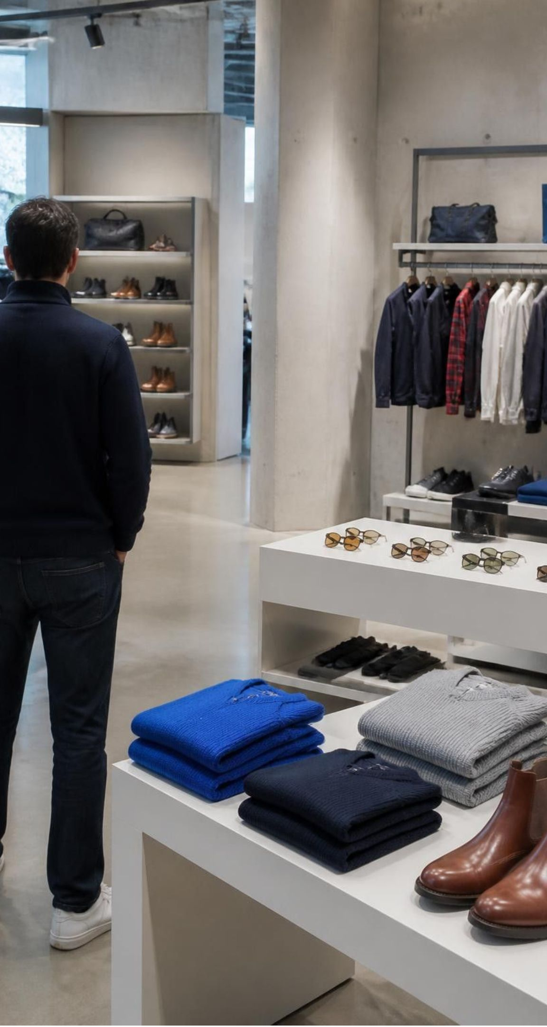
MERCHANDISING & CATALOG PERFORMANCE
Product demand is broad, but a few items lead each aisle
TOP-RATED CATALOG LEADERS
Gloves
Sandals
Boots
3.86 / 5.0
3.84 / 5.0
3.82 / 5.0
TOP-SELLING VOLUME ANCHORS BY DEPARTMENT
Accessories
Jewelry & Sunglasses anchor high-margin impulse attach
Clothing
Blouses & Pants generate highest overall daily transaction frequency
Footwear
Sandals & Shoes drive cross-season volume across customer cohorts
Strategic guidance: Use top ratings to build storefront trust and deploy proven best sellers to anchor seasonal acquisition campaigns.
06
Notes:
Aisle leaders stand out clearly: gloves, sandals, and boots win on ratings, while jewelry, sunglasses, blouses, pants, and footwear drive core volume. Pair them in front-of-store merchandising.

Slide 7
COMMERCIAL ROADMAP
Three moves follow from the data
01
02
03
Convert loyalty into subscriptions
Target discounts
Prioritize demand
Focus offers where discount dependence is highest and measure margin impact.
Feature high-rated and high-volume products, especially in clothing and accessories.
Test exclusive benefits with the 3,116 loyal customers.
07

Slide 8
ACTION PLAN & GOVERNANCE
Leadership decisions for the next test cycle
STRATEGIC DECISION | CORE TESTING QUESTION | PRIMARY SUCCESS METRIC
Subscription Model | Which subscription benefit is compelling enough to change behavior? | Subscription adoption rate
Promotional Governance | Where can discounting be narrowed without weakening baseline demand? | Gross margin & basket AOV
Merchandising Focus | Which age, category, and product combinations deserve the next campaign? | Repeat purchase & conversion
Mandate: Use the dashboard as the shared baseline, then measure conversion, repeat purchase, subscription adoption, and margin across each sprint cycle.
08
Notes:
Conclude with executive accountability: agree on the three test questions, track the four primary metrics, and establish the next review checkpoint.

