Slide 1
TREE DATA STRUCTURE

Slide 2
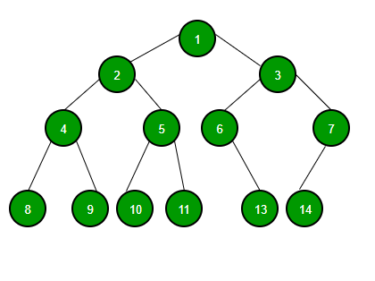
A tree is a non-linear data structure that organizes data in a hierarchical structure and this is a recursive definition. It is a set of one or more nodes, with one node identified as the tree’s root and all remaining nodes partitionable into non-empty sets, each of which is a subtree of the root. Since it is a non-linear data structure, different tree data structures provide for faster and easier access to the data.

Slide 3
Tree Terminologies Node A node is a unit of data that contains a key or value as well as pointers to its child nodes. Edge The connecting link between two nodes is called a link. Root The topmost node in a tree is called the root node. This is where the tree is originated from. Parent Node A parent node or ancestor is a node that has a branch from it to another node. Child Node A child node (descendant or successor) is a node that is a descendent of another node. Sibling Nodes Nodes that have the same parent are called sibling nodes.

Slide 4
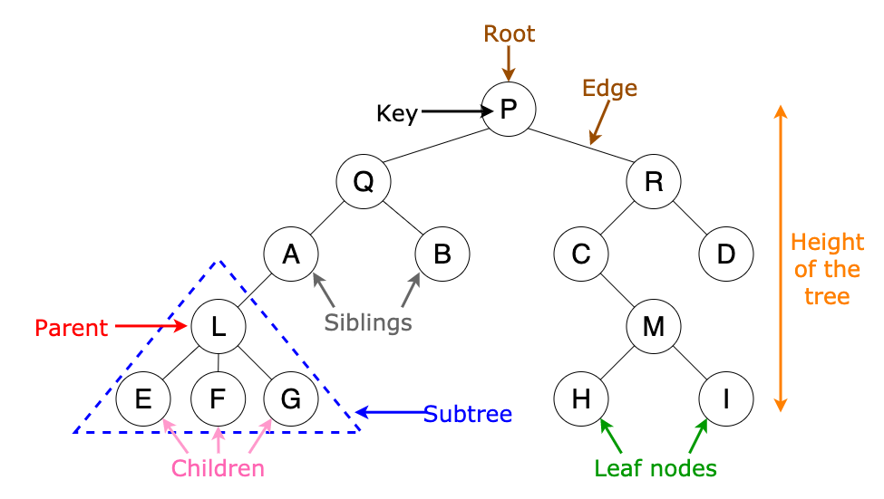

Slide 5
Leaf Node and Internal Node The node which does not have any child is called a leaf node or terminal node. The nodes having at least a child node is called an internal node. Level of a Tree Each step from top to bottom in a tree is referred to as the level of a tree. Degree The total number of children of a node is the degree of a node. The number of edges arriving at that node is called the in-degree of a node. The number of edges leaving that node is the out-degree of a node. The highest degree of a node among all the nodes in the tree is referred to as the degree of the tree. Depth The total number of edges from the root node to a particular node is called the depth of that node. Height The height of a node is the total number of edges that lie on the longest path from the node to any leaf node. The height of a tree is the height of the root node.

Slide 6
Types of Tree
Binary Tree
Binary Search Tree
AVL Tree
B-Tree
Expression trees
Tournament trees
Applications of Tree
To search an element in a set quickly, Binary Search Trees(BSTs) are used.
Heap sort is done by a kind of tree called Heap.
Tries are modified version of trees used to store routing informations in routers.
Compiler use a syntax tree to parse program you write.
Shortest path trees and spanning Trees are used in bridges and routers.

Slide 7
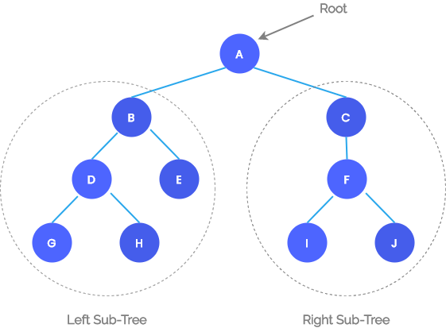
A Binary tree is a special tree where each node can have no more than two children. A non-empty binary tree consist of the following: A node called the root node. A left sub-tree. A right sub-tree. Both the sub-trees are themselves binary trees.
BINARY TREE

Slide 8
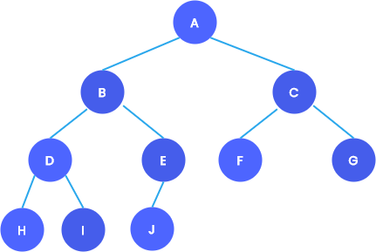
Types of Binary Trees
Complete Binary Tree
The tree T is said to be complete if,
All it’s levels, except possibly the last, must be completely filled.
All the leaf nodes must appear as far left as possible.

Slide 9
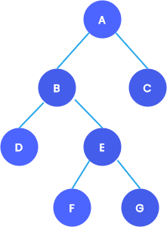
Full Binary Tree
A full binary tree is a special type of tree in which the leaf nodes will have zero children and other non-leaf nodes will have exactly 2 children.

Slide 10
Representation of Binary Tree
Binary trees can be maintained in memory using either an array or a linked list.
Sequential representation of binary trees
The simplest technique for representing a binary tree is to store the elements using a one-dimensional array.
Suppose we are using a one-dimensional array TREE to store the elements of a tree. The rules for a sequential binary tree are as follows:
The root of the tree will be stored in TREE[0].
If an element is stored in TREE[K], then
It’s left child is stored in TREE[2K + 1].
It’s right child is stored in TREE[2K + 2].
A tree of height h will require an array of maximum size 2^{h}-1. A tree is empty if
TREE[0] = NULL
.

Slide 11
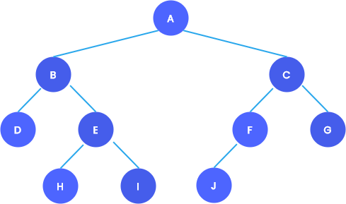
The following figure shows a binary tree and its corresponding sequential representation.
This method is inefficient unless the tree is (almost) full. Also, it is not possible to add a new node if the tree is already full.

Slide 12
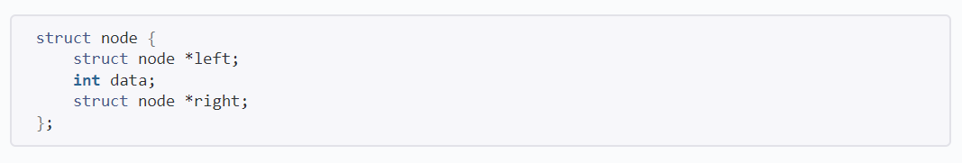
Linked representation of binary trees
Every node in a linked representation of binary tree will contain three parts:
The data element.
A pointer to the left node.
A pointer to the right node.
It can be represented by a structure.
The root node is pointed by a pointer ROOT. The tree is empty if ROOT = NULL

Slide 13
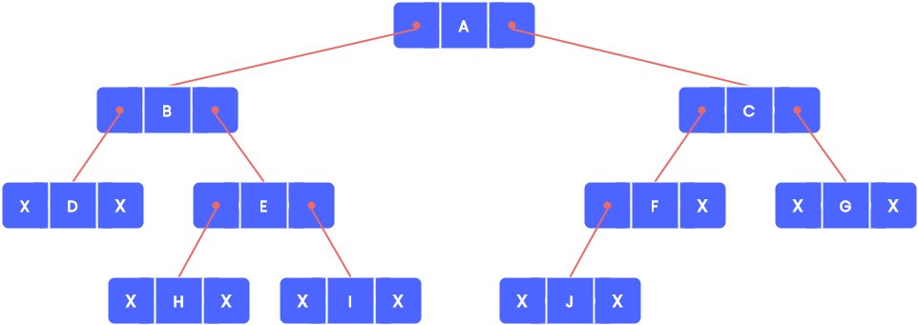
The schematic diagram of the linked representation of the binary tree is shown below.
Applications of Binary Tree
For rapid and easy access to data.
Routing algorithms.
To implement heap data structure.
Syntax tree, Binary Search Tree, Hash Trees, Treap, T-tree, etc.

Slide 14
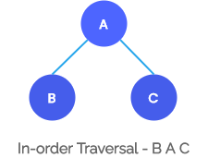
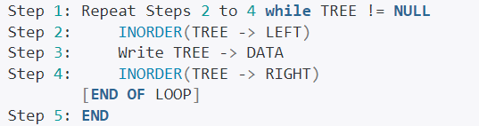
Binary Tree Traversal
A binary tree can be traversed in three different ways, namely, pre-order, post-order and in-order. The order in which the nodes are visited differs between these techniques.
In-order Traversal of Binary Tree
The following operations are done recursively at each node to traverse a non-empty binary tree in order.
Traverse the left subtree of R in inorder.
Process the root, R.
Traverse the right subtree of R in inorder.
The algorithm for in-order traversal is given below:

Slide 15
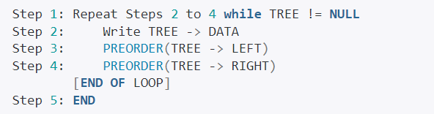
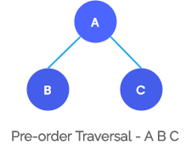
Pre-order Traversal of Binary Tree
The following operations are done recursively at each node to traverse a non-empty binary tree in pre-order. Pre-order traversal is also called depth-first traversal.
Process the root, R.
Traverse the left subtree of R in preorder.
Traverse the right subtree of R in preorder.
The algorithm for pre-order traversal is given below:

Slide 16
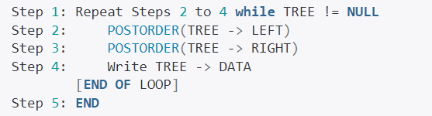
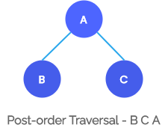
Post-order Traversal of Binary Tree
The following operations are done recursively at each node to traverse a non-empty binary tree in post-order.
Traverse the left subtree of R in postorder.
Traverse the right subtree of R in postorder.
Process the root, R.
The algorithm for post-order traversal is given below:

Slide 17
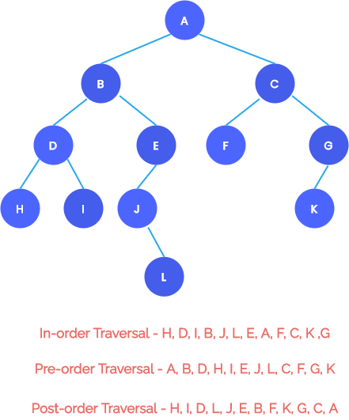
Example
Consider the following tree. The sequence of nodes that will be visited using different traversal algorithms is also given.

Slide 18
Inorder Traversal using Stack:
As we already know, recursion can also be implemented using stack. Here also we can use a stack to perform inorder traversal of a Binary Tree. Below is the algorithm for traversing a binary tree using stack.
Create an empty stack (say S).
Initialize the current node as root.
Push the current node to S and set current = current->left until current is NULL
If current is NULL and the stack is not empty then:
-Pop the top item from the stack.
-Print the popped item and set current = popped_item->right
-Go to step 3.
If current is NULL and the stack is empty then we are done.

Slide 19
Preorder Traversal using Stack:
There are two approaches for Preorder Traversal of Binary Tree using the Stack data structure:
Create an empty stack S.
Initialize the current node as root.
Push the current node to S and set current = current->left print the peek element in the stack until the current is NULL.
If current is NULL and stack is not empty then a) Pop the top item from stack. b) set current = popped_item->right. c) Go to step 3.
If the current is NULL and the stack is empty then we are done.

Slide 20
PostOrder Traversal using Stack:
1. Create an empty stack
2. Do the following while the root is not NULL
Push root’s right child and then the root to stack.
Set root as root’s left child.
3. Pop an item from the stack and set it as root.
If the popped item has a right child and the right child is at top of the stack, then remove the right child from the stack, push the root back, and set the root as root’s right child.
Else print root’s data and set root as NULL.
4. Repeat steps 2 and 3 while the stack is not empty.

Slide 21
Graph Data Structure
A graph is a non-linear data structure consisting of vertices and edges that connect these vertices.
Definition
A graph is an ordered set
G = (V, E)
consist of two sets: V and E, where V is the set of nodes (vertices, points or nodes)
E is the set of edges, identified with a unique pair of nodes in V, denoted by e=(u, v)
The following figure shows an example of a graph where V(G) = {A, B, C, D, E}
and E(G) = { (A,B), (B,C), (C,D), (D,E), (E,A), (A,D) }

Slide 22
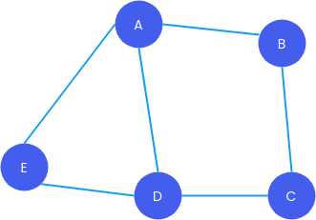
Graph Terminology
Let e = [u, v]. Then nodes u and v are referred to as endpoints of e, and u and v are referred to as adjacent nodes or neighbours.
The number of edges containing u is the degree of node u.
If u does not belong to any edge (degree of u = 0), then u is referred to as an isolated edge.
A finite sequence of edges that connects a series of vertices is called a path.
The number of edges in a path is the length of the path.

Slide 23
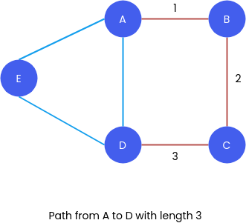
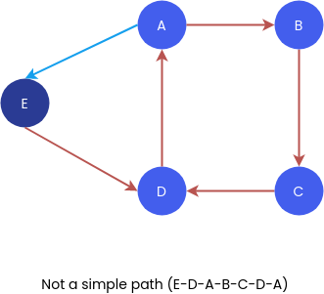
A path is said to be closed if it starts and ends at the same node.
A path is considered to be simple if all of its nodes are distinct, except the initial and last node.

Slide 24
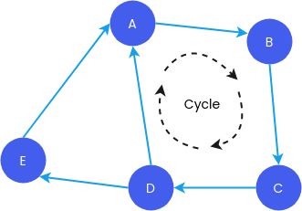
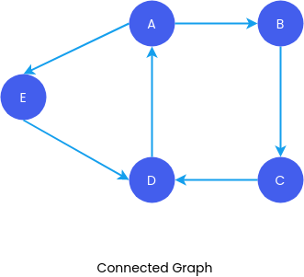
A cycle is a closed simple path with a length of 3 or more.
A graph is considered to be connected if and only if any two of its nodes have a path between them.

Slide 25
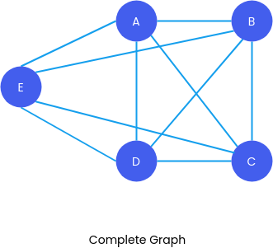
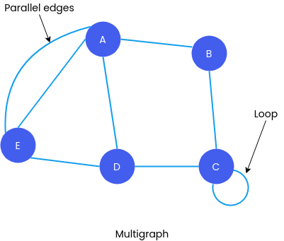
If every node u in a graph is adjacent to every other node v in the graph, then the graph is said to be complete.
An edge e is called a loop if it has identical endpoints, that is if e = [u,u].
When multiple edges in a graph connect the same pair of nodes, the edges are referred to as parallel edges.
An edge e is called a loop if it has identical endpoints, that is if e = [u,u].
When multiple edges in a graph connect the same pair of nodes, the edges are referred to as parallel edges.

Slide 26
Types of Graphs
Directed and Undirected Graph
A graph with edges that don’t have direction is called an undirected graph. The edges in an undirected graph indicate a two-way relationship.
A Directed graph(digraph) is a graph that has edges with direction. These edges represent a one-way relationship. That is edges can be only traversed in one direction.
If a digraph has a directed edge e = [u, v], then
e begins at u, and ends at v.
u is the origin or initial point of e, and v is the destination or terminal point of e.
The number of edges beginning at a node u is its outdegree. The number of edges that finish at a node u is its indegree. If a node u has a positive outdegree but a negative indegree, it is referred to as a source. If a node u has a zero outdegree but a positive indegree, it is referred to as a sink.
If there is a directed path from v to u, then node v is said to be reachable from u. A directed graph G is said to be connected (strongly connected) if there is a path from u to v and also a path from v to u for each pair u, v of nodes in the graph.

Slide 27
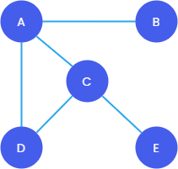
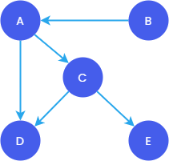
UNDIRECTED GRAPH
DIRECTED GRAPH

Slide 28
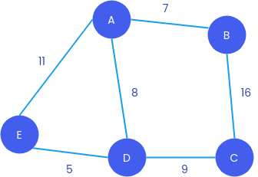
Weighted Graph
A weighted graph is a graph that has a number associated with each of its edges. The number is called the weight of the edge. A weighted graph can be undirected or directed. The weight of a path P is the sum of the weights of the edges along the path.

Slide 29
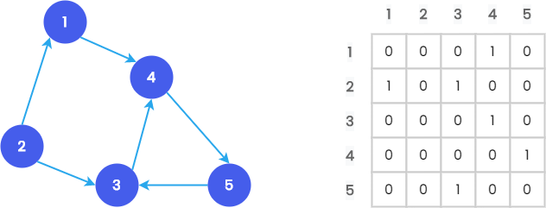
Representation of Graphs
Sequential Representation : Adjacency Matrix
A graph with N nodes can be represented by an NxN square matrix with row and column numbers representing the vertices. A cell at the cross-section of the vertices can only have the values 0 or 1. An entry in the adjacency matrix [V_{i}, V_{j}] = 1 only if there exists an edge from V_{i} to V_{j}. A graph and its corresponding adjacency matrix are illustrated below:
In the case of a weighted graph, the weight of the edge is saved instead of the value 1. Since the adjacency matrix will be sparse, a lot of space will be wasted. Adding or removing new nodes may be difficult.

Slide 30
Linked Representation
The linked representation of a graph contains two lists, a NODE list and an EDGE(Adjacency) list.
Each element in the NODE list will correspond to a node in the graph. It contains:
Name of the Node.
Pointer to adjacent nodes.
Pointer to next node.
Each element in the edge list will represent an edge of the graph. It contains:
Destination node of the edge.
Link that link together the edges with the same initial node.
A graph and its corresponding linked representation are illustrated below.

Slide 31
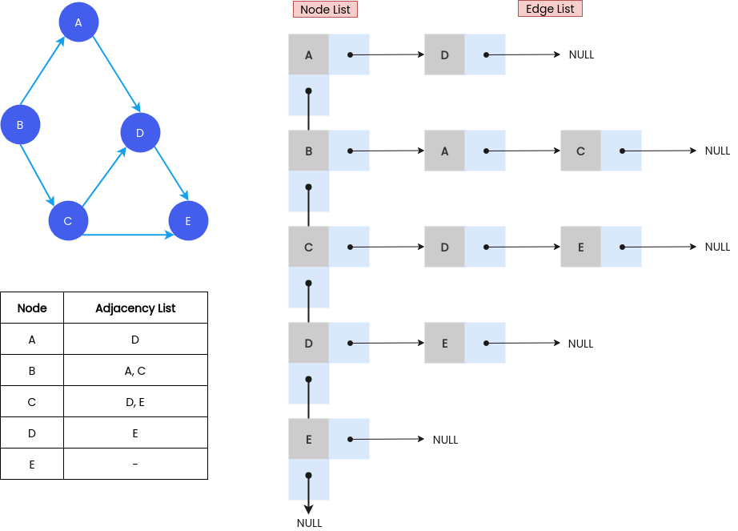
Linked Representation of Graph
Because we only need to keep the values for the edges, an adjacency list is efficient in
terms of storage.

Slide 32
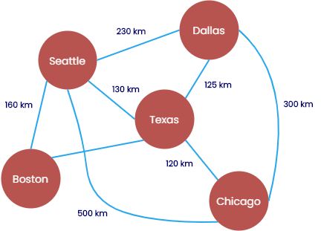
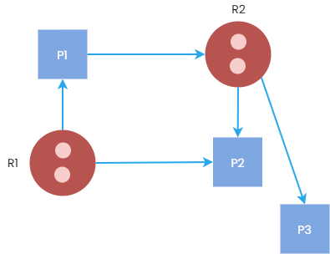
Applications of Graph
In circuit networks: connection points as vertices and wires as edges.
In transport network: stations as vertices and routes as edges.
For finding shortest paths.
In state diagrams: states as vertices and transition between states as edges.
For scientific computations.
In recommendation algorithms.
Google Maps as a Graph
Resource Allocation Graph

