Slide 1

DATA ANALYTICS INTERNSHIP 2026
Superstore Sales Analytics
Task 5: Final Reporting, Deployment and Presentation
An end to end retail analytics project on the Sample Superstore dataset: data cleaning and SQL extraction, Python and Power BI visualisation, statistical modelling, and evidence based business recommendations.
10,194 ORDERS ANALYSED · $2.33M IN REVENUE EXAMINED · 5 TASKS COMPLETED
PYTHON · SQL · POWER BI · SARIMA FORECASTING · RFM SEGMENTATION
PREPARED BY
PROGRAMME
REPOSITORY
Khushi Vig
ApexPlanet Software Pvt. Ltd.
github.com/KhushiVig/apexplanet-data-analytics

Slide 2
INTRODUCTION
About This Project
WHAT THIS IS
This presentation documents the 45 day Data Analytics Internship at ApexPlanet Software Pvt. Ltd., completed by Khushi Vig across five structured tasks, from environment setup through final deployment.
THE DATASET
The project works with the Sample Superstore retail dataset: a four year transactional record of 10,194 orders across the United States, chosen for its realistic mix of sales, discount, profit, and geographic fields.
THE JOURNEY
Across the five tasks, the work moves through data cleaning and exploratory analysis, SQL based data extraction, Python and Power BI visualisation, statistical and machine learning modelling, and a final packaged report with an automated pipeline.
HOW TO READ THIS DECK
This presentation is narrated through on screen text rather than a spoken voiceover, so every slide is written to stand on its own, with figures and findings drawn directly from the accompanying Jupyter notebooks, SQL scripts, and Power BI dashboard.
ApexPlanet Data Analytics Internship | Khushi Vig
2

Slide 3
OVERVIEW
What This Presentation Covers
1
Task 1: Foundational Setup and Exploratory Data Analysis
Environment setup, dataset audit, data cleaning, and exploratory analysis of the Sample Superstore dataset.
2
Task 2: SQL and Data Extraction
Twenty two SQL queries covering joins, aggregations, subqueries, and window functions, integrated with Python.
3
Task 3: Visualisation and Dashboarding
Thirteen plus Python visualisations and a drill through Power BI executive dashboard.
4
Task 4: Advanced Analytics and Statistical Modelling
Hypothesis testing, correlation analysis, SARIMA forecasting, K-Means segmentation, and predictive modelling.
5
Task 5: Final Reporting and Presentation
An executive report, an automated analytics pipeline, and this end to end presentation.
ApexPlanet Data Analytics Internship | Khushi Vig
3

Slide 4
PROJECT BRIEF
Problem and Objectives
OBJECTIVES
THE PROBLEM
1
Clean and understand the data
ApexPlanet's internship programme needed a portfolio ready, end to end demonstration of the analytics lifecycle applied to a real retail dataset, one that goes beyond isolated exercises and shows how cleaning, querying, visualising, and modelling connect into a single coherent story a business can act on.
Audit the Sample Superstore dataset for quality, structure, and business meaning before any analysis begins.
2
Answer business questions in SQL
Use joins, window functions, and aggregations to quantify seasonality, top customers, and category performance.
3
Visualise and dashboard the findings
WHY IT MATTERS
Build 13+ Python visualisations and a drill through Power BI executive dashboard.
Retailers routinely sit on transaction data without a clear view of what drives profit versus what merely drives revenue. Turning raw orders into tested, decision ready insight is the core skill this project sets out to demonstrate.
4
Model statistically and predictively
Apply hypothesis testing, SARIMA forecasting, K-Means segmentation, and classification.
5
Report and recommend
Package findings into an executive report and a set of actionable, evidence backed recommendations.
ApexPlanet Data Analytics Internship | Khushi Vig
4

Slide 5
TASK 1: FOUNDATIONAL SETUP
Data Overview
Sample Superstore dataset (Tableau public sample), a transactional retail dataset spanning four years of orders, chosen for its mix of numeric and categorical fields across sales, discount, profit, shipping, and geography.
ORDERS BY CATEGORY
Technology
1,865
10,194
21
0
800
Furniture
2,201
Orders analysed
Data fields
Missing values
Unique customers
Office Supplies
6,128
Data cleaning: no missing values or duplicate rows were found across the 10,194 records. Categorical fields (Ship Mode, Segment, Region, Category, Sub-Category) were converted to category type; 1,913 profit and 1,183 sales outliers were identified by the IQR method and retained as genuine bulk orders and heavy discount transactions rather than data errors.
CUSTOMER SEGMENTS
Consumer
5,281
Corporate
3,090
Consumer leads the segment mix (5,281 of 10,194 orders), and Office Supplies dominates order volume at roughly 60 percent of all orders, though volume alone does not predict profitability, as later sections show.
Home Office
1,823
Regions: West (3,253) leads, followed by East (2,986), Central (2,335), and South (1,620).
ApexPlanet Data Analytics Internship | Khushi Vig
5

Slide 6
METHODOLOGY
Tools and Technology Stack
Python
SQL
Power BI
scikit-learn
Core analysis and visualisation
Data extraction and querying
Dashboarding
Statistical and ML modelling
pandas, NumPy, Matplotlib, Seaborn, Plotly
SQLite, SQLAlchemy, 22 queries
DAX measures, drill-through, bookmarks
statsmodels, SciPy, K-Means, ARIMA/SARIMA
HOW IT ALL FITS TOGETHER
Each task builds directly on the last. Cleaned data from Task 1 is loaded into a SQL database for Task 2, whose query outputs feed the Python visualisations and Power BI dashboard in Task 3.
Task 4 layers statistical testing, forecasting, and segmentation on top of the same cleaned dataset, and Task 5 packages every finding into an executive report, an automated pipeline, and this presentation.
The result mirrors how a real analytics team works: one dataset, one connected pipeline, and a consistent set of business questions carried through cleaning, querying, visualising, and modelling.
AUTOMATION
GitHub Actions runs the analytics pipeline on a weekly schedule, refreshing the cleaned dataset and KPI exports automatically.
ApexPlanet Data Analytics Internship | Khushi Vig
6

Slide 7
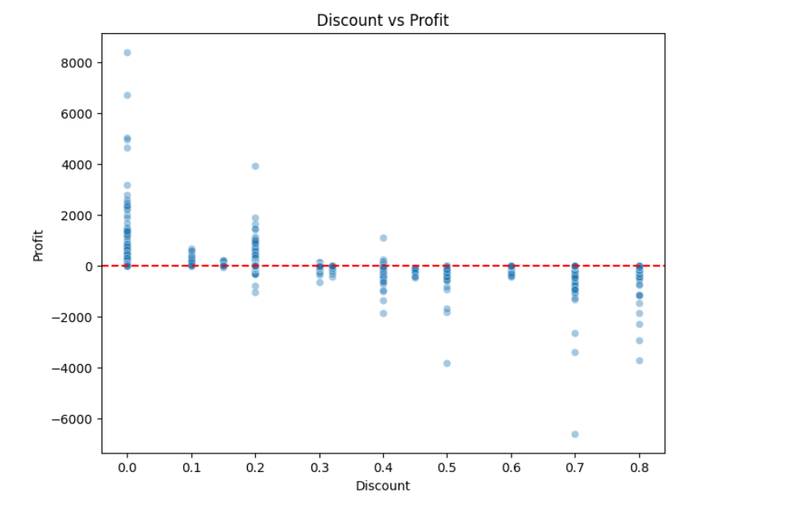
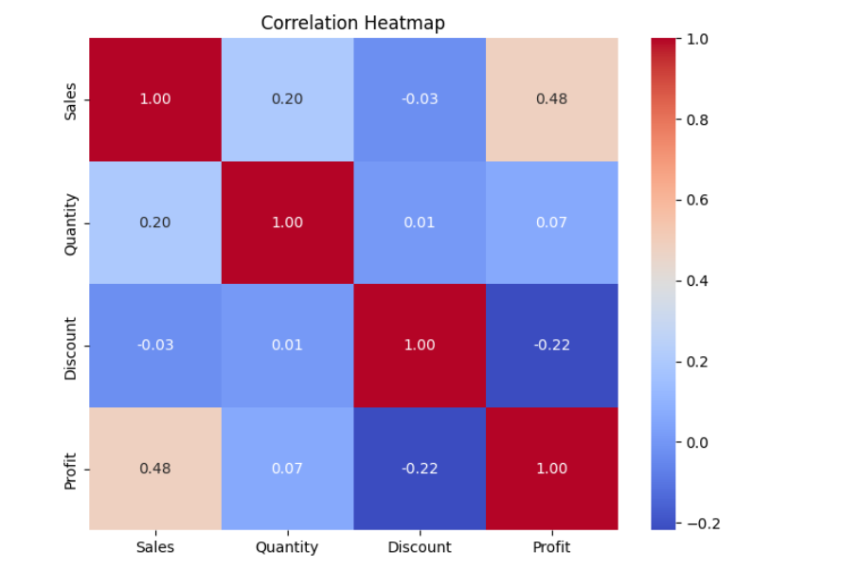
TASK 1: EXPLORATORY DATA ANALYSIS
EDA Insights: Before and After Cleaning
BEFORE 10,194 raw rows · mixed data types · outliers unflagged · structure undocumented
AFTER 0 missing values · 0 duplicates · categories typed · outliers IQR-flagged and retained as genuine business activity
-0.22
Discount vs. Profit
correlation
p < 0.0001
Past a 0.7-0.8 discount, almost every order loses money.
Figure 1. Discount versus profit, by order.
Figure 2. Correlation heatmap: Sales, Quantity, Discount, Profit.
Discount is the clearest risk factor in the dataset: Discount and Profit correlate at r = -0.22 (p < 0.0001), and orders past a 0.7 to 0.8 discount are overwhelmingly loss making.
Sales and Profit correlate positively at +0.48, while Quantity shows almost no relationship with either Discount (0.01) or Profit (0.07).
Sales is heavily right skewed (skewness 12.98) with a long tail past $20,000; Profit clusters tightly around zero with occasional large swings (kurtosis 401.69).
ApexPlanet Data Analytics Internship | Khushi Vig
7

Slide 8
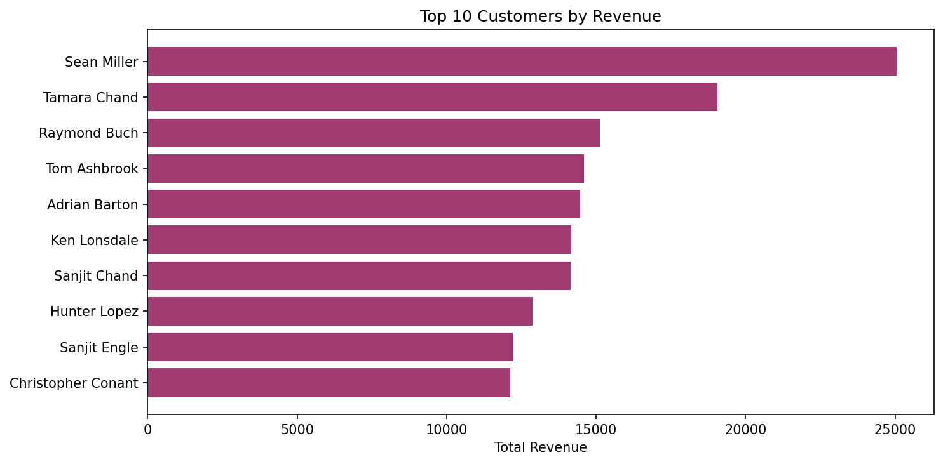
TASK 2: SQL AND DATA EXTRACTION
Querying the Business Questions
22
98.5%
$25,043
4
SQL queries written
Customer retention rate
Top customer revenue
Join types practised
SELECT through window functions
788 of 800 customers ordered again
Sean Miller, highest lifetime spend
Inner, left, right, and full outer
QUERY HIGHLIGHTS
Monthly sales trends aggregated by order month using GROUP BY and SQLite date functions.
Customer retention measured with a CTE that counts repeat purchasers against total customers.
Seven day moving average and running total computed with window functions over ordered sales.
Query performance checked with EXPLAIN QUERY PLAN, then sped up with an index on Customer Name.
Python connects to the database through SQLAlchemy, so every query result loads directly into a pandas DataFrame for further analysis.
Figure. Top 10 customers ranked by total revenue.
ApexPlanet Data Analytics Internship | Khushi Vig
8

Slide 9
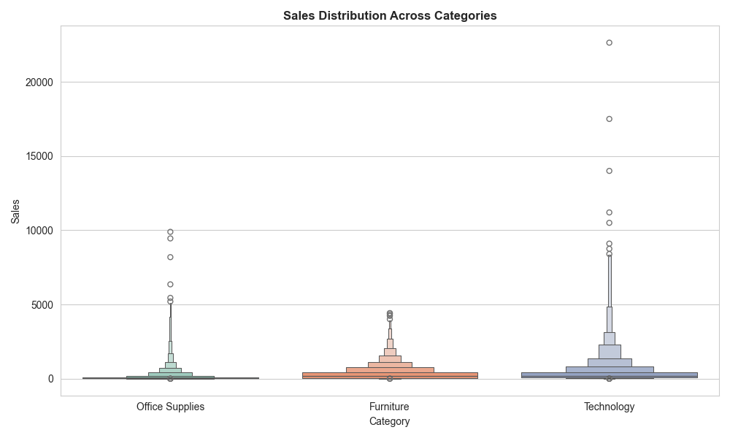
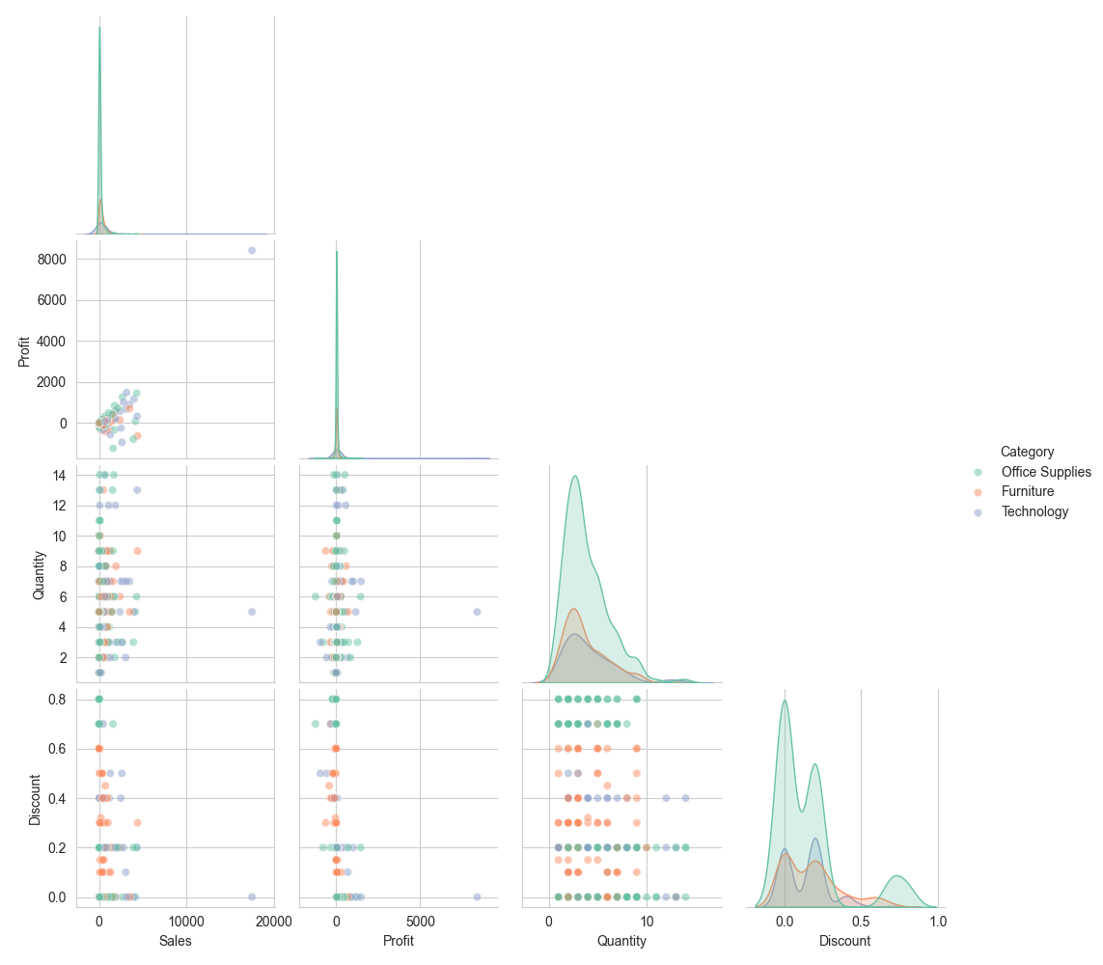
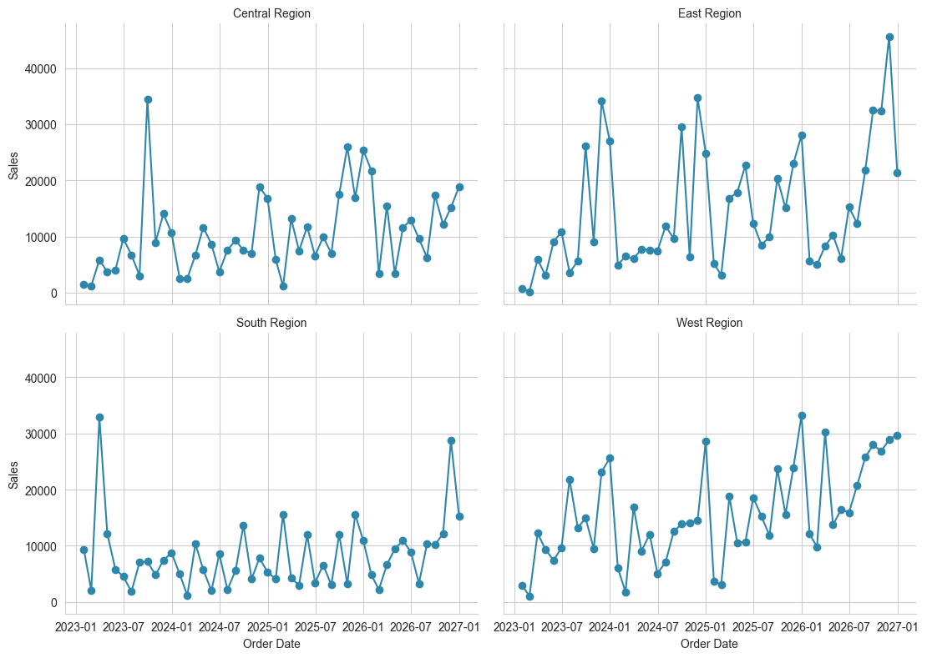
TASK 3: DATA VISUALISATION
Thirteen Plus Python Visualisations
Boxen plot: Sales distribution by category, showing spread and extremes.
Pairplot: Sales, Quantity, Discount, and Profit, coloured by category.
FacetGrid: monthly sales trend split by region.
Matplotlib covers line, bar, histogram, and scatter plots for core distributions and trends.
Seaborn adds heatmaps, pairplots, boxen plots, and FacetGrids for deeper multi-variable analysis.
Plotly delivers interactive charts, dropdown filters, and range sliders, exported as shareable HTML.
ApexPlanet Data Analytics Internship | Khushi Vig
9

Slide 10
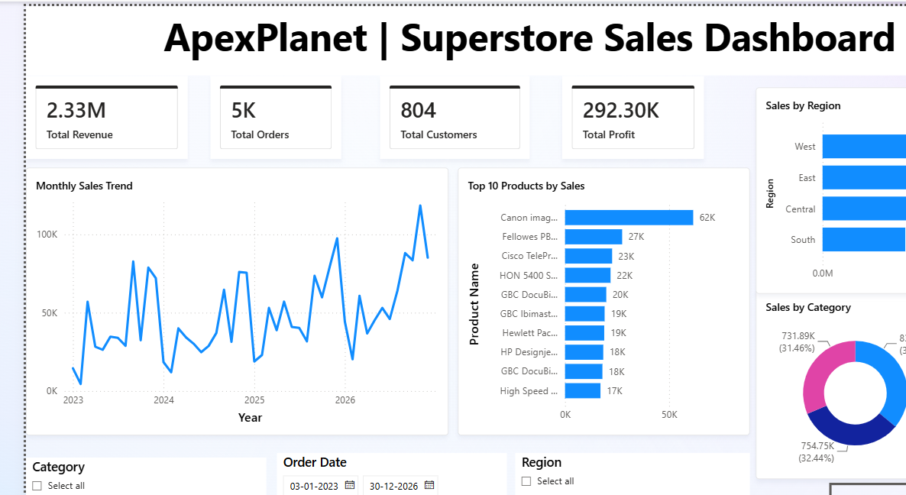
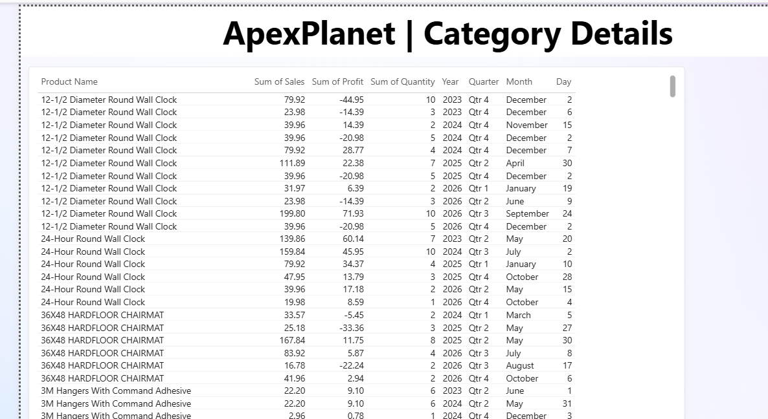
TASK 3: VISUALISATION AND DASHBOARDING
Executive Dashboard
Overview: KPI cards, monthly sales trend, category and region breakdown, top 10 products.
Category Details: product level detail reached by drilling through from the category donut chart.
4 KPI cards
Slicers & drill-through
Reset Filters bookmark
Page navigation
Revenue, orders, customers, profit at a glance.
Category, Region, Order Date; right-click any slice to drill in.
One click restores every slicer and filter to default.
Buttons move between Dashboard and Category Details.
ApexPlanet Data Analytics Internship | Khushi Vig
10

Slide 11
TASK 4: ADVANCED ANALYTICS
Descriptive Statistics and Correlation
DESCRIPTIVE STATISTICS
Sales is heavily right skewed (skewness 12.98); most orders are small, while a handful of large orders pull the average well above the median.
Profit shows extreme kurtosis (401.69): a sharp peak near zero with occasional large gains or losses.
Mean profit per order is $28.67, with a 95% confidence interval of $24.16 to $33.19, so the business is reliably profitable on average despite loss making orders.
CORRELATION VS CAUSATION
Discount and Profit correlate at r = -0.22 (p < 0.0001), a real but moderate relationship. This does not prove discounting causes losses; product category and seasonality are likely confounders behind the pattern.
Figure. Correlation matrix across Sales, Quantity, Discount, and Profit.
ApexPlanet Data Analytics Internship | Khushi Vig
11

Slide 12
TASK 4: ADVANCED ANALYTICS
Statistical and ML Results
73.9%
18.20%
5
0.53
Churn model accuracy
SARIMA forecast MAPE
Customer segments
R-squared, sales regression
Decision Tree
vs 28.39% for ARIMA
via RFM and K-Means
MAE $218.76
Forecast Error: ARIMA vs SARIMA (MAPE)
HYPOTHESIS TESTING
28.4%
T-test, West vs East profit: p = 0.67, no significant difference
Chi-square, Segment vs Region: p = 0.40, independent
ANOVA, Sales across regions: p = 0.60, no significant difference
18.2%
Regional and segment differences are not statistically significant; profitability is driven by discounting and category, not geography.
RFM SEGMENTS (K-MEANS, K = 5)
Top Tier (6.9%, +$2,329/cust.) · Core Active (30.9%) · Efficient Buyers (28.3%) · Discount Heavy (24.0%, -$182.60/cust.) · Lapsed (10.5%)
ARIMA
SARIMA
ApexPlanet Data Analytics Internship | Khushi Vig
12

Slide 13
FROM ANALYSIS TO ACTION
Business Recommendations
1
Tighten discount governance
Cap or add approval steps for discounts in the 0.5 to 0.8 range, the clearest and most consistent driver of unprofitability across every stage of analysis.
2
Investigate Furniture's margin gap
Furniture matches Technology and Office Supplies on sales volume but returns barely a tenth of their profit, pointing to a pricing or cost issue specific to the category.
3
Act on customer segments
Build a loyalty programme for the high value Top Tier segment; review discount eligibility for the loss making Discount Heavy segment.
4
Plan around confirmed seasonality
Staff and stock for the consistent November to December peak, and adopt SARIMA over ARIMA for operational forecasting given its materially lower error.
5
Keep pricing strategy national, not regional
Hypothesis testing found no statistically significant regional effect on profit or order value; regional revenue gaps are a volume story, not a pricing story.
ApexPlanet Data Analytics Internship | Khushi Vig
13

Slide 14
REFLECTIONS
Challenges and Learnings
CHALLENGES
LEARNINGS
Heavily right skewed Sales and high kurtosis Profit values made choosing between dropping and retaining outliers a genuine judgement call, not a mechanical step.
Correlation is a starting point, not a conclusion. Hypothesis testing (t-test, chi-square, ANOVA) was essential to confirm which patterns were real and which were noise.
With only around 48 months of data and a 12 month seasonal cycle, there were very few full cycles for SARIMA to learn from.
Seasonal models beat naive ones by a wide margin here: SARIMA cut forecast error by about 36 percent over plain ARIMA by capturing the yearly cycle.
The churn models reached reasonable accuracy but low recall, most true churners were not flagged, which meant learning to read a confusion matrix honestly rather than optimising for accuracy alone.
Behavioural segmentation (RFM) surfaces sharper, more actionable customer groups than demographic fields like Segment or Region ever did.
Keeping Python, SQL, and Power BI outputs consistent with one another as the cleaned dataset evolved required a disciplined, single source of truth workflow.
A dashboard is only as convincing as the narrative around it; pairing visuals with a written executive summary made the findings usable by a non technical audience.
ApexPlanet Data Analytics Internship | Khushi Vig
14

Slide 15
WHAT'S NEXT
Future Scope
1
Time aware churn features
2
More forecasting cycles
Move beyond static RFM snapshots to trend based, time aware features to improve the churn model's low recall.
Extend the SARIMA forecast as more historical data becomes available, and benchmark against Prophet or gradient boosted alternatives.
3
Full pipeline automation
4
Causal analysis of discounting
Automate extraction, cleaning, and KPI refresh end to end so the dashboard and models stay current without manual reruns.
Apply causal inference methods to the discount to profit relationship to move from correlation to a defensible estimate of its true margin impact.
ApexPlanet Data Analytics Internship | Khushi Vig
15

Slide 16
Thank You
45-day Data Analytics Internship completed at ApexPlanet Software Pvt. Ltd.
SARIMA FORECASTING · RFM CUSTOMER SEGMENTATION · POWER BI DASHBOARD · HYPOTHESIS TESTING
PREPARED BY
GITHUB REPOSITORY
LINKEDIN
Khushi Vig
github.com/KhushiVig/apexplanet-data-analytics
linkedin.com/in/khushi-vig
Submitted as the Task 5 deliverable for the ApexPlanet Data Analytics Internship Programme 2026.

