Slide 1
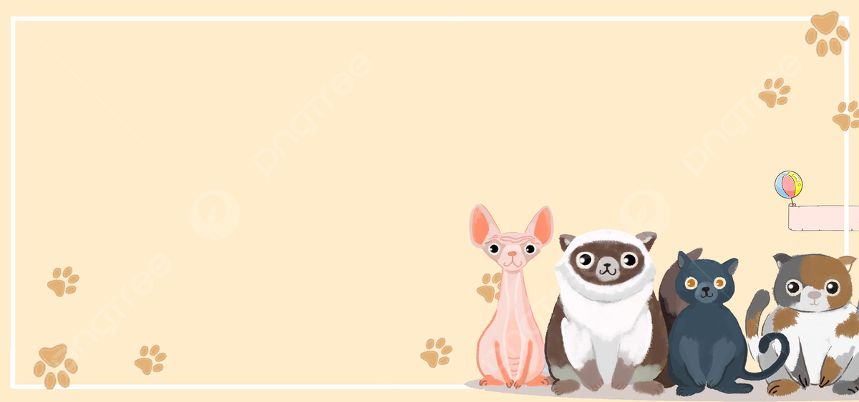
PET ADOPTION WEBSITE
SNOUTIFY

Slide 2
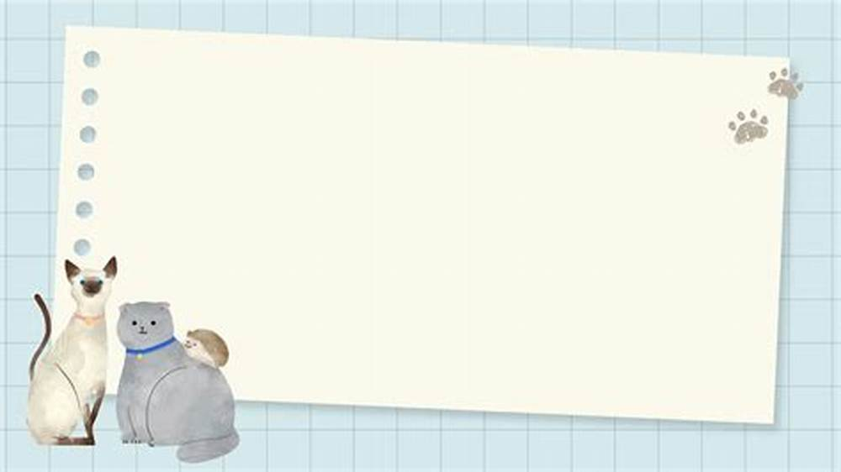
SUBMITTED BY:-
KHUSHI (2310992122)
RIYA SHARMA (2310992133)
VANSHIKA SARDANA (2310992171)
SUBMITTED TO:-

Slide 3

INTRODUCTION
What is the project about?
A user-friendly Pet Adoption Website that allows people to browse pets, fill out adoption forms, and track adoption requests.
Why did I choose this project?
To help pet lovers easily find and adopt pets.
To practice full-stack web development using HTML, CSS, JavaScript, Node.js, and EJS.

Slide 4
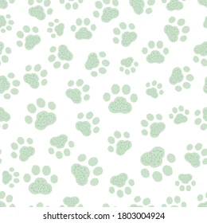
PROBLEM STATEMENT
Problems faced in pet adoption:
Lack of online platforms for pet adoption.
People don’t know where to find pets.
Difficulties in tracking adoption requests.
Solution:
Create a simple, easy-to-use website for pet adoption.

Slide 5
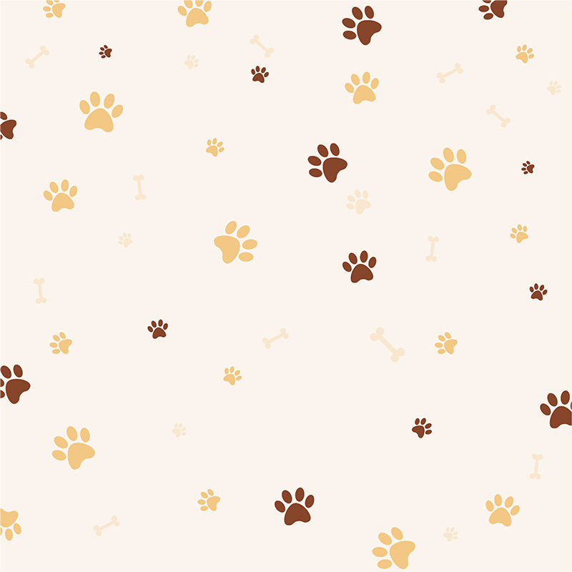
FEATURES OF THE WEBSITE
Key Features: ✅ Home Page – Introduction & Navigation ✅ Pet Listing Page – Displays available pets ✅ Adoption Form – Users can submit adoption requests ✅ User Dashboard – Tracks adopted pets
✅ Chatbot – Interactive chatbot to assist users with adoption queries
📌 Additional Features:
Responsive Design
Form Validation

Slide 6
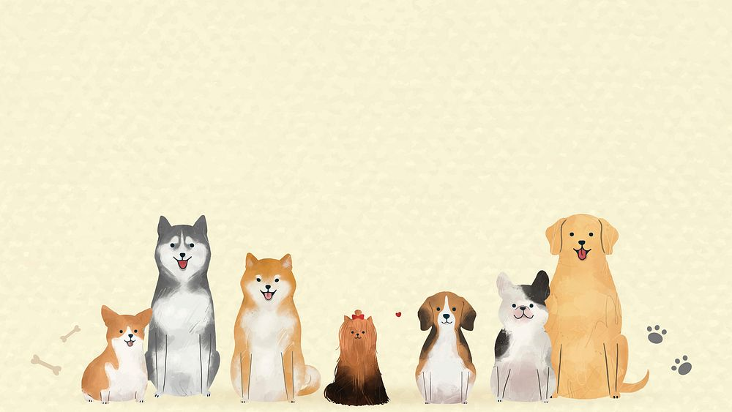
TECHNOLOGY STACK
💻 Frontend:
HTML
CSS
JavaScript
⚙️ Backend:
Node.js
Express.js
EJS (Embedded JavaScript)

Slide 7
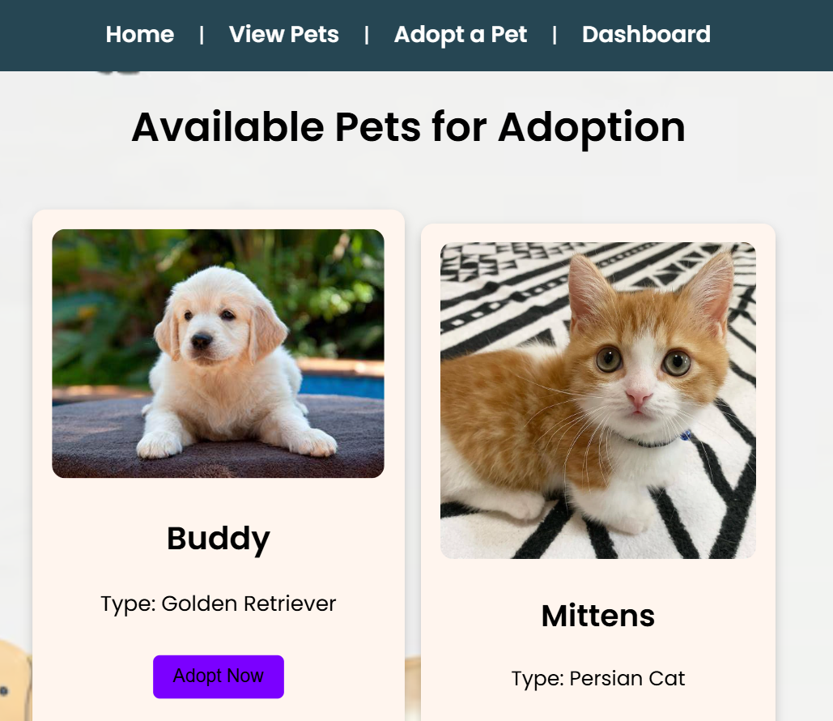
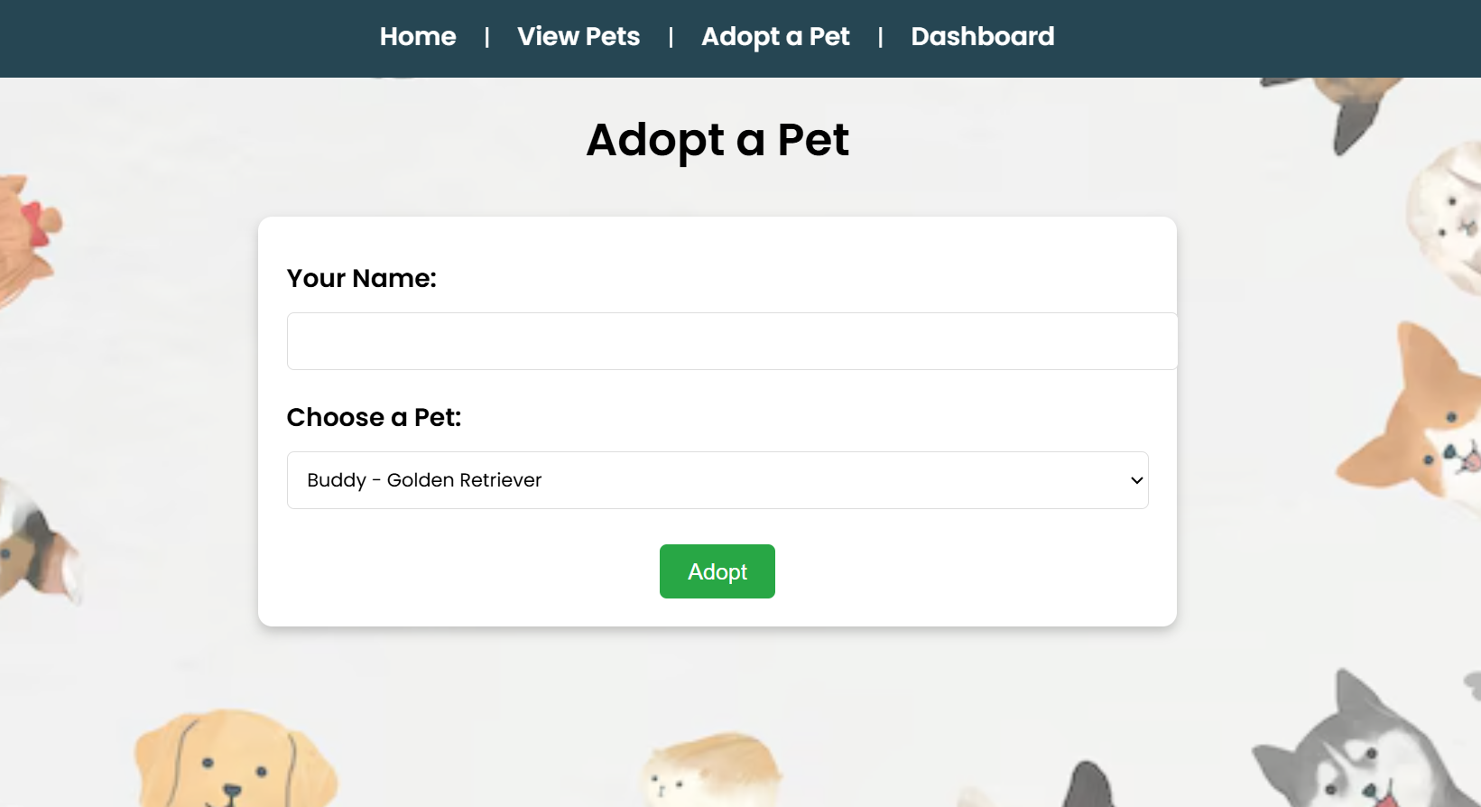
SCREENSHOTS

Slide 8
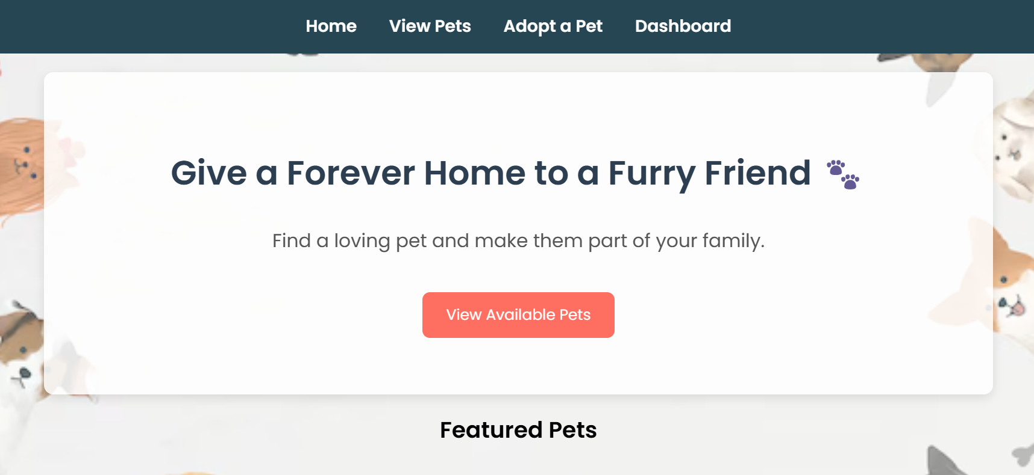
SCREENSHOTS

Slide 9
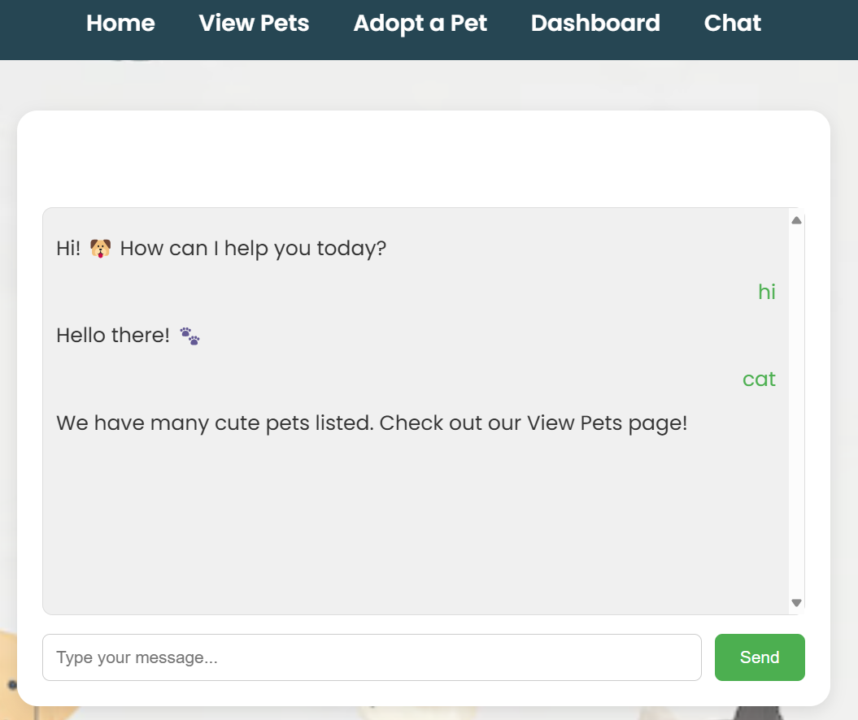
SCREENSHOTS

Slide 10
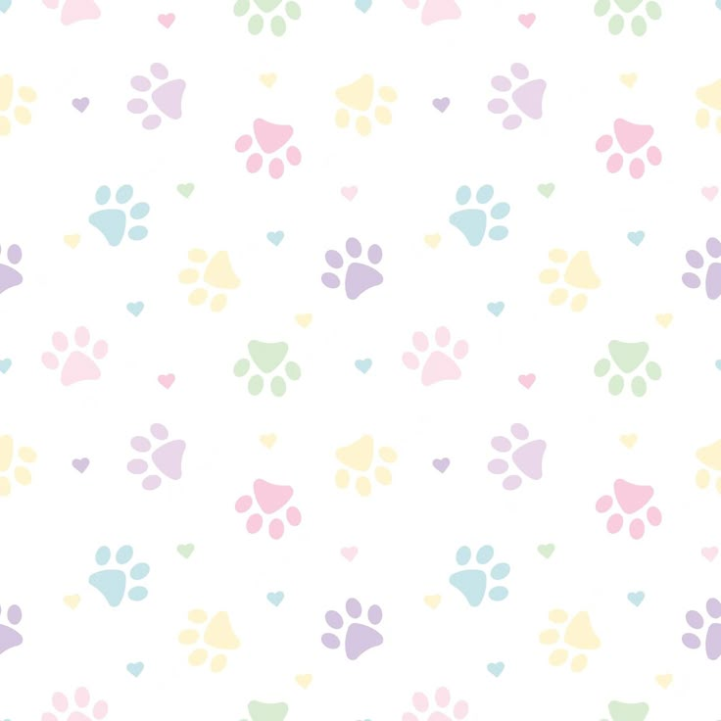
CHALLENGES & LEARNINGS
🚨 Challenges faced:
Setting up Node.js and Express.js
Handling form submission & routing
Fixing server errors & debugging
🎓 Key Learnings:
How to build a full-stack website
How to use EJS for dynamic pages
Importance of UI/UX design in web development
How to handle errors effectively
How to use third-party middleware for added functionality

Slide 11
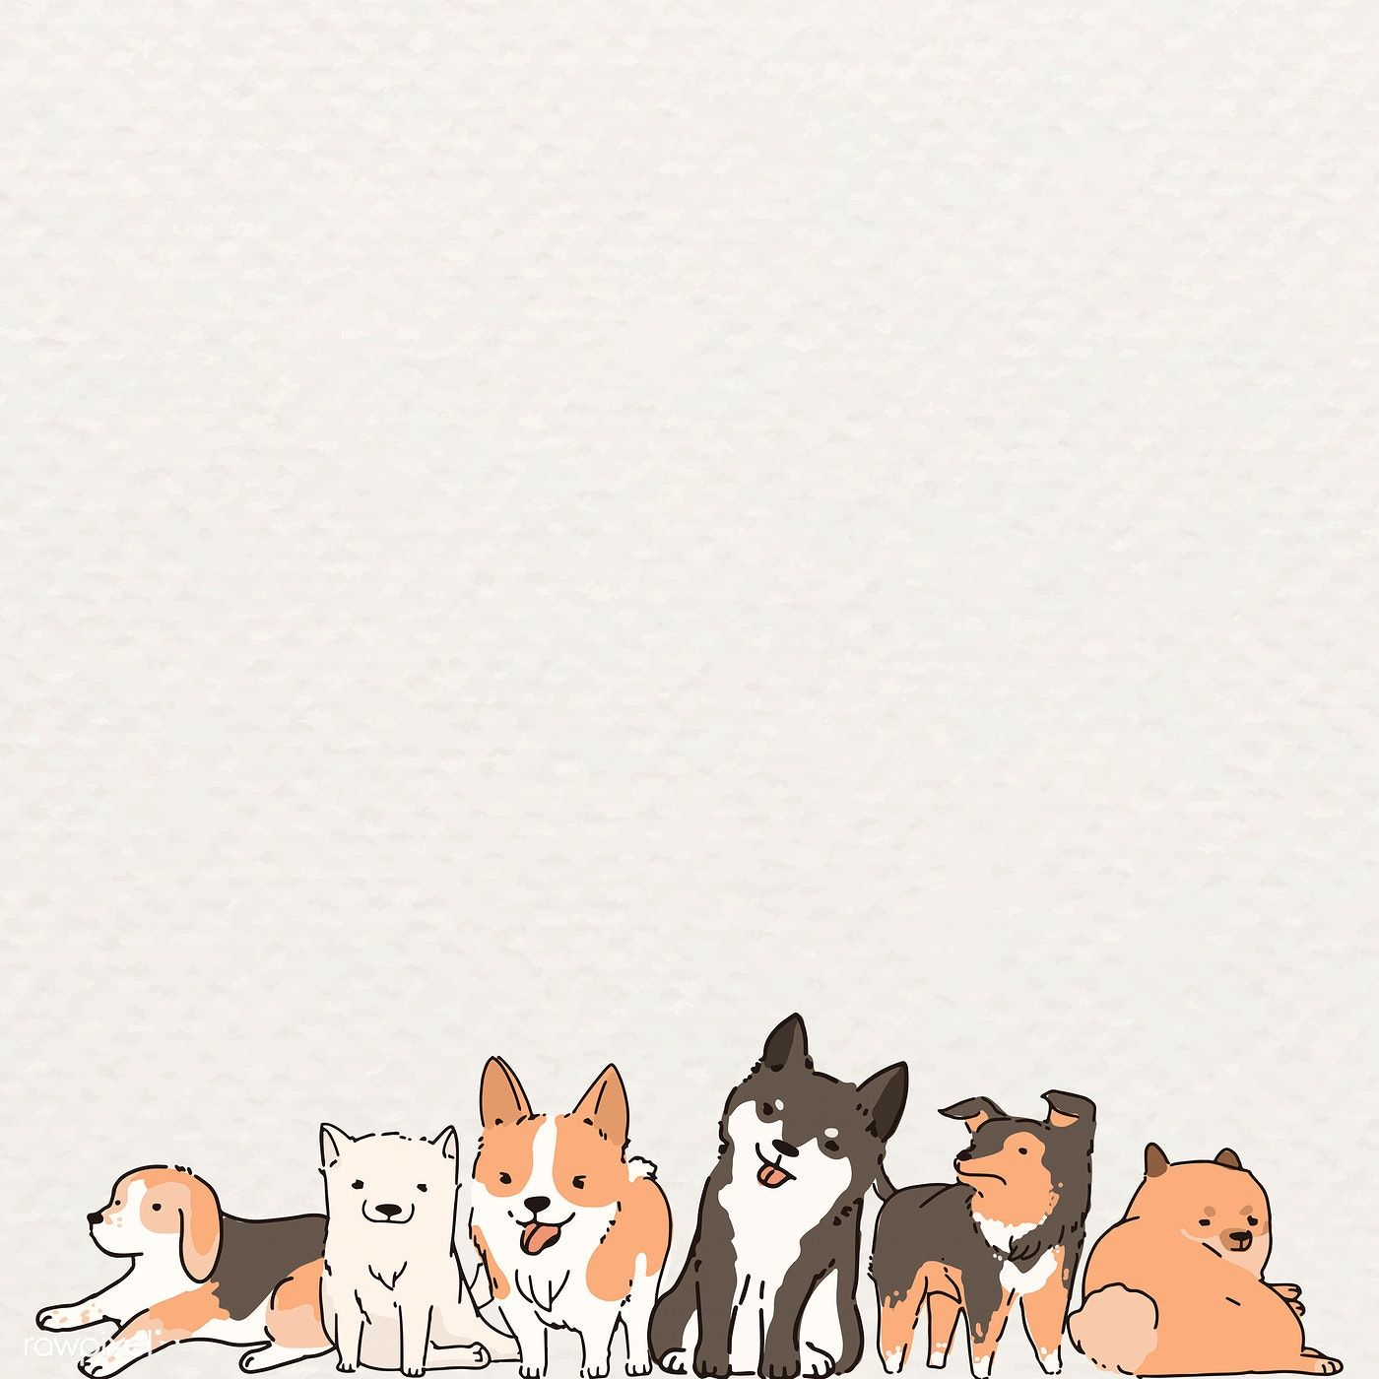
FUTURE ENHANCEMENT
🔹 Possible Improvements: ✅ User Authentication – Allow users to register & login ✅ Admin Panel – Manage pets & users ✅ Database Integration – Store adoption requests

Slide 12
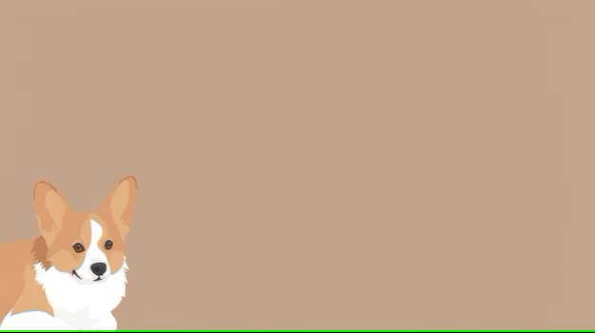
CONCLUSION
📌 Final Thoughts:
This project solves a real-world problem by making pet adoption easy.
It helped me learn web development & backend integration.

Slide 13


