Slide 1
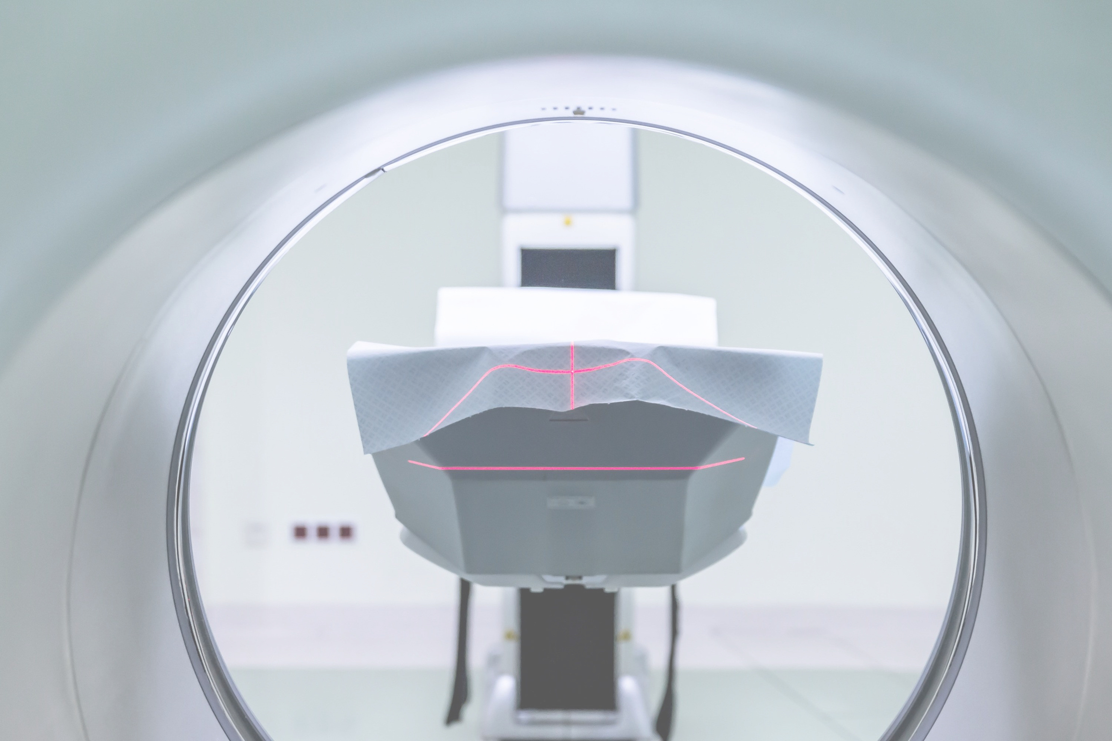
Multi-Modal Deep Learning Framework for Intelligent Knee MRI Diagnosis and Clinical Decision Support
An AI-based framework integrating MRI analysis, tabular learning, temporal risk prediction and grounded report generation
Notes:
1

Slide 2

Problem Statement & Motivation
Diagnostic Complexity
Knee MRI interpretation involves complex volumetric information across multiple slices and planes.
CORE OBJECTIVE
The proposed framework integrates MRI diagnosis with tabular context, temporal modelling, and grounded reporting to support clinical research and decision-making.
ACL Variability
Abnormalities vary in appearance, making single-view reasoning insufficient for robust diagnosis.
Beyond Classification
A useful AI system should provide clinical context and grounded reasoning, not just a label.
Notes:
2

Slide 3

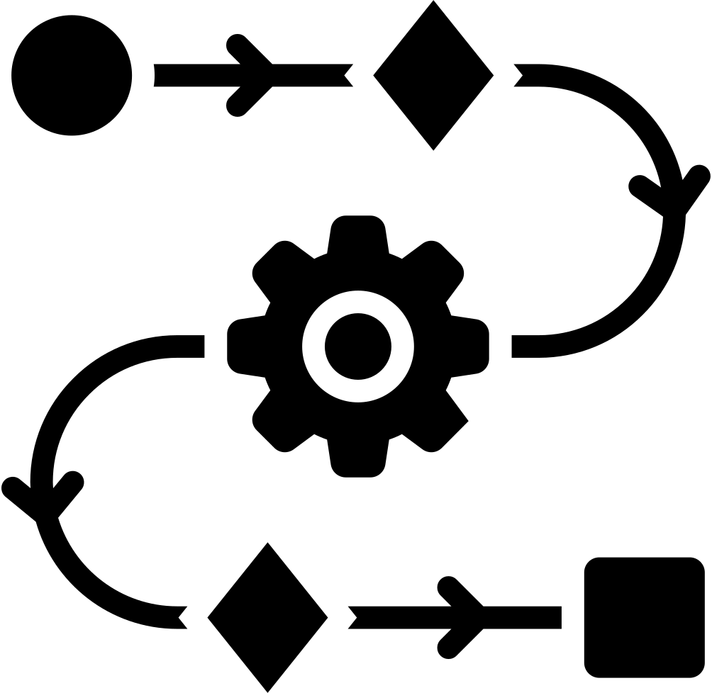
Project Objectives: Five Modules, One Framework
01
ANN / MLP
Establish a tabular-feature baseline for abnormality classification using structured clinical data.
02
ROBUST TRAINING PIPELINE
Standardize MRI preprocessing, augmentation, and regularization for model stability.
03
CNN / TRANSFER LEARNING
Detect ACL abnormalities from MRI volumes using deep learning and volume-level predictions.
04
LSTM / GRU
Model longitudinal risk and recovery trajectories based on temporal patient history.
05
GROUNDED LLM
Convert structured findings into clinical radiology-style reports for decision support.
Notes:
3

Slide 4


Dataset Landscape Requires Deliberate Separation
DATA SOURCE
ROLE IN FRAMEWORK
KEY INFORMATION
KneeMRI Dataset
MRI Diagnosis & EDA
917 knee MRI volumes; 3 classes (Healthy, Partial, Complete); ROI information available.
MRNet
CNN Benchmark
1,370 knee MRI exams across sagittal, coronal, and axial planes; established training corpus.
OAI
Tabular & Longitudinal
Real longitudinal clinical data: Age, BMI, KL Grade, WOMAC, and activity levels.
RSNA Challenge 2026
Report Grounding
4,407 multilingual radiology reports; 58 studies with structured finding labels for validation.
INTEGRATED DATA FLOW
MRI → CNN
Clinical/Tabular → ANN
Longitudinal → LSTM
Reports → LLM Grounding
Note: Datasets serve distinct modular purposes and are not silently mixed during training or evaluation.
Notes:
4

Slide 5
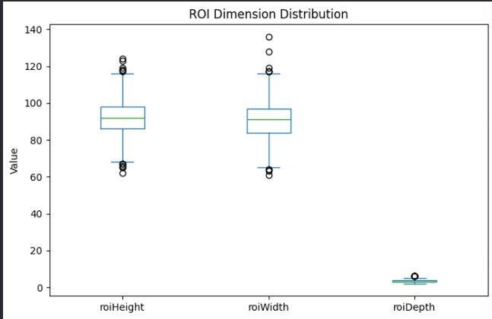
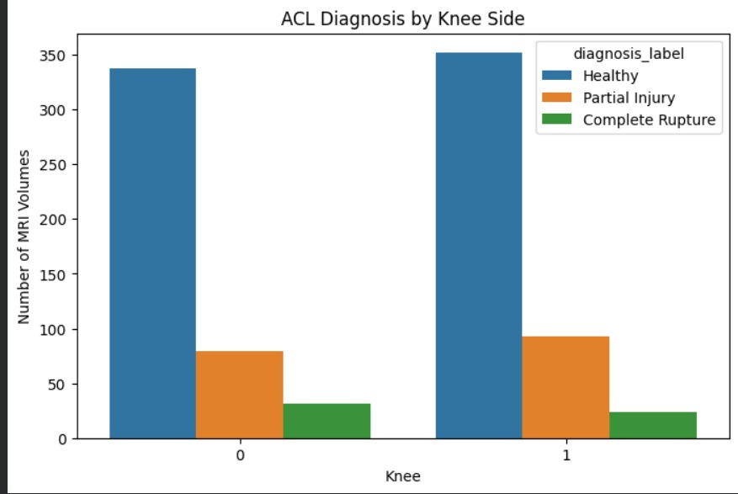
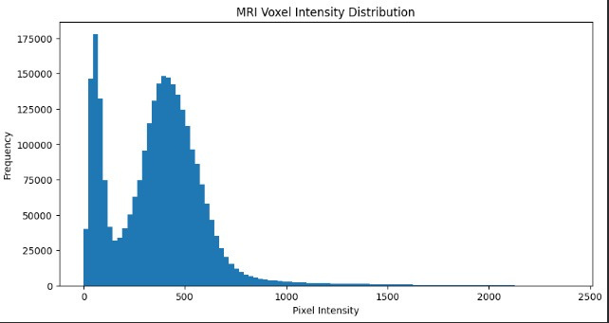
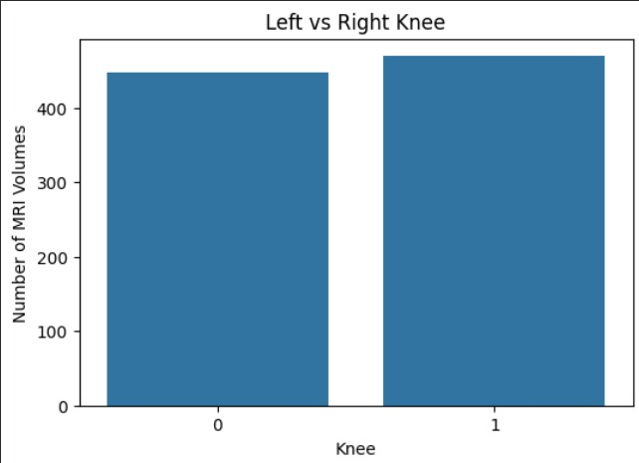
Preliminary MRI Dataset Analysis
MRI volumes contain variable slice and depth dimensions across the dataset.
ROI height and width cluster around similar ranges, with identifiable outliers.
Balanced representation of both left and right knee sides.
Voxel-intensity distribution is highly non-uniform, requiring normalization.
Dataset covers three distinct ACL diagnosis categories for classification.
Notes:
5

Slide 6
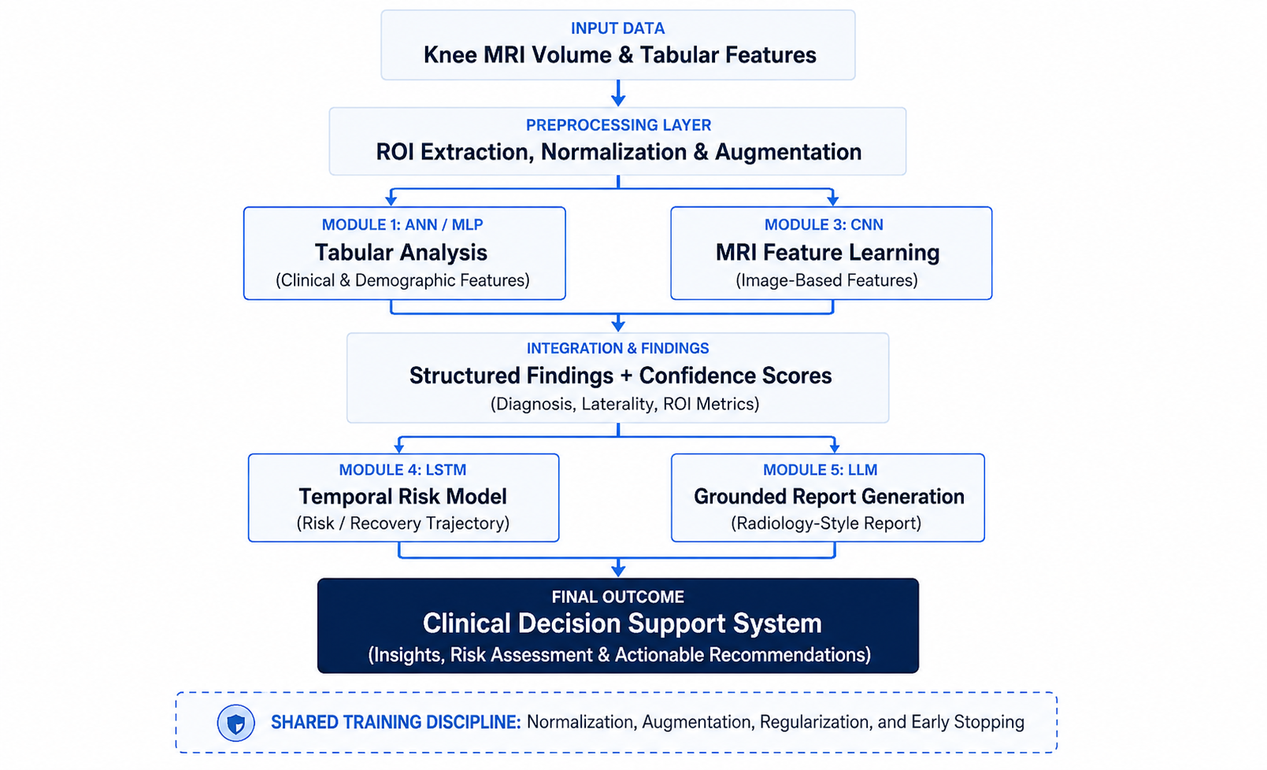
Proposed System Architecture
Notes:
6

Slide 7
Module 1 — Baseline ACL Classification
INPUT FEATURES (TABULAR)
PROPOSED PIPELINE
Demographics: Age, Sex, BMI
Clinical History: Prior injury/surgery
Tabular Data
→
Feature Engineering
Scaling
→
ANN / MLP Model
Symptoms: Duration and severity
Output
→
3 ACL Classes
Clinical Scores: KL grade, WOMAC
EVALUATION METRICS
Activity: Physical activity level
Context: CNN-derived probabilities
CLASSIFICATION
STATISTICAL
Precision, Recall, F1-score
ROC-AUC, Confusion Matrix
Note: Logistic regression is utilized as a baseline to establish a performance floor, justifying the transition to a multi-layer perceptron (MLP) architecture.
Notes:
7

Slide 8

Modules 2 & 3 — MRI Preprocessing and CNN-Based Detection
MODULE 2: PREPROCESSING WORKFLOW
MODULE 3: CNN-BASED DETECTION
Slice Extraction
Feature Extraction
Processing MRI volumes across Sagittal, Coronal, and Axial planes.
Deep CNN backbones capturing complex spatial ACL patterns.
ROI Localization
Transfer Learning
Targeted cropping to ACL regions to minimize background noise.
Fine-tuning ResNet, DenseNet, or EfficientNet architectures.
Normalization
Volume-Level Prediction
Intensity scaling and spatial resizing to uniform tensor dimensions.
Aggregating slice-level probabilities for final diagnosis.
TRAINING CONTROLS
PLANNED MODELS
DROPOUT
WEIGHT DECAY
BATCH NORM
EARLY STOPPING
RESNET-50
DENSENET-121
EFFICIENTNET-B0
EXPLAINABILITY
Grad-CAM Integration: Visualizing informative regions by mapping CNN gradients back to the original MRI slice for clinical transparency.
Notes:
8

Slide 9

Module 4 — Longitudinal Risk and Recovery Modelling
DATA CONSTRAINTS & STRATEGY
PROPOSED TEMPORAL PIPELINE
Primary Limitation: The KneeMRI dataset lacks longitudinal recovery outcomes for ACL injuries.
t
₀
→
t
₁
→
t
₂
→
t
n
OAI Integration: Utilizing the Osteoarthritis Initiative (OAI) for its robust repeat-visit temporal structure.
Sequence Modelling
Simulation Layer: Injury-specific recovery labels may require a separately constructed or simulated layer for training.
Implementation of LSTM or GRU architectures to capture dependencies across patient history and clinical visits.
Transparency: Any synthetic components will be explicitly identified as such in the final framework.
Risk Trajectory
Predicting the probability of future joint degradation or successful recovery based on multimodal inputs.
Current Status: Planned modelling component; no real-world ACL recovery prediction is claimed at this stage.
Notes:
9

Slide 10

Module 5 — AI-Assisted Radiology Report Generation
GROUNDING SOURCE: RSNA 2026
PROPOSED GENERATION PIPELINE
Utilizing 4,407 real multilingual radiology reports to establish clinical tone and terminology.
1
MRI Volume Input
58 structured-label records serve as a high-fidelity validation key for report-to-finding extraction.
2
CNN Diagnosis & Confidence
SAFETY & GROUNDING PRINCIPLE
3
Structured Findings Extraction
The LLM is restricted to generating language from structured findings only. It is strictly prohibited from inventing medical observations not present in the upstream CNN/ANN output.
4
Grounded LLM Reasoning
DATA HANDLING
5
Preference for local/open-weight models (e.g., Llama-3, Mistral) to ensure data privacy and avoid unresolved API data-use considerations.
Radiology-Style Report
Notes:
10

Slide 11

Integration, Evaluation & Expected Outcome
INPUT
→
MODULE 2/3
→
MODULE 4
→
MODULE 5
→
OUTPUT
MRI UPLOAD
CNN DIAGNOSIS
TEMPORAL RISK
GROUNDED LLM
CLINICAL REPORT
EVALUATION PLAN
CRITICAL LIMITATIONS
Classification: Precision, Recall, F1, and ROC-AUC for all diagnostic modules.
Longitudinal injury-recovery labels are not directly available in primary datasets.
Explainability: Grad-CAM visualization for CNN decision transparency.
RSNA structured labels cover only a small subset for report validation.
Intended for research and decision support, not autonomous diagnosis.
Language: Factual consistency and clinical tone assessment for LLM reports.
Temporal: Trajectory prediction accuracy for risk/recovery modelling.
EXPECTED OUTCOME
A unified, modular and explainable multimodal AI framework for knee MRI analysis and clinical decision support.
Notes:
11

