Slide 1
Automatic Number Plate Recognization Project ID: PCSE23-74 Mentor: Vipin Devgal

Slide 2
Project Members
CSE – 4th year
1. KHUSHI GUPTA (1900290100079)
2. SARAH HANDU (1900290100133)

Slide 3
Content
Background/Problem Statement
System Requirements
Working of the Project
Advantages
System Description
Limitation/Disadvantages
Application
Progress

Slide 4
Background/Problem Statement
Traffic control and vehicle owner identification have become a major problem in every country. Sometimes, it becomes difficult to identify vehicle owner who violates traffic rules and drives too fast.
Therefore, it is not possible to catch and punish those kinds of people because the traffic personnel might not be able to retrieve the vehicle number from the moving vehicle because of the speed of the vehicle. Therefore, there is a need to develop the system as one of the solutions to this problem.
Our Detect and Recognize Vehicle License Plate will detect the license plate from an image and video. It can also detect in real-time using OpenCV and Generative Adversarial Network. The user will just need to upload an image or video from their device.

Slide 5
System Requirements
Hardware Requirement
Windows 7 or higher
I3 processor system or higher
4 GB RAM or higher
100 GB ROM or higher
Software Requirements
Python
Jupyter Notebook

Slide 6
Working of the Project
This system will detect and recognize vehicle license plates from a user’s uploaded file. The system can also detect vehicle number plates in real-time, by just clicking on the device’s camera.
The system will detect and recognize the license plate and if it’s been detected, it will be displayed to the user using OpenCV, Optical Character Recognition(OCR) and Generasive Adversarial Network(GAN) is used to detect images.
OCR is a python package that allows the image to be converted to text.

Slide 7
Working of the Project
Image Capture (Choosing HDR camera and maintaining proper angle)
Preprocessing (Using OpenCV)
Number Plate Extraction (GAN)
Character Segmentation and Character Recgnition (OCR)

Slide 8
Advantages
It is easy to maintain.
It is user-friendly.
The system will automatically detect and recognize the license plate.
It can detect vehicle license plates from an image and videos.
It can also detect in real-time.

Slide 9
Limitation/Disadvantages
Application
The system might not be able to detect vehicle license plates if there’s a dim light environment while capturing.
This application detects and recognizes the vehicle number plate automatically.
We can add many upcoming features to support traffic control.

Slide 10
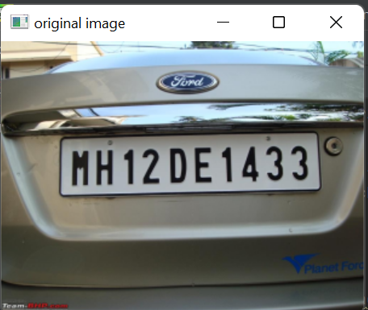
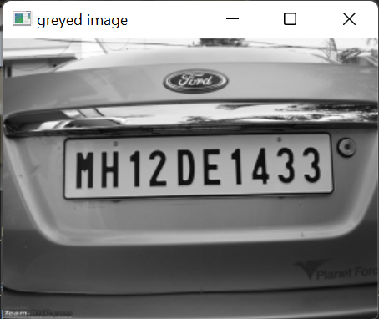
Progress:

Slide 11
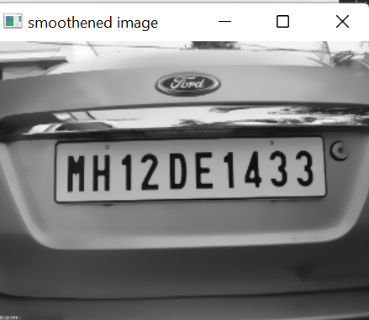
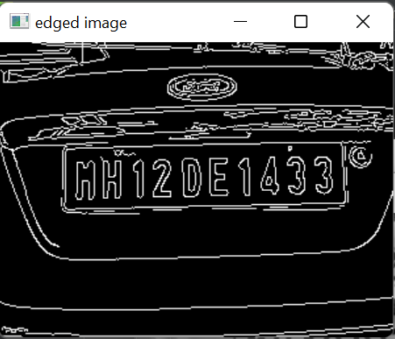
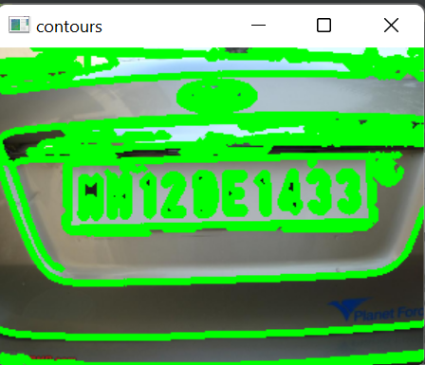
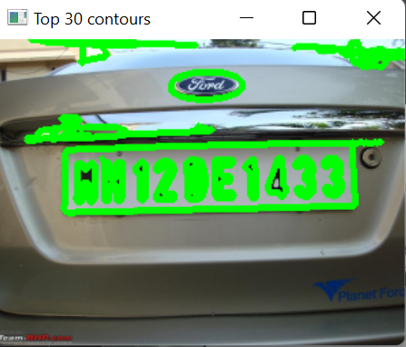
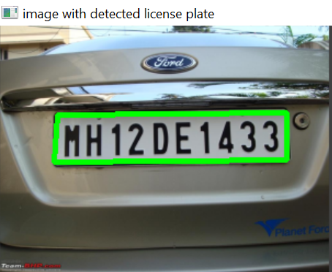
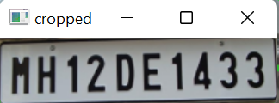

Slide 12
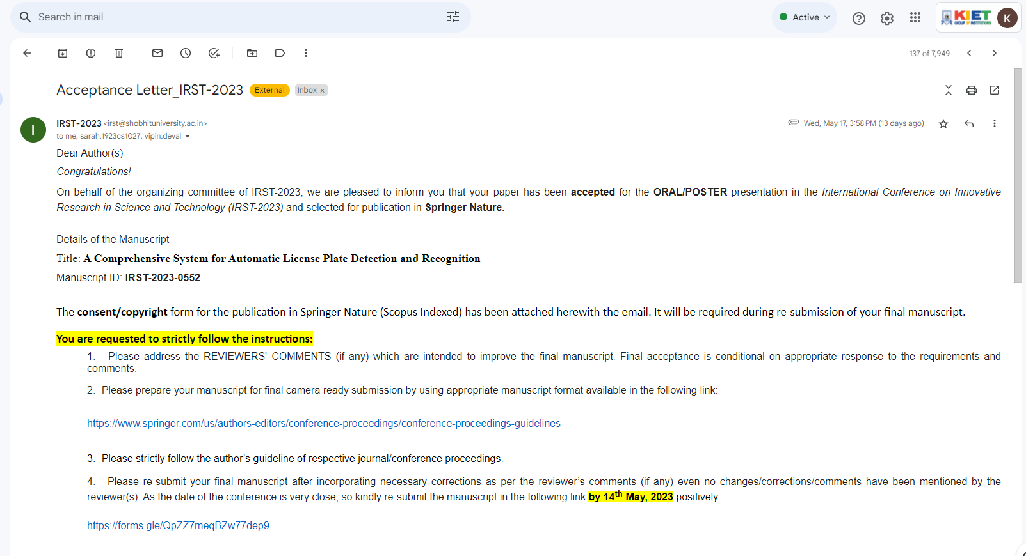
Research Paper:

Slide 13
THANK YOU

