Slide 1

AI-Driven Intelligent Network
for Smart Campus Applications
Course: Computer Networks
Course Code: __________________
Faculty: Ms. Pragya Vats
Group Members: Khushi Malani, Krishna Shah, Nirali Kodavala, Mansoor Anas
WI-FI AP
CLASSROOM
LMS SERVER
AI CORE
LIBRARY
IoT NODES
CCTV

Slide 2

PROJECT OVERVIEW
1. Smart campus network problem
2. Cisco Packet Tracer network topology
3. Python-based traffic simulation and feature engineering
4. ML models: Naive Baseline, Linear Regression, Random Forest and Isolation Forest
5. Evaluation, findings, limitations and future scope

Slide 3
What is this project about?
Project purpose
Study how AI can analyse campus network traffic, forecast bandwidth demand and flag unusual usage.
Networking link
Connects campus devices through a simulated network topology using core networking concepts.
Prototype output
Bandwidth predictions, anomaly alerts, evaluation metrics and saved result graphs.
COMPUTER NETWORKS | SMART CAMPUS MINI PROJECT

Slide 4
Introduction to Smart Campus Networks
Why do campuses need intelligent networks?
Smart campus
Classrooms, library, labs, CCTV, IoT devices and servers use shared network resources.
Network challenge
High user activity and simultaneous services can increase bandwidth demand and congestion.
AI opportunity
Traffic patterns can be analysed to forecast bandwidth demand and identify unusual activity.
COMPUTER NETWORKS | SMART CAMPUS MINI PROJECT

Slide 5
Problem Statement
The challenge we want to solve
Problem
A growing number of campus devices and applications increases network load and makes monitoring harder.
Need
A data-driven approach that can estimate upcoming bandwidth demand and flag suspicious traffic patterns.
Project scope
Packet Tracer topology simulation and a separate Python ML prototype using simulated traffic data.
COMPUTER NETWORKS | SMART CAMPUS MINI PROJECT

Slide 6
Aim and Objectives
Project goals
Aim
Develop and study an AI-driven smart-campus network prototype using network simulation and machine learning.
Objective 1
Create simulated hourly campus traffic data and prepare useful traffic features.
Objective 2
Compare bandwidth prediction models and detect unusual traffic using Isolation Forest.
Objective 3
Evaluate models using regression metrics and present results through graphs and CSV files.
COMPUTER NETWORKS | SMART CAMPUS MINI PROJECT

Slide 7
Existing System and Limitations
Traditional monitoring approaches
Traditional approach
Fixed bandwidth allocation, rule-based monitoring and manual inspection of network activity.
Limitations
Manual monitoring can be time-consuming and may not anticipate changes in traffic demand.
Balanced view
ML predictions can be inaccurate; alerts and proposed actions should be reviewed by a network administrator.
COMPUTER NETWORKS | SMART CAMPUS MINI PROJECT

Slide 8
Proposed AI-Driven Network
Machine-learning workflow
Input
Simulated hourly user-count and bandwidth data representing campus network activity.
Preparation
Handle lag features, prepare inputs and split the time series chronologically.
Prediction
Random Forest and Linear Regression forecast bandwidth; Isolation Forest flags anomalies.
Output
Save predictions, evaluation metrics and graphs; QoS changes remain proposed administrator actions.
COMPUTER NETWORKS | SMART CAMPUS MINI PROJECT

Slide 9
Computer Networks Concepts Used
Connection to the five syllabus units
Unit I – Application Layer
Campus portal, LMS, DNS and web-based learning services.
Unit II – Transport Layer
TCP/UDP traffic, ports, congestion, throughput and latency.
Unit III – Network Layer
IP addressing, subnetting and routing between campus segments.
Unit IV – Data Link Layer
Ethernet switching, Wi-Fi access and device connectivity.
Unit V – Network Security
Traffic monitoring, unusual-activity detection and security awareness.
COMPUTER NETWORKS | SMART CAMPUS MINI PROJECT

Slide 10
System Architecture
Proposed architecture and prototype workflow
1. Network layer
Campus devices connect through the Packet Tracer network topology.
2. Traffic data
Python prototype simulates hourly users and bandwidth; lag features are derived.
3. AI engine
Random Forest / Linear Regression predict bandwidth; Isolation Forest detects anomalies.
4. Results layer
Metrics and graphs are generated for analysis; automatic SDN/QoS control is future work.
COMPUTER NETWORKS | SMART CAMPUS MINI PROJECT

Slide 11
Dataset and Campus Traffic Features
Simulated campus traffic dataset
Dataset
60 days of hourly simulated traffic (1,440 initial records); no live campus logs are used.
Features
Hour, day of week, active users, bandwidth, previous-hour bandwidth, previous-day bandwidth and previous-hour users.
Anomaly labels
24 artificial bandwidth spikes are inserted to test anomaly detection.
Data split
Lag features are created, missing initial rows are removed, then data is split chronologically (75% train / 25% test).
COMPUTER NETWORKS | SMART CAMPUS MINI PROJECT

Slide 12
AI/ML Algorithm and Methodology
Models used in the prototype
Prediction model
Random Forest Regressor predicts bandwidth using historical traffic features.
Baseline comparison
Naive previous-day forecast and Linear Regression are compared with Random Forest.
Anomaly detection
Isolation Forest identifies unusual combinations of active users and bandwidth.
Evaluation
MAE, RMSE and R² for prediction; precision and recall for anomaly detection.
COMPUTER NETWORKS | SMART CAMPUS MINI PROJECT

Slide 13
Tools and Technologies
Tools used in the project
Programming language
Python for simulated traffic generation and ML implementation.
Python libraries
NumPy, Pandas, Scikit-learn and Matplotlib.
Outputs
Terminal metrics, CSV result files and Matplotlib graphs (no live dashboard is claimed).
Network simulation
Cisco Packet Tracer is used to build and test the campus network topology.
COMPUTER NETWORKS | SMART CAMPUS MINI PROJECT

Slide 14
Implementation and Working
Implemented workflow: Packet Tracer + Python
Step 1 – Network
Build the campus topology in Cisco Packet Tracer using network devices and end systems.
Step 2 – Dataset
Generate 60 days of hourly simulated user-count and bandwidth data in Python.
Step 3 – Preparation
Create lag features, remove initial missing rows and use a chronological 75:25 split.
Step 4 – Models
Train Naive / Linear Regression / Random Forest prediction approaches and Isolation Forest.
Step 5 – Evaluation
Calculate metrics and save prediction, feature-importance and anomaly graphs. QoS automation is future work.
COMPUTER NETWORKS | SMART CAMPUS MINI PROJECT

Slide 15
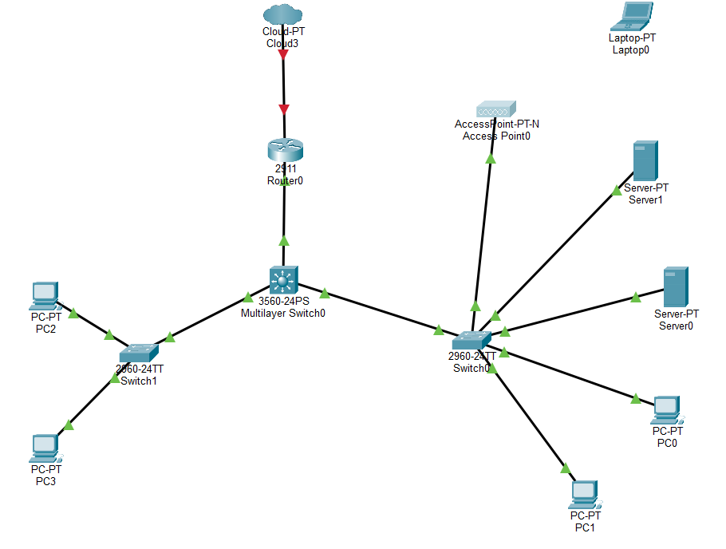
Cisco Packet Tracer: Network Topology
Campus network topology built in Cisco Packet Tracer
Complete topology
Network path
Cloud3 connects to Router0 (Cisco 2911).
Router0 connects to the 3560-24PS multilayer switch.
The multilayer switch links the two access switches, Switch0 and Switch1 (both 2960-24TT).
End devices
Switch0: Access Point0, Server0, Server1, PC0 and PC1.
Switch1: PC2 and PC3.
COMPUTER NETWORKS | SMART CAMPUS MINI PROJECT

Slide 16
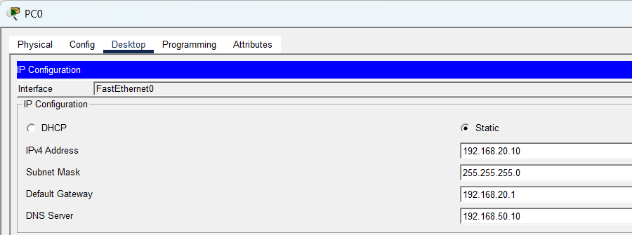
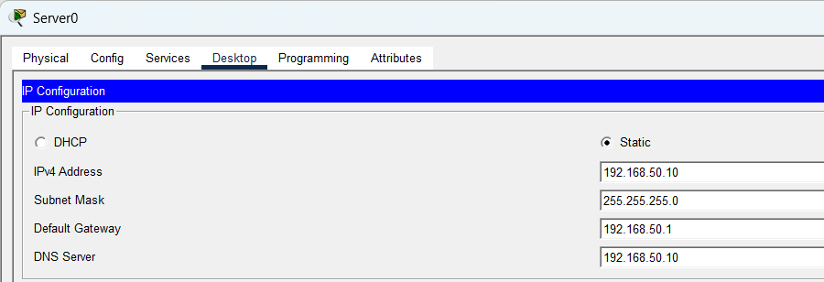
Cisco Packet Tracer: IP Configuration
PC0 and Server0 use static addresses in two different /24 subnets, each with its own default gateway
PC0
Server0
IPv4 address: 192.168.20.10, mask 255.255.255.0 (/24)
Default gateway: 192.168.20.1
DNS server: 192.168.50.10 (Server0)
IPv4 address: 192.168.50.10, mask 255.255.255.0 (/24)
Default gateway: 192.168.50.1
DNS server: 192.168.50.10 (itself)
Subnet 192.168.20.0/24
Subnet 192.168.50.0/24
COMPUTER NETWORKS | SMART CAMPUS MINI PROJECT

Slide 17
Results and Performance Metrics
Reported results from the revised project report
Naive baseline
MAE 101.6 Mbps | RMSE 155.1 Mbps | R² −0.12
Linear Regression
MAE 48.3 Mbps | RMSE 80.9 Mbps | R² 0.69
Random Forest
MAE 42.0 Mbps | RMSE 76.9 Mbps | R² 0.72
Isolation Forest
14 test-period alerts; 7 injected spikes found | Precision 0.50 | Recall 1.00
Key finding
Random Forest has the lowest reported prediction error. Recall 1.00 means all 7 inserted test anomalies were detected.
COMPUTER NETWORKS | SMART CAMPUS MINI PROJECT

Slide 18
Advantages, Limitations and Applications
Benefits and limitations of the prototype
Advantages
Compares traffic forecasting methods and demonstrates anomaly detection on simulated campus traffic.
Limitations
Uses simulated data; results may differ on real networks. False-positive anomaly alerts occur.
Applications
The proposed design can support planning for classrooms, hostels, libraries, labs and campus services.
Implementation boundary
Packet Tracer simulation and Python ML analysis are separate prototypes, not a live integrated system.
COMPUTER NETWORKS | SMART CAMPUS MINI PROJECT

Slide 19
Conclusion and Future Scope
What has been demonstrated and what comes next
Conclusion
The project demonstrates a simulated campus network topology and a Python ML prototype for bandwidth prediction and anomaly detection.
Future scope 1
Connect authorised real network-flow data to the prediction pipeline.
Future scope 2
Explore SDN/QoS integration after controlled testing and administrator approval.
Future scope 3
Build a dashboard, reduce false positives and evaluate on larger real-world datasets.
COMPUTER NETWORKS | SMART CAMPUS MINI PROJECT

Slide 20
References
References and implementation resources
Networking textbook
Kurose, J. F. and Ross, K. W., Computer Networking: A Top-Down Approach.
ML documentation
Scikit-learn User Guide: RandomForestRegressor, IsolationForest and model evaluation.
Network simulation
Cisco Packet Tracer documentation / learning resources used for the topology.
Project materials
Add the exact URLs, access dates and versions of the resources actually consulted by the team.
COMPUTER NETWORKS | SMART CAMPUS MINI PROJECT

