Slide 1

Mobile App Signup Flow
UI/UX Internship Project
[Khushi Kundariya]
UI/UX INTERNSHIP
2026

Slide 2

Problem Statement
Users frequently abandon the signup process before completing registration. A confusing, slow, or insecure experience directly impacts user acquisition and retention.
Long Forms
Excessive input fields overwhelm users and increase drop-off rates.
Confusing UI
Poor visual hierarchy and unclear navigation frustrate first-time users.
Security Concerns
Users hesitate to share data without clear trust signals.
Poor Mobile Experience
Non-responsive layouts break the flow on smaller screens.
Goal: Design a quick, secure, and user-friendly signup flow that reduces friction and increases completion rates.

Slide 3
User Research
Target Users
User Needs
Fast registration with minimal steps
Intuitive navigation and clear labels
Secure authentication they can trust
Students
Tech-savvy but impatient with lengthy processes
Pain Points Identified
Professionals
Too many input fields causing fatigue
OTP delays leading to frustration
Weak or unclear password guidance
Value speed, security, and clean design
First-Time App Users
Need clear guidance and reassurance

Slide 4
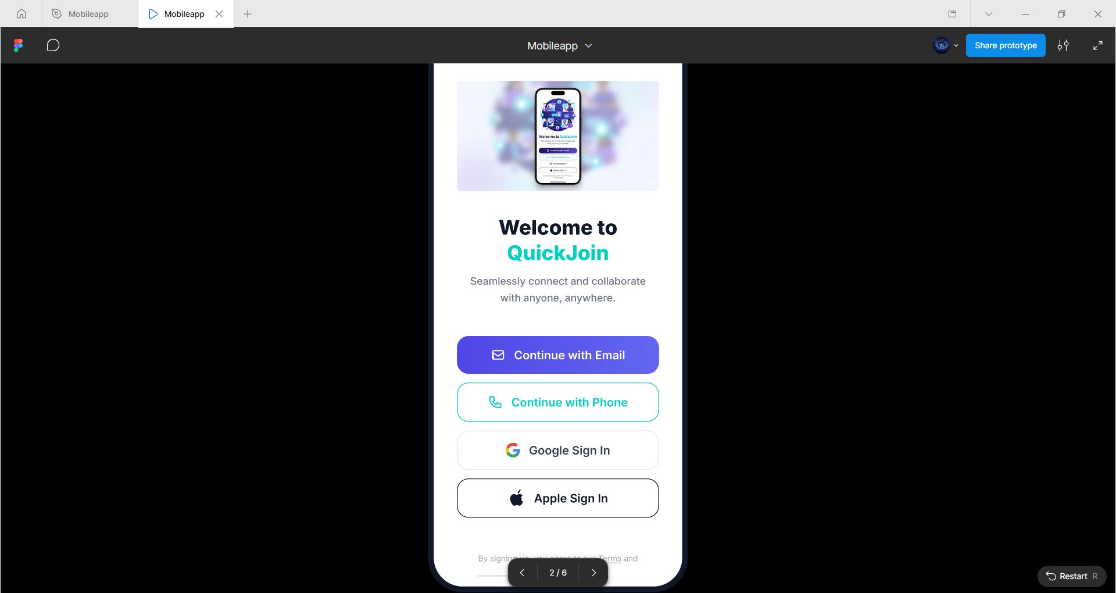
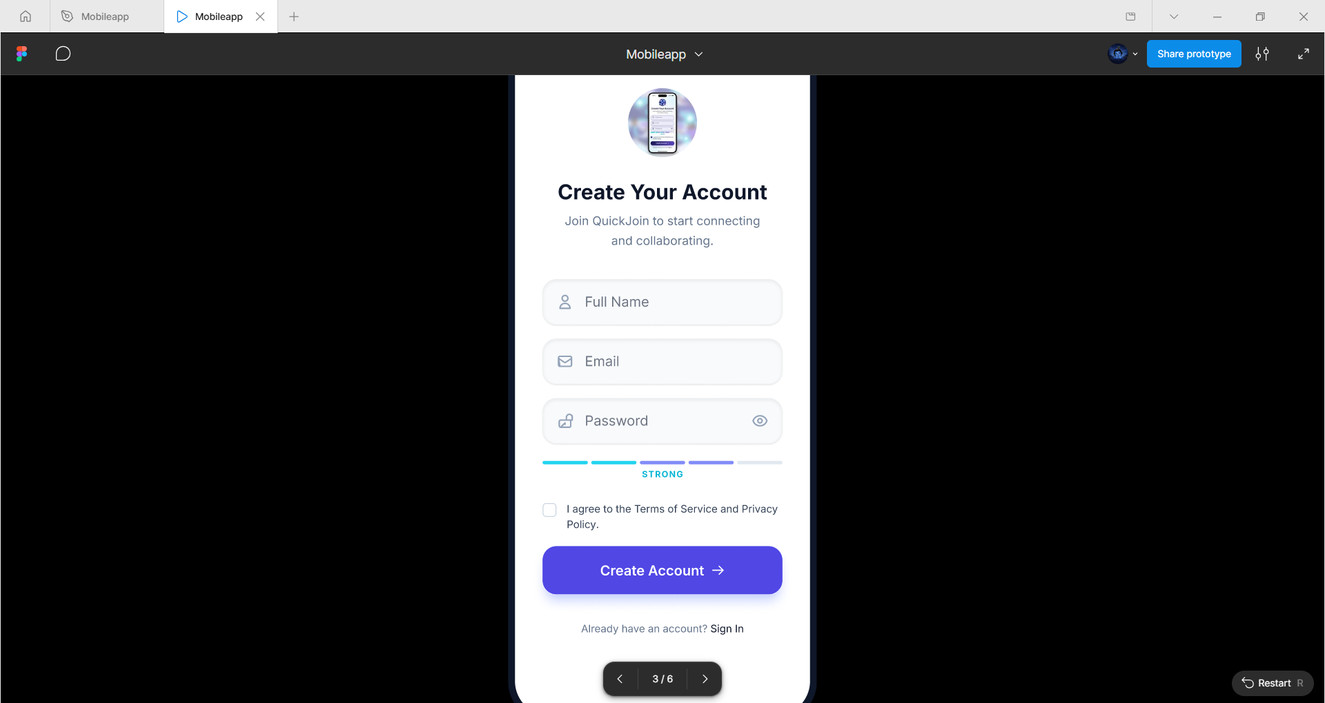
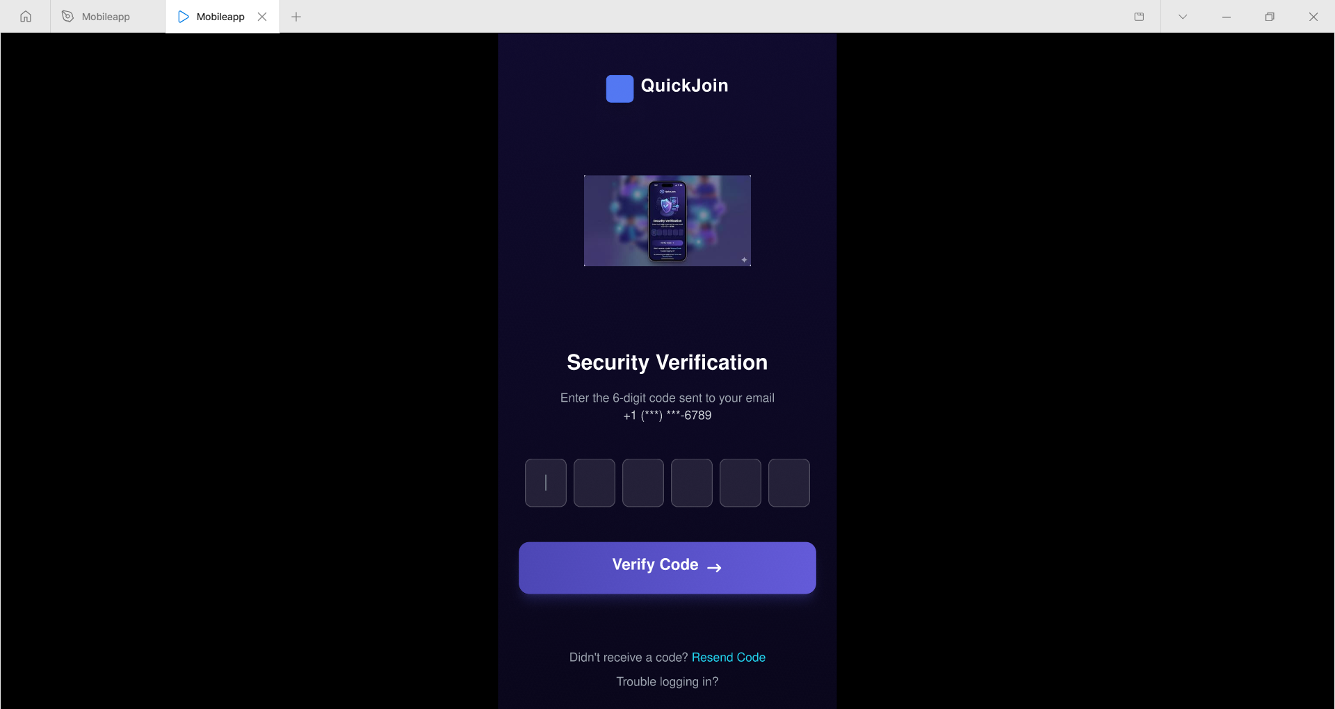
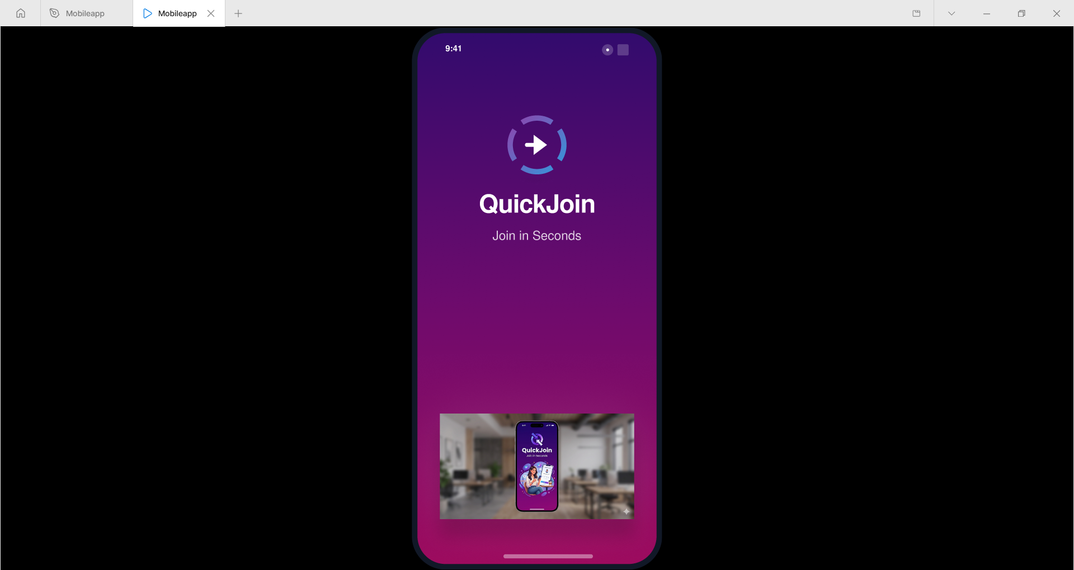
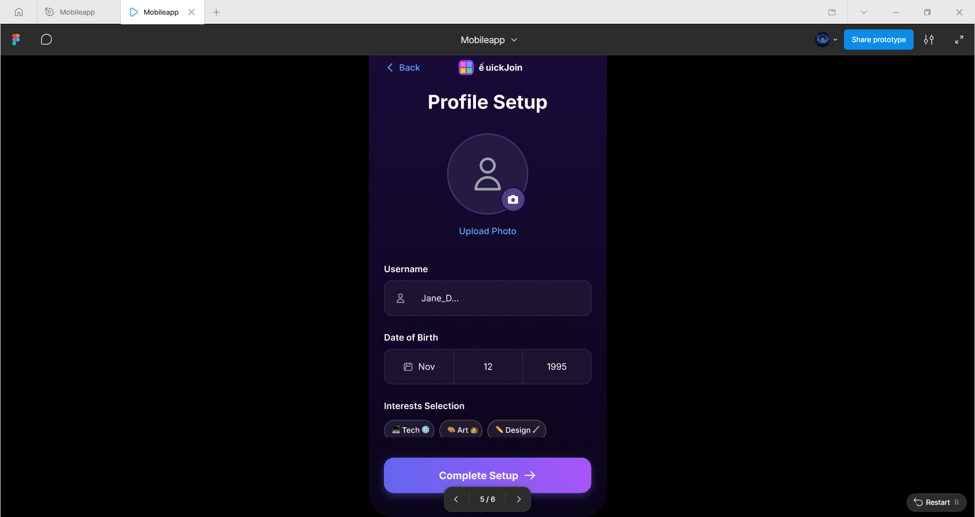
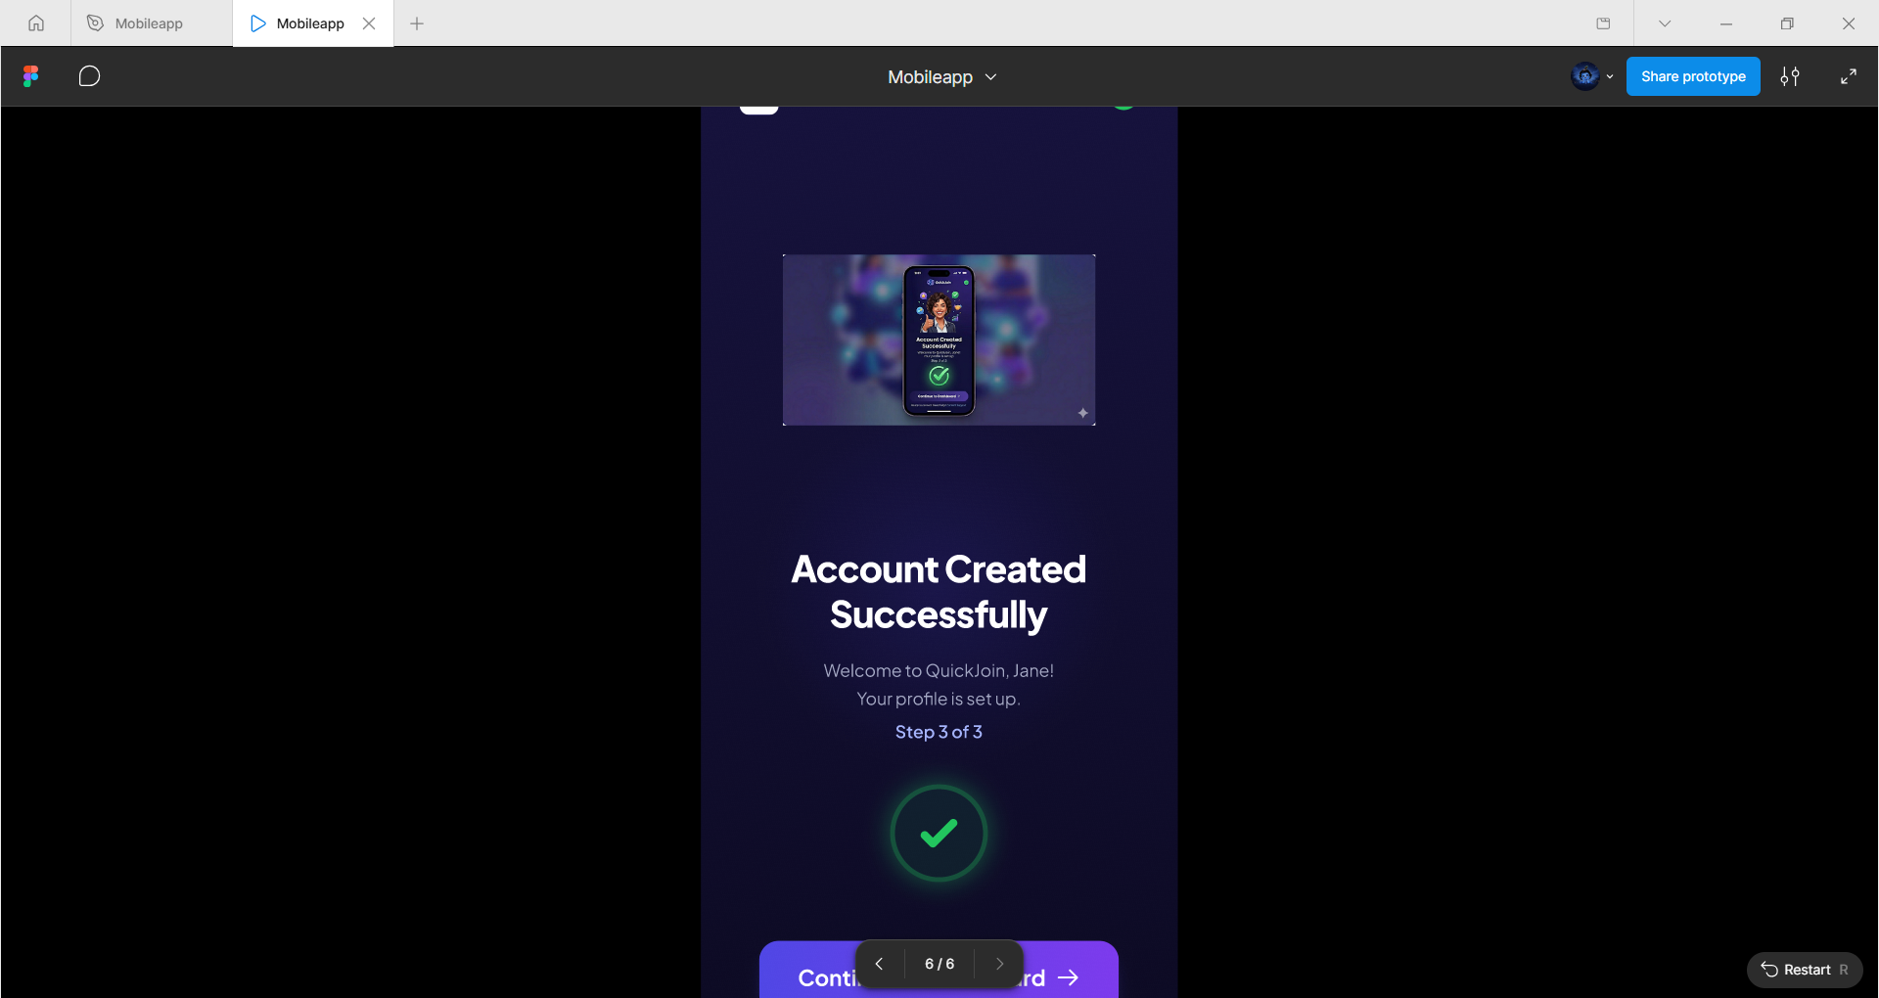
Low-Fidelity Wireframes
Early-stage wireframes map out the structure and flow of each screen before visual design decisions are made. This ensures the user journey is logical and complete.
Splash Screen
Welcome Screen
Sign Up Screen
OTP Screen
Profile Setup
Success Screen

Slide 5
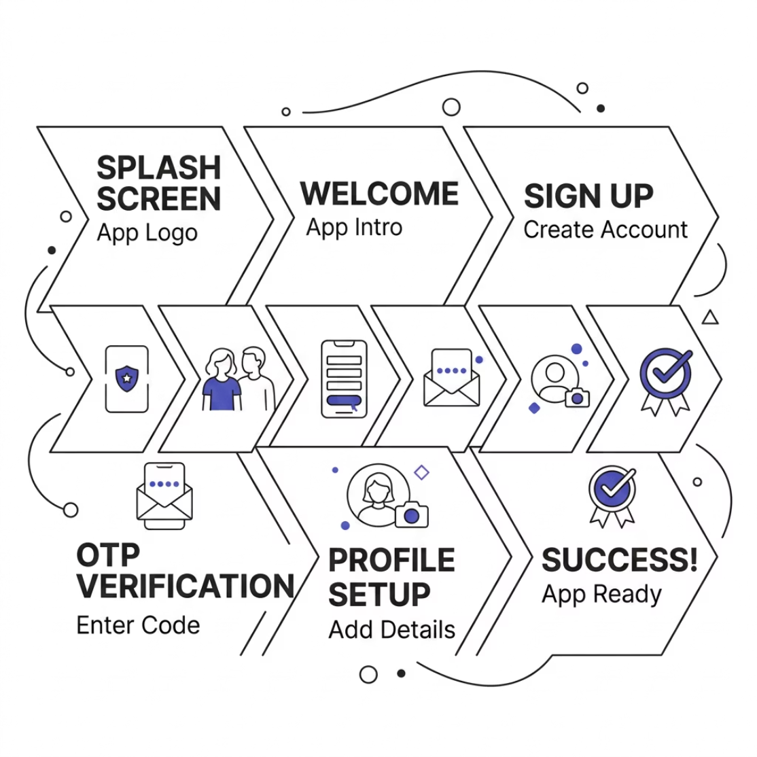
User Flow
The signup journey is designed to be linear and frictionless. Each screen has a single clear purpose, guiding users naturally from first launch to a fully activated account.
01
02
Splash Screen
Welcome Screen
Brand introduction
Onboarding context
03
04
Sign Up Screen
OTP Verification
Account creation
Identity confirmation
05
06
Profile Setup
Success Screen
Personalization
Confirmation & next steps

Slide 6
Key Features
Email Signup
Phone Signup
Traditional email-based registration with validation.
Mobile number registration with OTP verification.
OTP Verification
Password Strength
One-time password for secure identity confirmation.
Real-time indicator guiding users to create strong passwords.
Google Login
Apple Login
One-tap social authentication for faster onboarding.
Privacy-focused sign-in option for iOS users.

Slide 7
Design System
A consistent design system ensures visual harmony and scalability across all screens and future updates.
Color Palette
UI Components
Typography
Headings: Bold, prominent type for screen titles
Body Text: Readable, medium weight for content
Buttons
Input Fields
Primary, secondary, and disabled states
Validated, labeled, and error-state ready
Cards
Icons
Container components for grouped content
Consistent stroke weight and style
Primary
Secondary
Accent
Brand color for CTAs and key elements
Supporting color for backgrounds and accents
Highlight color for alerts and highlights

Slide 8
Usability Improvements
Reduced Signup Time
Streamlined steps and auto-fill support cut registration time significantly.
Better Accessibility
High contrast, readable fonts, and clear tap targets support all users.
Error Prevention
Inline validation and helpful error messages reduce user mistakes.
Improved Onboarding
A guided, progressive flow builds user confidence from the first screen.
Higher Conversion Potential
Fewer friction points directly improve signup completion rates.

Slide 9

Conclusion & Thank You
This project delivers a modern, secure, and user-centered signup experience — designed to reduce drop-off and build trust from the very first interaction.
Seamless Onboarding
Intuitive flow from splash to success
Secure Signup
OTP + social login options
Modern UI
Clean, consistent design system
User-Friendly
Accessible and responsive
Thank you for your time and attention. I welcome any questions or feedback.

