Slide 1
UI/UX INTERNSHIP PROJECT
Project 2: Email Template Design
A professional, responsive email template crafted to boost engagement, improve readability, and maintain brand consistency across all devices.
Designed By: [Khushi Kundariya] · Tools: Figma

Slide 2
OVERVIEW
What Is an Email Template?
An email template is a pre-designed layout used for marketing campaigns, promotions, product launches, and customer engagement — ensuring a consistent, polished brand experience every time.
Professional Design
Higher Engagement
Clean, brand-aligned visuals
Improved click-through rates
Brand Consistency
Responsive Layout
Unified identity across campaigns
Optimized for all screen sizes

Slide 3
PROBLEM & SOLUTION
Why Most Marketing Emails Fail
The Problem
The Solution
Design a clean, visually appealing, and fully responsive email template that improves user experience, guides the eye naturally, and drives meaningful engagement.
Poor visual hierarchy
Cluttered, overwhelming layouts
Low readability on mobile
Weak or missing CTAs
Not optimized for devices

Slide 4
RESEARCH
Understanding Our Users
Target Audience
User Needs
Pain Points
Online shoppers & e-commerce customers
Brand subscribers
Mobile-first users
Easy-to-read content
Attractive visuals & clear offers
Fast navigation & mobile-friendly experience
Too much information at once
Confusing layouts
Difficult-to-tap buttons on mobile

Slide 5
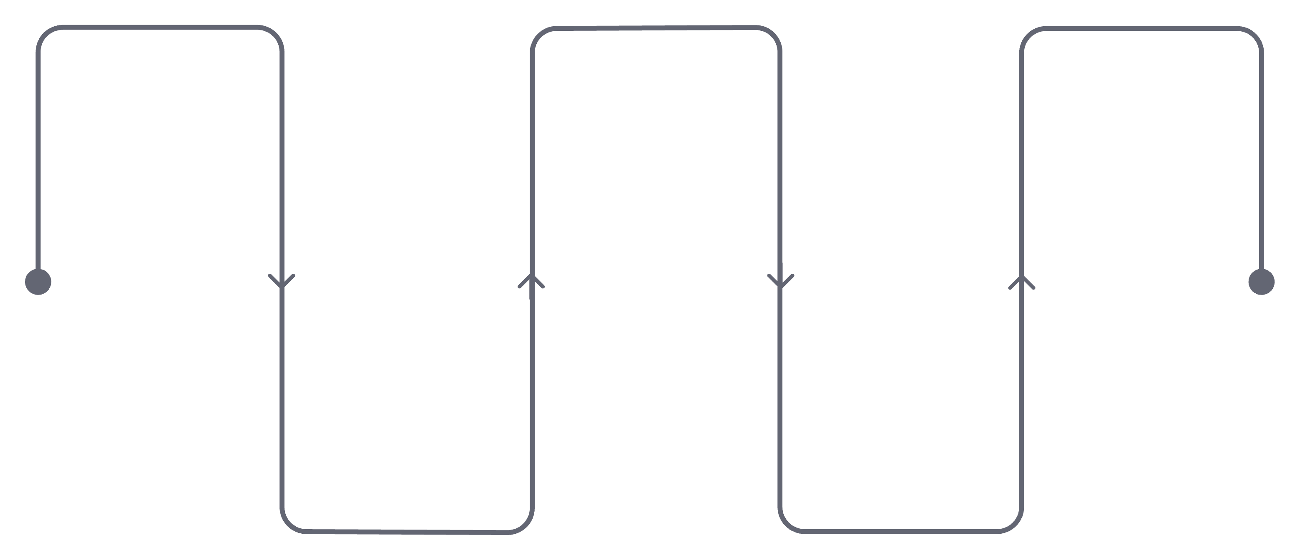
WIREFRAMES
Structuring the Email Flow
Wireframes were created first to define content hierarchy and layout before moving to high-fidelity design — ensuring a logical, user-friendly flow.
Header
Featured Products
Footer
Branding and navigation
Contact and legal links
Showcase top items
Hero Banner
Special Offer
Attention-grabbing visual
Limited-time promotion
Each section serves a specific purpose — from capturing attention at the top to driving action at the bottom.

Slide 6
HIGH-FIDELITY DESIGN
The Final Email Template
Header Nav
Hero Banner
Product Showcase
Logo & brand navigation
Promotional headline & CTA
Featured product cards
Discount Offer
Reviews
Newsletter
Time-sensitive promotion
Customer testimonials
Subscription input field
Footer
Links, social & legal

Slide 7
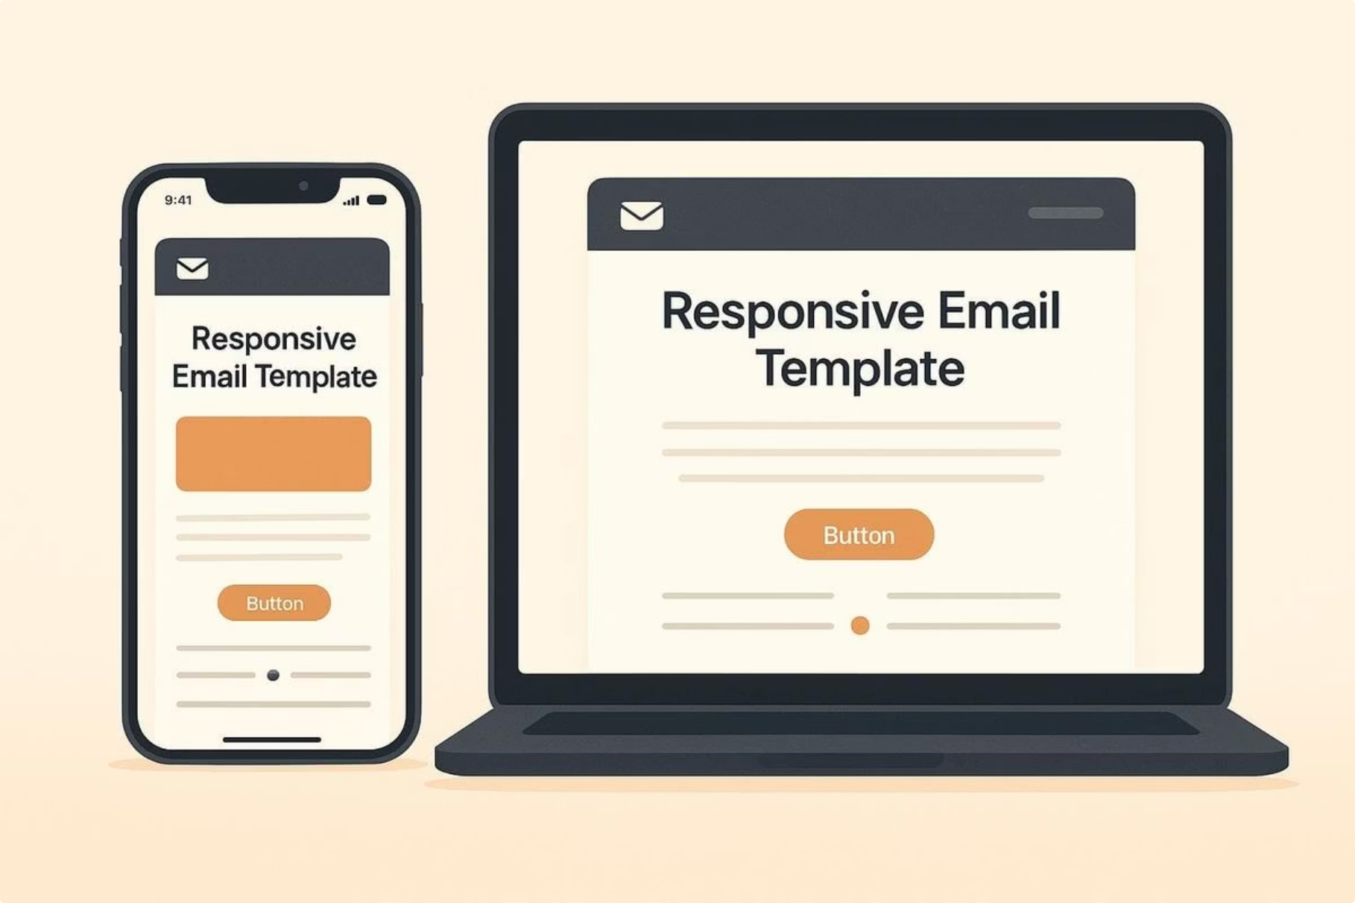
RESPONSIVE DESIGN
Designed for Every Screen
The template adapts seamlessly across all device sizes, ensuring a consistent and accessible experience for every user.
Desktop & Laptop
Tablet
Mobile
Full-width layout with rich visuals
Optimized grid and spacing
Stacked layout, larger tap targets

Slide 8
FEATURES
Key Features Included
Modern Layout
Promotional Banner
Clean, structured design
Eye-catching hero section
Product Cards
Testimonials
Featured items with details
Customer reviews & trust
Newsletter Signup
Responsive Design
Easy subscription input
Works on all screens
Social Integration
Strong CTAs
Connected social links
Clear, clickable buttons

Slide 9
DESIGN SYSTEM
Typography, Color & Components
Typography
Reusable Components
Poppins — a modern, geometric sans-serif chosen for its clean readability on screens.
01
Color Palette
Buttons
Primary & secondary CTA styles
02
Product Cards
Image, title, price & CTA
03
Navigation Bar
Logo, links & utility items
04
Input Fields
Newsletter & form elements
05
Footer
Links, social icons & legal
Primary — #4F46E5 (Indigo)
Secondary — #7C3AED (Purple)
Accent — #06B6D4 (Cyan)

Slide 10

CONCLUSION
Project Outcomes
7
Email Sections
Fully designed & structured
4
Device Types
Fully responsive layouts
8
Key Features
Integrated into final design
3
Design Tools
Figma
Thank You

