Slide 1

INTERNSHIP · PROJECT 3
Restaurant Menu UI Design
A UI/UX internship project focused on redesigning the restaurant menu experience — making it intuitive, visually engaging, and conversion-friendly.

Slide 2

Problem Statement
Many restaurant menus fail to guide customers effectively, leading to confusion and lost orders. This project addresses four core challenges:
Difficult Navigation
Customers struggle to find what they're looking for quickly.
Poor Categorization
Food items lack logical grouping, causing decision fatigue.
Confusing Layouts
Cluttered screens overwhelm users and reduce engagement.
Low Engagement
Without visual appeal, customers are less likely to explore and order.

Slide 3

User Research
Target Users
Restaurant customers (dine-in & takeout)
Online food ordering users
First-time visitors
What Users Need
Easy navigation with clear categories
Quick food discovery with attractive images
Transparent, readable pricing
Pain Points
Cluttered, hard-to-scan menus
Items difficult to locate
Weak or missing categorization

Slide 4
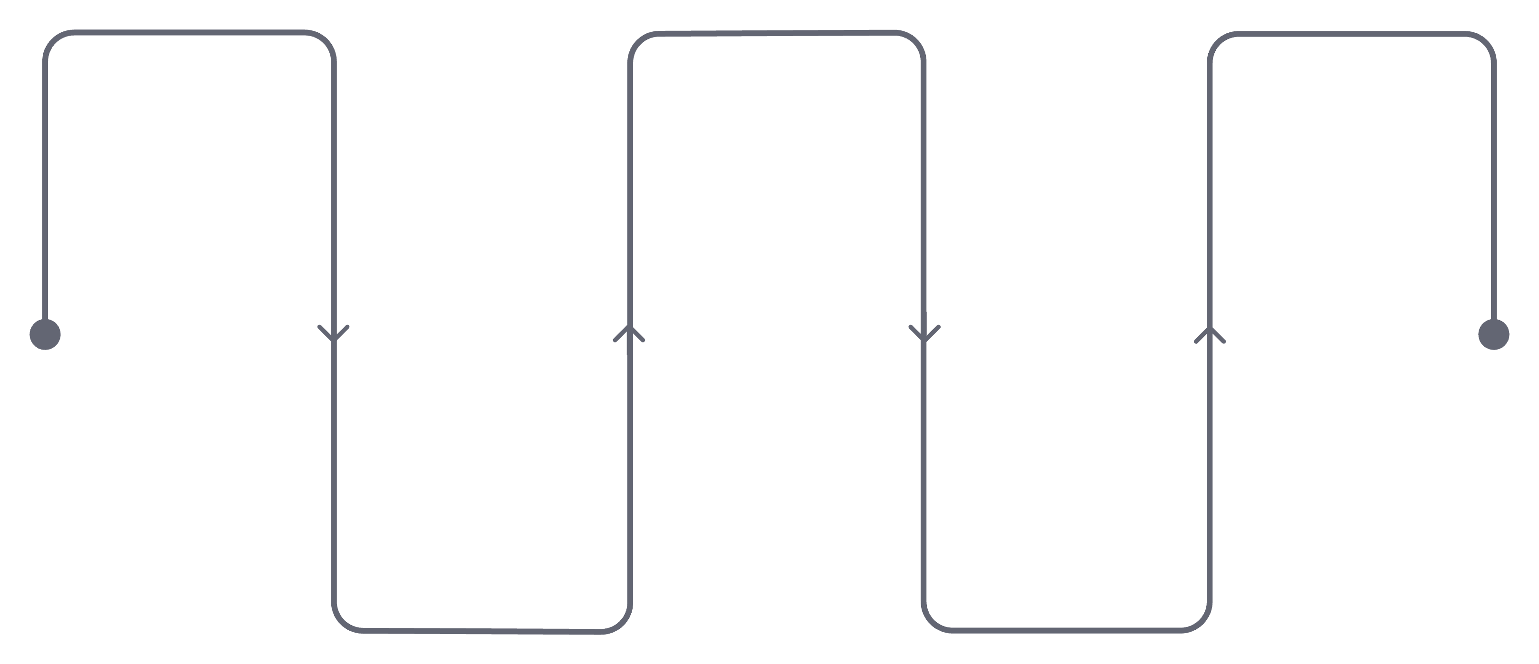
Low-Fidelity Wireframe
Wireframes were created first to establish a clear content hierarchy and user flow before investing in visual design.
Header
Categories
Food Grid
Logo and primary links
Browse by cuisine or meal type
Cards with images and info
Search
Featured
Quick dish and restaurant lookup
Highlight popular dishes
This structure ensures users can search, browse categories, discover featured items, and place orders in a seamless top-to-bottom flow.

Slide 5

Final UI Design
The high-fidelity design brings the wireframe to life with modern aesthetics, warm food-inspired colors, and a layout optimized for both discovery and ordering.
Readability First
Clear typography and generous spacing make every dish easy to scan.
Food Discovery
Featured dishes and category chips guide users toward popular and new items.
Visual Appeal
High-quality food imagery and warm accent colors stimulate appetite and trust.

Slide 6
Key Features
Search Food
Category Navigation
Featured Dishes
Instant search to find any dish by name.
Scrollable chips for quick category filtering.
Highlighted cards showcasing popular or new items.
Ratings & Reviews
Add to Cart
Promotional Banner
Star ratings build trust and aid decision-making.
One-tap ordering with clear visual feedback.
Strategic placement for offers and special deals.
Responsive Layout
Adapts seamlessly across all screen sizes.

Slide 7
Design System & Outcomes
Color Palette
Project Outcomes
Typography
Easy Navigation — Clear categories reduce friction
Poppins Bold — Headings & CTAs
Poppins Regular — Body text
Core Components
Better UX — Intuitive flow from browse to order
Search Bar · Category Chips · Food Cards · Buttons
Clear Categorization — Logical grouping improves discovery
Attractive Interface — Warm colors and imagery drive engagement
Orange
Yellow
White
Dark Gray
#FF6B35 — Primary CTA
#FFC857 — Highlights
#FFFFFF — Background
#1F2937 — Text

