Slide 1
Project Overview and Business Problem
Logistics KPI Performance Review • Yuva Intern — Logistics Data Analytics Specialist Internship
How reliable, how costly — and where is time lost? A KPI review of a fictional Kolkata-based cold-chain distributor serving 12 hubs across East India in 2025.
Prepared by Khushi Tomar • Final-year B.Tech, CSE (AI & ML)
• Business problem: delivery reliability is below target — 63,118 of 268,330 eligible shipments arrived late (OTD 76.48%) — while cost (₹4,102.68 per shipment) and destination dwell (15.49 h) both sit above their green thresholds.
• Objective: measure on-time delivery, cost per shipment and hub dwell time; find where lateness, cost and dwell concentrate; and quantify what closing the gap to the network median would be worth.
• Scope: all shipments in calendar year 2025 (Jan–Dec), 12 destination hubs, 60 routes, 24 warehouses, 6 product categories.
⚠ ALL DATA IS SYNTHETIC (seed 42), generated for this internship evaluation. It is NOT real company data and no finding here describes a real business.
Logistics KPI Performance Review • SYNTHETIC DATA (seed 42) — fictional company, not real company data
1

Slide 2
Dataset, Data Architecture and Methodology
Scale • Star schema • Seven-step method
• Scale: 1,504,500 raw records — 304,500 shipment rows and 1,200,000 scan events; 300,000 shipments and 1,194,000 scans after cleaning.
• Coverage: Jan–Dec 2025 only. No true year-over-year exists; H1 vs H2 2025 is the prior-period comparison used in this review.
• Sources: synthetic shipment + scan-event files (seed 42) and reference dimensions built alongside them.
Method — 7 steps
• 1. Generate — synthetic data, seed 42, with known defects injected.
• 2. Profile — column profiles and integrity checks on raw data.
• 3. Clean — deduplicate, standardise, flag invalid values (slide 3).
• 4. Transform — build the star schema and trusted analysis table.
• 5. Calculate KPIs — OTD, cost per shipment, dwell, by month / hub / route / warehouse / category.
• 6. Validate — 38 independent recomputation checks: 38/38 PASS, 0% variance.
• 7. Visualise — 8 charts; this deck summarises the headline views.
Star schema — trusted analysis table
• Facts: Fact_Shipment — 1 row per shipment (300,000); Fact_Scan_Event — 1 row per scan (1,194,000).
• Dimensions: Dim_Hub (12), Dim_Route (60 + UNKNOWN), Dim_Vehicle (180), Dim_Category (5 + Unknown), Dim_Warehouse (24), Dim_Date (2025 calendar).
Logistics KPI Performance Review • SYNTHETIC DATA (seed 42) — fictional company, not real company data
2

Slide 3
Data Quality Issues and Cleaning Process
What was wrong with the raw data — and what cleaning did about it
• Duplicates: 9,000 duplicate shipment rows (4,500 extra copies) — removed, keeping the most complete record; 0 duplicate shipment IDs remain.
• Orphan scans: 6,000 scan events with no matching shipment — removed; referential integrity holds after cleaning.
• Messy hub identifiers: 91,486 origin and 92,027 destination hub values in non-standard spellings — standardised via hub_crosswalk.csv to the 12 canonical hubs.
• Bad timestamps & costs: invalid / missing promised and actual timestamps excluded from the OTD denominator; negative (2,439), zero (1,156) and missing (2,920) costs excluded from the cost KPI — 293,485 valid-cost shipments remain.
• Scan order & dwell: 29,287 out-of-order scan events in 20,914 shipments re-sequenced by UTC; negative dwell pairs flagged and excluded (2,885 destination, 18 origin).
Cleaning discipline
• 19 issue types logged, 200,528 changed records logged — every change is traceable; nothing was silently dropped or imputed (missing category / vehicle kept as “Unknown”).
• Result: 300,000 clean shipments, 1,194,000 clean scans; validation 38/38 PASS, 0% variance.
Logistics KPI Performance Review • SYNTHETIC DATA (seed 42) — fictional company, not real company data
3

Slide 4
Executive KPI Scorecard
2025 full year • All three headline KPIs are AMBER — below green, above red
ON-TIME DELIVERY
76.48%
268,330 eligible · 63,118 late
COST PER SHIPMENT
₹4,102.68
₹1,204,074,834 total valid cost
AVG DESTINATION DWELL
15.49 h
Origin dwell 2.5 h · combined 8.9 h
DATA QUALITY
GREEN
38/38 validation checks passed
KPI | 2025 result | Thresholds | Status
On-time delivery (OTD) | 76.48% | GREEN ≥ 85% • AMBER 75–85% • RED < 75% | AMBER
Cost per shipment | ₹4,102.68 | GREEN ≤ ₹4,000 • AMBER ₹4,000–4,500 • RED > ₹4,500 | AMBER
Avg destination dwell | 15.49 h | GREEN ≤ 12 h • AMBER 12–18 h • RED > 18 h | AMBER
Data quality | 38/38 checks passed, 0% variance | GREEN: 100% changed-record logging, all checks pass | GREEN
• OTD 76.48% — AMBER: 85% is the service level a reliable cold chain should promise; the network is 8.5 pp short of it.
• Cost ₹4,102.68 — AMBER: ₹4,000 is the cost anchor; the network runs ₹102.68 above it per shipment.
• Dwell 15.49 h — AMBER: 12 h is the same-day unload target; destination dwell runs 3.5 h over it, while origin dwell (2.5 h) is not the problem.
Logistics KPI Performance Review • SYNTHETIC DATA (seed 42) — fictional company, not real company data
4

Slide 5
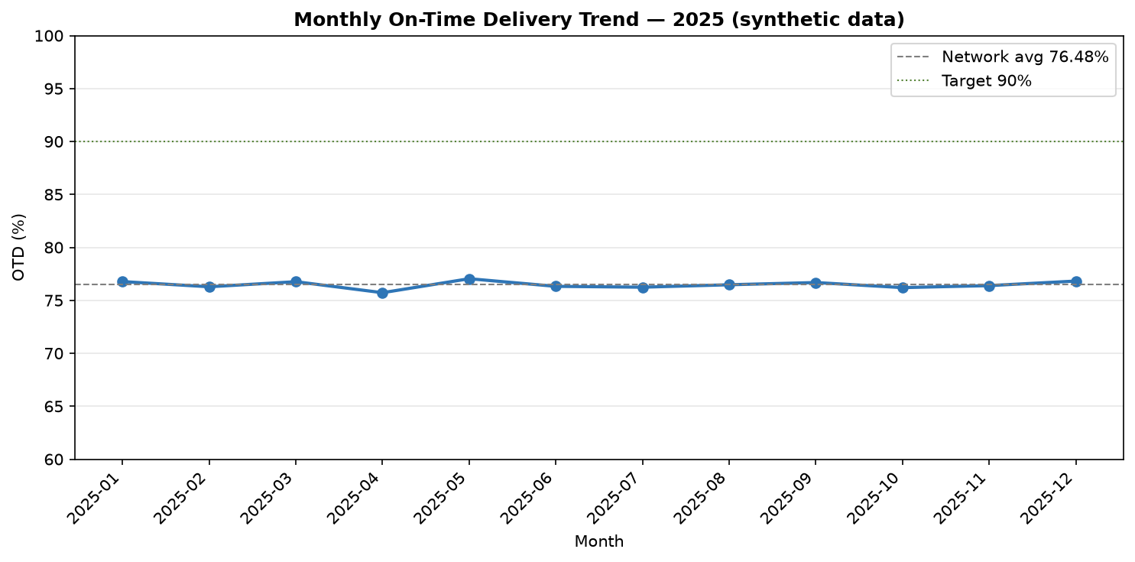
Monthly Delivery Performance
OTD by month, Jan–Dec 2025 • No true YoY — 2025 only
• Flat all year: monthly OTD ranges only 75.72% (Apr) to 77.04% (May) — no seasonal peak or trough.
• No improvement: H1 2025 OTD 76.49% vs H2 2025 76.47% — the prior-period comparison is essentially unchanged.
• Cost and dwell flat too: monthly cost ₹4,077–₹4,127 and destination dwell 15.42–15.59 h — the network is stable, not deteriorating.
Chart 01 — Monthly OTD trend (synthetic data, seed 42). Monthly OTD stays in a narrow 75.7–77.0% band all year.
Logistics KPI Performance Review • SYNTHETIC DATA (seed 42) — fictional company, not real company data
5

Slide 6
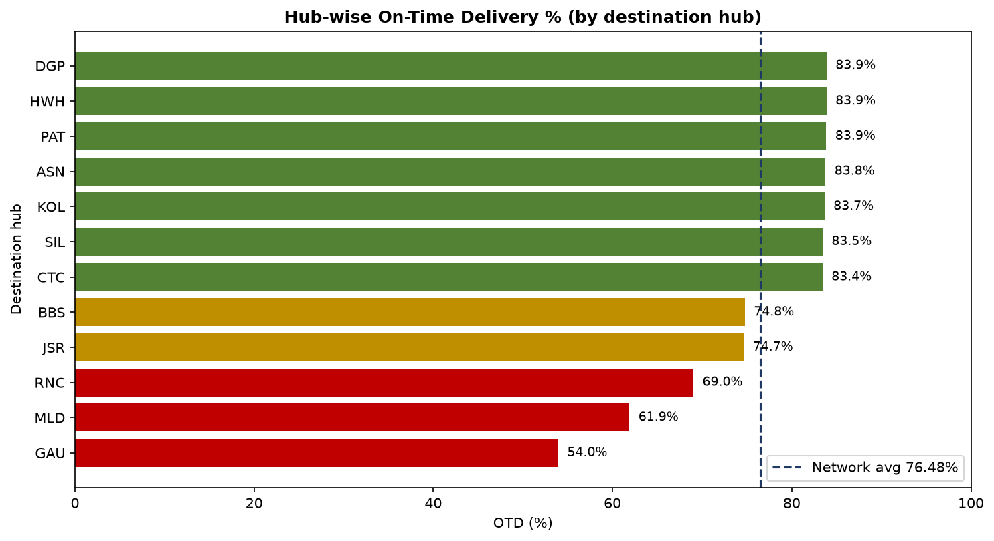
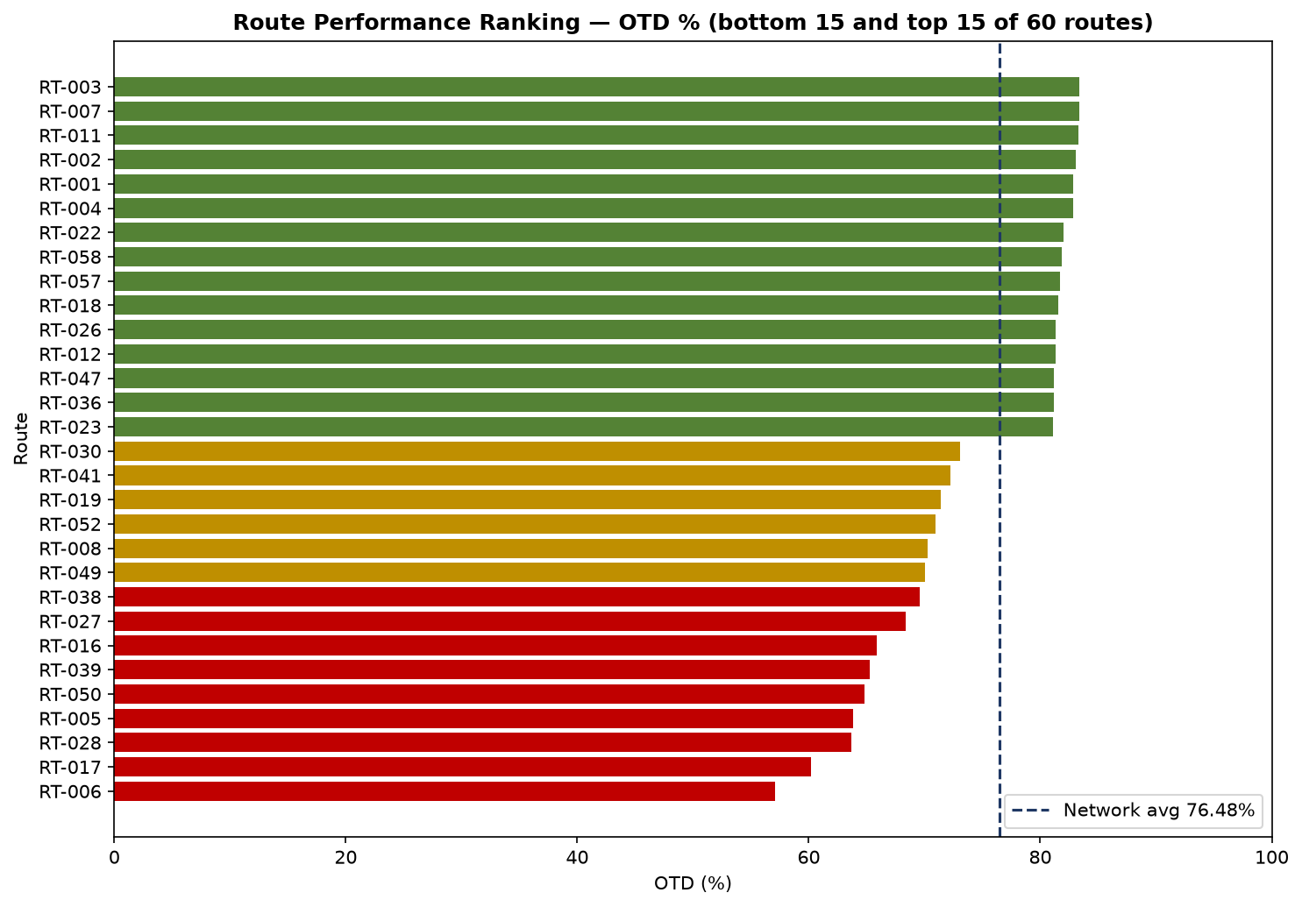
Hub, Warehouse and Route Analysis
Lateness is concentrated — in three hubs, a few routes, and one category
Chart 02 — OTD by destination hub
Chart 04 — Route performance ranking (60 routes + UNKNOWN)
• Worst hubs: Guwahati 53.95% (10,364 late — 16.4% of all late deliveries), Malda 61.89%, Ranchi 69.04%; best is Durgapur 83.89%. Nine hubs sit at 83–84%.
• Worst routes: RT-006 57.11% (4,182 late), RT-017 60.20%, RT-028 63.67% — vs best route RT-003 83.41%. Bottom-quartile routes (OTD ≤ 73.69%) hold 69,332 eligible shipments at 66.07% OTD.
• Frozen is the weak category: 72.06% OTD (lowest) and 33.1% of all late deliveries; Pharma is best at 84.59%. Warehouse dwell is narrow (15.21–15.95 h) — dwell is network-wide, not one bad warehouse.
Logistics KPI Performance Review • SYNTHETIC DATA (seed 42) — fictional company, not real company data
6

Slide 7
Business Impact and Key Findings
What closing the gap to the network median would be worth — modelled estimates on synthetic data
Scenario | Gap closed | Late deliveries avoided | Cost saving | Excess dwell recovered
Conservative | 50% | 4,853 | ₹15,56,916 | 2,147.9 h
Realistic | 100% to median | 9,706 | ₹31,13,833 | 4,295.8 h
Optimistic | 100% + 10% gain | 9,706 | ₹34,25,216 | 4,295.8 h
Key findings
• Concentrated, not diffuse: 39 of 61 routes account for 80% of late deliveries; Guwahati, Malda and Ranchi together account for 41.8% of all late deliveries.
• Realistic case is the planning case: 9,706 late deliveries avoided, ₹31,13,833 saved and 4,295.8 excess dwell hours recovered if bottom-quartile routes, costs and warehouses converge to the network median.
• Read the numbers honestly: these are modelled estimates on synthetic data, not a forecast of real savings — no causal mechanism, capacity constraint, customer-behaviour change or implementation cost is included.
Basis: bottom-quartile routes (15 of 60, median route OTD 80.06%), bottom-quartile route costs (median ₹4,099.68) and bottom-quartile warehouses (7, median dwell 15.51 h).
Logistics KPI Performance Review • SYNTHETIC DATA (seed 42) — fictional company, not real company data
7

Slide 8
Three Prioritised Recommendations and Conclusion
Fix the concentrated gap first — then hold the network at the median
1
Guwahati / Malda / Ranchi corridor recovery
Dedicated route planning + hub capacity review for the three worst destination hubs (OTD 53.95% / 61.89% / 69.04%).
Owner: Operations • Monitor: destination-hub OTD
2
Destination-hub dwell reduction
Unloading-slot scheduling and labour planning at bottom-quartile warehouses — dwell is 15.49 h vs a 12 h green target.
Owner: Warehouse Operations • Monitor: avg destination dwell
3
Frozen-category cold-chain reliability + cost control on bottom-quartile routes
Reefer maintenance checks and route cost review — Frozen is the weakest category (72.06% OTD, 33.1% of late deliveries).
Owner: Fleet & Category Management • Monitor: category OTD and route cost / shipment
Conclusion: the network is stable, not deteriorating — the gap is concentrated in three hubs, fifteen routes and one category, and it is measurable and closable to the median. Start with the Guwahati / Malda / Ranchi corridor.
Logistics KPI Performance Review • SYNTHETIC DATA (seed 42) — fictional company, not real company data
8

