Slide 1




Management Of Materials during disaster
~ GOONJ

Slide 2

Problem Statement
One of the initiative of Goonj is to work with people and for people in the regions devastated by any sort of disasters - floods, earthquake, landslides, cloud burst, drought, winters, cyclones, Tsunami etc. Our involvement is in-
Providing relief material in the initial phase.
Providing rehabilitation material to those whose livelihood is severed for example giving sewing kit (including machine) to a tailor to restart the livelihood, basic utensils and raw material to someone whose eatery is destroyed and likewise. Our centers all over India, run collection drives for material required as per the type of disaster, regional and local culture. Material need, availability, movement, receipt to the last person becomes quite tedious to maintain. Give us a SOLUTION - to maintain and know the exact material available at each center, what has been dispatched against the demand, record/tally material reached the last location vis-a-vis the dispatch. Account for the material handed over for relief, development activities to the last person at the disaster location. Goonj team in remotest of areas should be able to use the application on the hand held device in online or offline mode. Drill down Dashboards to bring in efficiently in operations. So that Goonj team Pan India is updated situation across all Goonj centers.

Slide 3
Our approach
The aim of the problem is to maintain the flow of relief material between diff centers to the disaster location. To solve this problem we will build a web app that will help us know the availability of materials at diff centers, tally the material reaching the disaster location after it’s dispatch and confirmation of the materials reached. The key features of the web app include:
Dashboard
Record Page
Demand Page
Dispatched Page

Slide 4
Overview
Dashboard: This will connect all fundamental elements of the application. This will help easy user access.
Records Page: This page will hold the details of the materials available at diff centers. Stock details can be added as well, this can be done by authorized members only. Other users can only view the records.
Demand Page: This page will provide a form for the user to demand for the materials based on requirements. Once the demand is accepted successfully a receipt will be generated for future use.
Dispatched page: This page will maintain various orders that has been dispatched from the center. This page can be accessed by center’s stock manager or other authorized members only.

Slide 5



Tracking system would be provided so that user can know the status of its order that whether the materials are dispatched or not, estimated time to reach and whether materials are out for delivery.
Offline capabilities: Users can use this application both online and offline mode. For this we will be storing the necessary data locally and sync them with the database whenever user gets online. While filing a demand request if the user is offline, user will also be asked to send the request details via mobile sms through his registered mobile no. so that his order can be acknowledged immediately.
This application is to be used by goonj members only. User must be a member of goonj organization else access would be denied.

Slide 6
3 Level Access
H.O ADMIN
Head Office Admin Page
A separate page for H.O Admin so he can track every Employee and Stock of all centers
Admin Panel
Center Admin Panel
Employee
He will monitor his own center and Acknowledge Incoming Requests
Employee Panel
Can see stock details of all centers, can raise demands & receive acknowledgement for the same. Tracking of in process demands will be provided & will have the record of previous requests.Get live update.

Slide 7
Uniqueness
Distance Capacity algorithm
Offline capability
Employee Progressive app

Slide 8
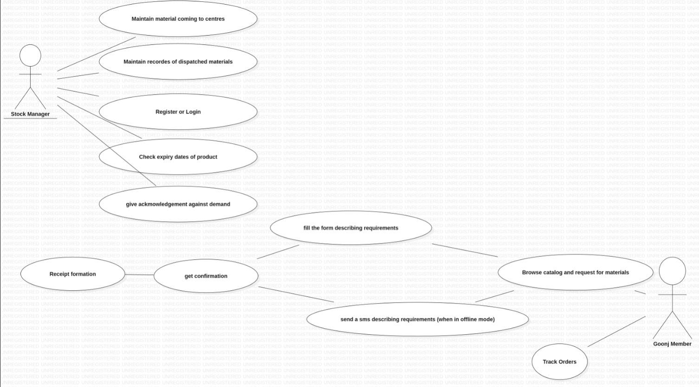

Slide 9
Thank You!
1. ADITI RATHORE(TEAM LEADER)​
2. AYUSH SHARMA​
3. KHUSHI PAREEK​
4. HITESH SUBNANI​
5. PURVA SINGHAL ​
6. RISHABH SHARMA​
BRANIACS

