Slide 1
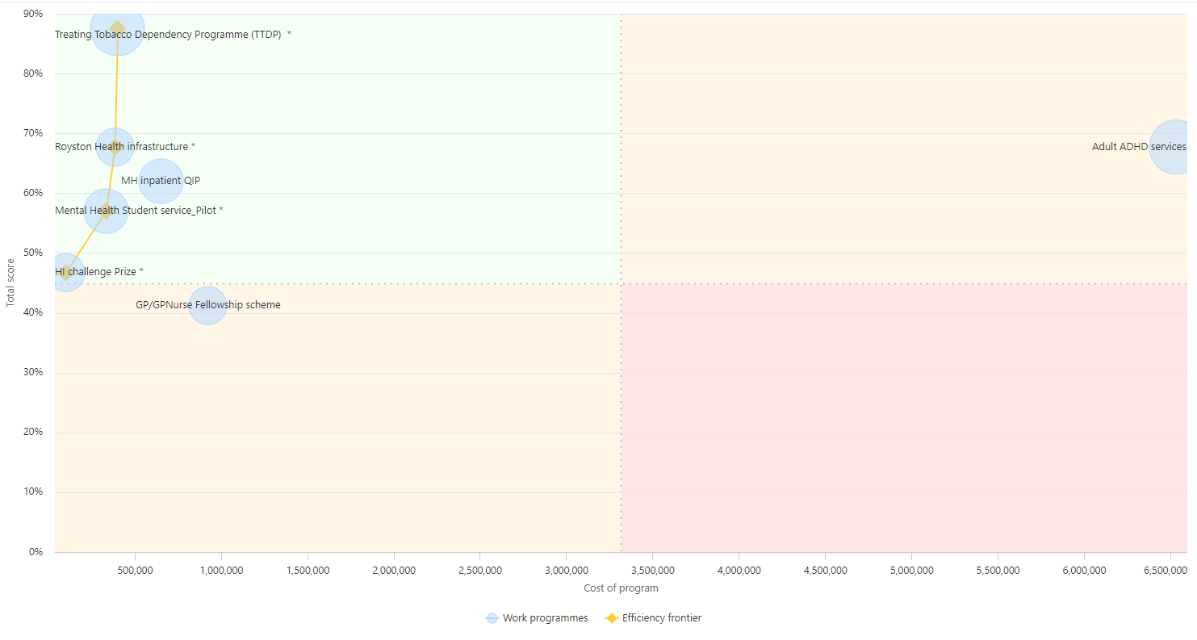
Ophthalmology: Cataracts
Ophthalmology pathway: Clinical cataracts pathway
Multiple providers: 4-5 providers (NHS and independent)
Draft of the clinical pathway
Data relative to the caseload of each provider (cases in the waiting list stratified by clinical procedure)
GIRFT further faster guidelines recommend 8 procedures should be carried out per 4-hour list: the system is averaging 4-5 procedures per list

Slide 2
Ophthalmology: Cataracts
Outpatient appointment
Diagnostics
Patient
Time
Provider A
Provider B
Provider C
Provider D

