Slide 1
Action code
Muhammad Zain
Farrukh
Khusmanda

Slide 2

Home page

Slide 3
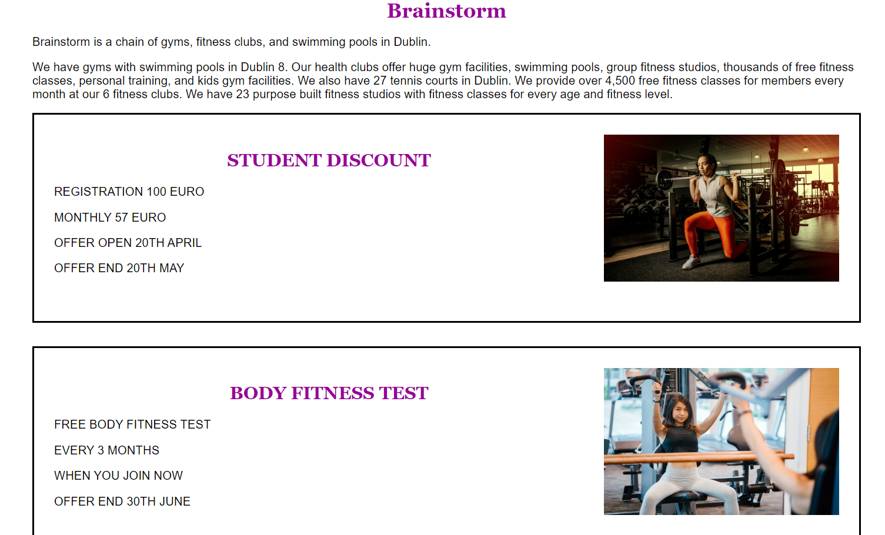
Home page

Slide 4

CLASSES PAGE

Slide 5

Member Backend

Slide 6

Admin Backend

Slide 7

Admin Backend

Slide 8
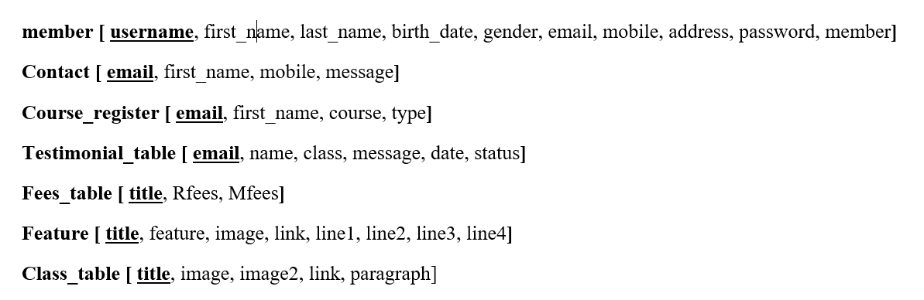
Database table’s(ERD Diagram)

Slide 9
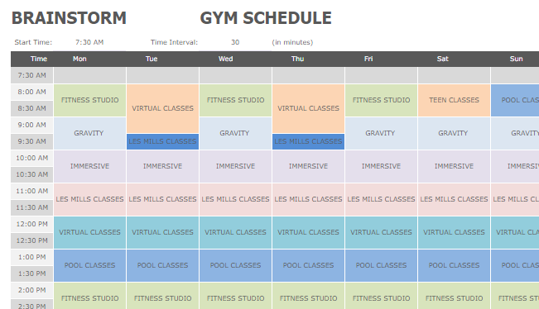
Member/Admin

Slide 10
Technologies Used
HTML
CSS
PHP
MYSQL
BOOTSTRAP

Slide 11
Thank you so much!

