Slide 1
Brannigans Restaurant Management System
By Khusmanda Devi Ramanjooloo
2953316

Slide 2
Problem
Taking order on paper.
Managing different table at the same time.
There are always missing orders in large tables
Customers don’t really know when the restaurant is full, so when they have to wait for a table which is time consuming.
Manager do not really know how much food and drinks have been sold.

Slide 3
Solution
Make an application where orders can be taken on a device and the order goes directly to kitchen.
Customers should be able to reserve a table as soon as they find it free.
Customers should be able to see rate of occupancy.
Manager should be able to see different report for sale.

Slide 4
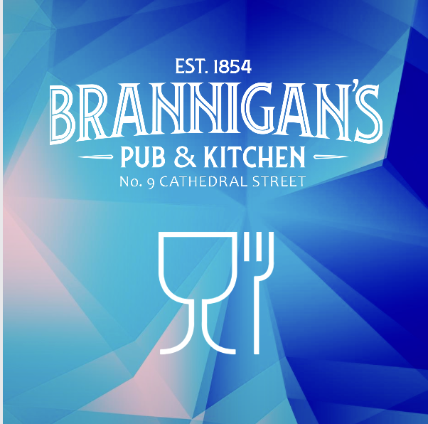
The Brannigans Application
The application is designed for four type of users:
Manager
Waiter
Chef
Customer
The users’ login the application using Gmail ID and
password.

Slide 5
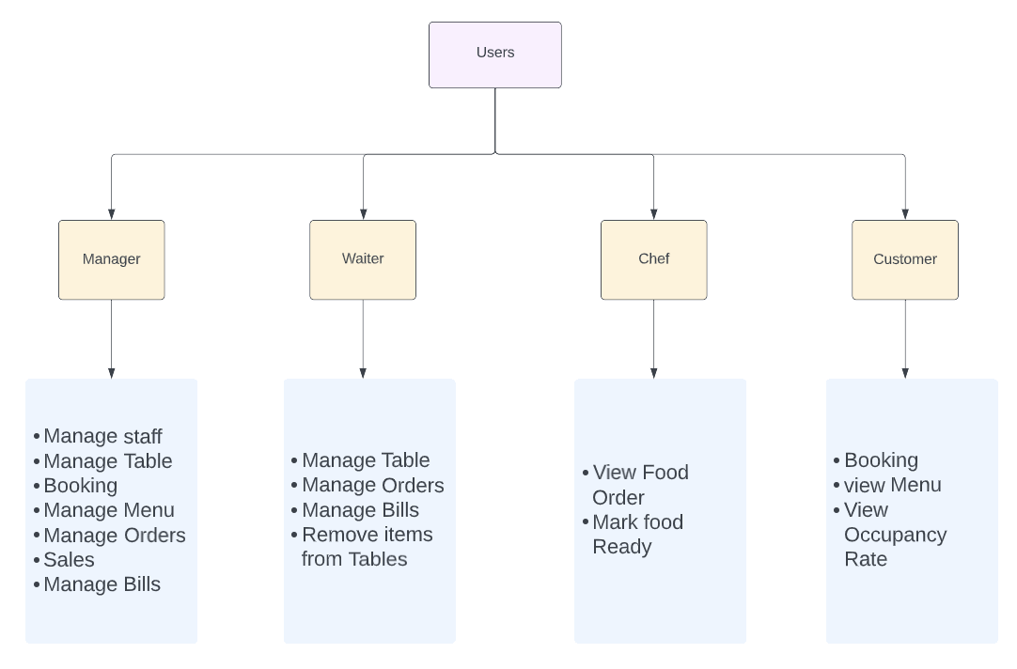

Slide 6
The Brannigans Application Technologies
Android Studio
Kotlin Language
Firebase Database

