Slide 1




A project on oops with c++
Project Title: Store Management System
Faculty in-charge:
Prof Shubha V Rao
ISE 3 B
KHUSHI AGRAWAL
1BM20IS066
VIGNESH JR
1BM20IS181

Slide 2
PROBLEM STATEMENT
Managing a Store isn’t as easy as taking candy from a baby, it requires a proper functioning system with zero errors or bugs to hold a proper, well managed Database. With the help of concepts of object oriented programming in c++ it is possible to create a system that stores all the input given by the store staff about the items present in the store.

Slide 3
OVERALL PROJECT DIAGRAM
ASKING USER FOR CHOICE
FUNCTION CALL TO INSERT, SEARCH,
DELETE
FUNCTION CALL
DISPLAYS THE RESULT
USER INPUTS THE DETAILS

Slide 4


SOFTWARE USED
The software requirements are:
OPERATING SYSTEM: LINUX / WINDOWS / iOS
CODE EDITOR: VISUAL STUDIO CODE

Slide 5
OOPS CONCEPT USED
Classes and objects
Constructors
Inheritance
Encapsulation
Operator Overloading
Files
Exceptions
Modularity

Slide 6
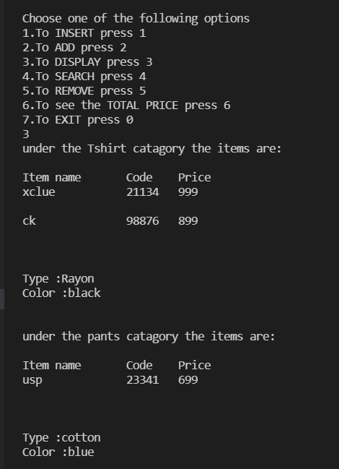
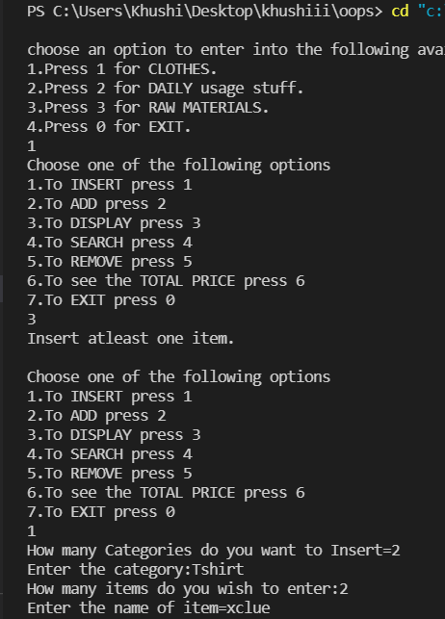
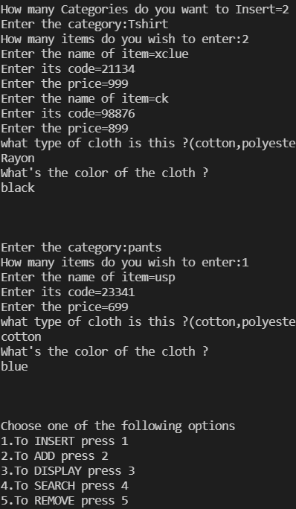
SCREENSHOTS

Slide 7
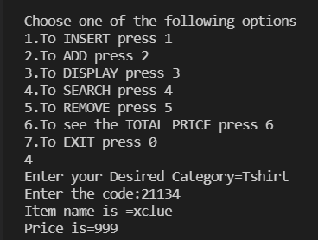
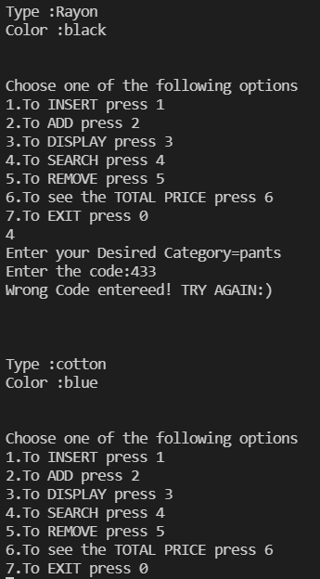
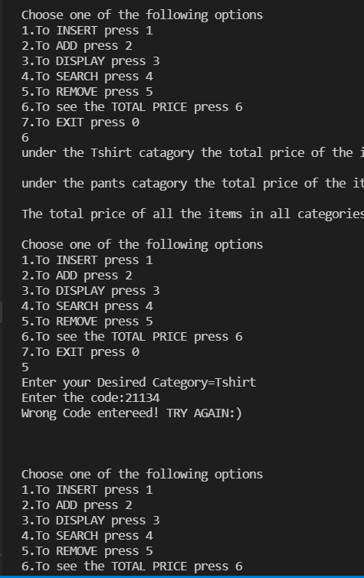
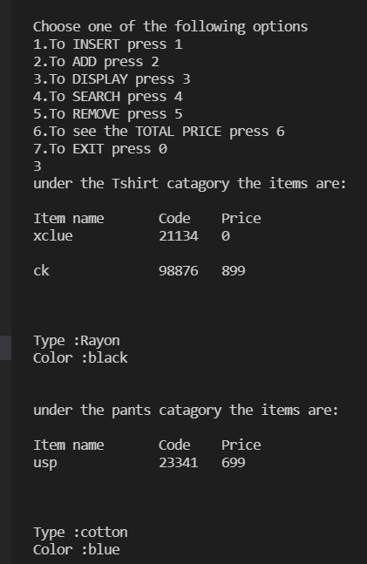
SCREENSHOTS

Slide 8
REFERENCES
Wikipedia.com
GeeksforGeeks.com
Javapoint.com
THANK YOU!

