Slide 1
A project on operating system
Project Title: Junction Traffic Simulation using Process Synchronization
Faculty in-charge:
Prof BS Mahalakshmi
ISE 3 B
Pranav Deepak- 1BM20IS101
Kashish Agarwal- 1BM20IS061
Lekha G Patel- 1BM20IS074
Khushi Agrawal- 1BM20IS066

Slide 2
PROBLEM STATEMENT
Managing a Junction Traffic Jam isn’t easy, it takes enormous effort of the coders to develop a program that solves the jamming problem. With the help of concepts of Operating System it is possible to create a system that manages easy release of traffic.

Slide 3


SOFTWARE USED
The software requirements are:
OPERATING SYSTEM: LINUX / WINDOWS / iOS
CODE EDITOR: VISUAL STUDIO CODE

Slide 4
CONCEPTS USED
Synchronization and the Critical Section Problem:
The critical section is assumed to be the green signal.
Mutual exclusion. If Traffic Signal Ti is executing in its critical section(Green signal), then no other signals can be executing in their critical sections(Green signal).
Progress: If no signal is executing in its critical section(Green signal) and some processes wish to enter their critical sections(Green signal), and this selection cannot be postponed indefinitely.(limit of 10s for each signal)
Bounded waiting. There exists a bound, or limit, on the number of times that other processes are allowed to enter their critical sections(50 function calls) after a signal has made a request to enter its critical section and before that request is granted.

Slide 5
CONCEPTS USED
Thread Creation from pthread library
Semaphore
Mutex Locks
Operating System commands under the <windows.h> file

Slide 6
CODE
#include <pthread.h>
#include <semaphore.h>
#include <stdio.h>
#include <unistd.h>
#include <stdlib.h>
#include<windows.h>
#define N 4
#define RED 3
#define YELLOW 1
#define GREEN 0
#define FRONT (phnum+2)% N
#define LEFT (phnum + 3) % N
#define RIGHT (phnum + 1) % N
int state[N], count=0;
int sig[N] = { 0, 1, 2, 3 };
sem_t mutex;
sem_t S[N];

Slide 7
CODE
void test(int phnum)
{
if (count==50)
exit(0);
count++;
if (state[phnum] == YELLOW && state[LEFT] != GREEN && state[FRONT] != GREEN && state[RIGHT] != GREEN)
{
// state that GREEN
state[phnum] = GREEN;
sleep(10);
system("Color 0A");
printf("SIGNAL %d is GREEN for 10 seconds\n", phnum + 1);
sem_post(&S[phnum]);
}
}

Slide 8
CODE
void ready(int phnum)
{
sem_wait(&mutex);
// state that READY(YELLOW)
state[phnum] = YELLOW;
//system("Color 0E");
printf("SIGNAL %d is YELLOW\n", phnum + 1);
test(phnum);
sem_post(&mutex);
sem_wait(&S[phnum]);
sleep(1);
}

Slide 9
CODE
void stop(int phnum)
{
sem_wait(&mutex);
// state that RED
state[phnum] = RED;
sleep(10);
system("Color 0C");
printf("SIGNAL %d is RED for 10 seconds\n", phnum + 1);
test(LEFT);
test(FRONT);
test(RIGHT);
sem_post(&mutex);
}

Slide 10
CODE
void* tsignal(void* num)
{
while (1)
{
int* i = num;
sleep(1);
ready(*i);
sleep(0);
stop(*i);
}
}

Slide 11
CODE
int main()
{
int i;
pthread_t thread_id[N];
// initialize the semaphores
sem_init(&mutex, 0, 1);
for (i = 0; i < N; i++)
sem_init(&S[i], 0, 0);
for (i = 0; i < N; i++)
{
pthread_create(&thread_id[i], NULL, tsignal, &sig[i]);
printf("SIGNAL %d is RED\n", i + 1);
}
for (i = 0; i < N; i++)
pthread_join(thread_id[i], NULL);
}

Slide 12
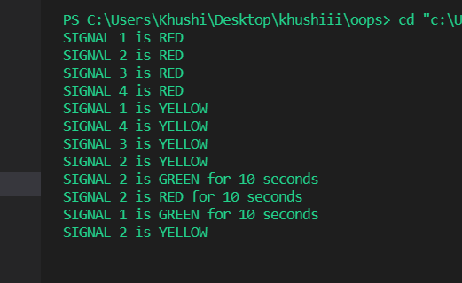
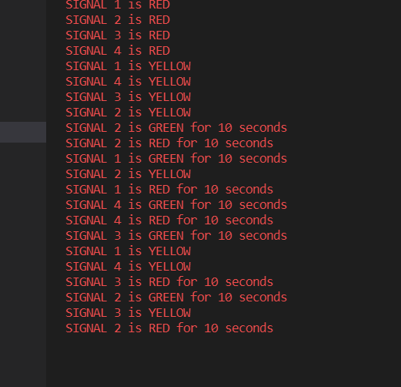
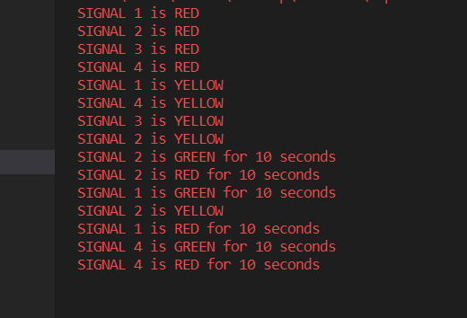
OUTPUT

Slide 13
REFERENCES
Wikipedia.com
Textbook- Abraham Silberschatz
THANK YOU!

