Slide 1

MCA Major Project Mid Term Evaluation
AI Voice Assistant Roosh
Under the guidance of
Faculty Guide Name:- Pramod Soni
Department of Computer Applications
Faculty of Science, Technology and Architecture
Manipal University Jaipur
By
Khushi Shekhawat
23FS20MCA00031
2023-25

Slide 2
Outline
Introduction
Motivation
Process Model
Software Requirement Specification (SRS)
ER Diagram
DFD Diagram
Use Case Diagram
Output
Conclusion
Future Scope

Slide 3
1. Introduction
Roosh is an AI-powered voice assistant designed to recognize speech, generate synthesized responses, and execute various commands. Developed using Python, it leverages advanced speech recognition and text-to-speech technologies to facilitate seamless human-computer interaction. The assistant is capable of browsing the web, playing music, providing time updates, and responding to queries, making it a valuable tool for personal and professional use.

Slide 4
2. Motivation
The development of Roosh is driven by several key objectives:
Automation of Daily Tasks: Reducing the need for manual input and enabling hands-free operation.
Enhancing Accessibility: Assisting individuals with disabilities by providing a voice-based interface.
Improving User Convenience: Allowing users to interact with their devices more efficiently through voice commands.
Enabling Smart Assistance: Integrating AI to assist with internet searches, multimedia control, and task management.
Bridging Human-Computer Interaction: Making technology more intuitive and user-friendly.

Slide 5
3. Process Model
Roosh follows a structured workflow to process user commands:
User Input: Captures audio through a microphone.
Speech Recognition: Converts spoken words into text using Natural Language Processing (NLP) algorithms.
Processing and Decision Making: Analyzes the command and determines the appropriate action.
Execution: Executes tasks such as searching the internet, playing music, or providing time updates.
Text-to-Speech Output: Responds with synthesized voice output to confirm actions or provide information.

Slide 6
4. Software Requirement Specification (SRS)
Functional Requirements:
Speech Recognition: Converts spoken input into text.
Text-to-Speech (TTS): Converts responses into audio output.
Web Browsing: Opens websites based on user requests.
Multimedia Control: Plays music from local files or online sources.
Time and Date Updates: Announces the current time and date.
Voice Interaction: Responds to general queries and engages in basic conversations.
Non-functional Requirements:
Real-Time Processing: Ensures quick response times to user queries.
User-Friendly Interface: Simplifies interaction for users of all skill levels.
Scalability: Allows future integration of additional features and services.

Slide 7
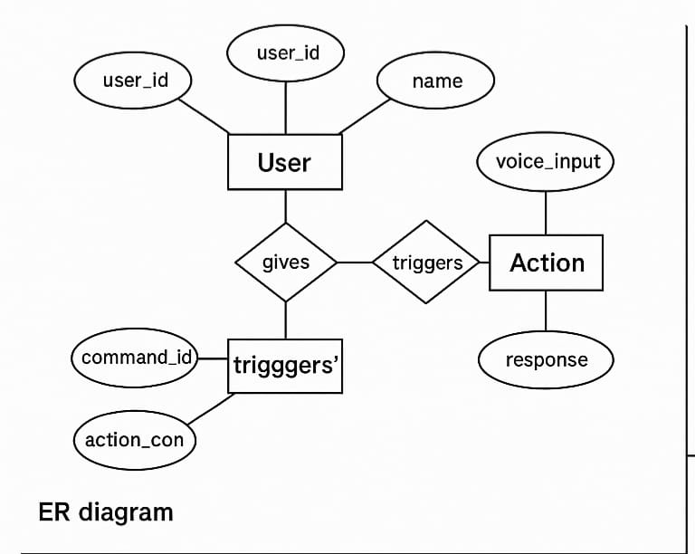
6. ER DIAGRAM

Slide 8
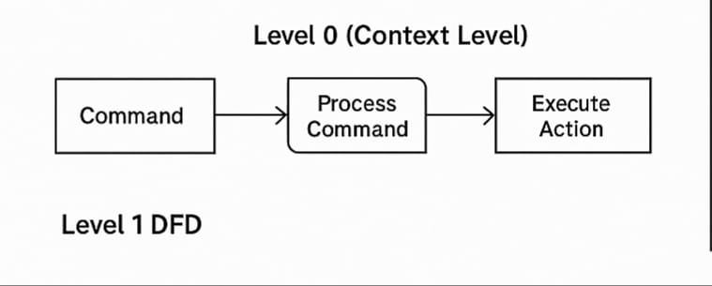
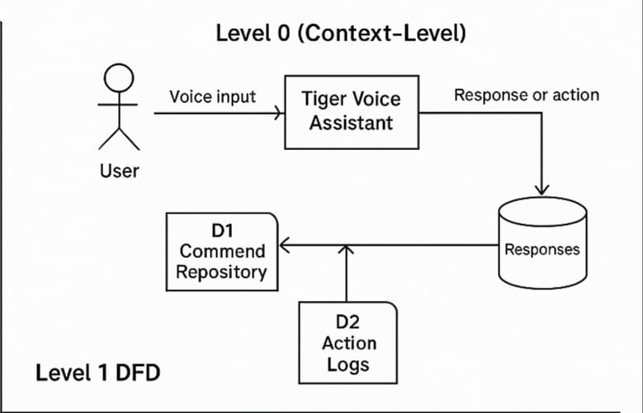
7. DFD Diagram

Slide 9
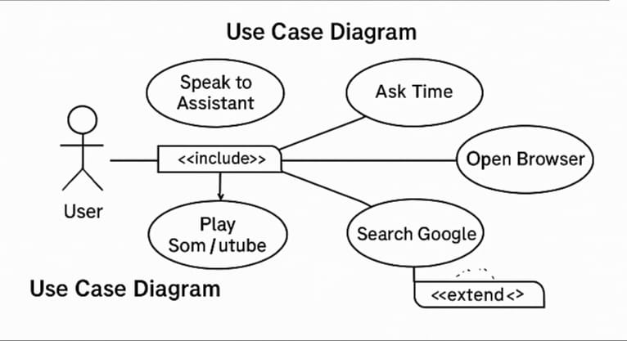
8. Use Case Diagram

Slide 10
9. Output
Roosh functionalities include:
Opening Web Pages: Directs users to Google, YouTube, and other requested sites.
Playing Music: Supports local file playback and online song searches.
Time Announcements: Provides real-time updates on time and date.
General Assistance: Answers common questions and assists with basic tasks.
YouTube Search & Playback: Searches for videos and plays them based on user input.

Slide 11
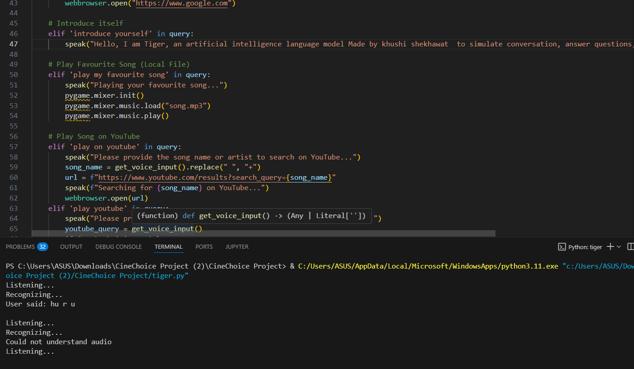

Slide 12
10. Conclusion
Roosh is a robust AI voice assistant capable of executing various voice-activated tasks with high efficiency. It significantly enhances user experience by reducing manual effort and enabling natural language communication. With further enhancements, it can be integrated into smart home systems, corporate workflows, and various other applications to provide seamless assistance.

Slide 13
7. Future Scope
IoT Integration: Connecting Roosh with smart home devices for voice-controlled automation.
Multi-Language Support: Expanding the system to understand and respond in multiple languages.
Advanced NLP Capabilities: Enhancing conversation handling for more natural interactions.
AI-Powered Chatbot Integration: Making the assistant more interactive and intelligent.
Cross-Platform Compatibility: Developing mobile and desktop versions for wider accessibility.
Machine Learning Enhancements: Improving accuracy and efficiency through adaptive learning techniques.

