Slide 1

Faculty of Computer Science

Slide 2


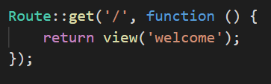
Laravel Basic Routing
Routing is one of the essential concepts in Laravel. The main functionality of the routes is to route all your application requests to the appropriate controller.

Slide 3
Default Route files
All Laravel routes are defined inside the route files located in the routes directory. When we create a project, then a route directory is created inside the project. The route/web.php directory contains the definition of route files for your web interface.

Slide 4
Continue…
In the above case, Route is the class which defines the static method get(). The get() method contains the parameters '/' and function() closure.
The '/' defines the root directory and function() defines the functionality of the get() method.
Closure
What is Closure in Laravel? What is Closure and what does it do? A Closure is an anonymous function.
Closures are often used as callback methods and can be used as a parameter in a function.

Slide 5
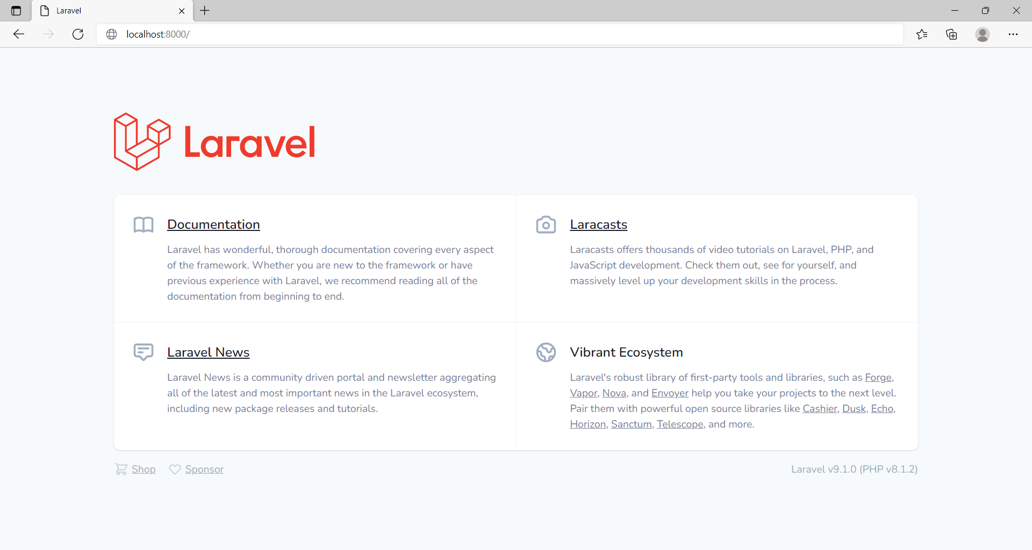
Output

Slide 6
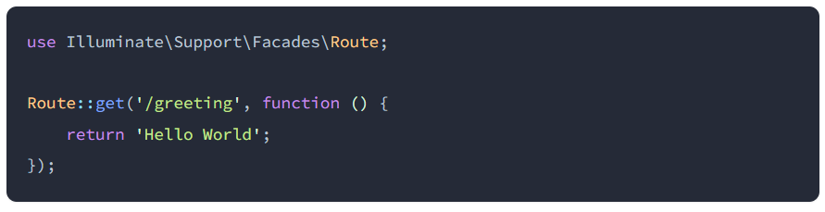
Continue…
Let's see another example.
Now, we provide another url in this example.

Slide 7
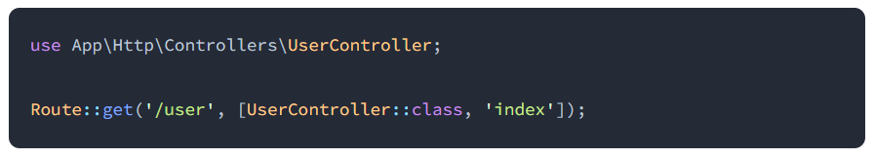
Continue…
Let's see another example.
Route with controller.

Slide 8
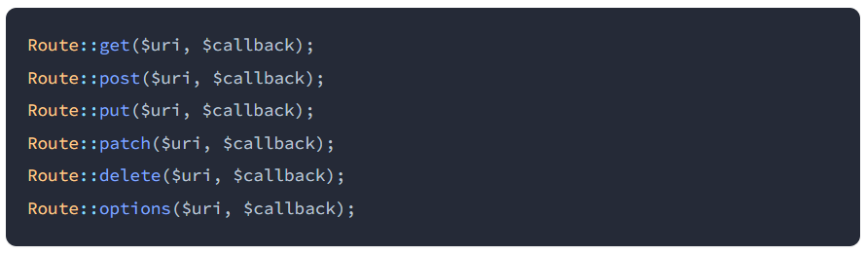
Available Router Methods
The router allows you to register routes that respond to any HTTP verb:

Slide 9
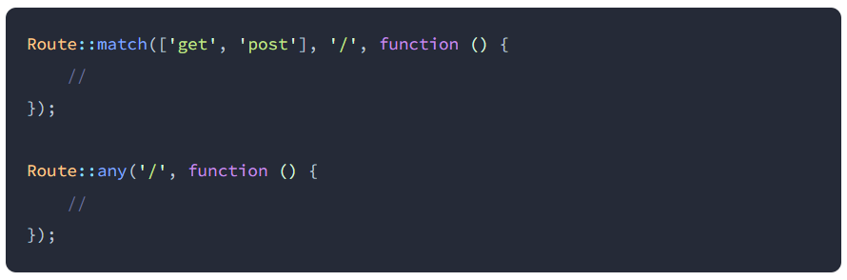
Continue…
Sometimes you may need to register a route that responds to multiple HTTP verbs. You may do so using the match method.
You may even register a route that responds to all HTTP verbs using the any method:

Slide 10

Continue…
use Illuminate\Http\Request;

Slide 11


Redirect Routes
Redirect() method is used to navigate from one URL to another URL. This method provides a convenient or shortcut way to move from one URI to another URI. With the help of this method, you don't need to define the full route.
First way is to declare the redirect() method in get() method:
Second way is to access the redirect() method directly.

Slide 12
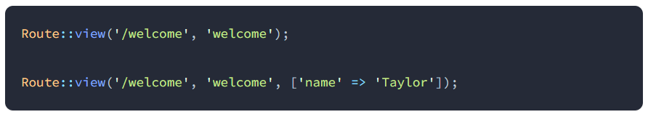
View Routes
If your route only needs to return a view, you may use the Route::view method. Like the redirect method, this method provides a simple shortcut so that you do not have to define a full route or controller.
The view method accepts a URI as its first argument and a view name as its second argument. In addition, you may provide an array of data to pass to the view as an optional third argument:

Slide 13
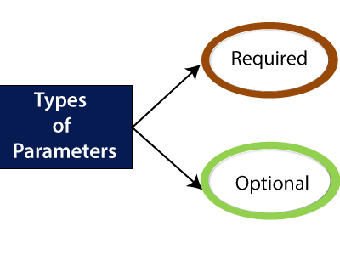
Routing Parameters

Slide 14
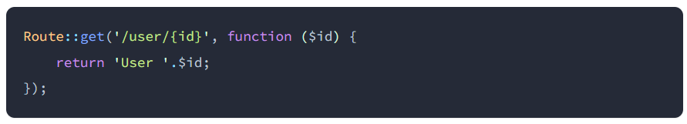
1. Required Parameters
The required parameters are the parameters that we pass in the URL. Sometimes you want to capture some segments of the URI then this can be done by passing the parameters to the URL. For example, you want to capture the user id from the URL.

Slide 15
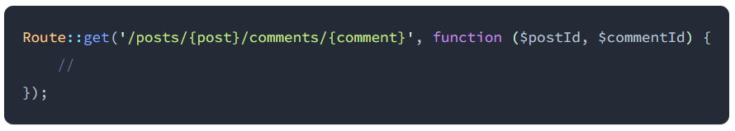
Continue…
You may define as many route parameters as required by your route:

Slide 16
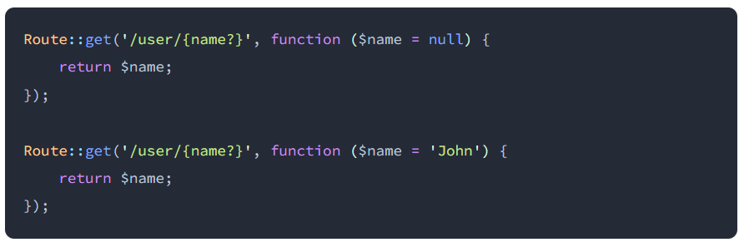
Optional Parameters
Occasionally you may need to specify a route parameter that may not always be present in the URI. You may do so by placing a ? mark after the parameter name. Make sure to give the route's corresponding variable a default value:

Slide 17
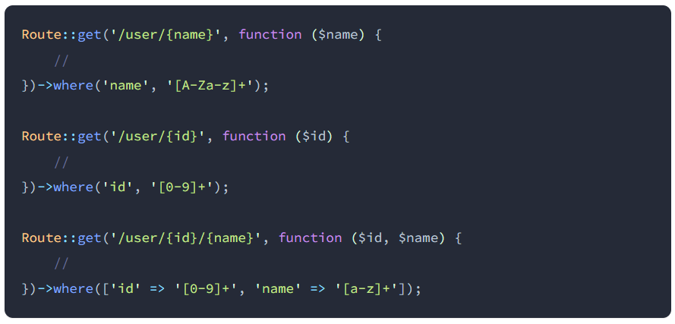
Regular Expression Constraints
You may constrain the format of your route parameters using the where method on a route instance. The where method accepts the name of the parameter and a regular expression defining how the parameter should be constrained:

Slide 18
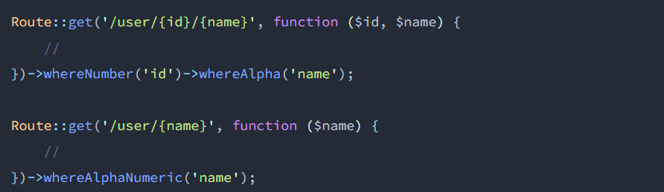
Continue…
For convenience, some commonly used regular expression patterns have helper methods that allow you to quickly add pattern constraints to your routes:

Slide 19
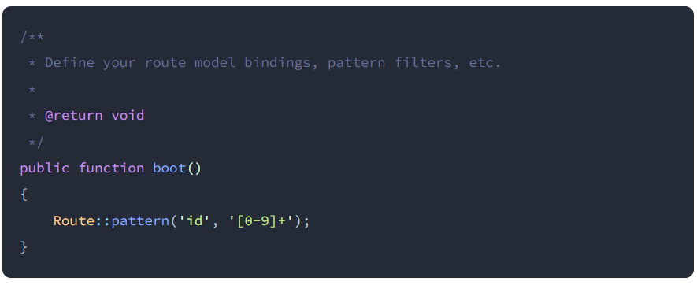
Global Constraints
If you would like a route parameter to always be constrained by a given regular expression, you may use the pattern method. You should define these patterns in the boot method of your App\Providers\RouteServiceProvider class:

Slide 20
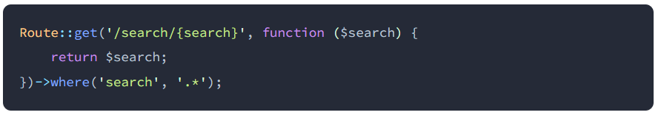
Encoded Forward Slashes
The Laravel routing component allows all characters except / to be present within route parameter values. You must explicitly allow / to be part of your placeholder using a where condition regular expression:

Slide 21
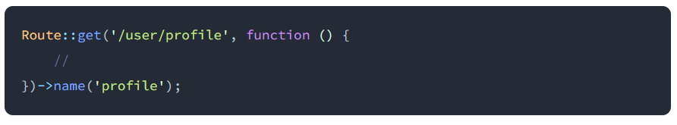
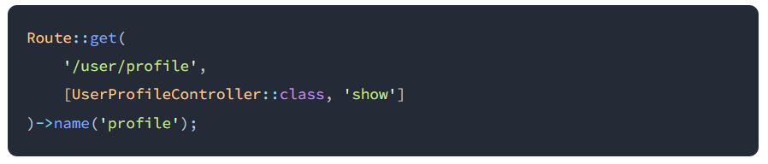
Named Routes
Named routes allow the convenient generation of URLs or redirects for specific routes. Route names should always be unique. You may specify a name for a route by chaining the name method onto the route definition:
You may also specify route names for controller actions:

Slide 22
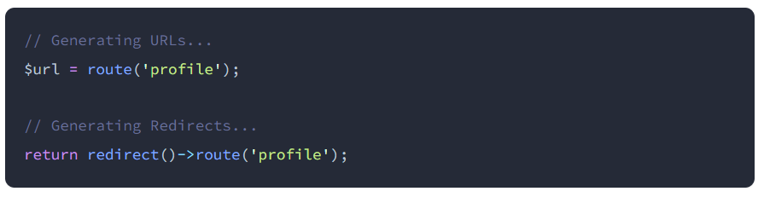
Generating URLs to named routes
Once you have assigned a name to a given route, you may use the route's name when generating URLs or redirects via Laravel's route and redirect helper functions:

Slide 23
Route Groups
Route groups allow you to share route attributes, such as middleware, across a large number of routes without needing to define those attributes on each individual route.
Groups are beneficial when you want to apply the attributes to all the routes. If you use route groups, you do not have to apply the attributes individually to each route; this avoids duplication.
It allows you to share the attributes such as middleware, without defining these attributes on each individual route. These shared attributes can be passed in an array format as the first parameter to the Route::group method.
Syntax:
  Route::group( [ ] , callback);

Slide 24
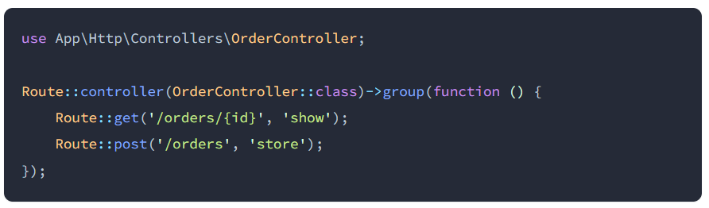
Route Groups
Controllers
If a group of routes all utilize the same controller, you may use the controller method to define the common controller for all of the routes within the group. Then, when defining the routes, you only need to provide the controller method that they invoke:

Slide 25
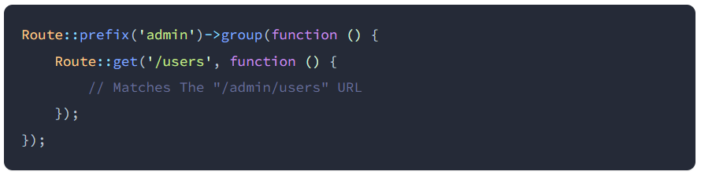
Route Groups
Route prefixes
The prefix method may be used to prefix each route in the group with a given URI. For example, you may want to prefix all route URIs within the group with admin:

Slide 26
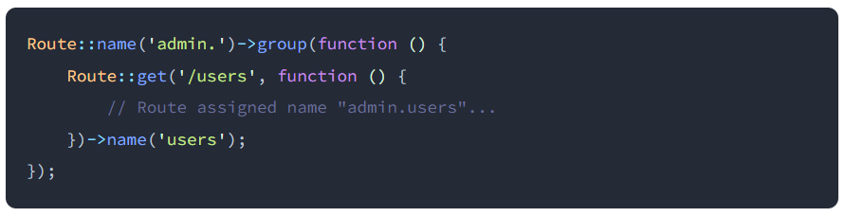
Route Groups
Route Name prefixes
The name method may be used to prefix each route name in the group with a given string. For example, you may want to prefix all of the grouped route's names with admin. The given string is prefixed to the route name exactly as it is specified, so we will be sure to provide the trailing . character in the prefix:

Slide 27
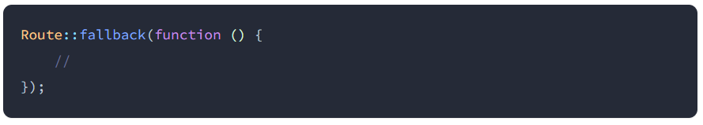
Fallback Routes
Using the Route::fallback method, you may define a route that will be executed when no other route matches the incoming request. Typically, unhandled requests will automatically render a "404" page via your application's exception handler. However, since you would typically define the fallback route within your routes/web.php file.
Note: The fallback route should always be the last route registered by your application.

Slide 28

Route Caching
When deploying your application to production, you should take advantage of Laravel's route cache. Using the route cache will drastically decrease the amount of time it takes to register all of your application's routes. To generate a route cache, execute the route:cache Artisan command:
You may use the route:clear command to clear the route cache:

Slide 29
Thank You!

