Slide 1

Faculty of Computer Science

Slide 2


Introduction
Instead of defining all of your request handling logic as closures in your route files, you may wish to organize this behavior using "controller" classes. Controllers can group related request handling logic into a single class.
For example, a UserController class might handle all incoming requests related to users, including showing, creating, updating, and deleting users.
By default, controllers are stored in the app/Http/Controllers directory.
Laravel framework follows the MVC (Model View Controller) architecture in which controllers act as moving the traffic back and forth between model and views.

Slide 3

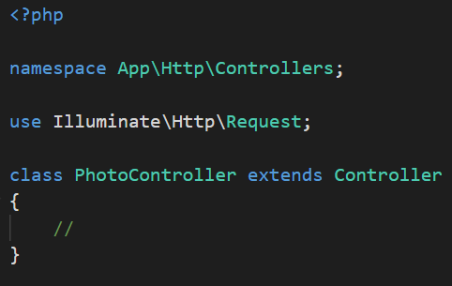
How To Create Controller
To create controller we use the following command.
The default code of the PhotoController.php file is given below:

Slide 4
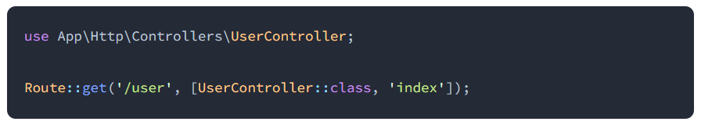
Routing Controllers
Route with controller.

Slide 5

Single Action Controllers
If we want to use the single method in a controller, then we can use the single __invoke() method on the controller.
To accomplish this, you may define a single __invoke method within the controller:

Slide 6
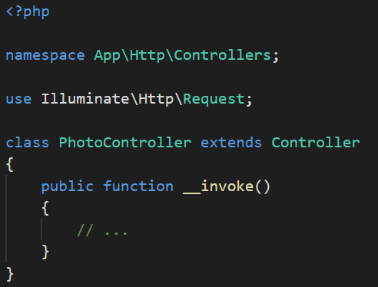
Single Action Controllers

Slide 7

Resource Controllers
Laravel resource controllers provide the CRUD routes to the controller in a single line of code. A resource controller is used to create a controller that handles all the http requests stored by your application.
The resource() is a static function like get() method that gives access to multiple routes that we can use in a controller.

Slide 8
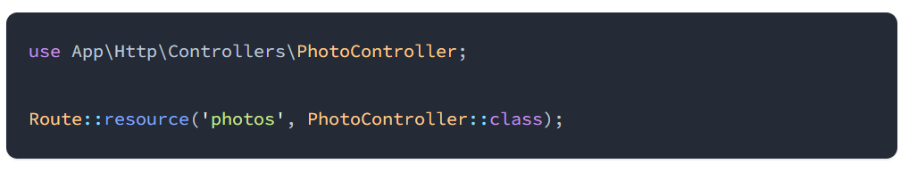
Resource Controllers
This command will generate a controller at app/Http/Controllers/PhotoController.php.
The controller will contain a method for each of the available resource operations. Next, you may register a resource route that points to the controller:

Slide 9
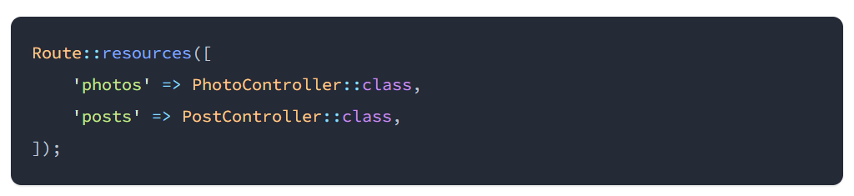
Resource Controllers
You may even register many resource controllers at once by passing an array to the resources method:

Slide 10
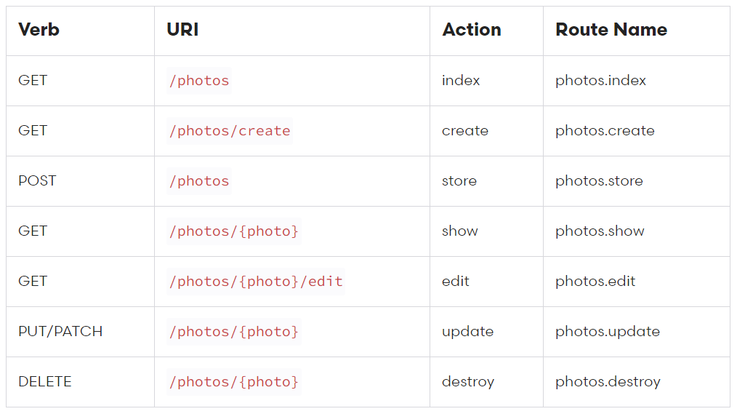
Actions Handled By Resource Controller

Slide 11
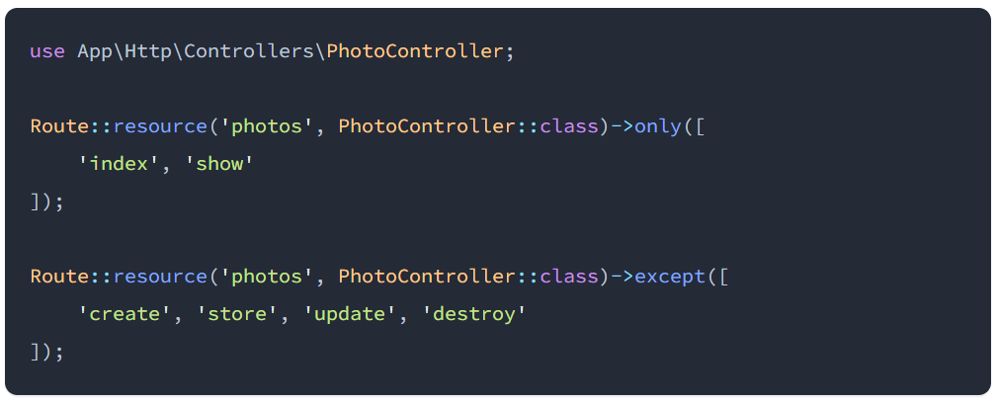
Partial Resource Routes
When declaring a resource route, you may specify a subset of actions the controller should handle instead of the full set of default actions:

Slide 12
Middleware
Middleware provide a convenient mechanism for inspecting and filtering HTTP requests entering your application.
For example, Laravel includes a middleware that verifies the user of your application is authenticated.
If the user is not authenticated, the middleware will redirect the user to your application's login screen.
However, if the user is authenticated, the middleware will allow the request to proceed further into the application.
Middleware are located in the app/Http/Middleware directory.

Slide 13
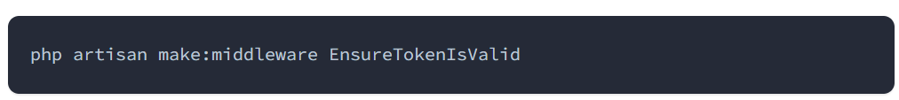
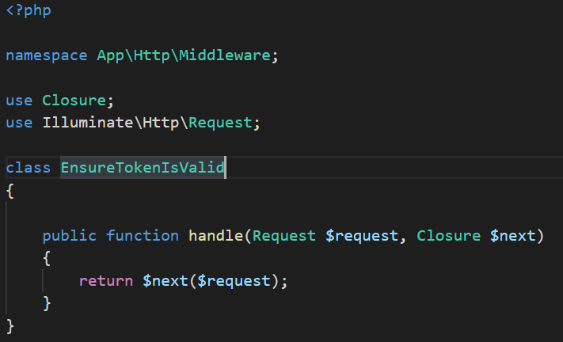
Defining Middleware
To create a new middleware, use the make:middleware Artisan command:

Slide 14
Registering Middleware
Assigning Middleware To Route
If you would like to assign middleware to specific routes, you should first assign the middleware a key in your application's app/Http/Kernel.php file.
By default, the $routeMiddleware property of this class contains entries for the middleware included with Laravel.
You may add your own middleware to this list and assign it a key of your choosing:

Slide 15
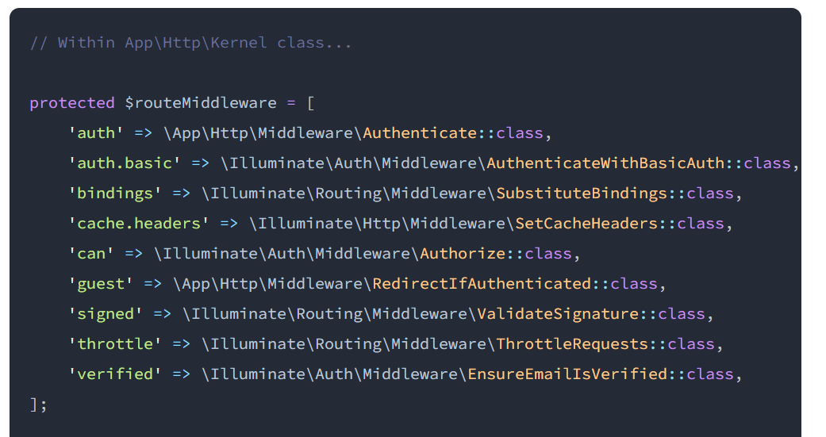
Defining Middleware

Slide 16
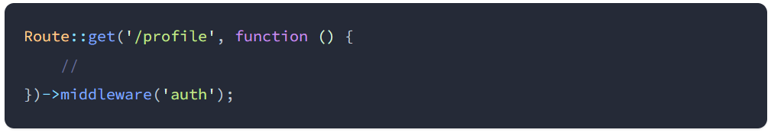
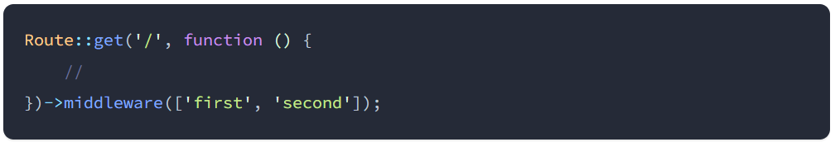
Defining Middleware
Once the middleware has been defined in the HTTP kernel, you may use the middleware method to assign middleware to a route:
You may assign multiple middleware to the route by passing an array of middleware names to the middleware method:

Slide 17
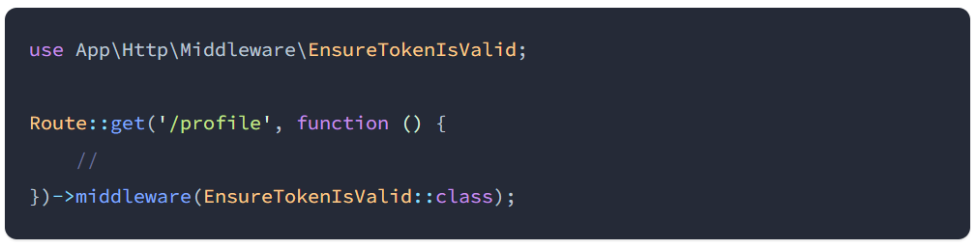
Defining Middleware
When assigning middleware, you may also pass the fully qualified class name:

Slide 18
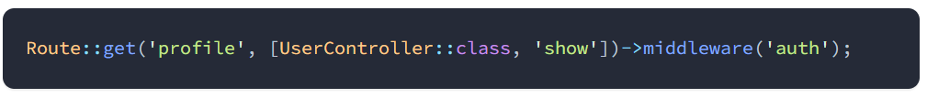
Controller Middleware
Middleware may be assigned to the controller's routes in your route files:

Slide 19
HTTP Requests
Laravel's Illuminate\Http\Request class provides an object-oriented way to interact with the current HTTP request being handled by your application as well as retrieve the input, cookies, and files that were submitted with the request.

Slide 20
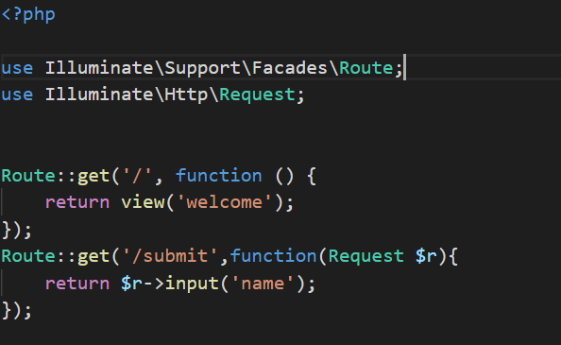
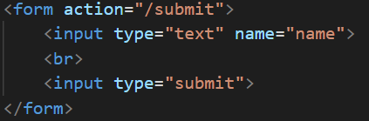
Retrieving Input
We can access HTML Form data with the help of Request class.

Slide 21
Retrieving All Input Data
You may retrieve all of the incoming request's input data.

Slide 22
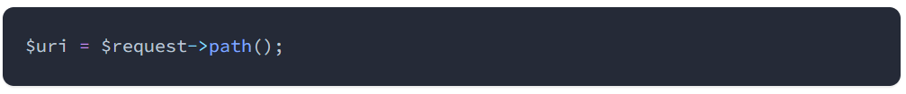
Retrieving The Request Path
The path method returns the request's path information. So, if the incoming request is targeted at http://example.com/foo/bar, the path method will return foo/bar:

Slide 23
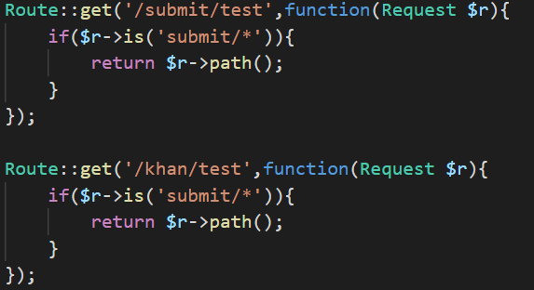
Retrieving The Request Path
The is method allows you to verify that the incoming request path matches a given pattern. You may use the * character as a wildcard when utilizing this method:

Slide 24
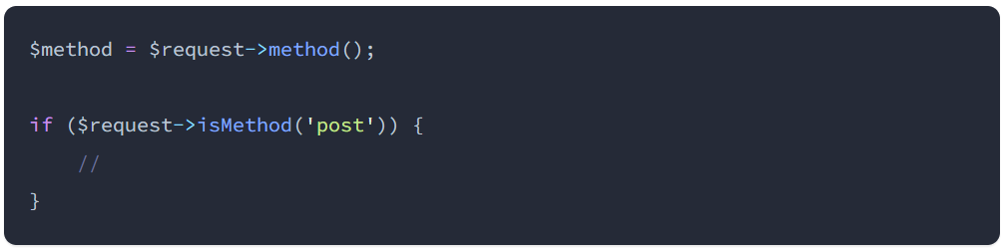
Retrieving The Request Method
The method method will return the HTTP verb for the request. You may use the isMethod method to verify that the HTTP verb matches a given string:

Slide 25
Request IP Address
The ip method may be used to retrieve the IP address of the client that made the request to your application:

Slide 26
Thank You!

