Slide 1

Faculty of Computer Science

Slide 2


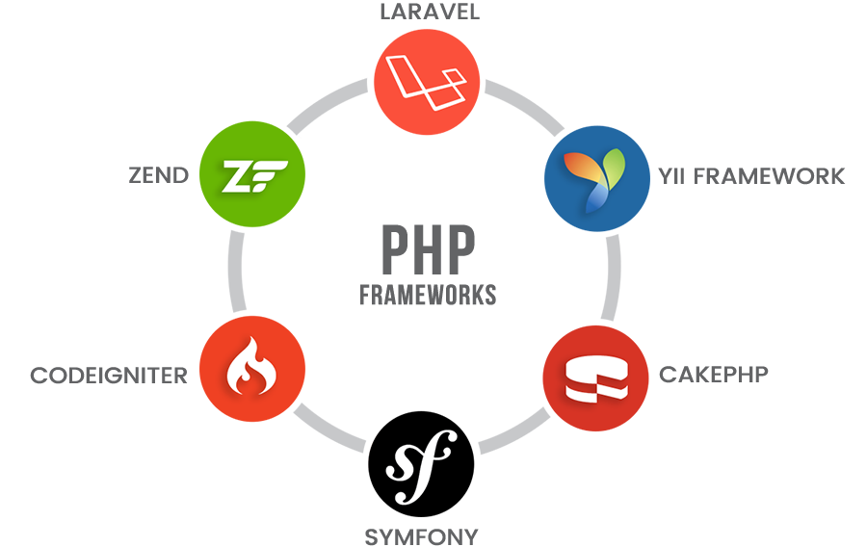
PHP Frameworks

Slide 3
What is Laravel?
Laravel is an open-source PHP framework. It also offers the rich set of functionalities.
Laravel is one of the world’s most popular PHP frameworks for building web applications from small to large projects.
Due to its performance, features and scalability, Laravel is the choice of professional developers.
Laravel is a PHP Framework that uses the MVC Architecture.
Framework: It is the collection of methods, classes, or files that the programmer uses, and they can also extend its functionality by using their code.
Architecture: It is the specific design pattern that the framework follows. Laravel is following the MVC architecture.

Slide 4
History of Laravel
Laravel is a Free Open-source PHP framework that was created by Taylor Otwell a .net developer in Arkansas in the year 2011.
The intention behind creating this framework was to make programming simpler and to provide an excellent substitute for the older PHP framework named CodeIgniter.
CodeIgniter did not facilitate the features like support for built-in customer authentication and proper user authorization.

Slide 5
Laravel Version Release
Version | Released on
Laravel 1 | June 9, 2011
Laravel 2 | November 24, 2011
Laravel 3 | February 22, 2012
Laravel 4 | May 28, 2013
Laravel 5 | February 2015
Laravel 5.1 | June 2015
Laravel 5.2 | December 2015
Notes:
https://www.w3schools.in/laravel-tutorial/history/

Slide 6
Laravel Version Release
Version | Released on
Laravel 5.3 | August 23, 2016
Laravel 5.4 | January 24, 2017
Laravel 6 | September 3, 2019
Laravel 7 | March 3, 2020
Laravel 8 | September 8, 2020
Laravel 9 | February 8, 2022

Slide 7
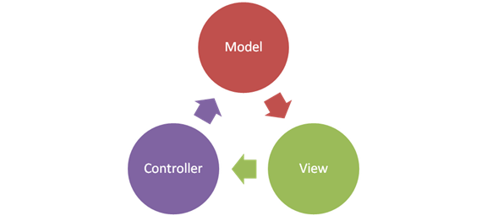
What is MVC?

Slide 8
What is Model?
M: 'M' stands for Model. A model is a class that deals with a database.
For example, if we have users in an application then we will have users model that deals with a database to query the table of users if we have users model, then we will also have a users table.
We conclude from the example that the model is going to have a table for that specific model.

Slide 9
What is View?
V: 'V' stands for View. A view is a component that deals with an HTML.
Everything that we can see on the application in the browser is the view or the representation.
Examples include displaying a window or buttons or text within a window. It includes anything that the user can see.

Slide 10
What is Controller?
C: 'C' stands for Controller. A controller is the middle-man that deals with both model and view.
A controller is the class that retrieves the data from the model and sends the data to the view class.

Slide 11

Why Laravel?
8

Slide 12
08 Reasons Why Use Laravel PHP Framework?

Slide 13
1. Object-Oriented Libraries
One of the topmost reasons which make Laravel as one of the best PHP frameworks is that it has object-oriented libraries and various other pre-installed ones, which are not seen in any of the popular PHP frameworks.
Here, one of the pre-installed libraries is the ‘authentication library’. Though it is easy to device,.
it has many progressive features, such as Bcrypt hashing, checking active users, Cross-site Request Forgery (CSRF) protection, and encryption, and password reset.

Slide 14
2. Authorization Technique
Laravel makes the execution of authentication practices very easy.
Nearly everything is configured particularly. Laravel also delivers a simple method to establish authorization reasoning and control access to the resources.

Slide 15
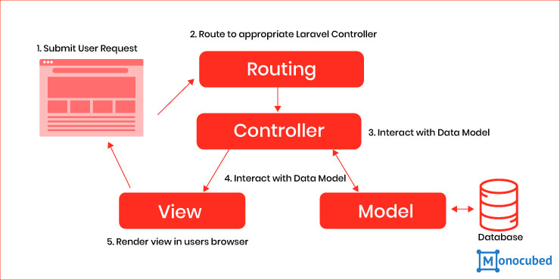
3. MVC Support
Laravel Framework Follow the MVC Model.

Slide 16
4. Artisan
Laravel framework provides a built-in tool for a command-line known as Artisan that performs the repetitive programming tasks that do not allow the php developers to perform manually.
These artisans can also be used to create the skeleton code, database structure, and their migration, so it makes it easy to manage the database of the system. It also generates the MVC files through the command line.

Slide 17
5. Database Migration
For developers, one aspect to worry about is to retain the database in sync between development machines. With Laravel database migrations, it is enormously easy. After long working hours, you may have done several alterations to the database.
In our opinion, MySQL Workbench is not an apt technique to sync databases between the development machines. Provided that you keep all the database work in seeds and migrations, you can simply migrate the variations into other development devices you possess. This is another motive that states Laravel to be the best PHP framework.

Slide 18
6. Security
While building an application every developer has to utilize some or the other ways to make the application safe.
Laravel ensures security inside its framework. It employs a hashed and salted password, which states that the password will not be saved as the plain text in the database.
It practices the Bcrypt hashing algorithm for producing an encrypted demonstration of the password. Laravel exercises ready-made SQL statements which make the injection attacks unbelievable.

Slide 19
7. Blade Templating Engine
The Blade templating engine is very instinctive and aids to function with the typical PHP or HTML spaghetti so better, that it is one of the vital features of the Laravel framework.
This trait combines one or more templates with a data model to generate resultant views, doing that by emerging the templates into cached PHP code for enhanced performance.
Blade also offers a collection of its control constructions such as loops and conditional statements, which are mapped inside to PHP counterparts.

Slide 20
8. Tutorials (Laracasts)
Your developers or you require to study more in order to convey more. Dissimilar to other frameworks like Yii, Codeigniter, and CakePHP, Laravel presents Laracasts which gives a mixture of paid and free video tutorials that depicts how you can use Laravel.
These videos are made by Jeffery Way, an experienced and expert instructor. He offers concise and clear guidelines. The creation quality is great, and the teachings are well-thought and significant.

Slide 21


Laravel Installations

Slide 22
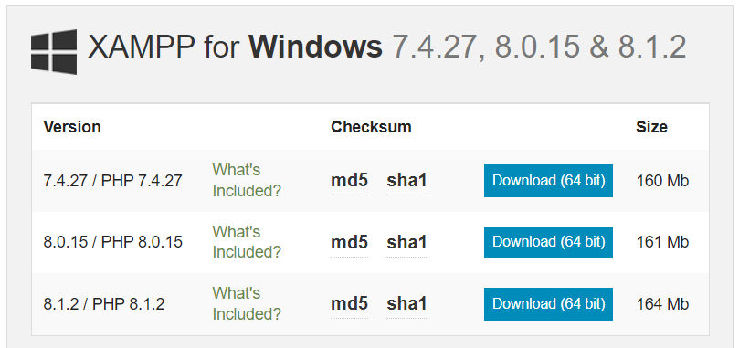
XAMPP Installation
Link For Download:
https://www.apachefriends.org/download.html
Notes:
https://www.apachefriends.org/download.html

Slide 23
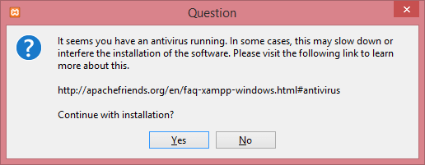
XAMPP Installation
Download the PHP 8.1.2 version. To download this version, click on the Download button.
Click on the file, i.e., xampp-windows-x64-8.1.2-0-VS16-installer.exe to install the XAMPP.
When you click on the downloaded file, the screen appears shown below:
Notes:
https://www.apachefriends.org/download.html

Slide 24
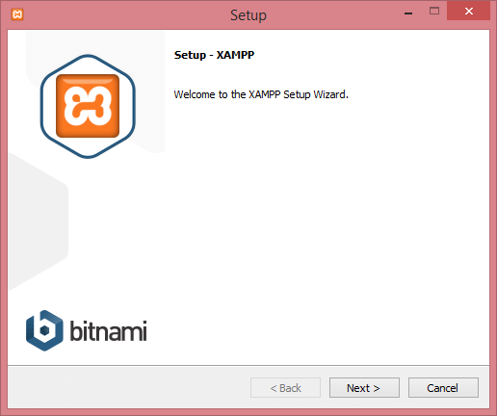
XAMPP Installation
Click on the Yes button.
After clicking on the Yes button, the warning appears, but ignores this warning and click on the OK button.
On clicking the OK button, the Setup window appears shown as below:
Notes:
https://www.apachefriends.org/download.html

Slide 25
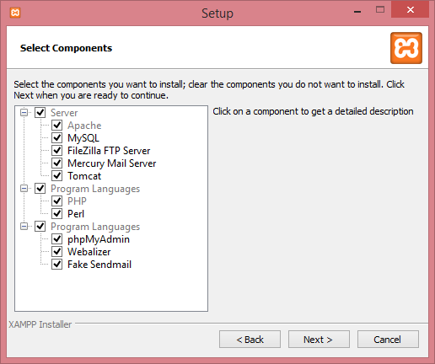
XAMPP Installation
Click on the Next button.
Select the components in the below screen, and then click on the Next button.
Notes:
https://www.apachefriends.org/download.html

Slide 26
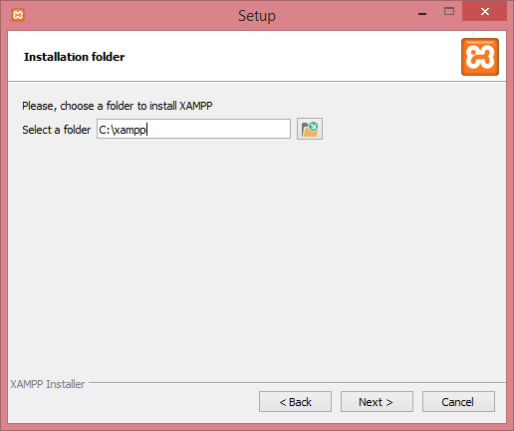
XAMPP Installation
Select the folder in which you want to install your XAMPP and click on the Next button.
Notes:
https://www.apachefriends.org/download.html

Slide 27
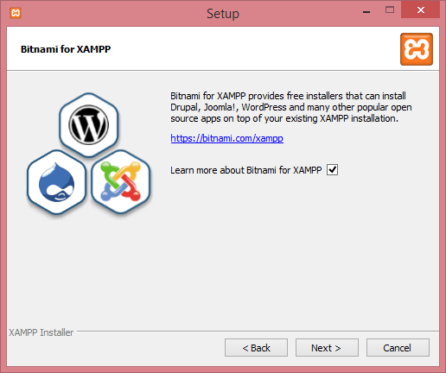
XAMPP Installation
Click on the Next button.
Notes:
https://www.apachefriends.org/download.html

Slide 28
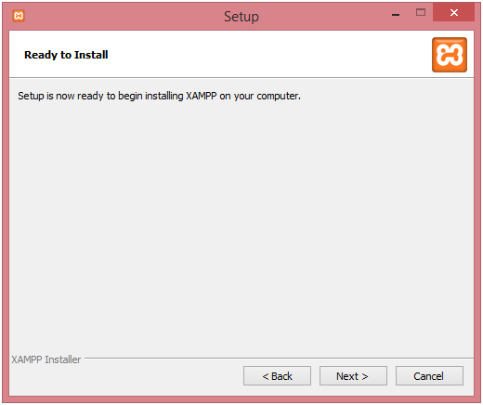
XAMPP Installation
The below screen shows that the setup is ready to install, click on the Next button.
Notes:
https://www.apachefriends.org/download.html

Slide 29
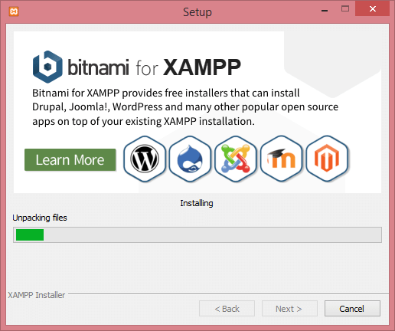
XAMPP Installation
The installation process is started, which is shown in the below screen:
Notes:
https://www.apachefriends.org/download.html

Slide 30
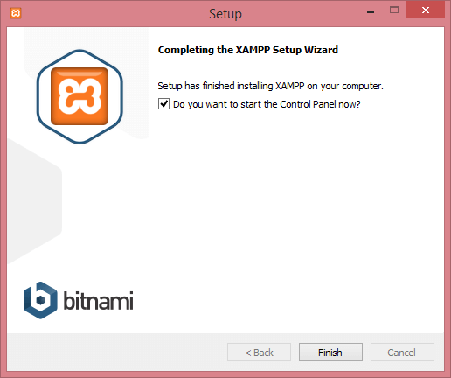
XAMPP Installation
When the installation is completed, the screen appears asking for the completion of a XAMPP Setup Wizard.
Notes:
https://www.apachefriends.org/download.html

Slide 31
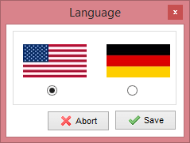
XAMPP Installation
Click on the Finish button.
Select the language and then click on the Save button.
Notes:
https://www.apachefriends.org/download.html

Slide 32
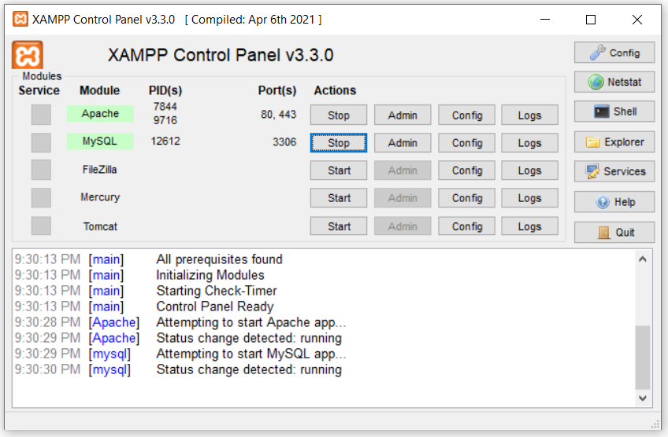
XAMPP Installation
Notes:
https://www.apachefriends.org/download.html

Slide 33
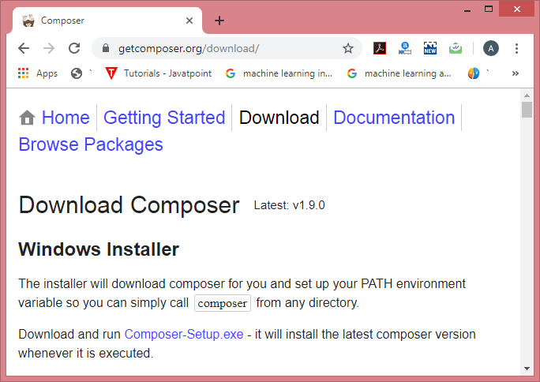
Composer Installation
Following are the steps to download the Composer:
Click on the link given below to download the Composer: https://getcomposer.org/download/.
To download the Composer for Windows, click on the link Composer-Setup.exe.

Slide 34
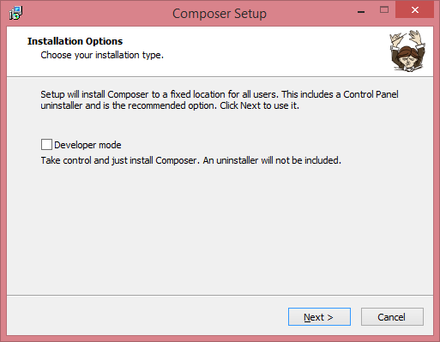
Composer Installation
On clicking the above link, the Composer-Setup.exe file gets downloaded.
To install the Composer, run the downloaded file.
After clicking on the downloaded file, the screen appears shown below:

Slide 35
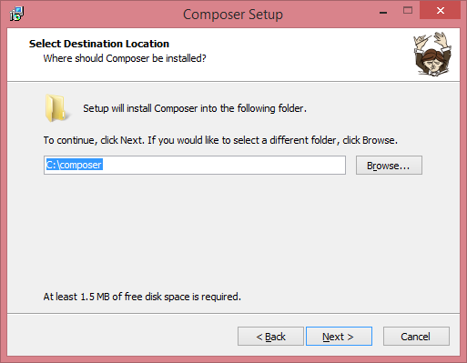
Composer Installation
Select the Developer mode in the above screen and click on the Next button.
Select the path in which you want to install the setup of the composer, and then click on the Next button.

Slide 36
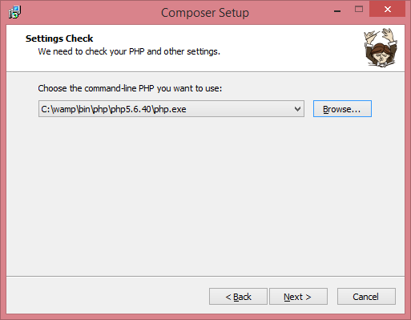
Composer Installation
Select the path of command-line PHP and the path is "c:\xampp\bin\php\php5.6.40\php.exe".

Slide 37
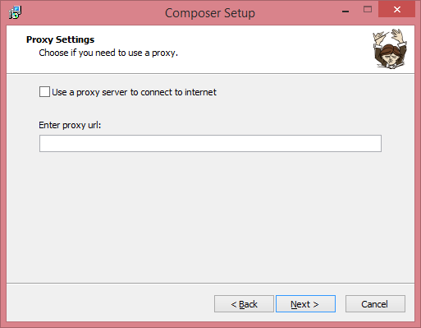
Composer Installation
If you want to use a proxy, then check the box of the proxy server and enter proxy url. Here, I am using Composer without a proxy server, so I uncheck the box. Click on the Next button.

Slide 38
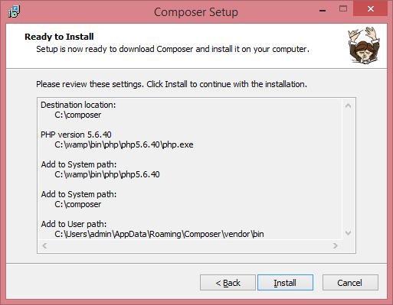
Composer Installation
The below screen shows that the setup is ready to install, click on the Install button.

Slide 39
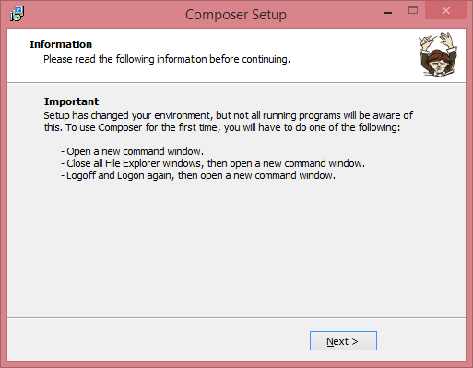
Composer Installation
After clicking on the install button, the screen appears shown below:

Slide 40
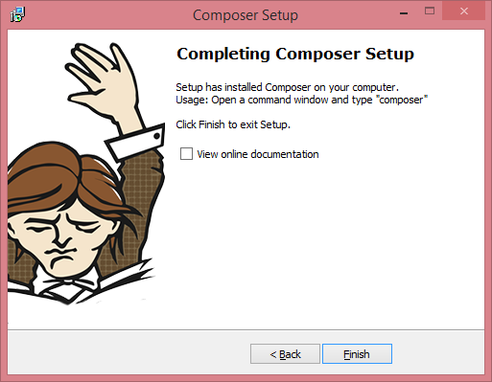
Composer Installation
Click on the Next button.
If you want to see the online documentation, then check the box of "View online documentation" and click on the Finish button.

Slide 41
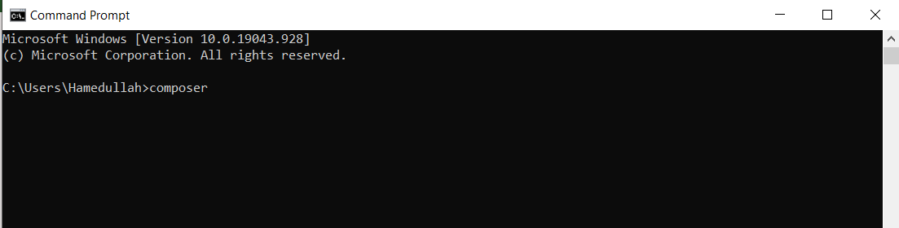
Composer Installation
The installation of the composer is completed. Now we will check whether the composer is installed successfully or not. To check this, open the command prompt and type Composer.

Slide 42
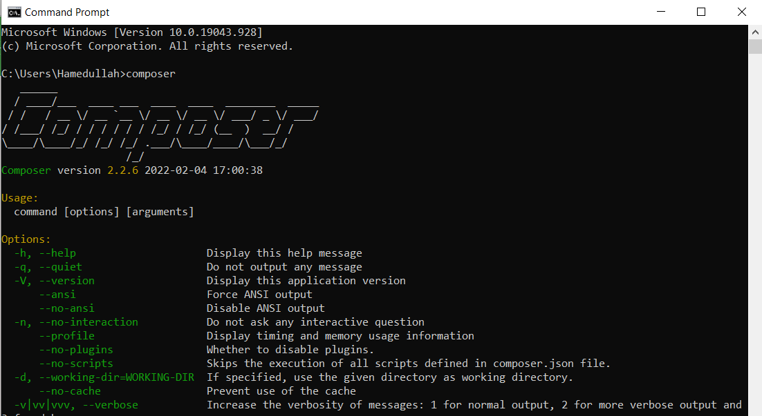
Composer Installation
After entering the Composer, press Enter.

Slide 43
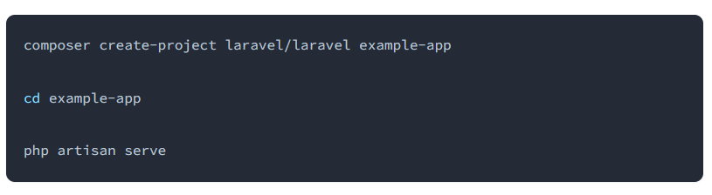
Creating First Laravel Project
Installation Via Composer
If your computer already has PHP and Composer installed, you may create a new Laravel project by using Composer directly.
After the application has been created, you may start Laravel's local development server using the Artisan CLI's serve command:

Slide 44
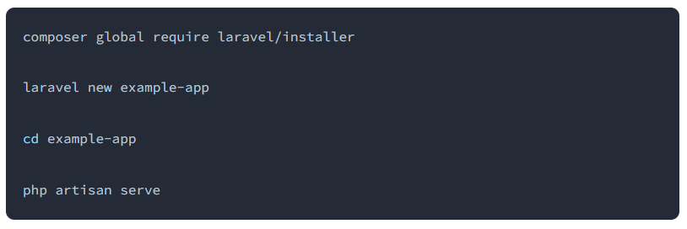
Creating First Laravel Project
The Laravel Installer
Or, you may install the Laravel Installer as a global Composer dependency:

Slide 45
Directory Structure
App Directory
The app directory contains the core code of your application. almost all of the classes in your application will be in this directory.
The App folder contains the following sub-folders:
  Console
  Exceptions
  Http
  Providers

Slide 46
Directory Structure
Console
Console folder contains the artisan commands required for Laravel. It contains the commands which are declared with the appropriate signature.
Exceptions
Exceptions folder contains the various exception handlers. It handles the exceptions thrown by the Laravel project. The Exceptions directory contains the methods that handle the exceptions.
The Exceptions directory contains the file handle.php that handles all the exceptions.

Slide 47
Directory Structure
Http
The http folder is a sub-folder of the app folder. It has sub-folders such as controllers, middleware.
Middleware: It is a sub-folder of the http directory. It provides a filter mechanism and communication between request and response.
Model
Providers
The Providers directory is used to contain all the service providers that are required to register events for core servers and provides configuration for Laravel application.

Slide 48
Directory Structure
Bootstrap Directory
The bootstrap directory contains the app.php file which bootstraps the framework.
The bootstrap folder contains a sub-folder cache used for caching a web application.
You should not typically need to modify any files within this directory.

Slide 49
Directory Structure
Config Directory
The config directory, as the name implies, contains all of your application's configuration files.
Database Directory
The database directory holds the database files. It contains sub-folders:
  Factories
  Migrations
  seeds

Slide 50
Directory Structure
Lang Directory
The lang directory houses all of your application's language files.
Public Directory
The public directory contains the index.php file, which is the entry point for all requests entering your application and configures autoloading. This directory also houses your assets such as images, JavaScript, and CSS.

Slide 51
Directory Structure
Resource Directory
The resources directory contains your views as well as your raw, un-compiled assets such as CSS or JavaScript.
Views: The views folder contains html files used to interact with the end-users, and it also plays an important role in MVC architecture.
Routes Directory
The routes directory contains all of the route definitions for your application.
By default, several route files are included with Laravel: web.php, api.php, console.php, and channels.php.

Slide 52
Directory Structure
Storage Directory
The storage directory contains your logs, compiled Blade templates, file based sessions, file caches, and other files generated by the framework.
  The app directory may be used to store any files generated by your application.
  The framework directory is used to store framework generated files and caches.
  The logs directory contains your application's log files.

Slide 53
Directory Structure
Test directory
The test directory holds all the automated unit test cases. The naming convention of test classes is camel_case but follow the naming convention according to the functionality of a class.
Vendor directory
The vendor directory contains the composer dependencies, for example, to install Laravel setup, the composer is required. The vendor folder contains all the composer dependencies.

Slide 54
Thank You!

