Slide 1
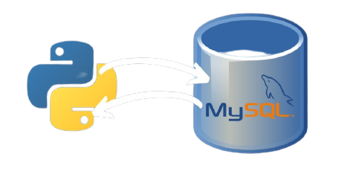
ONLINE VOTING
SYSTEM DATABASE
PRESENTATION BY
MANASI MURARKA - J038
KHYAATI NAYAK - J044
BHARATI PANIGRAHI - J045

Slide 2
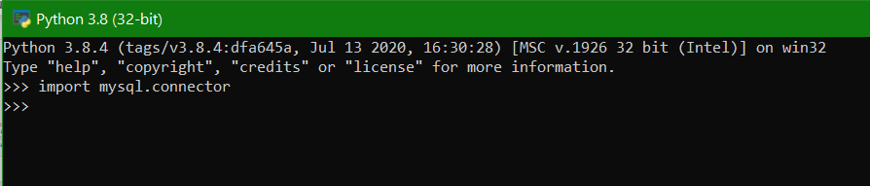
If NO error occurs it means mysql-connector has been installed properly!

Slide 3
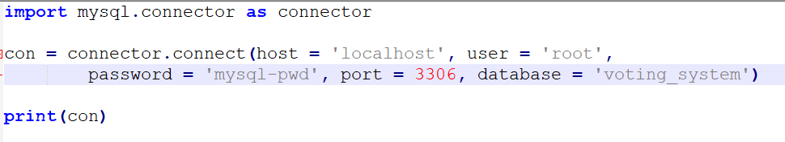
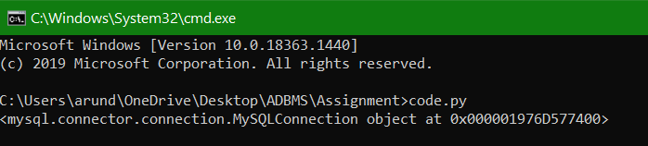
db
(db)
Connection established successfully!

Slide 4
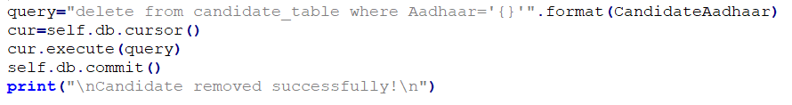
For every Select, Insert, Update, Delete statement, we use these lines of code to save the query in SQL from Python.
We do not commit the database after Select statements, since it does not make any changes to the database

Slide 5
DEMONSTRATION IN PYTHON

