Slide 1

1
SUMMER INTERNSHIP 2025
PRESENTATION
ON
AI POWERED RESUME SCREENING SYSTEM
Khyanrick Borah Roll no.- 38
Syed Jeeshan Javed Roll no.-39
Nilim kr. Gogoi Roll no.-12
Under the guidance of
Dr. Purabi Sharma
Department of ECE, Guwahati University

Slide 2
INTRODUCTION
.
Resume shortlisting is a tedious and time-consuming task during recruitment.
Traditional methods involve manual filtering which may be biased or inefficient.
Our system uses AI & NLP techniques to automatically screen and rank resumes based on job descriptions

Slide 3
OUTLINE
.
Use Case
Scope Of The Project
About the AI/NLP Model
Resume Dataset For Evaluation
Approach and Methodology
Tools Used
Logic
Example
Conclusion

Slide 4
USE CASE
Growing demand for automation in HR Tech.
Large volume of applicants makes manual screening impractical.
Need for unbiased, fast, and intelligent resume ranking solutions.
Enhances recruitment efficiency and decision-making accuracy.

Slide 5
SCOPE OF THE PROJECT
The scope of the project includes:
Accepts multiple PDF resumes, a job description and a match threshold.
Extracts and analyzes resume content using NLP.
Ranks resumes based on TF-IDF vectorization, Cosine Similarity and Decision tree classifier.
Displays scores, comparison charts.
Includes a user-friendly GUI interface via Tkinter.

Slide 6
About The AI/NLP Model:
TF-IDF Vectorizer: Converts job descriptions and resume texts into numerical vectors based on word importance
Cosine Similarity: Measures semantic similarity between job and resume vectors (range: 0 to 1).
Decision Tree Classifier: Binary classifier trained on similarity scores to label resumes as “Match” or “Not Match.”
Threshold Control: Match criteria can be tuned by adjusting similarity threshold (e.g., 20%).
Approach Type: Traditional NLP pipeline (rule-based + supervised ML), not deep learning.

Slide 7
Resume Dataset For Evaluation:
Type: Synthetic resume dataset
Source: A sample resume template was provided to ChatGPT
Generation: 21 unique resumes were generated by varying domains, skills, and experience levels
Format: Text data was converted to PDF for processing
Purpose: Used to test AI/NLP-based similarity ranking and classification against a provided job description

Slide 8
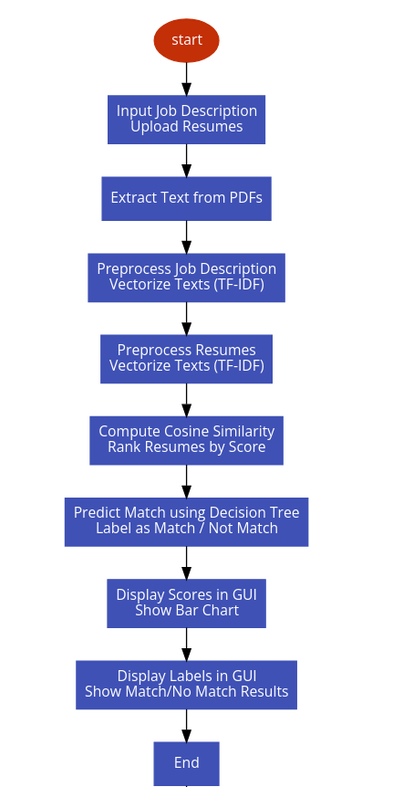
APPROACH AND METHODOLOGY
5
WORKFLOW

Slide 9
TOOLS USED:
6
Programming Language:
Python
Required Modules:
os (built-in)
tkinter (built-in)
PyPDF2 =3.0.1
Scikit-learn =1.4.2
Matplotlib =3.9.0

Slide 10
LOGIC
7
User Inputs a Job Description
This is the reference text we’ll match resumes against.
User Uploads Resumes (PDFs)
The code extracts plain text from each PDF using PyPDF2.
Text Vectorization with TF-IDF
All texts (job + resumes) are converted into number form using TF-IDF, which gives importance to unique words.
Basic Machine Learning Model is Trained
A DecisionTreeClassifier is trained using the job description as a positive match and the resumes as non-matches.

Slide 11
LOGIC
8
Cosine Similarity is Calculated:
This measures how close each resumes is to the job description.
Resumes are Ranked:
The results are stored from best to worst match based in a similarity score.
Threshold Filter is Applied:
A percentage Threshold is set. Resumes are marked based on it (Match/Not match)
Results are displayed:
You see the match results in a text box.
A bar chart visually shows how well each resume matches.

Slide 12
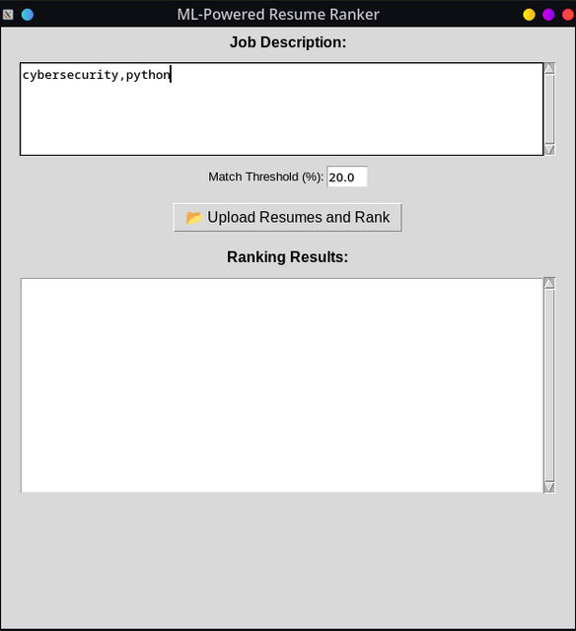
9
EXAMPLE
STEP 1:
Enter Job description.
Set a match threshold.

Slide 13
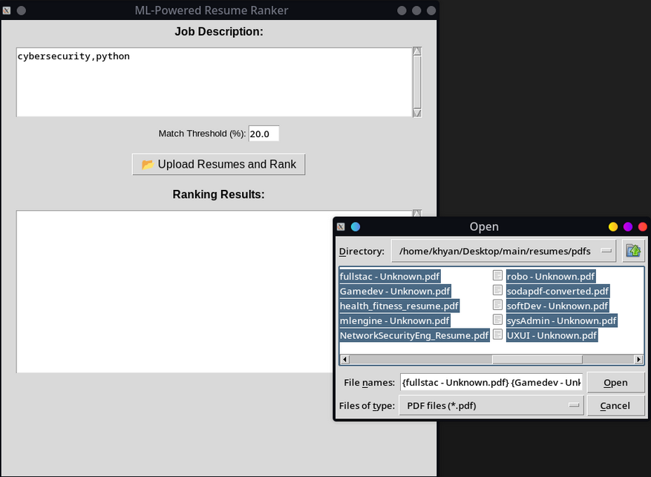
10
EXAMPLE
STEP 2:
Click on the upload resume button
Select the required resumes and click open

Slide 14
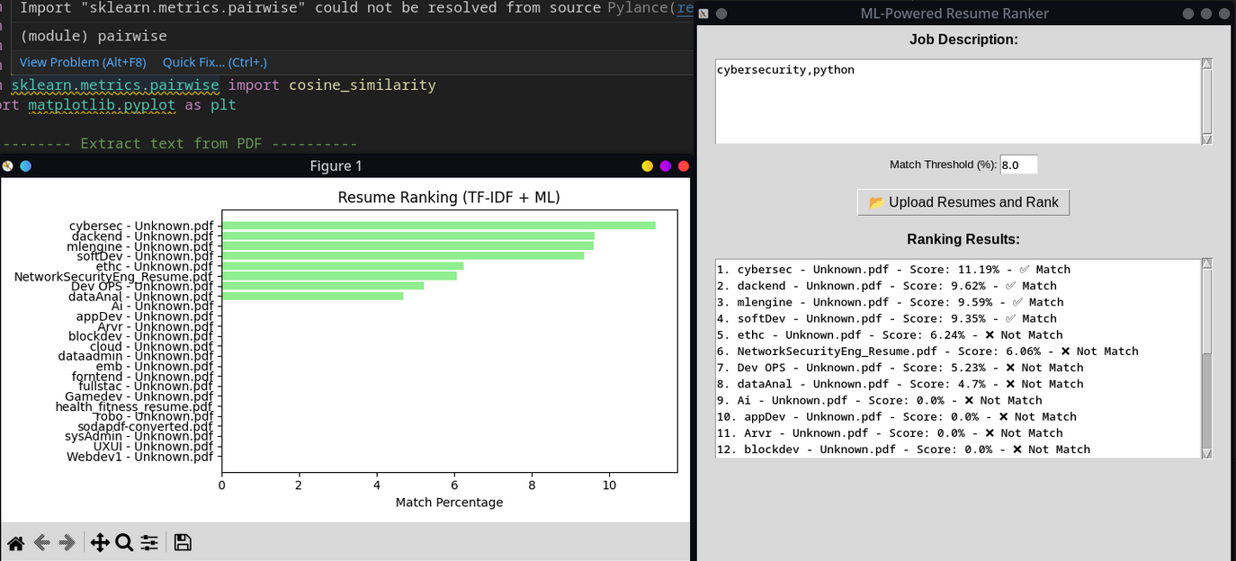
11
EXAMPLE
OUTPUT:
Displays the result in Barchart
Compares scores with threshold and labels them (Match/Not Match)

Slide 15
12
CONCLUSION
Our system automates resume screening with high efficiency.
Uses TF-IDF and cosine similarity for intelligent ranking.
GUI interface ensures ease-of-use for recruiters.
Saves time, reduces bias, and improves selection quality.

Slide 16
THANK YOU
13

