Slide 1
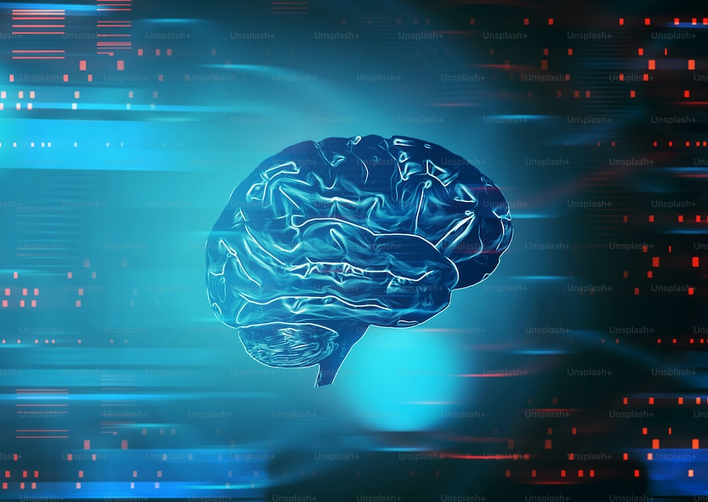
PARKINSONS DISEASE
By
B.Sriram - 22071A6608
J.Hariharan - 22071A6622
M.Khyathi Meghana – 22071A6638
M.Spoorthy - 22071A6640
Guided By
Mrs.N.Sandhya
Mr.Ajay

Slide 2
Problem Statement
The problem at hand is to develop a machine learning model using Support Vector Machines (SVM) to predict Parkinson's disease. The goal is to create an effective and interpretable model for Parkinson's disease diagnosis.

Slide 3
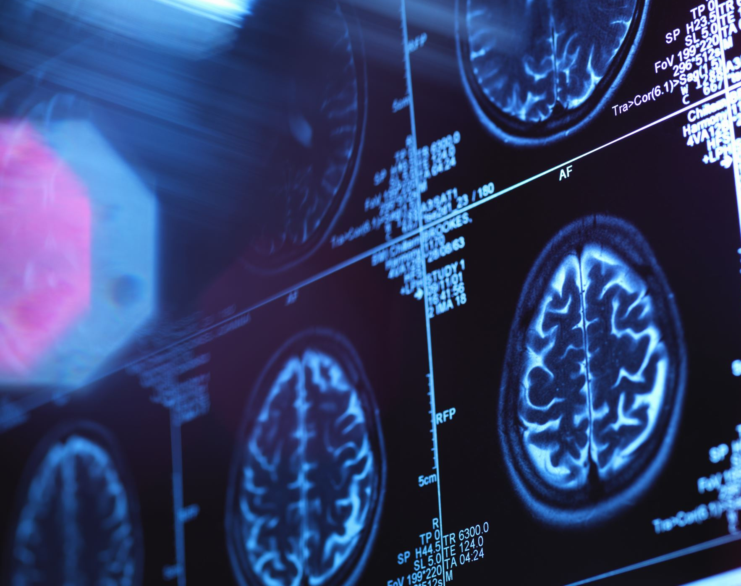
ABSTRACT
Parkinson's disease is a neurological disease which has symptoms Bradykinesia, eyes blinking, stiffness etc. and has no treatment as of date.
Predicting this disease is now a challenging task which can be done using growing technologies.
Our project to predict this disease is built using ML algorithm Support Vector Machine (SVM).
SVM is mainly used for classification or regression related works. It creates a hyperplane to classify the data to train and test data.

Slide 4
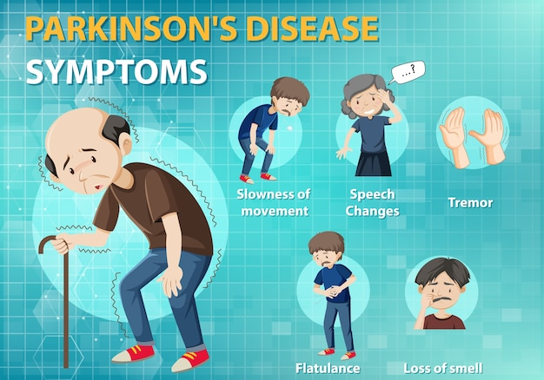
About Parkinson's
Parkinson's disease is a neurodegenerative disorder that primarily affects a person's motor functions.
It is a chronic and progressive condition that results from the gradual degeneration of nerve cells in the brain, specifically in a region called the substantia nigra.
Symptoms: tremors, slowness of movement, rigidity, postural instability
Causes: combination of genetic and environmental factors.

Slide 5

Literature Survey

Slide 6

Before 2000's
1817
James Parkinson publishes "An Essay on the Shaking Palsy," describing Parkinson's symptoms.
1872
Charcot suggests the term "Parkinson's Disease."
1967
Hoehn and Yahr propose a staging system for Parkinson's.

Slide 7
Before 2000's
The first medical information was written in 1817 by James Parkinson, he published "An Essay on the Shaking Palsy" in which he described it as a neurological syndrome and identified the following symptoms tremors, abnormal posture and gait, paralysis, and diminished muscle strength, and the way that the disease progresses over time.
Charcot was the first to suggest the term- "PARKINSON'S DISEASE", earlier it was recognized just as 'paralysis agitans' or 'shaking palsy'.He also differentiated this disorder from other tremorous disorders especially multiple sclerosis in 1872 which is a major turnover and important part of this disease prediction.
before 2000's the three stages of parkinson disease that includes- unilateral disease , bilateral disease and development of postural reflex impairment are detected. Before the diagnosis for the parkinson was only restricted for the non-motor symptoms but in mid 20th century this disease is primarily diagnosed based on motor symptoms

Slide 8
Late 20th century
Late 20th century
Advances in neuroimaging techniques contribute to understanding brain changes.
In late 20th century PET(positron emission tomography) and spect(single-photon emission computed tomography), MRI(magnetic resonance imaging) were used to unerstand the brain changes of a person affected by PD.

Slide 9
2000's
2000
Study by Marras et al. explores machine learning for early detection using voice recordings
2009
Gil and Manuel achieve 93.84% accuracy in diagnosing Parkinson's using vocal features
In 2000's machine learning models were introduced to detect PD that analyses voice recordings,patterns,brain imaging individually but they failed to anaylse all at once.In 2009 ML model was applied on the data of vocal records and 93.84% was the accuracy.

Slide 10
2010's
2010's
Das compares classification techniques for accurate diagnosis (genetic data).
Bilal et al. predict Parkinson's using a support vector machine with 88.9% accuracy.
In 2010 DAS had made four classification schemes they are decision trees, regression, neural networks and DMneural. Bilal studied the genetic data was the first to introduce SUPPORTVECTOR MACHINE(SVM) to detect PD and the accuracy obtained was 0.889% but it is restricted to only a single symptom of the patient

Slide 11
2016 to recent years
2000
Al-Fatlawai finds neural network classifiers yield 92.9% accuracy.
2023
Focus on deep learning in PD detection, lacking feature selection (2016 onward).
Raundale, Thosar, and Rane use Random Forest for PD prediction, reliant on MATLAB.
Wang et al. implement 12 ML models on a voice dataset, achieving 96.45% accuracy.
Ricciardi et al. analyze brain MRI scans with decision trees, random forests, and KNN for MCI detection, employing artificial data augmentation.

Slide 12
2016 to recent years
From 2016 to recent years several papers concluded that neural netwrok classifier gave the best outcome with an accuracy 92.9%. Raundale,Thosar,Rane trained random forest calssifier to predict PD but it is completely reliant on MATLAB.
Wang implemented 12 ML models and built a Deep learning model which gave 96.45% of accuracy but it is very expensive and it holds a large memory.
Ricciardi implemented decision trees, Random forests, KNN but this whole dataset is small and needs artificial data augumentation.
Over the past few several years many articles and papers concluded that several ML models trained and tested but most of them are not successfull.

Slide 13
2016 to recent years
SVM model intially in 2010 gave an accuracy of 88.9% but they considered only single symptom.From the available information and articles and researches by several authors the accuracy of SVM model in detecting PD is raised to 89% but they used a small data set i.e they included several symptoms of the patient but not all symptoms.
From previous studies we can conclude that intially before 2000's they ML models were not introduced and the PD is detected by some scanning techinques.In 2000's after ML models were introduced several techinques like decision trees,Neural networks,regression,DMneural,many more were used and got an higher accuracy in detecing but it was restricted only upto limited symptoms of the patient.In recent yeras SVM is used and gave an accuracy of 89% but it was trained only with small datset. We are implementing an SVM model which gives and accuracy of 84% considering all the symptoms of a patient suffering from the disease and we condisered a big amout of dataset.

Slide 14
Recent Contributions
Scientists like Marras, Espay, Hssayeni, Roy, and others contribute significantly to Parkinson's disease prediction research.

Slide 15

OUR SOLUTION
Our solution indeed boasts higher accuracy compared to existing methods.
This means that it can provide more precise and reliable results in detecting Parkinson's disease.
The increased accuracy can be attributed to the advanced machine learning algorithms and techniques employed in our solution.

Slide 16
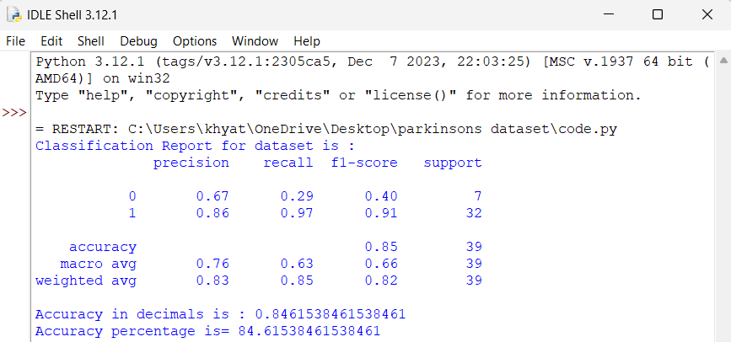
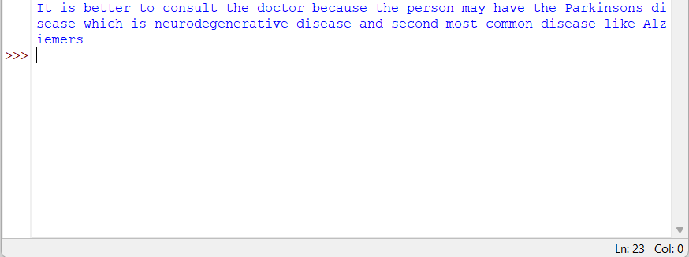
Implementation
import pandas as pd
from sklearn.model_selection import train_test_split
from sklearn.svm import SVC
from sklearn.metrics import classification_report,accuracy_score
file_path = "C:\\Users\\khyat\\OneDrive\\Desktop\\parkinsons dataset\\dataset\\parkinsons.csv"
p_data = pd.read_csv(file_path)
a = p_data.drop(columns=['name'])
b = p_data['status']
a_train, a_test, b_train, b_test = train_test_split(a, b, test_size=0.2, random_state=42)
classifier = SVC()
classifier.fit(a_train, b_train)
b_pred = classifier.predict(a_test)
print("Classification Report for dataset is :")
print(classification_report(b_test, b_pred))
accuracy = accuracy_score(b_test, b_pred)
print("Accuracy in decimals is :", accuracy)
print("Accuracy percentage is=", accuracy*100)
new_instance = pd.DataFrame([[119.992, 157.302, 74.997, 0.00784, 0.00007, 0.0037, 0.00554, 0.01109, 0.04374, 0.426, 0.02182, 0.0313, 0.02971, 0.06545, 0.02211, 21.033, 1, 0.414783, 0.815285, -4.813031, 0.266482, 2.301442, 0.284654]])
new_instance = new_instance.astype(float)
X = p_data.drop('name', axis=1)
predict = classifier.predict(new_instance)
if predict[0] == 1:
print("It is better to consult the doctor because the person may have the Parkinsons disease which is neurodegenerative disease and second most common disease like Alziemers")
else:
print("The person is prognosticated not to have Parkinson's complaint.")
print("The person may have some symptoms because of the age or some other factors")

Slide 17
Software Requirements
1. Programming Language​
Python is commonly used for machine learning tasks.​
Libraries such as scikit-learn, TensorFlow, PyTorch, and Keras are often employed for machine learning model development.​
2. Data Processing and analysis​
Pandas for data manipulation and analysis.​
NumPy for numerical operations on arrays.​
3. Data Visualization​
Matplotlib and Seaborn for creating visualizations.​

Slide 18
4. Machine Learning Fireworks​
Scikit-learn for traditional machine learning algorithms.​
TensorFlow and PyTorch for deep learning models.​
5. Statistical Analysis​
Statsmodels for statistical modeling and hypothesis testing.​
​
6. Integrated Development Environment(IDE)​
Jupyter Notebook or an IDE like VSCode, PyCharm, or Spyder for coding and analysis.​
​
NOTE:​
Other software requirements include version control, database, audio processing etc.

Slide 19
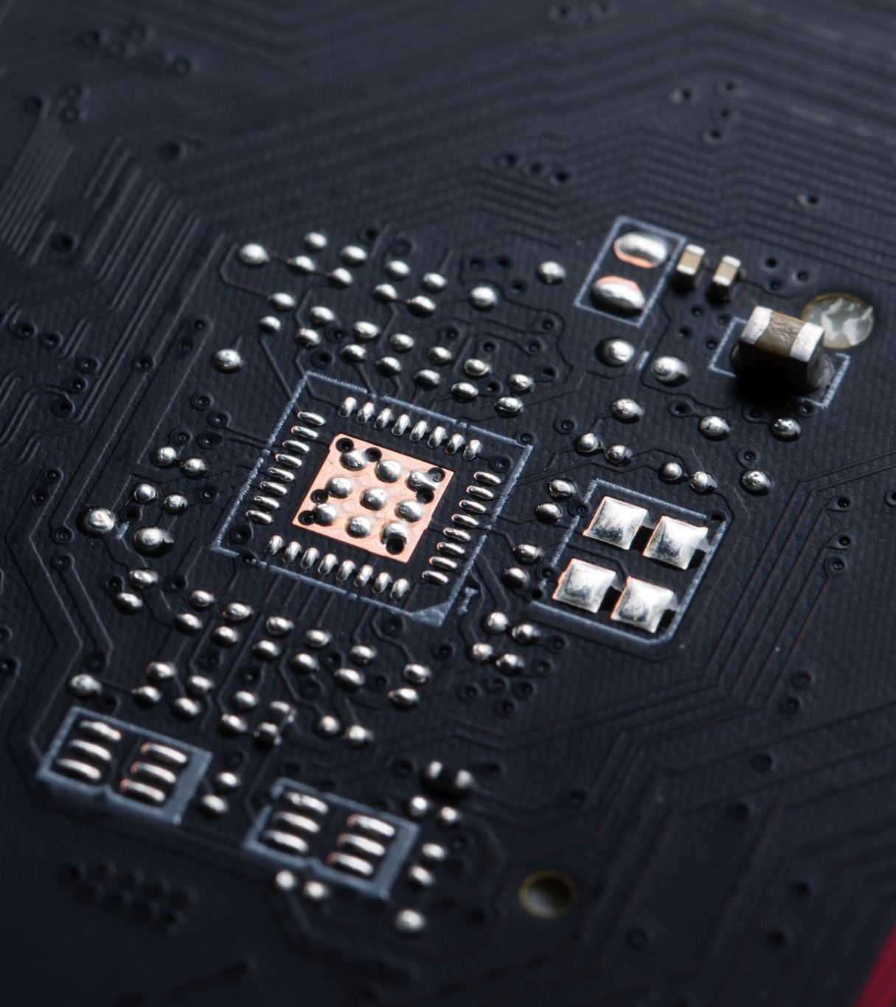
Hardware Requirements
1. CPU (Central Processing Unit)
2. RAM (Random Access Memory)
3. GPU (Graphics Processing Unit)
4. Storage

Slide 20
Design and Architecture

Slide 21
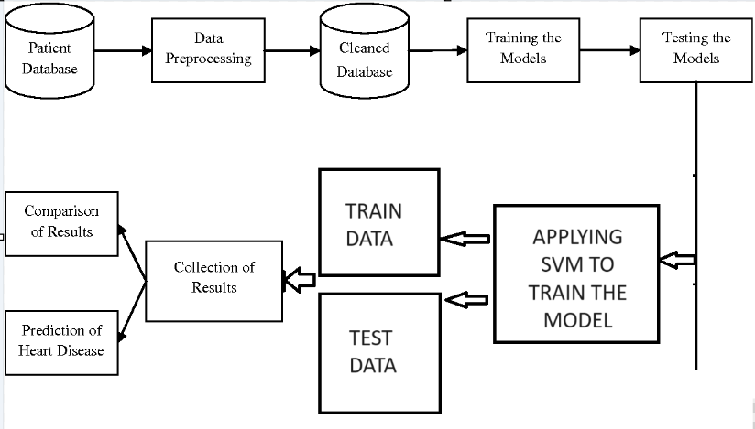
P
670
pre
Detection of disease
P

Slide 22
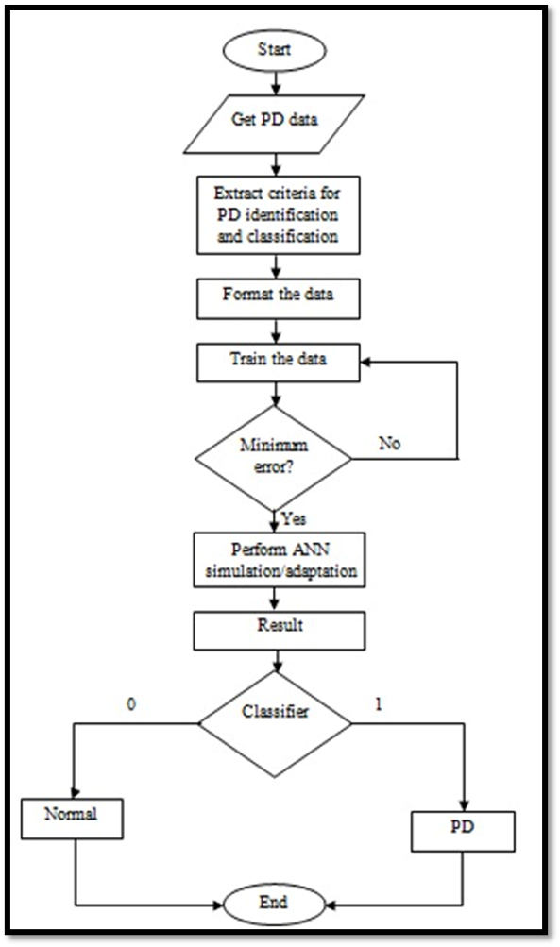
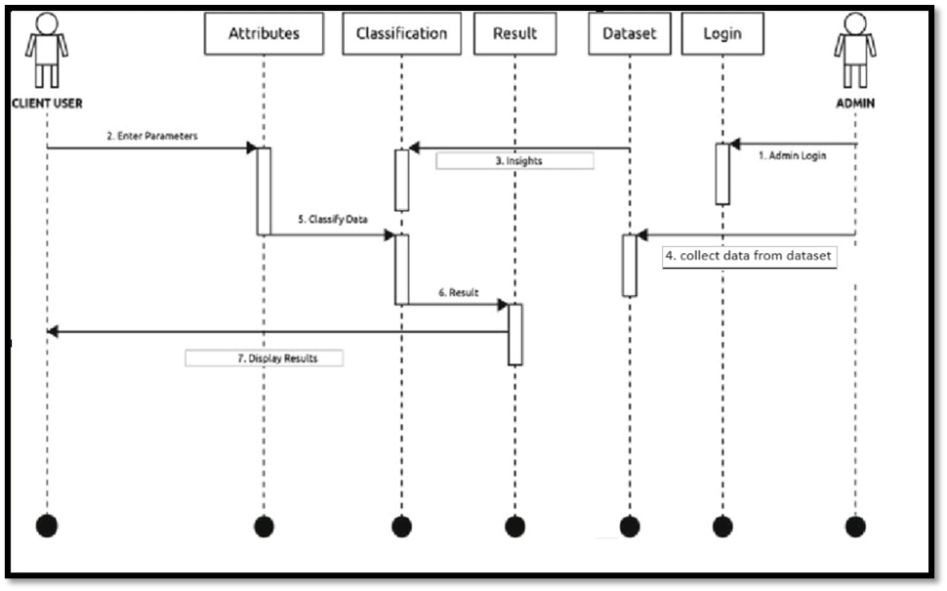

Slide 23

Technology Used
Support Vector Machine (SVM) is a supervised machine learning algorithm used for classification and regression tasks.
It works by finding the optimal hyperplane that best separates different classes in a dataset.
SVM seeks to maximize the margin (the distance between the hyperplane and the nearest data points of each class) to make robust and accurate predictions.
It can handle both linear and non-linear data by using kernel functions. SVM is widely used in various applications, including image classification, text classification, and bioinformatics, due to its effectiveness in finding clear decision boundaries.

Slide 24
Advantages of Our solution
Accuracy Representation
New Instance Prediction Handling
Relevance to Parkinson's Disease Diagnosis
Real-world Considerations
Effective Use of Libraries
Readability and Consistency
Informative Output Messages

Slide 25
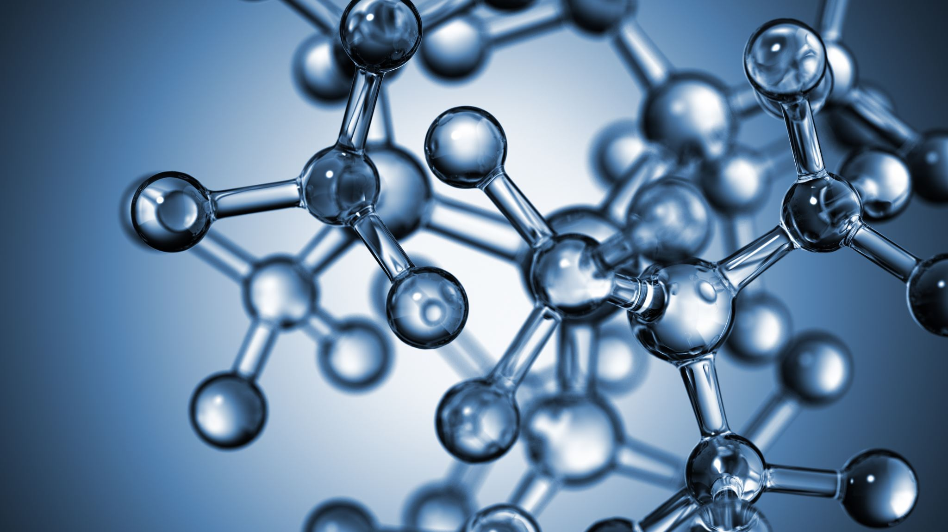
ABOUT DATASET
Data Set Characteristics: Multivariate
Number of Instances: 197
Area: Life
Attribute Characteristics: Real
Number of Attributes: 23
Abstract: Oxford Parkinson's Disease Detection Dataset

Slide 26
CONCLUSION
In conclusion, Support Vector Machines (SVM) stand out as a powerful and versatile class of algorithms in the realm of machine learning. Their effectiveness in high-dimensional spaces, ability to handle both linear and non-linear relationships through the kernel trick, and robustness against overfitting make them widely applicable in various domains. SVMs are commonly used for classification tasks, and their extension to regression and multiclass scenarios further underscores their flexibility.

Slide 27

THANK YOU ​

