Slide 1
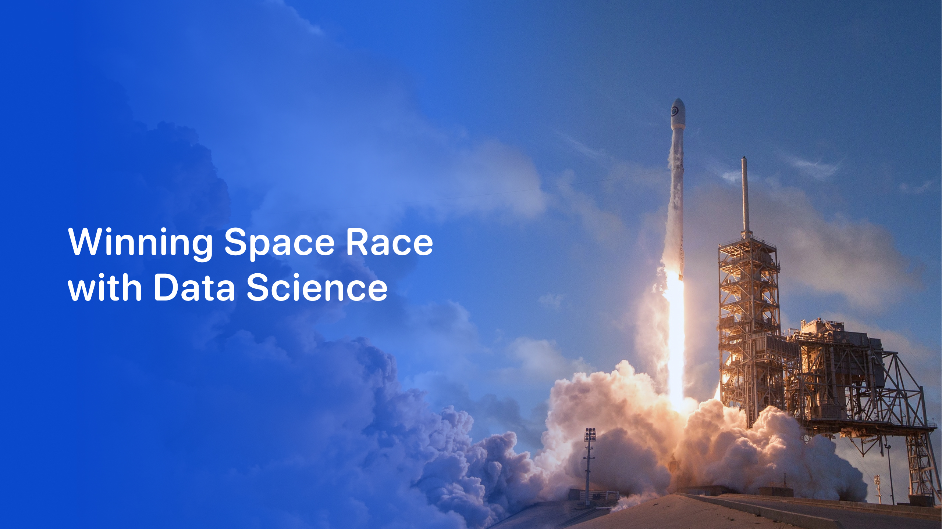

Khyati Kendhe
October 21, 2026
Applied Data Science Capstone | Falcon 9 first-stage landing prediction
Notes:
Open with the business question: can a new entrant (Space Y) predict whether a Falcon 9 first stage will land, and therefore what a launch really costs?

Slide 2

Outline
1
2
3
Executive Summary
Introduction
Methodology
What we did and what we found
Business problem and questions
Collection, wrangling, EDA, visual analytics, modelling
4
5
6
Results
Conclusion
Appendix
EDA, SQL, Folium, Dash, classification
Insights, recommendations, next steps
Code, queries and repository
GitHub repository: github.com/<your-username>/<your-repo>

Slide 3
Executive Summary
Methodology
Key results
Collect: SpaceX REST API + Wikipedia web scraping
Wrangle: clean, impute, define a binary landing Class
Explore: visual EDA and SQL on 101 Falcon launches
Visualise: Folium site maps, Plotly Dash dashboard
Predict: Logistic Regression, SVM, Decision Tree, KNN tuned with 10-fold GridSearchCV
61 of 101
0% to 88%
launches landed the first stage (2010-2020)
yearly landing success, 2014 to 2020
77%
71%
best site success rate: KSC LC-39A
best model test accuracy (Decision Tree)
Booster generation and payload explain most of the variation.
Notes:
Lead with the answer: landing success climbed from 0% to about 88% as the Falcon 9 matured; booster generation and payload are the dominant drivers; a tuned Decision Tree is the best of four models, but the test set is small.

Slide 4
Introduction
Background
Questions to answer
SpaceX reuses the Falcon 9 first stage, which is why it can advertise launches at a fraction of the price of competitors.
Which factors drive landing success: launch site, orbit, payload, booster version, experience?
1
$62M
$165M+
How has landing success evolved over time?
2
SpaceX Falcon 9 price
typical competitor price
If we can predict whether the first stage lands, we can estimate the real cost of a launch, and a new entrant (Space Y) can bid more intelligently.
Can a classifier predict the landing outcome well enough to inform pricing?
3
Notes:
Frame the stakes: $62M versus $165M. Each question maps to a results section later in the deck.

Slide 5

Section 1

Slide 6
Methodology
Collect
Wrangle
Explore
Visualise
Predict
SpaceX API
Web scraping
Missing values
Binary Class
Matplotlib / Seaborn
SQL
Folium maps
Plotly Dash
LR, SVM, Tree, KNN
GridSearchCV
Data science methodology: from raw JSON and HTML to a deployable landing predictor
Reproducible
Traceable
Comparable
Every step lives in a notebook in the GitHub repository
Each result slide links back to the notebook that produced it
Four classifiers tuned with identical splits and folds

Slide 7
Data Collection
SpaceX REST API
Combined launch dataset
Launch, rocket, launchpad, payload and core endpoints
JSON to pandas DataFrame
FlightNumber
Date
BoosterVersion
PayloadMass
Orbit
LaunchSite
Outcome
Flights
GridFins
Reused
Legs
LandingPad
Wikipedia scraping
Block
ReusedCount
Serial
Falcon 9 launch records page
BeautifulSoup parses the HTML tables
Longitude
Latitude
Falcon 9 launches only, one row per launch, 17 descriptive fields.

Slide 8
Data Collection: SpaceX API
Request launch history from the SpaceX v4 REST API
Resolve rocket, launchpad, payload and core IDs with helper functions
Filter Falcon 9 only, single-core, single-payload launches
Clean replace missing PayloadMass with the mean
GET /v4/launches/past
json_normalize to DataFrame
Call helper APIs for IDs
Keep Falcon 9 launches
Impute missing payload mass
GitHub: github.com/<your-username>/<your-repo>/jupyter-labs-spacex-data-collection-api.ipynb
Export dataset_part_1.csv

Slide 9
Data Collection: Web Scraping
Request the Falcon 9 launch records page with an HTTP GET
Parse HTML with BeautifulSoup
Extract column names and every launch row from the launch tables
Assemble a dictionary into a pandas DataFrame
HTTP GET Wikipedia page
BeautifulSoup parse HTML
Locate launch tables
Loop rows: date, booster, site, payload, outcome
Build dict to DataFrame
GitHub: github.com/<your-username>/<your-repo>/jupyter-labs-webscraping.ipynb
Export CSV

Slide 10
Data Wrangling
Load dataset
Inspect nulls
Count by site, orbit, outcome
Map outcomes to Class
Success rate = mean(Class)
Landing outcome to training label
Checks performed
Outcome | Meaning | Class
True ASDS / RTLS / Ocean | Landed (drone ship, ground pad, ocean) | 1
False ASDS / RTLS / Ocean | Landing attempted but failed | 0
None ASDS / None None | No landing attempted | 0
Missing PayloadMass imputed with the mean
LandingPad nulls kept: no pad means no landing attempt
Launch counts per site, orbit and mission outcome
The Class column becomes the target variable for every model.
GitHub: github.com/<your-username>/<your-repo>/labs-jupyter-spacex-Data wrangling.ipynb

Slide 11
EDA with Data Visualization
Chart | Variables | Why this chart
Scatter | Flight number vs launch site | Does experience at a pad improve outcomes?
Scatter | Payload vs launch site | Do pads handle different payload ranges?
Bar | Success rate by orbit | Which orbits are easiest to land from?
Scatter | Flight number vs orbit | Which orbits were flown early or late?
Scatter | Payload vs orbit | How does mass relate to orbit and outcome?
Line | Yearly success rate | Is there a clear learning curve over time?
GitHub: github.com/<your-username>/<your-repo>/edadataviz.ipynb
Green = landed, red = failed in every chart

Slide 12
EDA with SQL
1
Unique launch sites
6
Drone-ship successes with payload 4,000-6,000 kg
2
Five launches from sites starting with CCA
7
Count of success and failure mission outcomes
3
Total payload carried for NASA (CRS)
8
Boosters that carried the maximum payload
4
Average payload of booster F9 v1.1
9
2015 drone-ship landing failures
5
First successful ground-pad landing date
10
Landing outcomes ranked, 2010-06-04 to 2017-03-20
GitHub: github.com/<your-username>/<your-repo>/jupyter-labs-eda-sql-coursera_sqllite.ipynb
SQLite database queried from Jupyter

Slide 13
Build an Interactive Map with Folium
Map object | What it shows | Why it was added
Circle + Marker | Each launch site, with the NASA JSC reference point | Locate sites and compare their surroundings
MarkerCluster | Every launch, green = success and red = failure | Spot which sites win or lose most often
MousePosition | Live latitude and longitude on hover | Read coordinates to measure distances
PolyLine + distance label | Site to coastline, railway, highway and city | Quantify how close each site is to infrastructure
GitHub: github.com/<your-username>/<your-repo>/lab_jupyter_launch_site_location.ipynb
Sites cluster near coastlines (safe over-water trajectories) and far from cities.

Slide 14
Build a Dashboard with Plotly Dash
Inputs
Callbacks
Outputs
Launch-site dropdown
Payload range slider (0-10,000 kg)
Filter the data frame
Return updated figures
Success pie chart
Payload vs outcome scatter, coloured by booster
Why these interactions
Dropdown: compare a single site with all sites without writing new code
Slider: test whether payload mass changes success, booster by booster
GitHub: github.com/<your-username>/<your-repo>/spacex_dash_app.py

Slide 15
Predictive Analysis (Classification)
One-hot encode
Standardise
80/20 split
GridSearchCV, 10 folds
Test accuracy and confusion matrix
Features (15)
Models and search spaces
Flight number, payload mass, booster block
Orbit (one-hot, 8 categories)
Launch site (one-hot, 4 sites)
Target: Class (1 = first stage landed)
Logistic Regression: C
SVM: kernel, C, gamma
Decision Tree: criterion, depth, leaf and split sizes
KNN: k = 1-10, Manhattan or Euclidean
GitHub: github.com/<your-username>/<your-repo>/SpaceX_Machine_Learning_Prediction_Part_5.ipynb

Slide 16
Results
1
2
3
Exploratory data analysis
Interactive analytics
Predictive analysis
Learning curve: success rose from 0% (2014) to 88% (2020). Newer boosters land far more often.
Folium maps and a Plotly Dash dashboard show KSC LC-39A as the strongest site.
A tuned Decision Tree is best (test accuracy 71%), though the test set is small.
Plus two new insights on booster era and payload headroom, then a pricing playbook for Space Y.

Slide 17

Section 2

Slide 18
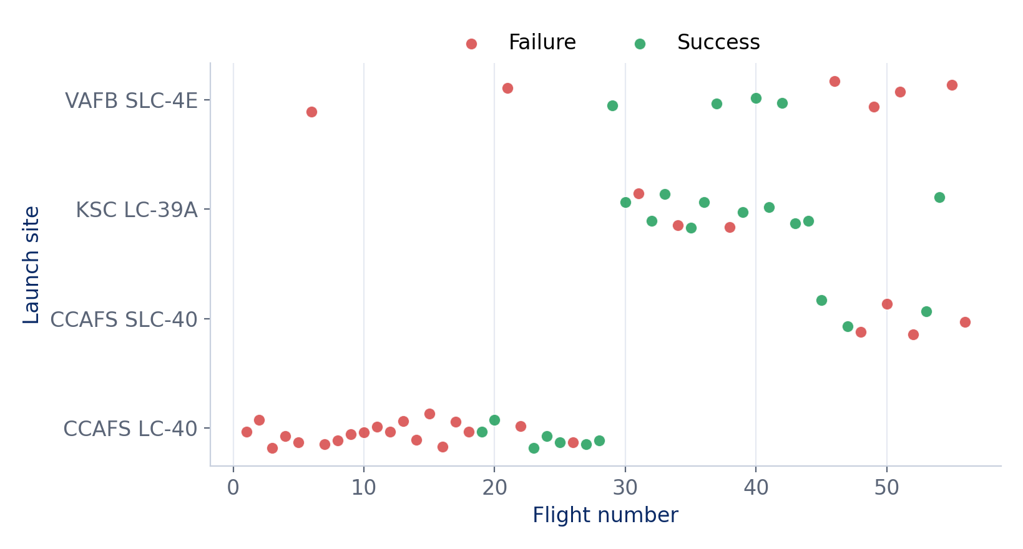
Flight Number vs. Launch Site
What it shows
CCAFS LC-40 hosted flights 1-28, mostly failed early on
KSC LC-39A opens at flight 30 and mostly lands
Later flights land more often overall
Source: spacex_launch_dash.csv (56 landing-attempt launches)

Slide 19
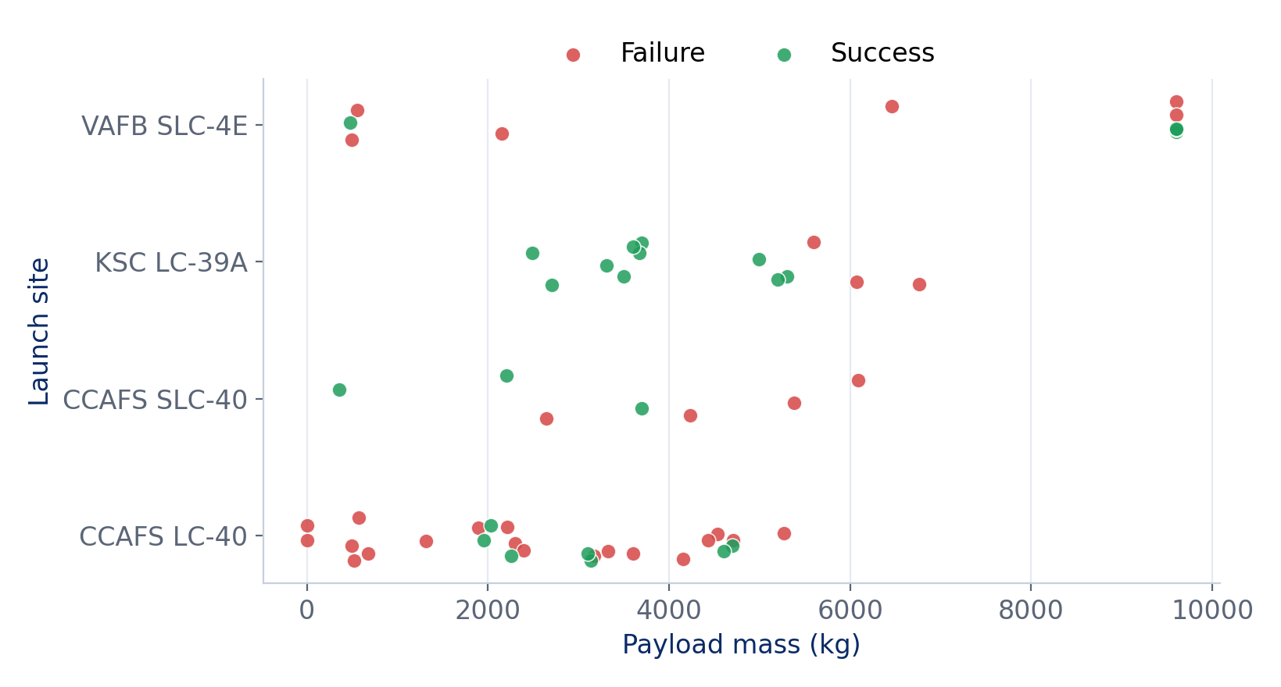
Payload vs. Launch Site
What it shows
VAFB SLC-4E flies payloads up to 9,600 kg
KSC LC-39A median payload: 3,697 kg
CCAFS LC-40 spans 0-5,271 kg
Heavier loads mostly fly from KSC and VAFB
Source: spacex_launch_dash.csv

Slide 20
Success Rate vs. Orbit Type
What it shows
SSO (83%) and LEO (80%) land most often
GTO and ISS missions land about half the time
Orbits with n below 3 are excluded: too few launches to trust
Source: SpaceX launch table, landing success = Landing_Outcome starts with Success

Slide 21
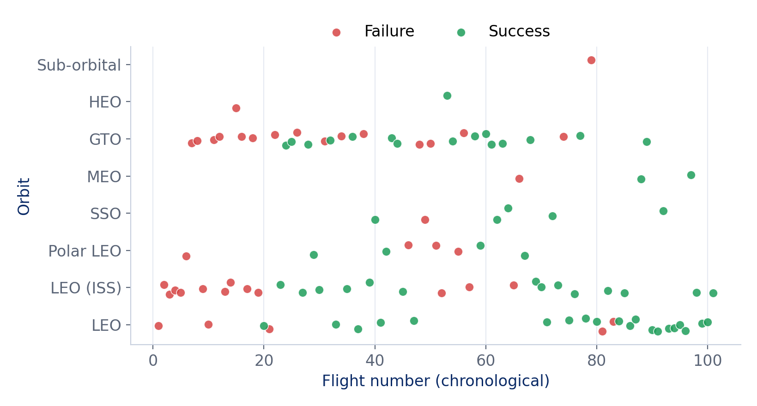
Flight Number vs. Orbit Type
What it shows
LEO and ISS missions run through the whole timeline
GTO first appears at flight 7 and recurs throughout
Newer flights succeed across orbits
Source: SpaceX launch table, flight number = chronological order

Slide 22
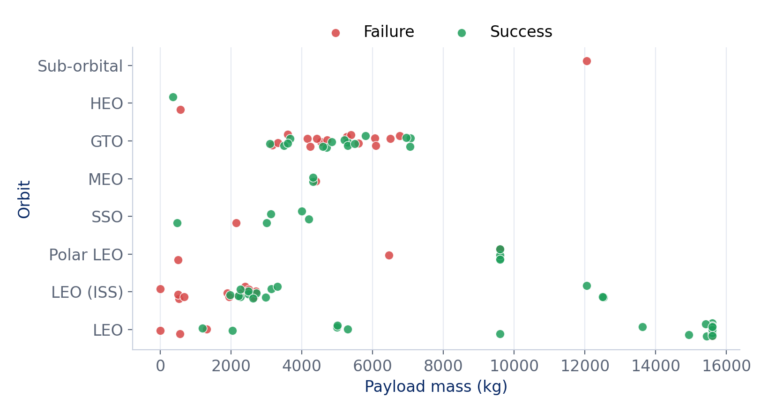
Payload vs. Orbit Type
What it shows
GTO payloads cluster at 3,100-7,075 kg
LEO carries the heaviest loads, up to 15,600 kg
Heavy LEO launches mostly land
Source: SpaceX launch table

Slide 23
Launch Success Yearly Trend
What it shows
No successful landing before 2015
Big jump in 2016 as drone-ship landings arrived
88% success in 2020
2018 dip: heavy missions flown without recovery
Source: SpaceX launch table (101 launches, 2010-2020)

Slide 24
All Launch Site Names
SQL
Launch_Site
CCAFS LC-40
VAFB SLC-4E
KSC LC-39A
CCAFS SLC-40
SELECT DISTINCT Launch_Site
FROM SPACEXTBL;
Explanation
DISTINCT collapses the table to the four launch sites used: three on the Florida coast (CCAFS LC-40, CCAFS SLC-40, KSC LC-39A) and one in California (VAFB SLC-4E).

Slide 25
Launch Site Names Begin with 'CCA'
SQL
Date | Booster | Site | kg | Landing
2010-06-04 | F9 v1.0 B0003 | CCAFS LC-40 | 0 | Failure (parachute)
2010-12-08 | F9 v1.0 B0004 | CCAFS LC-40 | 0 | Failure (parachute)
2012-05-22 | F9 v1.0 B0005 | CCAFS LC-40 | 525 | No attempt
2012-10-08 | F9 v1.0 B0006 | CCAFS LC-40 | 500 | No attempt
2013-03-01 | F9 v1.0 B0007 | CCAFS LC-40 | 677 | No attempt
SELECT *
FROM SPACEXTBL
WHERE Launch_Site LIKE 'CCA%'
LIMIT 5;
Explanation
LIKE with a wildcard finds both Cape Canaveral pads. The first five launches (2010-2013) were early F9 v1.0 flights, none of which landed.

Slide 26
Total Payload Mass
SQL
45,596 kg
SELECT SUM(PAYLOAD_MASS__KG_)
FROM SPACEXTBL
WHERE Customer = 'NASA (CRS)';
total payload for NASA (CRS)
Explanation
Boosters have carried 45,596 kg of cargo for NASA Commercial Resupply Services, the supply missions to the International Space Station.

Slide 27
Average Payload Mass by F9 v1.1
SQL
2,928.4 kg
SELECT AVG(PAYLOAD_MASS__KG_)
FROM SPACEXTBL
WHERE Booster_Version = 'F9 v1.1';
average payload, booster F9 v1.1
Explanation
The F9 v1.1 booster averaged about 2,928 kg per launch, well below later boosters that carried up to 15,600 kg.

Slide 28
First Successful Ground Landing Date
SQL
2015-12-22
SELECT MIN(Date)
FROM SPACEXTBL
WHERE Landing_Outcome =
'Success (ground pad)';
first ground-pad landing
Explanation
The first ground-pad landing took place on 2015-12-22, on the OG2 Mission 2 flight carrying 11 Orbcomm satellites. It marked the start of routine booster recovery.

Slide 29
Drone Ship Successes, Payload 4,000-6,000 kg
SQL
Booster_Version
F9 FT B1022
F9 FT B1026
F9 FT B1021.2
F9 FT B1031.2
SELECT Booster_Version
FROM SPACEXTBL
WHERE Landing_Outcome =
'Success (drone ship)'
AND PAYLOAD_MASS__KG_ > 4000
AND PAYLOAD_MASS__KG_ < 6000;
Explanation
Four Falcon 9 Full Thrust boosters landed on a drone ship while carrying mid-weight payloads, evidence that heavier launches can still be recovered.

Slide 30
Successful and Failed Mission Outcomes
SQL
Outcome | Count
Success | 100
Failure (in flight) | 1
SELECT Mission_Outcome,
COUNT(*) AS total
FROM SPACEXTBL
GROUP BY Mission_Outcome;
Explanation
100 of 101 missions succeeded: more than 99%. Mission success is separate from booster landing: a mission can succeed even when the booster is not recovered.

Slide 31
Boosters Carried Maximum Payload
SQL
Booster_Version (15,600 kg)
F9 B5 B1048.4
F9 B5 B1049.4
F9 B5 B1051.3
F9 B5 B1056.4
F9 B5 B1048.5
F9 B5 B1051.4
SELECT DISTINCT Booster_Version
FROM SPACEXTBL
WHERE PAYLOAD_MASS__KG_ = (
SELECT MAX(PAYLOAD_MASS__KG_)
FROM SPACEXTBL);
Explanation
A subquery finds the maximum payload, 15,600 kg. 12 different Block 5 boosters carried it, so the heaviest loads are routine for the newest hardware. Six shown.

Slide 32
2015 Launch Records
SQL
Date | Booster | Site
2015-01-10 | F9 v1.1 B1012 | CCAFS LC-40
2015-04-14 | F9 v1.1 B1015 | CCAFS LC-40
SELECT Date, Booster_Version,
Launch_Site
FROM SPACEXTBL
WHERE Landing_Outcome =
'Failure (drone ship)'
AND substr(Date,1,4) = '2015';
Explanation
Both 2015 drone-ship failures were F9 v1.1 boosters launched from CCAFS LC-40, early attempts at a technique that later became routine.

Slide 33
Rank Landing Outcomes, 2010-06-04 to 2017-03-20
SQL
SELECT Landing_Outcome,
COUNT(*) AS n
FROM SPACEXTBL
WHERE Date BETWEEN
"2010-06-04" AND "2017-03-20"
GROUP BY Landing_Outcome
ORDER BY n DESC;
"No attempt" leads (10), then drone-ship successes and failures tie at 5. Landing was still experimental in this window.

Slide 34

Section 3

Slide 35
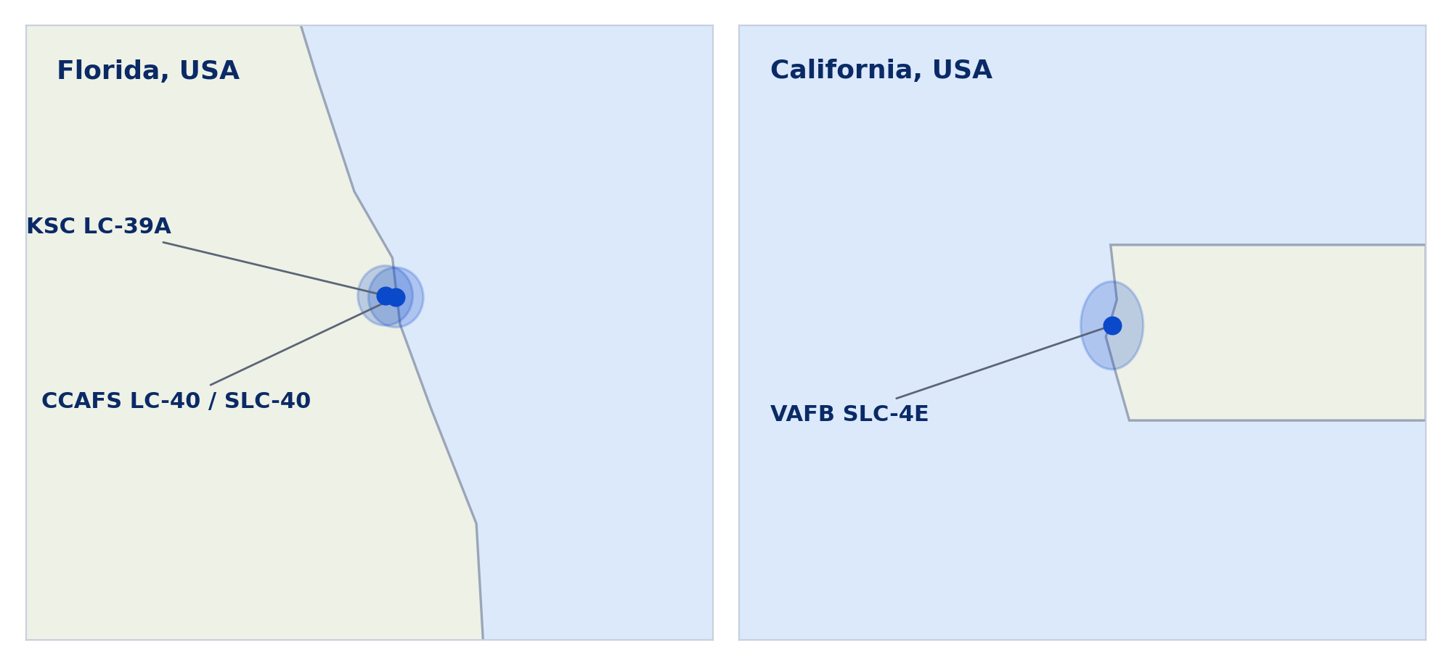
All Launch Sites Sit Near the Coast
Findings
Three sites on Florida's Atlantic coast, one in California
Low latitudes give rockets extra speed from Earth's spin
Coastal sites keep trajectories over water
Schematic reproduction of the Folium output, built from launch-site coordinates

Slide 36
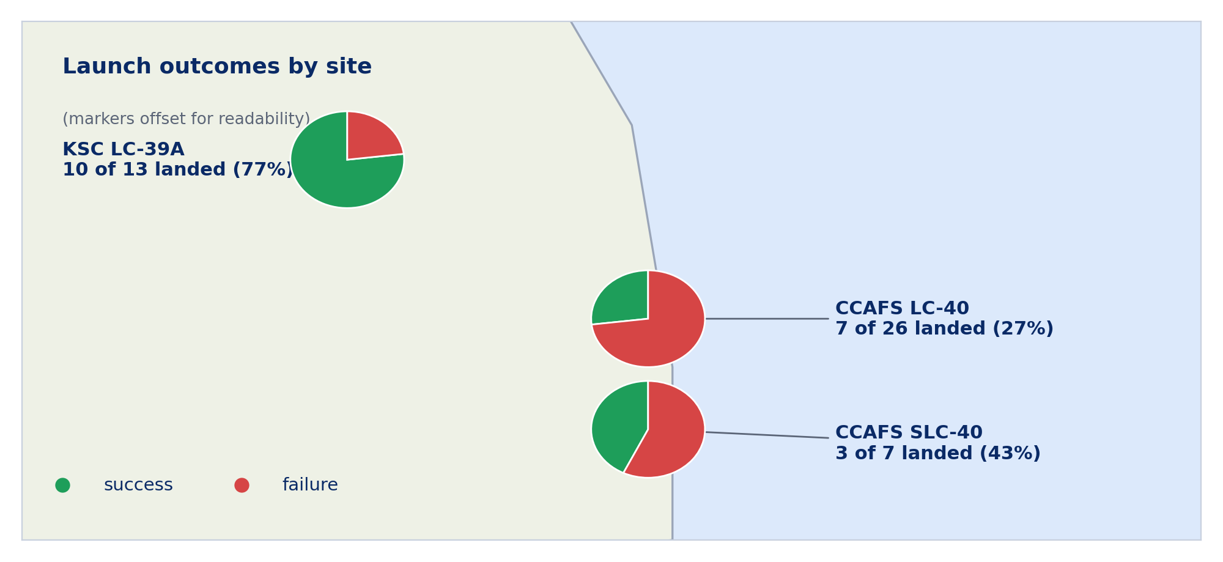
Launch Outcomes by Site
Findings
Green = landed, red = failed
KSC LC-39A: 10 of 13 landed (77%)
CCAFS LC-40: 7 of 26 (27%), the oldest and busiest pad
Newer pads show the best records
Schematic reproduction of the Folium output, built from launch-site coordinates

Slide 37
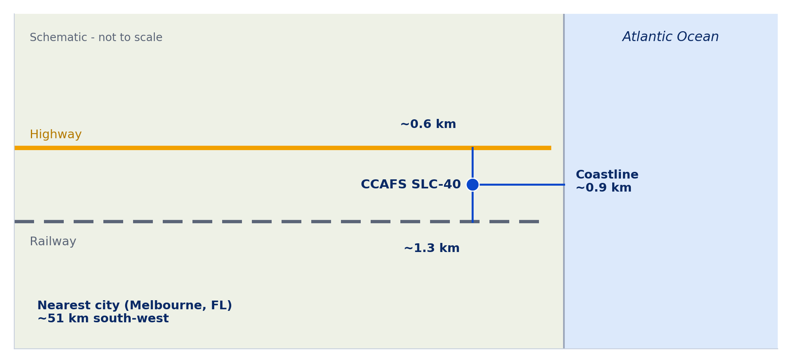
Launch Site Proximities: CCAFS SLC-40
Findings
Coastline ~0.9 km, highway ~0.6 km, railway ~1.3 km
Nearest city ~51 km away
Close to transport links for logistics, far from people for safety
Schematic, distances approximate (Folium distance lab); not to scale

Slide 38

Section 4

Slide 39
Launch Success Count by Site
Findings
KSC LC-39A holds 41.7% of all successful landings
24 landings across 56 attempts
Dropdown = All Sites
Dashboard view reproduced from spacex_launch_dash.csv

Slide 40
Highest Success Ratio: KSC LC-39A
Findings
10 successes, 3 failures: a 76.9% ratio
Next best: CCAFS SLC-40 at 42.9%
All KSC LC-39A launches used modern boosters
Dashboard view reproduced from spacex_launch_dash.csv

Slide 41
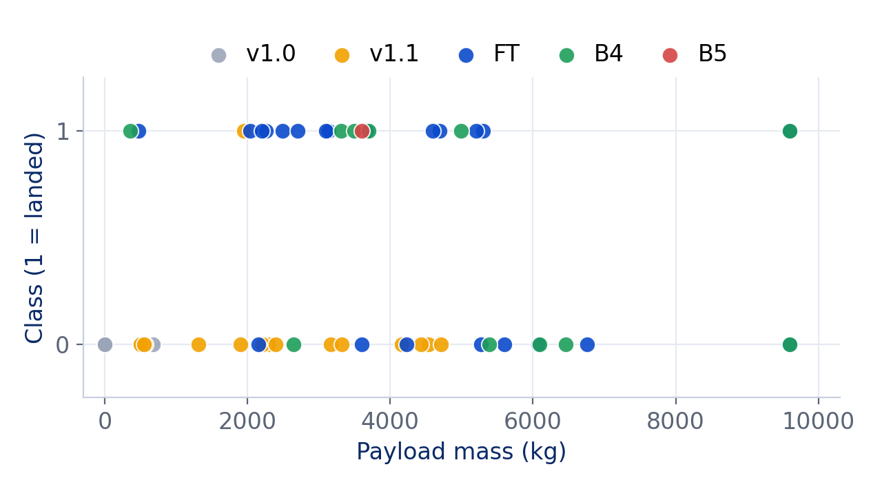
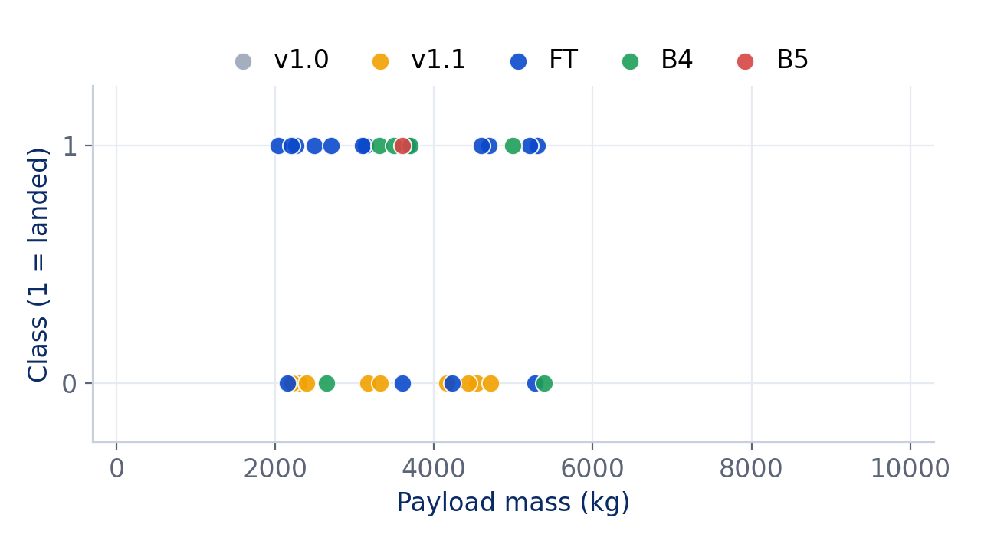
Payload vs. Launch Outcome
Slider: 0 to 10,000 kg
Slider: 2,000 to 5,500 kg
2,000-4,000 kg has the best success rate: 62%
Below 2,000 kg: 23%, mostly old v1.0/v1.1 boosters
FT boosters (blue) dominate the successes
B4 landed 6 of 11; the single B5 landed
Dashboard view reproduced from spacex_launch_dash.csv; slider shown at two settings

Slide 42

Section 5

Slide 43
Classification Accuracy
What it shows
Decision Tree: best cross-validated accuracy (79%)
Decision Tree and KNN tie on the test set (71%)
Test set is only 21 launches, so one launch moves accuracy by about 5 points
80/20 split (random_state=2), 15 features, GridSearchCV with 10 folds

Slide 44
Confusion Matrix: Decision Tree
Predicted class
Reading the matrix
Did not land
Landed
Accuracy 71.4% (15 of 21 correct)
Precision 78%: most predicted landings are real
Recall 64%: it misses 4 real landings
Errors lean cautious: more missed landings than false alarms
8
2
Did not land
Actual class
True negative
False positive
4
7
Landed
False negative
True positive
KNN produced the identical confusion matrix on this split

Slide 45
Insight 1: It Is the Booster, Not the Pad
Why it matters
CCAFS LC-40 looks weak (27%) because it flew the old boosters
With modern boosters only it reaches 75%, level with KSC LC-39A (77%)
Old boosters (v1.0, v1.1) landed 1 of 20; modern ones 23 of 36
Computed from spacex_launch_dash.csv; confounding by booster era
Notes:
Innovative insight: a naive site comparison misleads. Controlling for booster generation closes most of the gap between CCAFS LC-40 and KSC LC-39A.

Slide 46
Insight 2: Payload Headroom Drives Landing Odds
Why it matters
Modern boosters: 83% success up to 4,000 kg
Falls to 33% above 6,000 kg
Heavy missions leave less fuel for recovery, and some skip landing by design
Modern boosters only (FT, B4, B5), spacex_launch_dash.csv; class 0 includes no-attempt launches
Notes:
Caveat: class 0 includes launches where no landing was attempted, so heavy GTO missions are partly an economic choice, not only a physical limit.

Slide 47
Insight 3: Pricing Playbook for Space Y
Mission profile | Landing odds | Bid posture
Modern booster, up to 4,000 kg, LEO or SSO | High (about 80%+) | Price near reuse economics
Modern booster, 4,000-6,000 kg | Moderate (about 56%) | Add a recovery-risk margin
Heavy, over 6,000 kg, or GTO | Low (about 33-50%) | Assume expendable pricing
$103M
62%
Odds come from the landing data in this deck; treat the posture column as a starting point, not a quote.
headroom per reused stage ($165M minus $62M)
of a competitor price saved by reuse
Notes:
Illustrative decision matrix: ties the model and EDA findings back to the pricing problem from the introduction.

Slide 48
Conclusions
1
Learning curve
Landing success rose from 0% (2010-14) to 88% (2020) as boosters matured.
2
Booster generation
FT, B4 and B5 boosters land 64% of the time versus 5% for v1.0/v1.1.
3
Site and payload
KSC LC-39A leads (77%). Payloads under 4,000 kg land far more often.
4
Best model
Decision Tree: CV 79%, test 71%. Promising, but the test set is tiny.
5
Next steps
Add landing-pad type, grid fins and reuse count; use time-based validation.
Notes:
Close on the answer: yes, landing is predictable enough to inform pricing, driven mainly by booster generation and payload.

Slide 49
Appendix
SQL: ranking landing outcomes
Repository and tools
SELECT Landing_Outcome, COUNT(*) AS n
FROM SPACEXTBL
WHERE Date BETWEEN "2010-06-04"
AND "2017-03-20"
GROUP BY Landing_Outcome ORDER BY n DESC;
Repository: github.com/<your-username>/<your-repo>
SpaceX API, requests, BeautifulSoup
pandas, NumPy, SQLite
Matplotlib, Seaborn, Folium, Plotly Dash
scikit-learn (LR, SVM, Tree, KNN)
Datasets: dataset_part_1/2/3.csv, spacex_launch_dash.csv
Python: model tuning
gs = GridSearchCV(model, params, cv=10)
gs.fit(X_train, y_train)
print(gs.best_params_, gs.best_score_)
gs.score(X_test, y_test)

Slide 50
