Slide 1
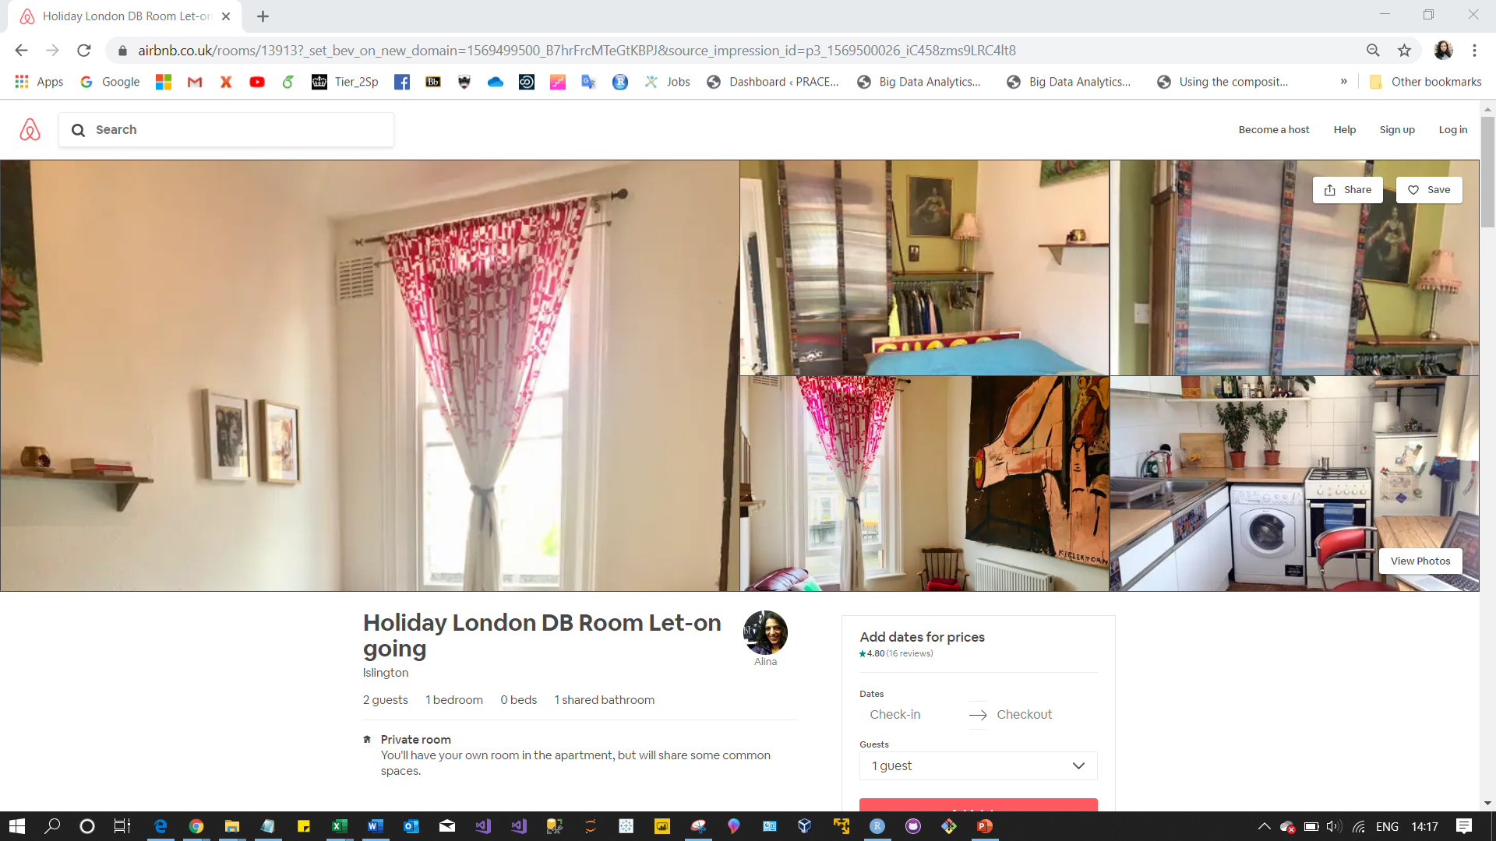
picture_url
accomodates, bathrooms, bedrooms, beds

Slide 2
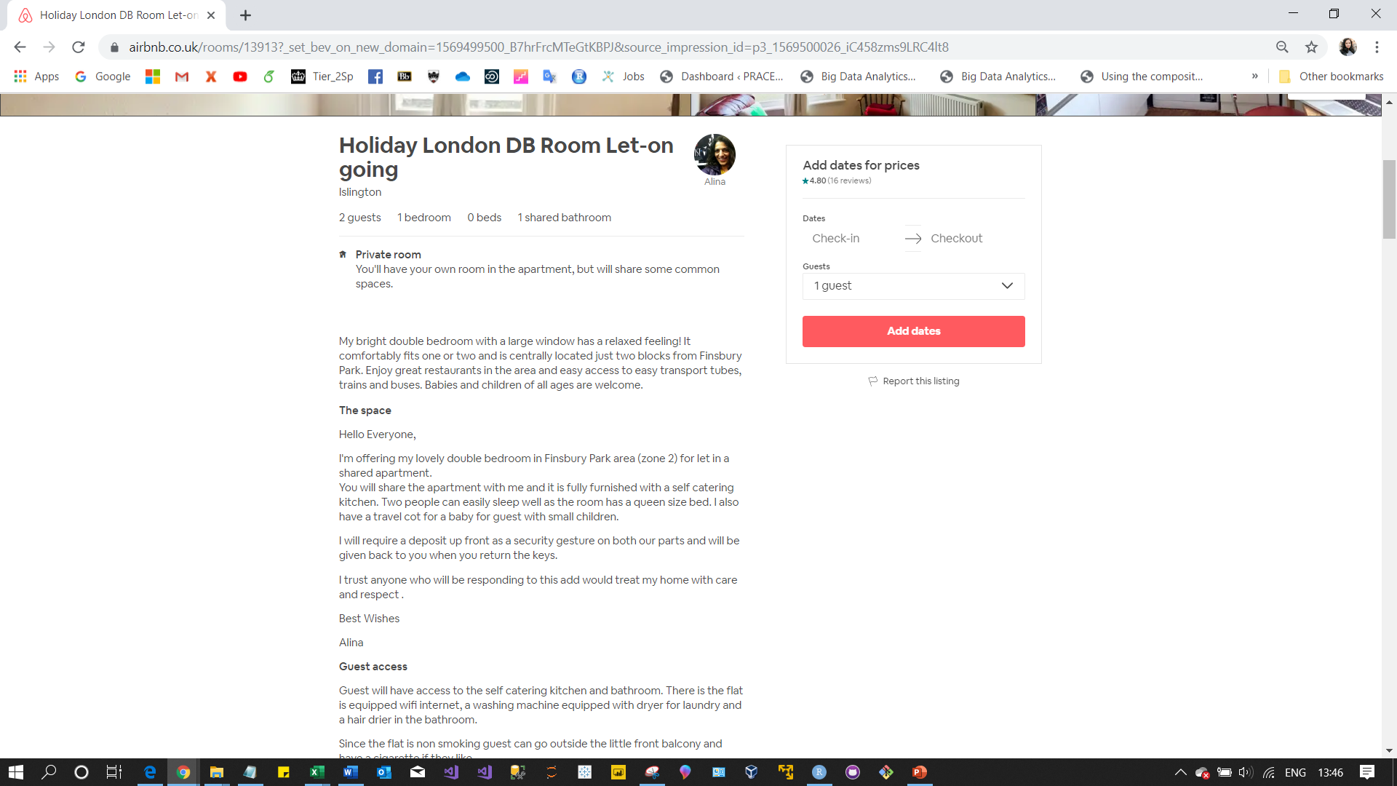
listing_url
id
name
summary
space

Slide 3
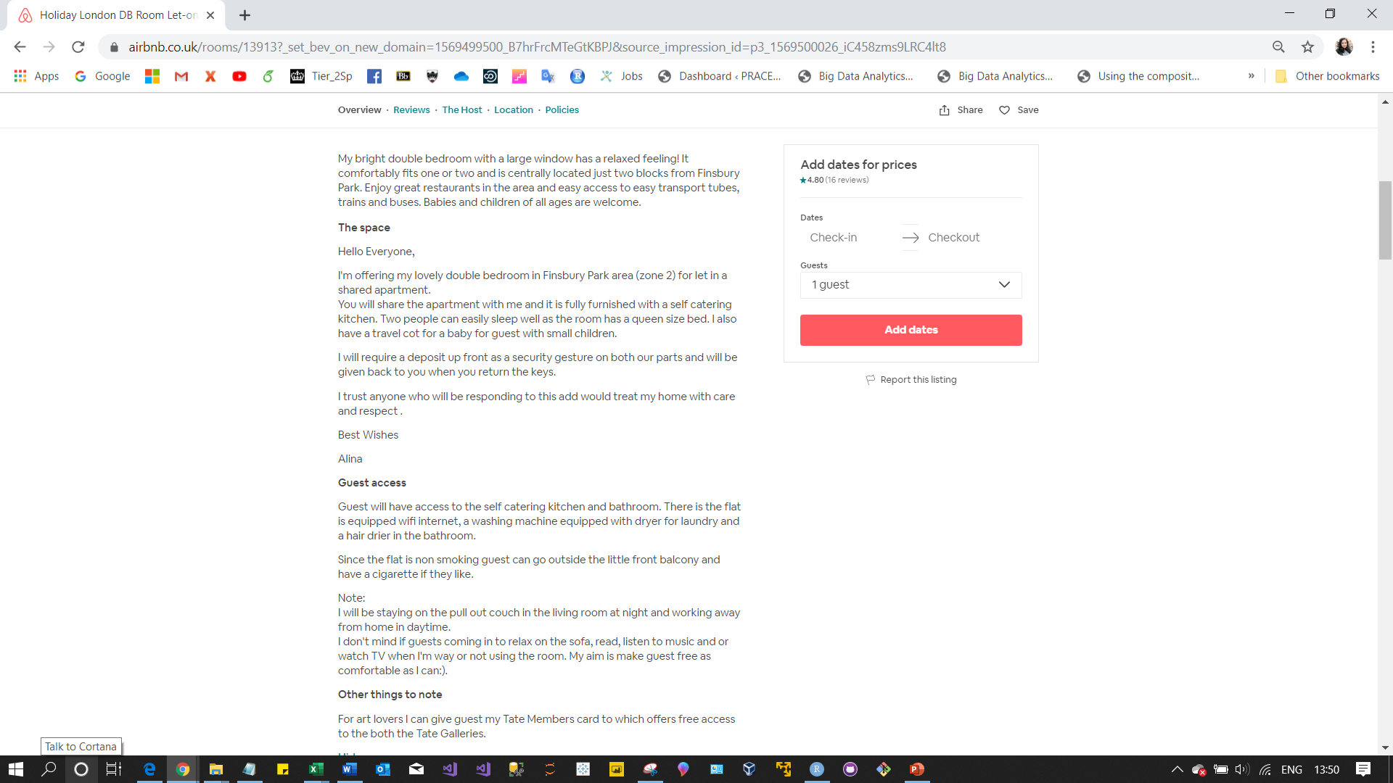
description
access
notes

Slide 4
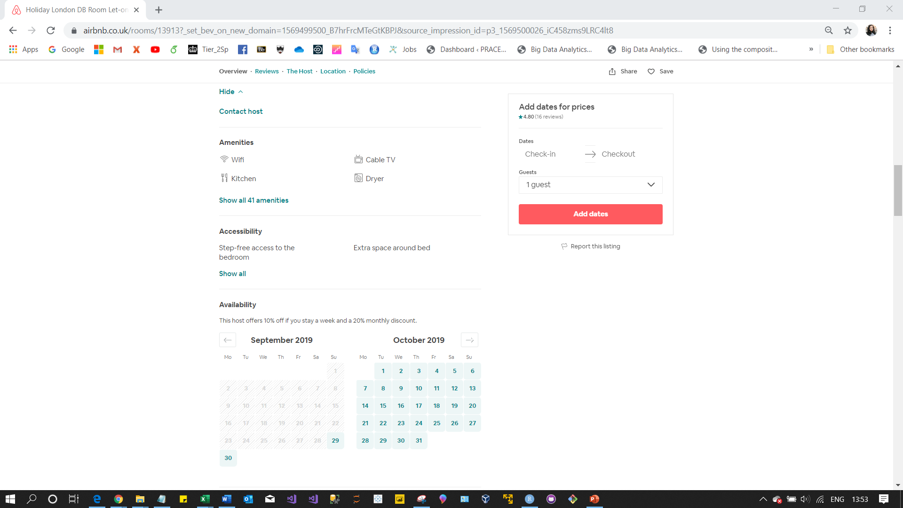
amenities

Slide 5
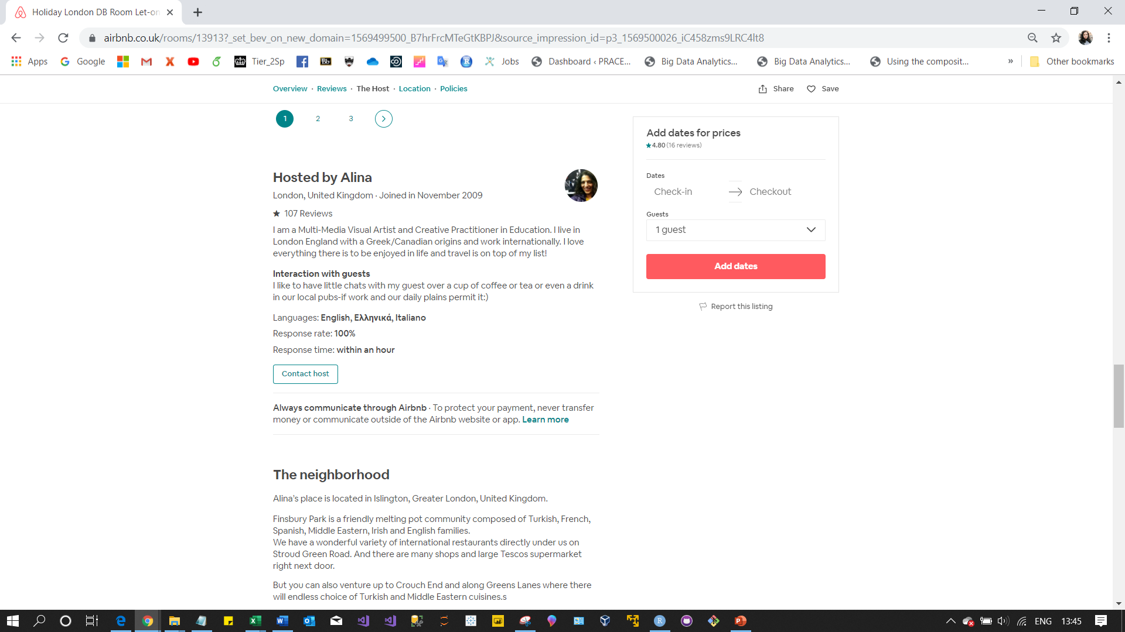
interaction

Slide 6
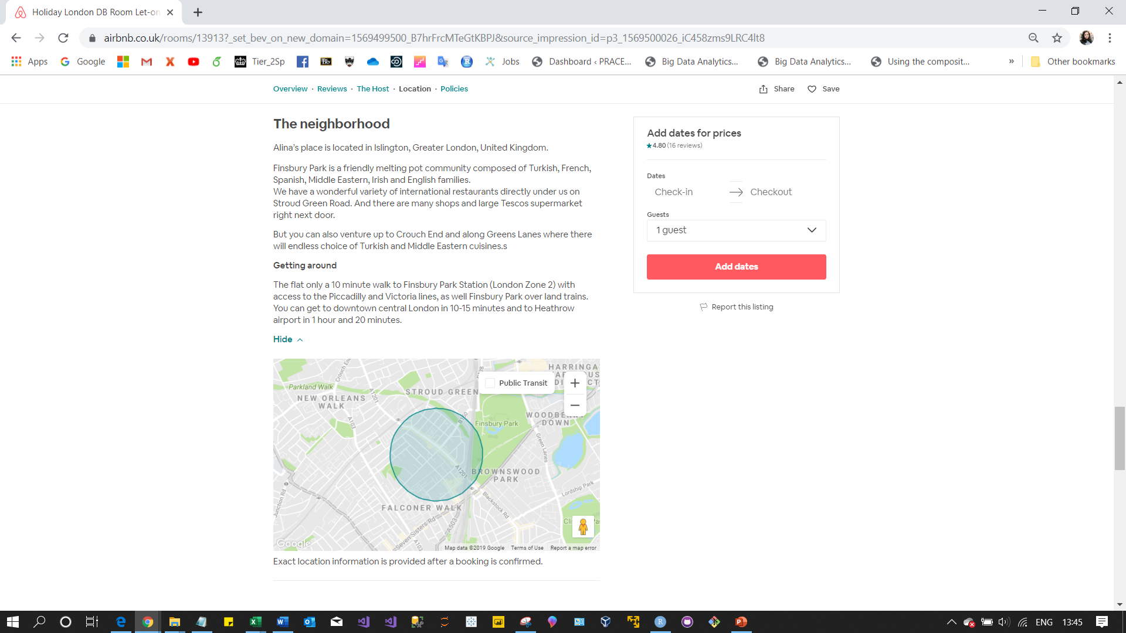
neighborhood_overview
transit

Slide 7
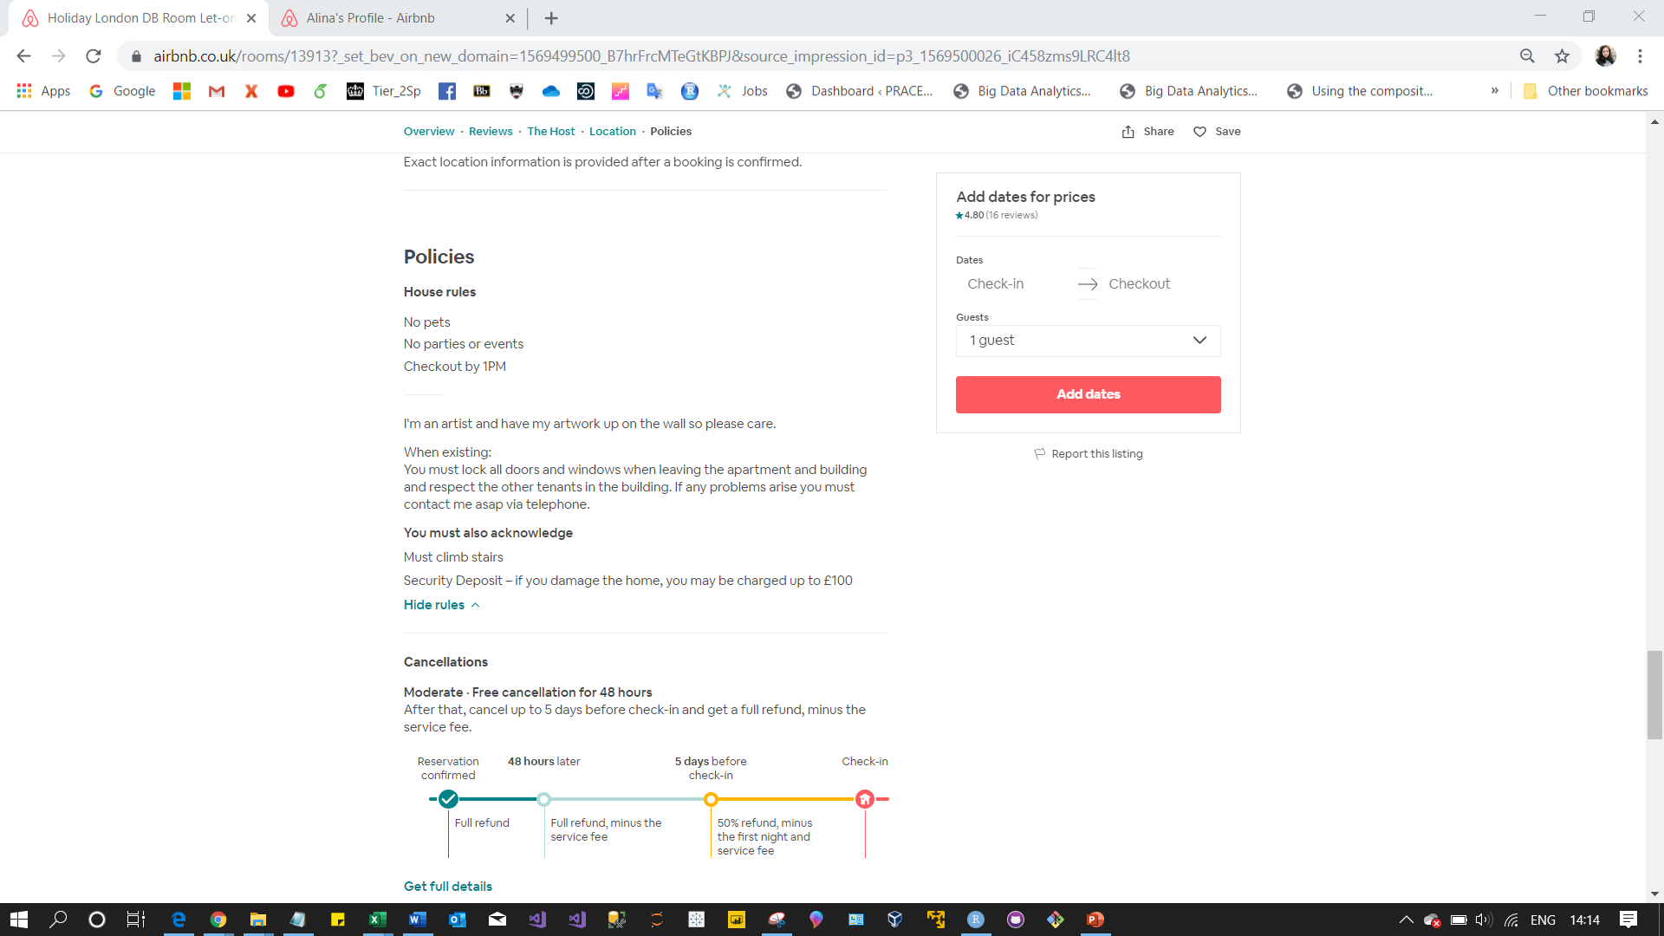
house_rules

Slide 8
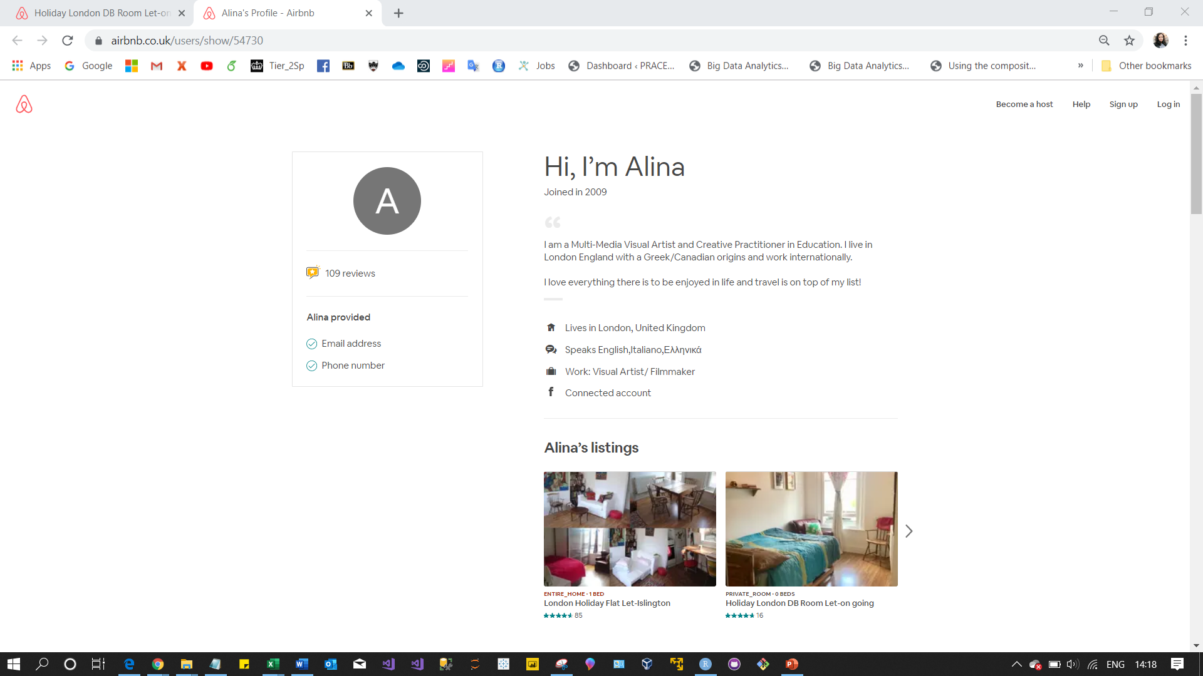
host_url
host_id
host_name
host_about
host_location

Slide 9
[1] "id"
[2] "listing_url"
[3] "scrape_id"
[4] "last_scraped"
[5] "name"
[6] "summary"
[7] "space"
[8] "description"
[9] "experiences_offered"
[10] "neighborhood_overview"
[11] "notes"
[12] "transit"
[13] "access"
[14] "interaction"
[15] "house_rules"
[16] "thumbnail_url"
[17] "medium_url"
[18] "picture_url"
[19] "xl_picture_url"
[20] "host_id"
[21] "host_url"
[22] "host_name"
[23] "host_since"
[24] "host_location"
[25] "host_about"
[26] "host_response_time"
[27] "host_response_rate"
[28] "host_acceptance_rate"
[29] "host_is_superhost"
[30] "host_thumbnail_url"
[31] "host_picture_url"
[32] "host_neighbourhood"
[33] "host_listings_count"
[34] "host_total_listings_count"
[35] "host_verifications"
[36] "host_has_profile_pic"
[37] "host_identity_verified"
[38] "street"
[39] "neighbourhood"
[40] "neighbourhood_cleansed"

Slide 10
[61] "price"
[62] "weekly_price"
[63] "monthly_price"
[64] "security_deposit"
[65] "cleaning_fee"
[66] "guests_included"
[67] "extra_people"
[68] "minimum_nights"
[69] "maximum_nights"
[70] "minimum_minimum_nights"
[71] "maximum_minimum_nights"
[72] "minimum_maximum_nights"
[73] "maximum_maximum_nights"
[74] "minimum_nights_avg_ntm"
[75] "maximum_nights_avg_ntm"
[76] "calendar_updated"
[77] "has_availability"
[78] "availability_30"
[79] "availability_60"
[80] "availability_90"
[41] "neighbourhood_group_cleansed"
[42] "city"
[43] "state"
[44] "zipcode"
[45] "market"
[46] "smart_location"
[47] "country_code"
[48] "country"
[49] "latitude"
[50] "longitude“
[51] "is_location_exact"
[52] "property_type"
[53] "room_type"
[54] "accommodates"
[55] "bathrooms"
[56] "bedrooms"
[57] "beds"
[58] "bed_type"
[59] "amenities"
[60] "square_feet"

Slide 11
[81] "availability_365"
[82] "calendar_last_scraped"
[83] "number_of_reviews"
[84] "number_of_reviews_ltm"
[85] "first_review"
[86] "last_review"
[87] "review_scores_rating"
[88] "review_scores_accuracy"
[89] "review_scores_cleanliness"
[90] "review_scores_checkin"
[91] "review_scores_communication"
[92] "review_scores_location"
[93] "review_scores_value"
[94] "requires_license"
[95] "license"
[96] "jurisdiction_names"
[97] "instant_bookable"
[98] "is_business_travel_ready"
[99] "cancellation_policy"
[100] "require_guest_profile_picture"
[101] "require_guest_phone_verification"
[102] "calculated_host_listings_count"
[103] "calculated_host_listings_count_entire_homes"
[104] "calculated_host_listings_count_private_rooms"
[105] "calculated_host_listings_count_shared_rooms"
[106] "reviews_per_month"

