Slide 1



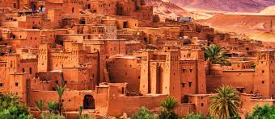


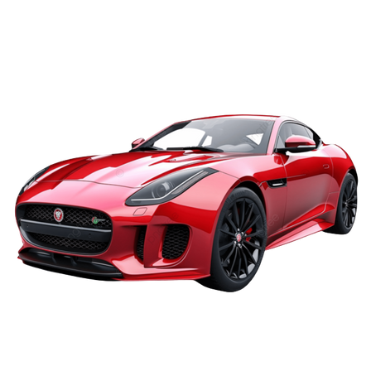
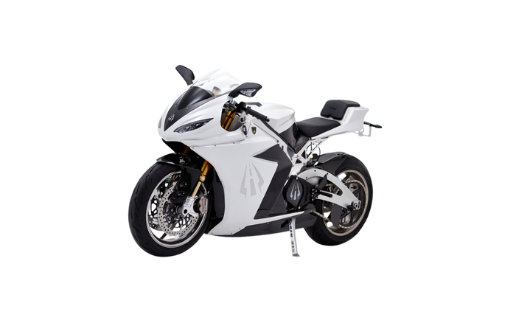
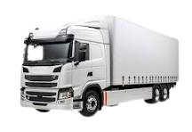

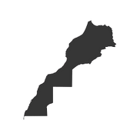




uto insurance
Ouarzazate
Your safety, our priority
AUTOMOBILE INSURANCE
IN MOROCCO
Third-Party Insurance
Third-Party Plus Insurance
Comprehensive Insurance (All Risks)
Our advantages
Cars
Motorcycles
Trucks
Open
€
24/7
Competitive prices
National coverage
24/7 assistance
  Fast subscription
Call us
:0578963152
email: contact@assuranceauto-oz.com
2025
adresse: avenue mohamed V,Oarzazate

