Slide 1

CSE 229:Engineering ethics and cyber law
Presented by:
Dr. Mst. Jannatul Ferdous
Professor
Department of Computer Science and Engineering
Jatiya Kabi Kazi Nazrul Islam University, Bangladesh
Email: mjferdous_cse@jkkniu.edu.bd, mjannatul@gmail.com
24th September, 2023

Slide 2

Ethics

Slide 3
What are the 7 codes of ethics?
#7 Ethical Principles:
Honesty and Integrity.
Fairness of commercial practices.
Data confidentiality.
Professional behavior.
Professional skills and added value.
Social respect.
Environmental care.

Slide 4
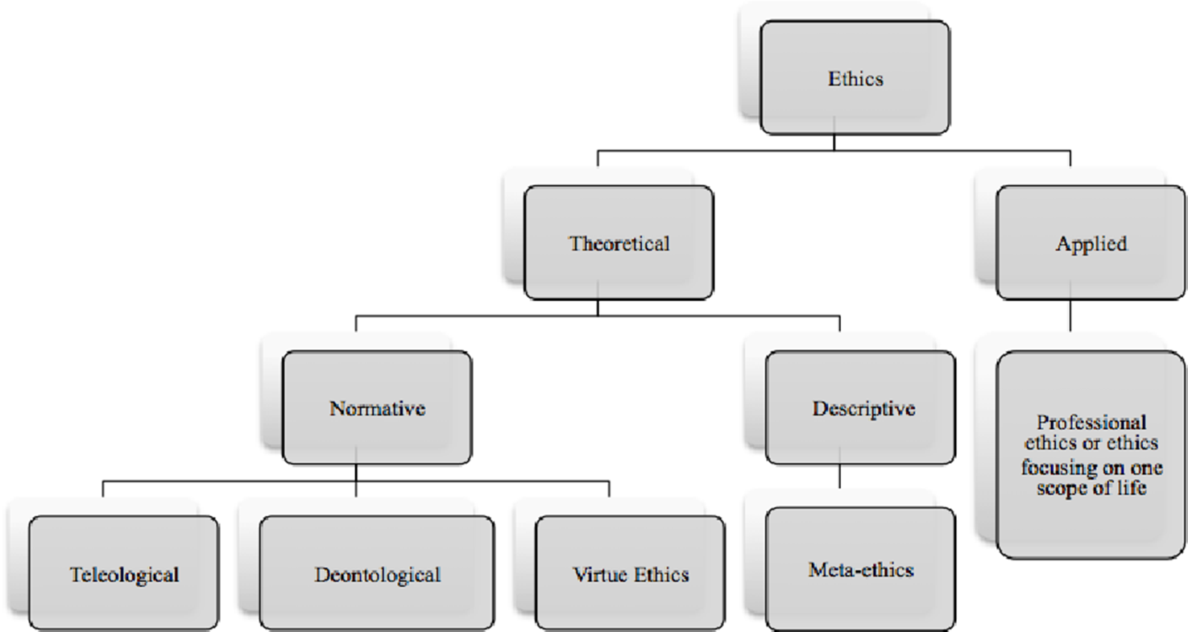

Slide 5
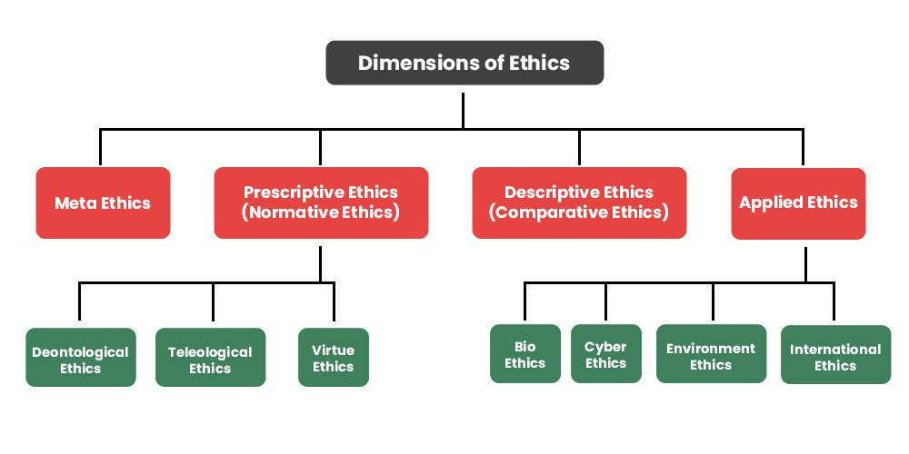

Slide 6
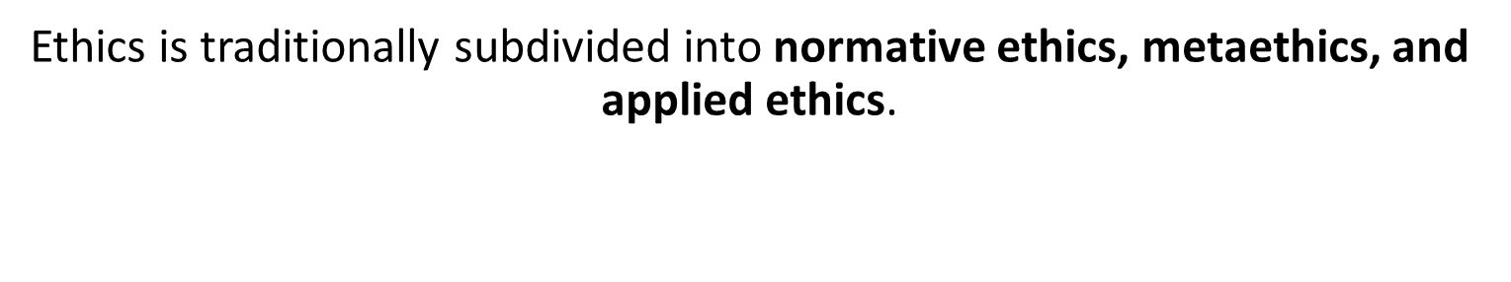
Ethics can be categorized as:
Metaethics: This looks at the origins of ethics and tries to understand what makes an action ethical or not.
Normative Ethics: This is concerned with setting out guidelines for behaving.
Descriptive Ethics: This applies to the study of what people believe is right.
What is the meaning of metaethics?
Metaethics is a branch of analytic philosophy that explores the status, foundations, and scope of moral values, properties, and words. Whereas the fields of applied ethics and normative theory focus on what is moral, metaethics focuses on what morality itself is.
Metaethics is the study of moral thought and moral language. Rather than addressing questions about what practices are right and wrong, and what our obligations to other people or future generations are – questions of so-called ‘normative’ ethics – metaethics asks what morality actually is. The metaethicist is interested in whether there can be knowledge of moral truths, or only moral feelings and attitudes, and asks how we understand moral discourse as compared with other forms of speech and writing.

Slide 7
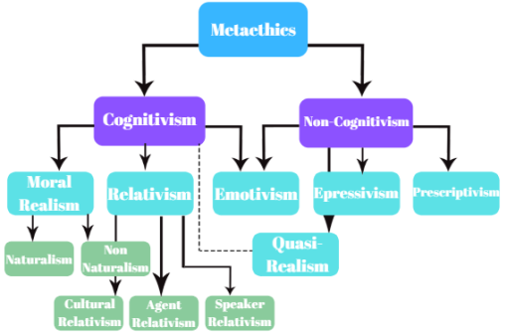

Slide 8
Cognitivism
Cognitive-জ্ঞান ভিত্তিক
What is the meaning of cognitivism?
Cognitivism is a learning theory that focuses on how information is received, organized, stored, and retrieved by the mind. It uses the mind as an information processor, like a computer. Therefore, cognitivism looks beyond observable behavior, viewing learning as an internal mental process.
What is the theory of cognitivism?
Psychologist Jean Piaget developed the first cognitive psychology theories in the 1930s from his work with infants and young children.

Slide 9
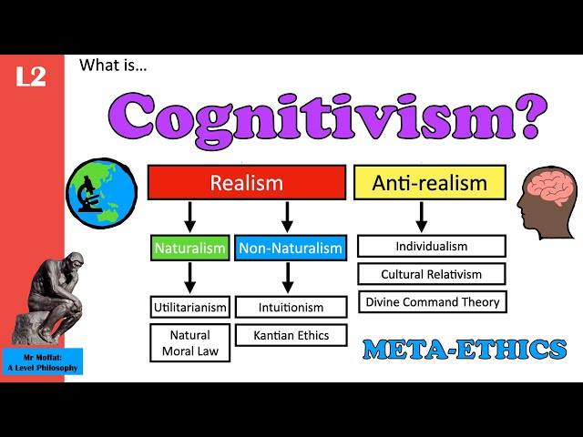

Slide 10
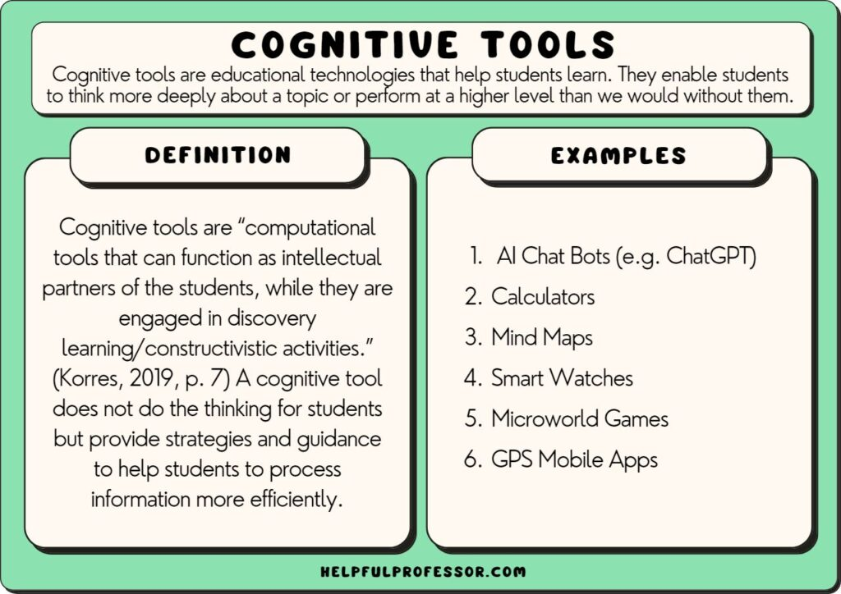

Slide 11
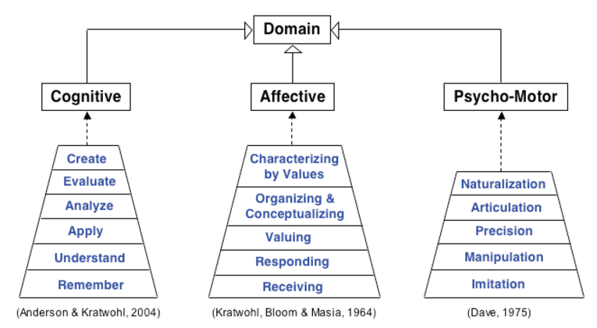

Slide 12
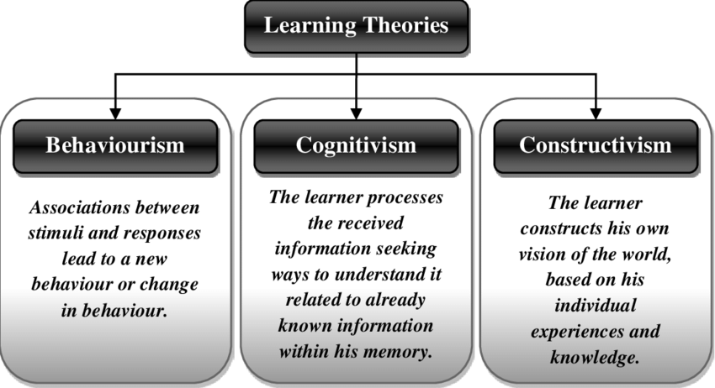
#What is cognitive learning?
Cognitive learning is a style of learning that encourages students to use their brains more effectively. This way of learning encourages students to fully engage in the learning process so learning, thinking, and remembering get easier and easier.

Slide 13
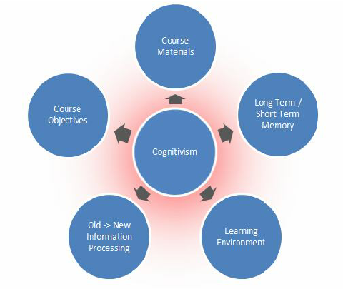

Slide 14
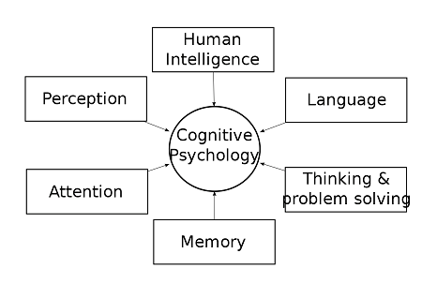
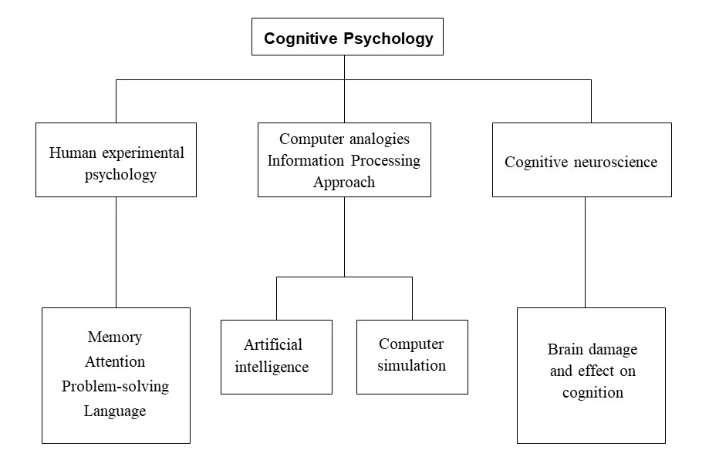

Slide 15
Non-cognitivism
Non-cognitivism is the meta-ethical view that ethical sentences do not express propositions (i.e., statements) and thus cannot be true or false (they are not truth-apt).

Slide 16
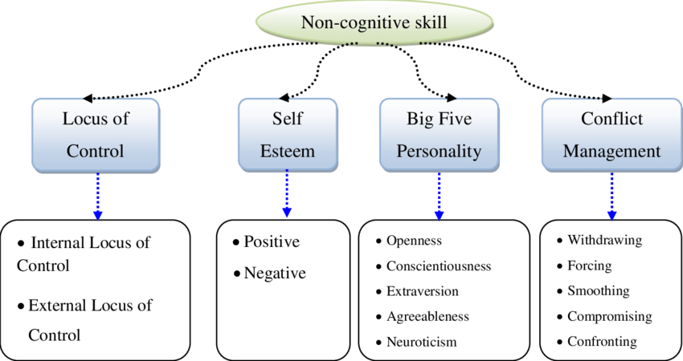

Slide 17
What is the difference between Cognitivism and non-cognitivism?
Cognitivism is valued knowledge whereas non-cognitivism is verified knowledge. They are not only a matter of linguistic expression but also a matter of subjective and objective expression. Cognitivism is subjective expression whereas non-cognitivism is objective expression.

Slide 18
Normative ethics
Normative ethics is the study of how we ought to act, morally speaking. It deals with questions about what is right and wrong, good and bad. Normative ethics is also sometimes called moral philosophy. There are three main types of normative ethical theories: consequentialism, deontology, and virtue ethics.
Consequentialism- ফলস্বরূপ, দীর্ঘমেয়াদী পরিণতি
the doctrine that the morality of an action is to be judged solely by its consequences.

Slide 19
What are the 3 normative ethics?
Normative ethical theories are classified into three main groups teleological, deontological, and virtue ethics theories. These types of theories differ in how they determine the moral worth of an action – whether an action is morally right or wrong, permissible or impermissible.
Teleological- পরমকারণমূলক
Philosophy-relating to or involving the explanation of phenomena in terms of the purpose they serve rather than of the cause by which they arise.
# What does teleological mean in simple terms?
Teleological means starting from the end and reasoning back, explaining things based on their end purpose. A teleological statement you've probably heard before is “Everything happens for a reason.“
# What are the main ideas of teleologicals?
The word teleological derives from the Greek word telos, which means end or goal, and logos, which means science. Therefore, teleological theories concentrate on the results of actions; in other words, they postulate that the ethics of our actions depend on the good or evil they produce.

Slide 20
Teleology (Philosophy)
the explanation of phenomena in terms of the purpose they serve rather than of the cause by which they arise.
"no theory of history can do without teleology“
Epistemic (জ্ঞানমূলক) relates to knowledge or to the degree of its validation.
What is an example of epistemic cognition?
Epistemic cognition is needed whenever people are required to do more than simply memorize information or conduct simple procedures; for example, people use their epistemic cognition to determine who or what to believe, and to decide among numerous alternatives for addressing complex problems.
The epistemic problem for cognitivism:
The epistemological problem of cognitive penetrability essentially stems from a clash of two conflicting intuitions about the credentials of this tribunal. The first intuition says that perceptual experiences in general possess the kind of intrinsic features that would make the beliefs based on them justified.
# Moral relativism is the idea that there is no universal or absolute set of moral principles. It's a version of morality that advocates “to each her own,” and those who follow it say, “Who am I to judge?” Moral relativism can be understood in several ways.

Slide 21
Deontological- নীতিশাস্ত্র; Deontology is an ethical theory that uses rules to distinguish right from wrong.
deontological ethics, in philosophy, ethical theories that place special emphasis on the relationship between duty and the morality of human actions. The term deontology is derived from the Greek deon, “duty,” and logos, “science.”
Virtue ethics-
Virtue ethics mainly deals with the honesty and morality of a person. It states that practicing good habits such as honesty, and generosity makes a moral and virtuous person. It guides a person without specific rules for resolving the ethical complexity.
# What are the 8 virtues of ethics?
The Eight Virtues are loyalty, filial piety (মাতাপিতার সেবা- the important virtue and primary duty of respect, obedience, and care for one's parents and elderly family members.), benevolence (kindness), love, honesty, justice, harmony, and peace.
পুণ্য নীতিশাস্ত্র

Slide 22
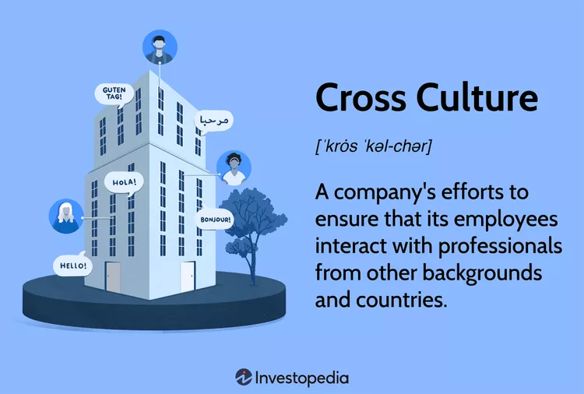
# What are the 4 normative ethics?
Four normative theories currently exist. These are utilitarianism, Kantianism, ethical intuitionism (in its methodological sense), and virtue ethics.
It implies a recognition of national, regional, and ethnic differences in manners and methods and a desire to bridge them.

Slide 23
Cross culture is a concept that recognizes the differences among business people of different nations, backgrounds, and ethnicities, and the importance of bridging them.
With globalization, cross-cultural education has become critically important to business success in opening up and maintaining new markets.
Business people working abroad need to learn subtle differences in style and substance in order to be effective.
Employees can obtain cross-culture training from their business and educational organizations.

Slide 24
Cross-cultural differences and similarities:
What are cultural differences and similarities?
Cultural differences are the various ways of life of people that are considered unique to different people, ethnicity, race, or national origin. These differences are beliefs, behaviors, languages, practices, and expressions., etc.
What are the similarities and differences between cross-cultural and intercultural?
In cross-cultural societies, one culture is often considered “the norm” and all other cultures are compared or contrasted to the dominant culture. Intercultural describes communities in which there is a deep understanding and respect for all cultures.

Slide 25
Different Psychological Issues in Meta-ethics:
Egoism (অহংবোধ) and Altruism (পরার্থপরতা)- disinterested and selfless concern for the well-being of others.
Egoism- an ethical theory that treats self-interest as the foundation of morality.
2. Emotion and Reason
3. Male and Female Morality
https://abhipedia.abhimanu.com/Article/IAS/Mzc4MgEEQQVVEEQQVV/Psychological-Issues-in-Metaethics-Ethics--Integrity-and-Aptitude-IAS

Slide 26
The term egoism is also referred to as egotism. This term can be defined as the quality of being excessively conceited or self-centered. A person, who is egoistic is usually inconsiderate of others and focuses solely on the individual self. Such a person would engage in any activity that harms others and benefit himself.
Altruism can simply be defined as unselfishness. It is when a person puts the needs of others even before himself. This is why it can be considered as the opposite of egoism. Such an individual is so concerned about others that he completely ignores himself. For example, take a soldier who sacrifices himself to save the others of his battalion, or else a parent who risks herself or himself to save a child. These are instances where an individual completely forgets his own self.
What is the difference between Egoism and Altruism?
• Egoism can be defined as extreme self-centeredness whereas altruism can be defined as selflessness.
• These two can be considered as two extremes of human quality.
• An egoistic person only cares for himself, but an altruistic person cares for others ignoring his own self.

Slide 27
Emotion and Reason
A second area of moral psychology involves a dispute concerning the role of reason in motivating moral actions. If for example, I make the statement “abortion is morally wrong” am I making a rational assessment or only expressing my feelings? On the one side of the dispute 18th century British philosopher David Hume argued that moral assessments involve our emotions and not our reason. We can amass all the reasons but that alone will not constitute a moral assessment. We need a distinctly emotional reaction in order to make a moral pronouncement. The reason might be of service in giving us the relevant data, but in Hume’s words “reason and ought to be, the slave of the passions”. Inspired by Hume’s anti-rationalist views some 56th-century philosophers most notably A.F. Ayer, similarly denied that moral assessments are factual descriptions.

Slide 28
Male and Female Morality
A third area of moral psychology focuses on whether there is a distinctly female approach to ethics that is grounded in the psychological differences between men and women. Discussions of this issue focus on claims that 378 traditional morality is male-centered and 358 there is a unique female perspective of the world which can be shaped into a value theory. According to many feminist philosophers, traditional morality is male-centered since it is modeled after practices that have been traditionally male-dominated such as acquiring property engaging in business contracts, and governing societies.

