Slide 1
Actor Critic Method Kihwan Lee

Slide 2
Contents 1. Actor Critic Method 2. Variants of Critic

Slide 3
1. Actor Critic Method

Slide 4
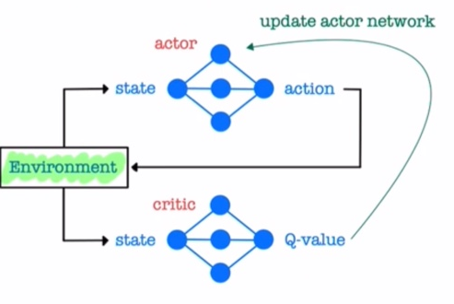
Actor-Critic Method
# Review
value ft Q(s,a) > Deep Q-Network
policy π(a|s) > Policy Gradient (REINFORCE)
=> value ft + policy > Actor-Critic (A3C)

Slide 5
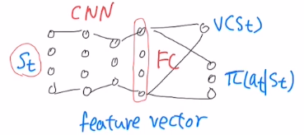
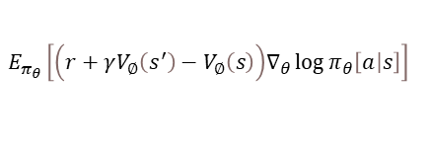
Actor-Critic Method
# TD Actor-Critic Method
Gt는 끝까지 고려해야 하기에 baseline을 줌에도 불구하고 high variance
=>
$$E_{π_{θ}}\left[\left(r+γV_{∅}\left(s^{′}\right)−V_{∅}\left(s\right)\right)∇_{θ}\log{π_{θ}\left[\left.a\right|s\right]}\right]$$
TD Error !
Policy Gradient
① Reduces variance
② Bootstrapping > Online Learning
③ Accelerates learning
Actor Critic

Slide 6
2. Variants of Critic

Slide 7
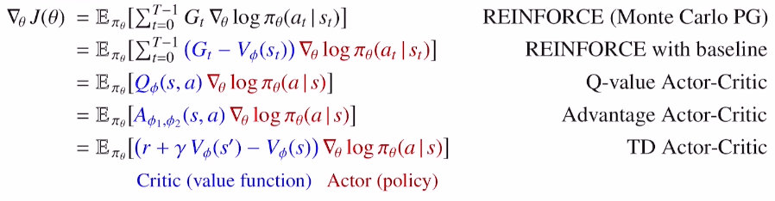


Actor-Critic Method
# Variants of Critic
① High variance
$\text{④}{ Q}_{∅}$ - $V_{∅}$
② TD Error
$${\text{③} Q}_{∅}\left(s,a\right)$$

Slide 8
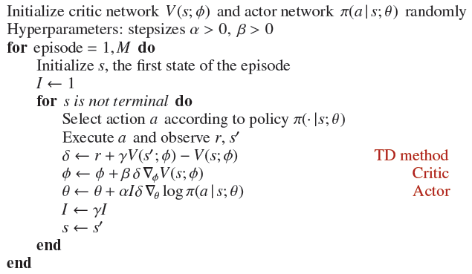
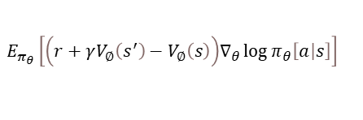
Actor-Critic Method
# 수도 코드
$$E_{π_{θ}}\left[\left(r+γV_{∅}\left(s^{′}\right)−V_{∅}\left(s\right)\right)∇_{θ}\log{π_{θ}\left[\left.a\right|s\right]}\right]$$
: TD Error!

