Slide 1
Antisense oligonucleotide (ASO) off-target finder
Computation and synthetic biology lab (CSBL)
김보근, 박연수

Slide 2
What is antisense oligonucleotide (ASO)?
Short, synthetic, single-stranded oligonucleotide
Bind to complementary RNA (coding or non-coding)
Modify protein expression through several method
Rinaldi, C., & Wood, M. J. (2018). Antisense oligonucleotides: the next frontier for treatment of neurological disorders. Nature Reviews Neurology, 14(1), 9-21.

Slide 3
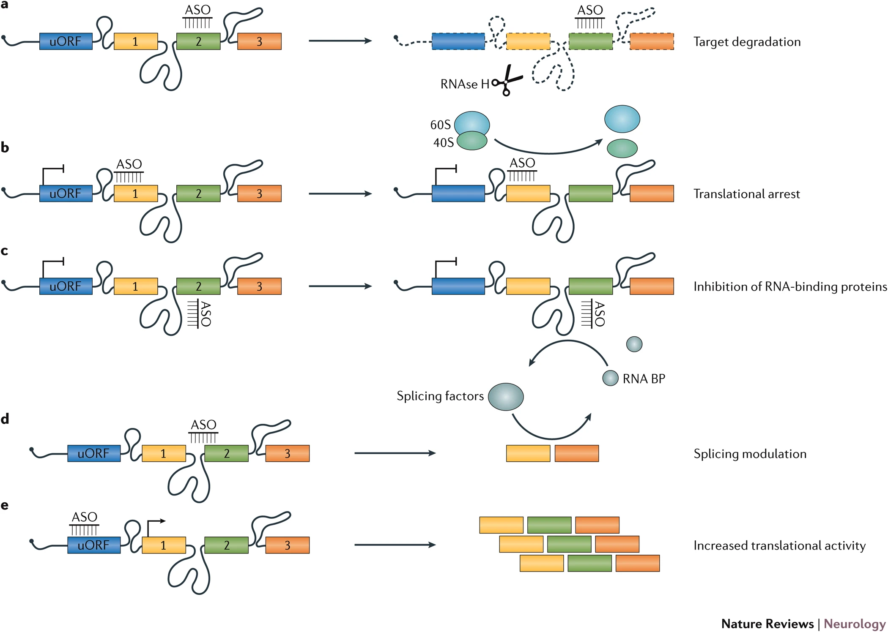
Various ASO mechanisms
Rinaldi, C., & Wood, M. J. (2018). Antisense oligonucleotides: the next frontier for treatment of neurological disorders. Nature Reviews Neurology, 14(1), 9-21.

Slide 4
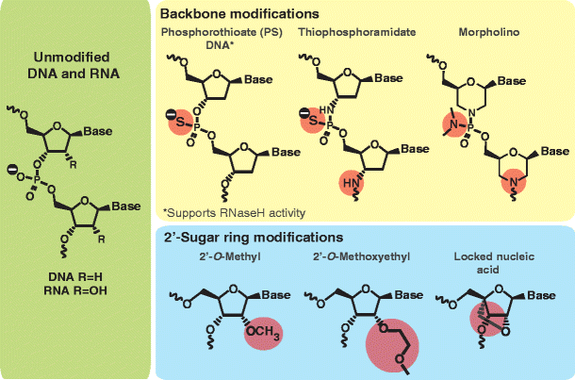
Different types of standard ASO
Gapmer ASO
High-affinity ribose modification (e.g. LNA) on wing
DeVos, S. L., & Miller, T. M. (2013). Antisense oligonucleotides: treating neurodegeneration at the level of RNA. Neurotherapeutics, 10(3), 486-497.

Slide 5
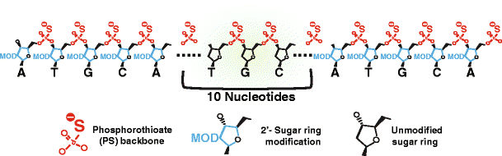
Different types of standard ASO
Gapmer ASO
Normal DNA in the central gap region
Target RNA sequence cleaved by RNase H
DeVos, S. L., & Miller, T. M. (2013). Antisense oligonucleotides: treating neurodegeneration at the level of RNA. Neurotherapeutics, 10(3), 486-497.

Slide 6
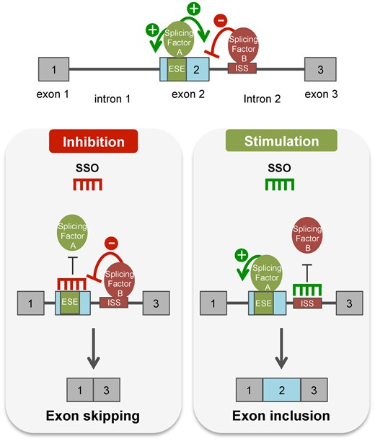
Different types of standard ASO
Splice-switching ASO
Does not use RNase H-mediated cleavage
Sterically block target RNA
Regulate pre-mRNA splicing and repair of defective RNA
Havens, M. A., & Hastings, M. L. (2016). Splice-switching antisense oligonucleotides as therapeutic drugs. Nucleic acids research, 44(14), 6549-6563.

Slide 7
What is the problem?
- Finding off-target site of antisense oligonucleotide (ASO)
Input: target genome and ASO sequence (FASTA format)
Output: target/off-target site coordinate
Options: Number of allowed mismatches, indels…

Slide 8
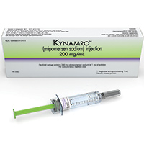
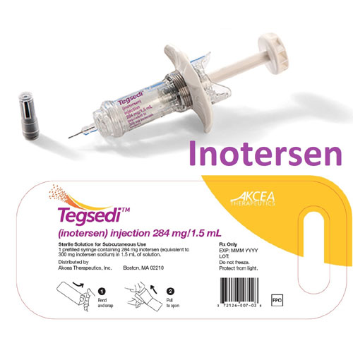
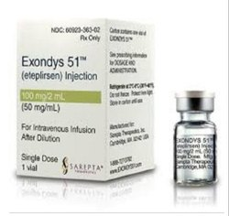
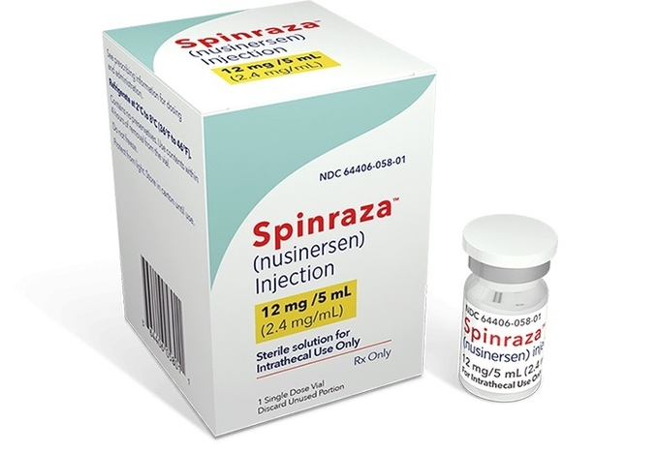
Why is it important?
ASO can be used to inhibit specific sequences of RNA
Some neurodegenerative disease result from single mutant protein (Alzheimer’s disease, Parkinson’s disease)
Several ASO therapies are approved for rare genetic diseases
Kynamro (Familial hypercholesterolemia, 가족성 고콜레스테롤혈증)
Tegsedi (Hereditary ATTR amyloidosis, 유전성 ATTR 아밀로이드증)
Exondys 51 (Duchenne muscular dystrophy, 듀센 근이영양증)
Spinraza (Spinal muscular atrophy, 척수성 근위축증)

Slide 9
Why is it important?
Specific ASO binding to target sequence needed for high selectivity
ASO might bind to off-target RNA (similar sequence to target)
Off-target binding might cause unintended toxicity
Animal studies cannot be used for off-target finding due to difference in genome sequence
In silico analysis using human RNA database + In vitro expression analysis using human cells

Slide 10
How problem can be solved?
Genome sequence
ASO sequence
Index
Genome
Options
# of gaps
# of indels
Align ASO to genome
No
Less than allowed gap/indels?
Yes
Save coordinate

