Slide 1
Data Science 2025 Final Project
Kiarash Gheisari Pour – EE SUT St. ID : 402102302

Slide 2
In-ear ECG Signal Enhancement
A Deep Learning Approach with Denoising Convolutional Autoencoders

Slide 3
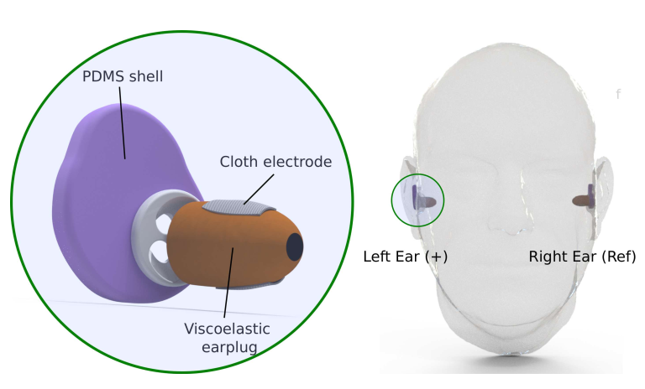
Project Goal & Explanation :
The goal of this project is to reproduce the paper by Occhipinti et al. (arXiv:2409.05891v1)
The aim of this paper is to Denoise the ECG signals sampled in the ear of subject using a denoising convolutional Auto Encoder

Slide 4
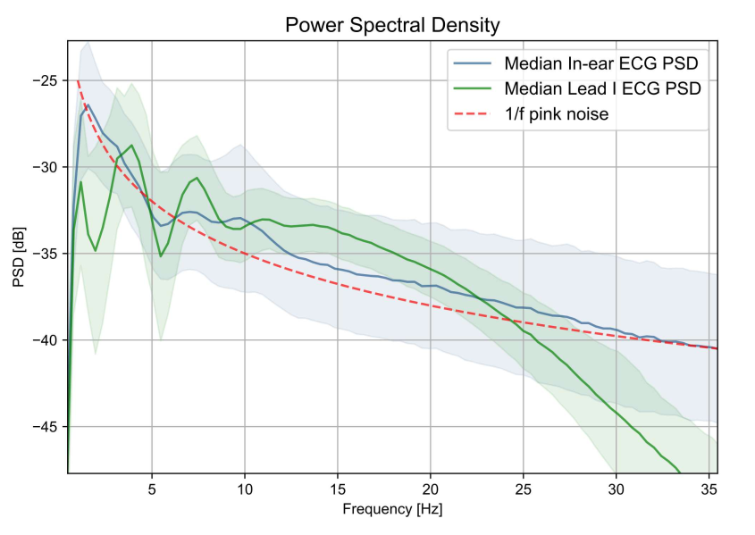
Problem Explanation :
In-ear ECG amplitude is about 100x smaller than chest ECG, making it highly susceptible to contamination.
Main noise sources:
Physiological: EEG (brain signals with 1/f spectrum, e.g., alpha waves at ~10 Hz), EOG (eye movements), EMG (muscle activity).
Artifacts: Jaw/head movements, eye blinks—overlapping frequencies obscure P, QRS, T waves.
Result: Low SNR (often negative, e.g., median -1.62 dB), resembling EEG more than ECG (see PSD comparison).

Slide 5
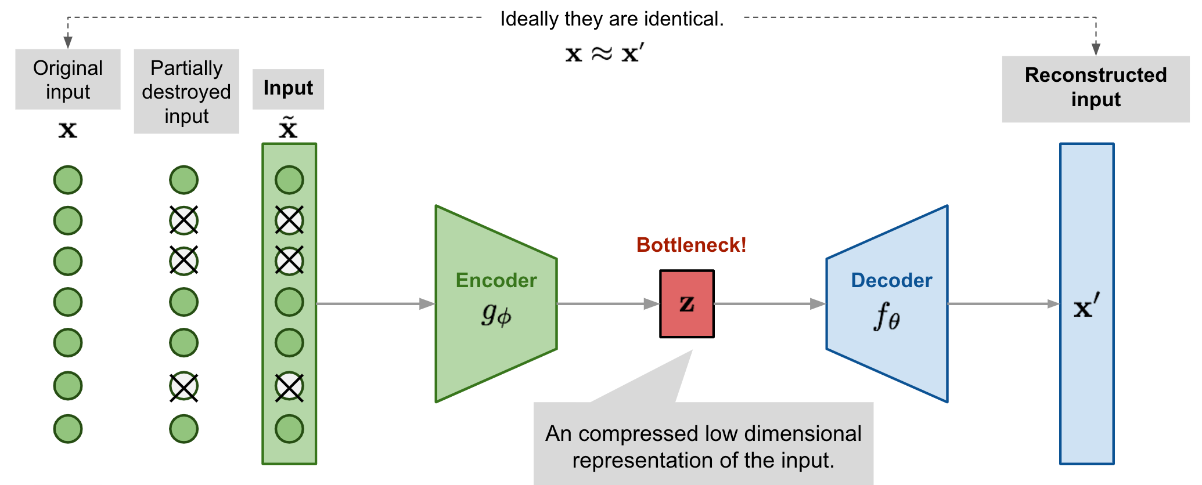
Our Approach to solving the problem is to train a deep learning model to map noisy in-ear ECG signals to clean Lead I ECG, preserving clinically relevant waveforms.
The model that we are going to be using is a DCAE (Denoising Convolutional AutoEncoders)
What we hope to achieve with this model is the following :
For the model to Learn to separate ECG from noise without rigid frequency assumptions (unlike traditional filters)
Encoder captures P-QRS-T features while discarding noise patterns.
To put it short we hope that the DAE learn the manifold of clean ECG signals, projecting noisy inputs back to this space.

Slide 6
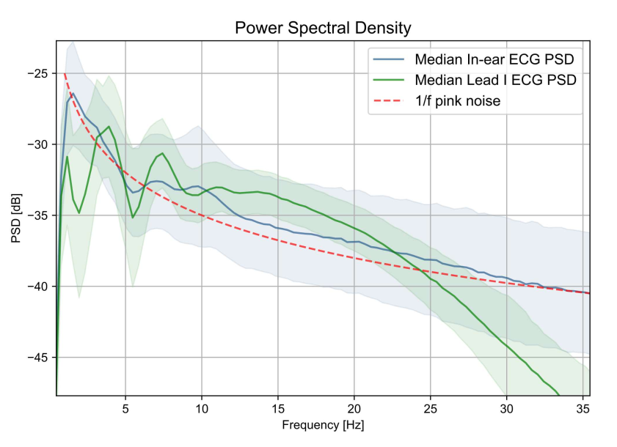
Noise modelling and data augmentation :
The data that we’re going to be using in this project is the PTB-XL that Consists of 21,799 Lead I ECG records (Sampled at 100 Hz) unfortunately the author of the paper was reached but they didn’t share the in-ear sampled data , but for our purposes the Lead I ECG records will do just fine.
As it turns out a great model of the noise that we’ll try to model is pink noise as its shown in the figure.

Slide 7
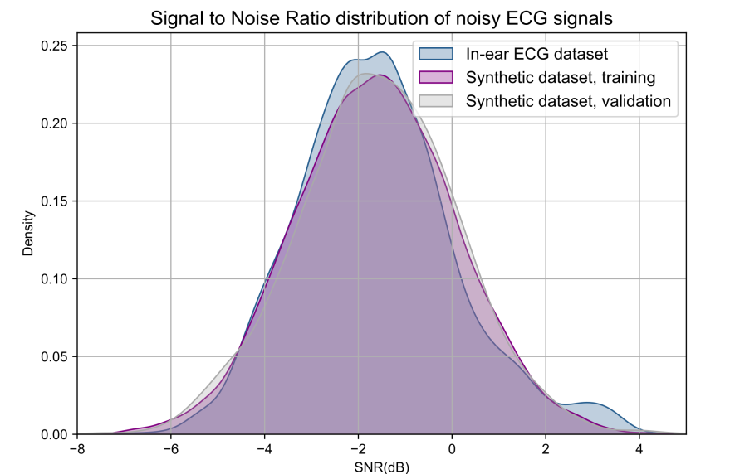

Pink noise modeling :
As it was calculated in the paper the SNR (eq. 1) of the noisy ECG signals would fall within a similar distribution to the normal distribution with : (${\text{µ}}_{SNR}$= -1.62, ${\text{σ}}_{SNR}$= 1.71dB )
SNR = 10 × log₁₀( ∑[x(n)²] / ∑[(x(n) – x̃(n))²] ) (1)
So, to model the noise in the signal , a SNR was sampled from the normal distribution above and it was added to our original signal.
Also, the noise and the signal itself were filtered to limit their bandwidth to 40 Hz.

Slide 8
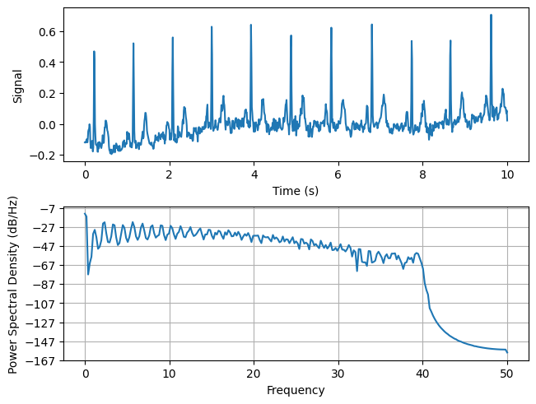
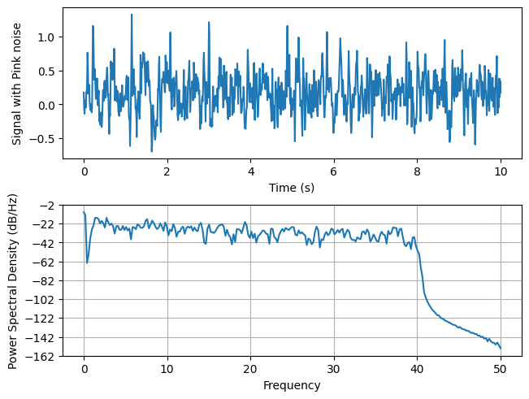
An Example of a clean/noisy Signal

Slide 9
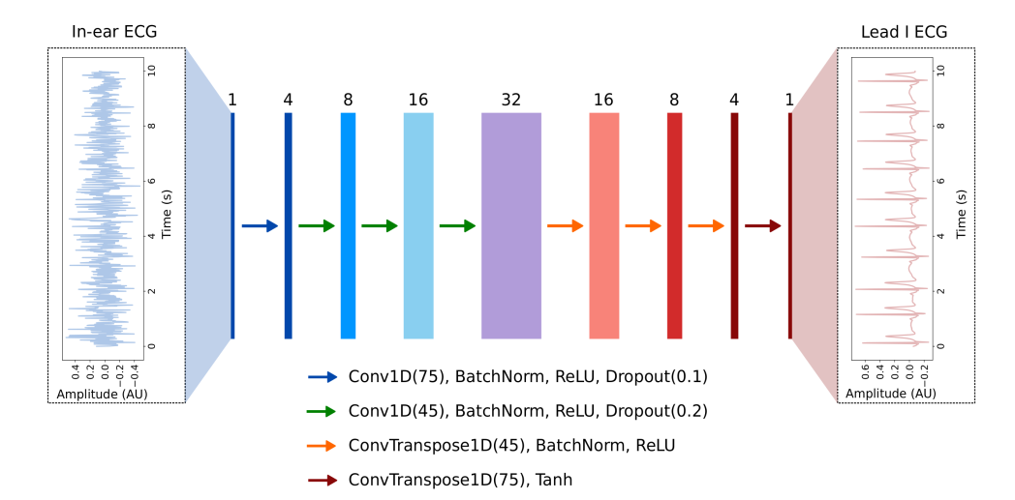
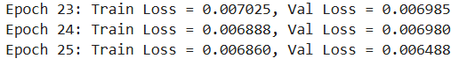
We now use the Pytorch library to implement the neural network architecture as shown in the figure below
And we train it under the MSE loss function for 25 epochs , which seemed to be a good amount and the loss was getting pretty Stable after 25 epochs.

Slide 10
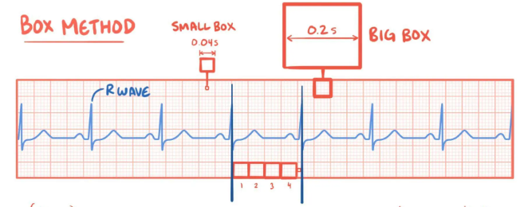
Metrics to Evaluate Model Performance
A - Signal-to-Noise Ratio (SNR) Improvement
Our first test to evaluate our model's performance is to calculate the SNR improvement.
B - Heart Rate Estimation Accuracy
We use the Matched Filter Hilbert Transform (MFHT) algorithm to estimate the HR of the subject
SNR = 10 × log₁₀( ∑[x(n)²] / ∑[(x(n) – x̃(n))²] ) (1)

Slide 11
Before moving on to measurements let’s see a couple of visual examples of how our model is doing in the time domain.

Slide 12
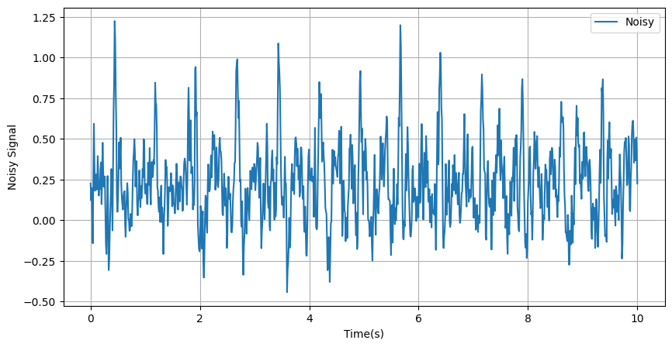
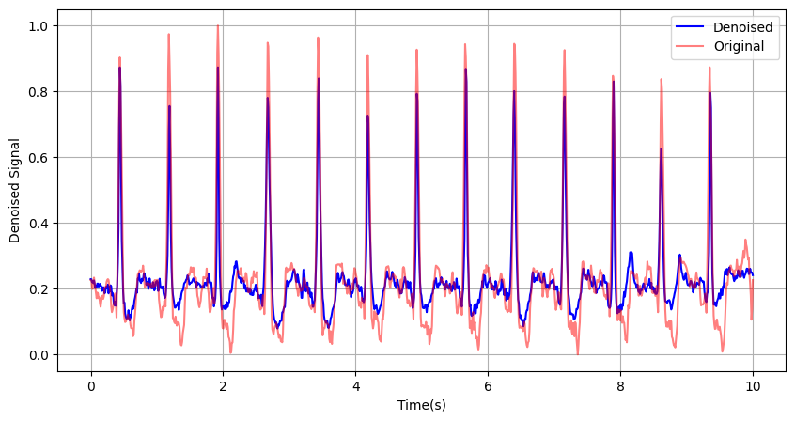

Slide 13
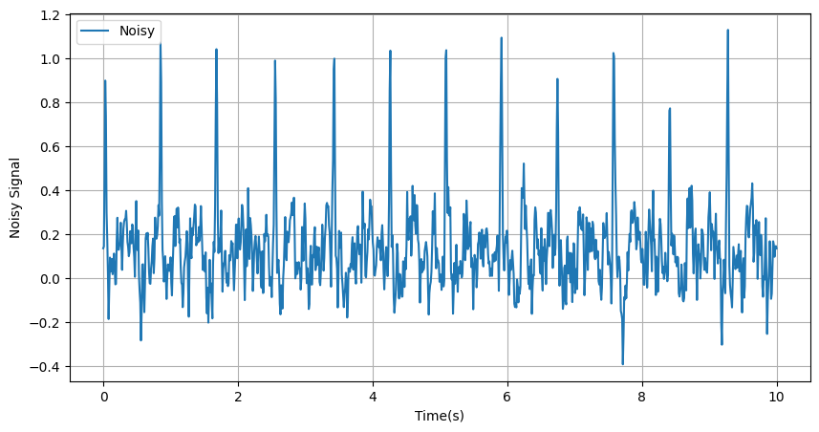
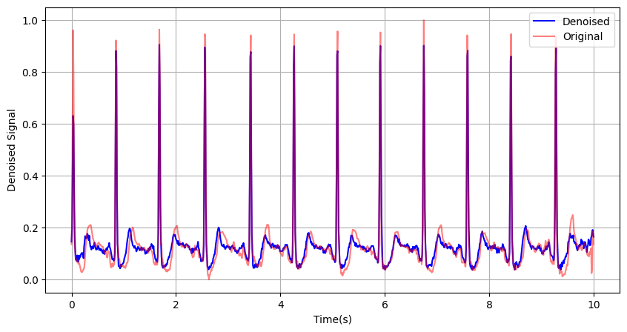

Slide 14
So far, these patients have had very steady heart rates.
Let’s check a patient with a little Arrhythmia or uneasiness (Motion Artifact)!

Slide 15
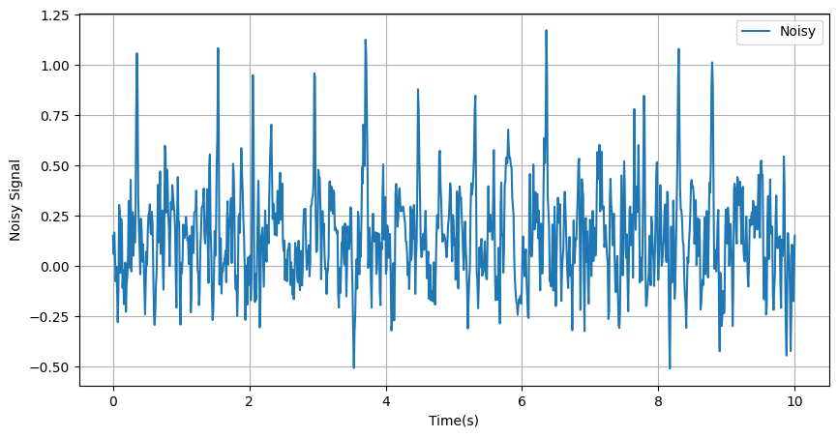
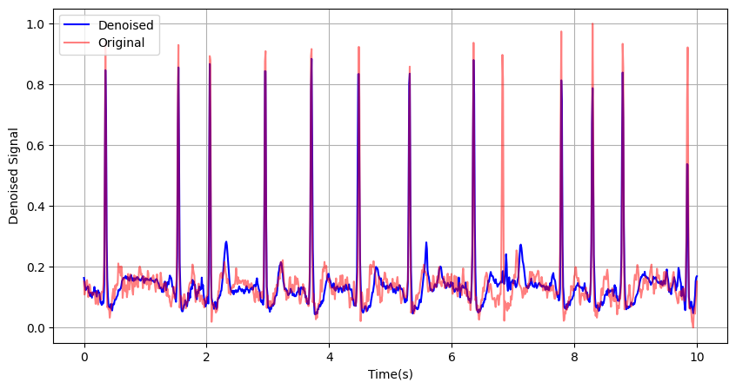

Slide 16
It looks like that the model loses a bit of precision and if we look closely the model even missed a peak
Let's move on to more Precise measurements!

Slide 17
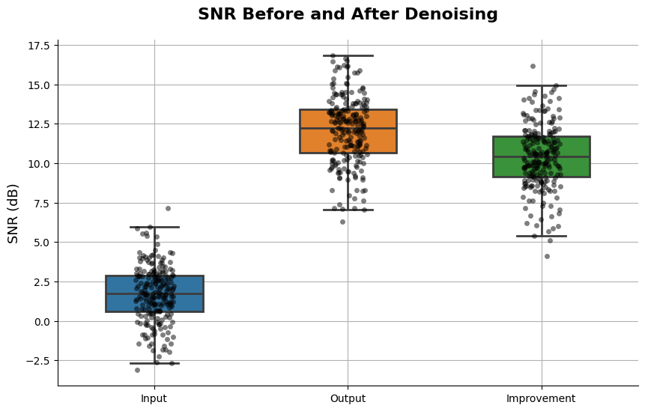
SNR Box Plot

Slide 18
Heart rate estimation , The MFHT algorithm :
1. Signal Preprocessing
ECG signal x(t)x(t)x(t) is bandpass filtered (5−20Hz)
Removes baseline drift & high-frequency noise.
2. Matched Filtering
A QRS template h(t) is used (learned or designed).
Peaks of y(t) occur when x(t) resembles the QRS complex.
3. Hilbert Transform & Envelope
Construct analytic signal:
z(t)=y(t)+j H{y(t)}
where H{⋅} is the Hilbert transform.
Envelope is magnitude: e(t)=∣z(t)∣
e(t) produces a smooth positive waveform with peaks aligned to QRS events.
After that it’s just a peak detection to estimate the HR.

Slide 19
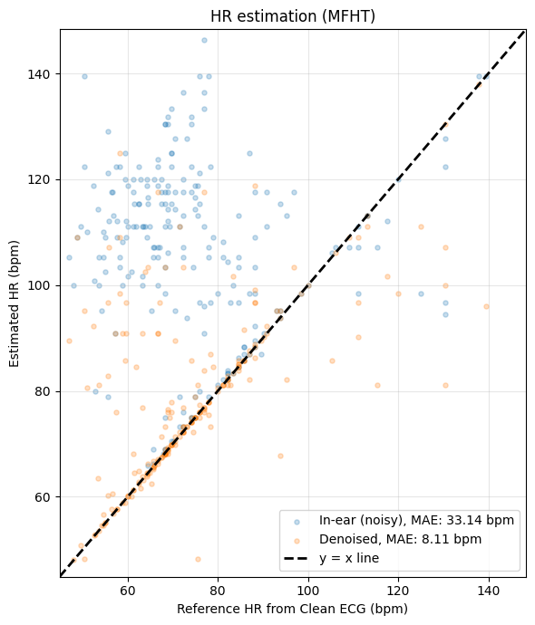
Scatter plot of Reference HR/Estimated HR

Slide 20
Core Achievement
The denoising convolutional autoencoder (DCAE) successfully enhances in-ear ECG signals to match the quality of clinical Lead I ECG, overcoming challenges like low amplitude and EEG noise.
Performance Highlights
SNR Boost: Median improvement of about +10 dB.
Heart Rate Accuracy: Reduced MAE by 75% .
Clinical Value
Preserves P-QRS-T morphology to a good extent (critical for diagnosing arrhythmias/ischemia).
Handles abnormal rhythms (e.g., PVCs), proving robustness beyond healthy cases.
Future Vision
Enables continuous, unobtrusive monitoring via hearables.
Next steps: Real-time deployment and clinical validation for early heart disease detection.

Slide 21
Room for Improvement :
I think Using more novel Preprocessing techniques if they have low computational Complexity could lead to a very good improvement.
And if we gather more data and make our network bigger as long as we are cautious of overfitting better results could follow.
Another thing to consider would be if we are looking to find irregularities in patients HR , an oversampling of the samples with irregularities would be a nice idea

Slide 22
All pictures used in this presentation are Hyperlinked to their Source
The link to the Original paper : https://arxiv.org/abs/2409.05891

Slide 23
Thank you for your attention
Kiarash Gheisari
kia.gheysari85@sharif.edu
EE SUT

