Slide 1
Search Engine PROJECT
Authored by Mohammad Nasr & sepehr sedigh

Slide 2
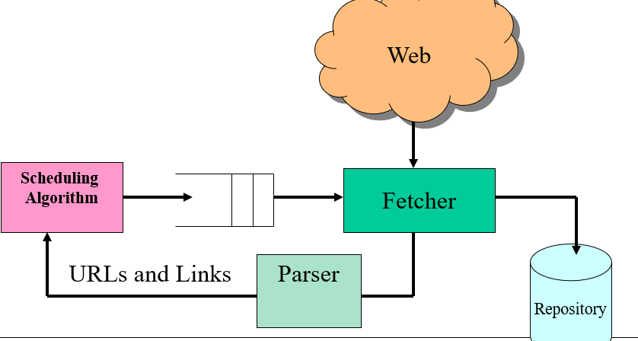
Crawler responsibility
At crawler module we want to crawl specific domain and other unique sublinks related to it . And finally store it in repository for other processing in future

Slide 3
Which language and tool used?
Java (jdk 21)
Maven ( build tool)
jsoup (library for download and parse webpage)
Spring boot(Spring Boot is a popular open-source Java-based framework)
Kafka (distributed streaming platform)
Redis ( in memory key value base it considered as nosql)
Mongodb (popular open-source, document-oriented NoSQL database management system designed for handling large volumes of unstructured or semi-structured data)

Slide 4
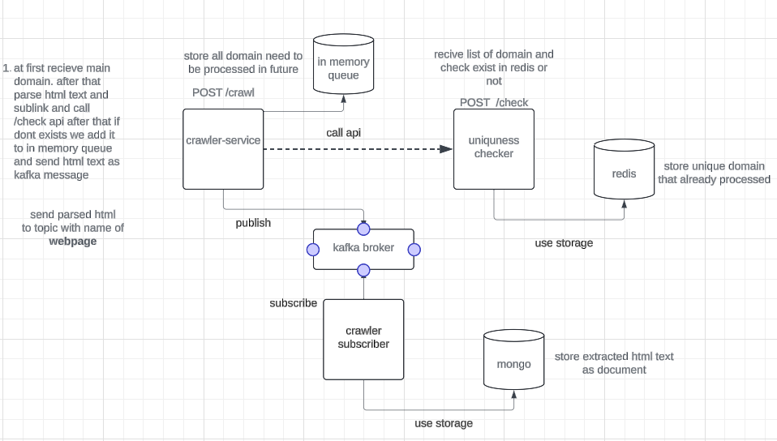
Crawler architecture

Slide 5
Why we use this architecture
Why we use crawler as web service? In high scale architecture suppose we balance domain to different crawler service in distribute system
Why we use different service for uniqueness checking? Consider we have 3 instance of crawler service . Those service need to have access share data(visited urls) and need has the ability to save on disk and be fast . Also for that we use different service and use redis for efficient performance
Why we use kafka ? Because kafka is distribute streaming platform . That enable process huge amount as well as guarantee HA (high availability)

Slide 6
Why we use this architecture
Why we use mongo db for storing extracted data? Our data is in unstructured format and better to use mongo db for unstructured or semi structure data.
What is responsibility of crawler-subscriber? We decouple this service from crawler for processing on extracted data and so on at better way.
What benefit of this architecture? This architecture is better in distribute system and production crawler environment that need to scale up or down base on requirement
Also we decouple service from that. And in future need to another service we are able to easy do it by subscribing kafka topic

Slide 7
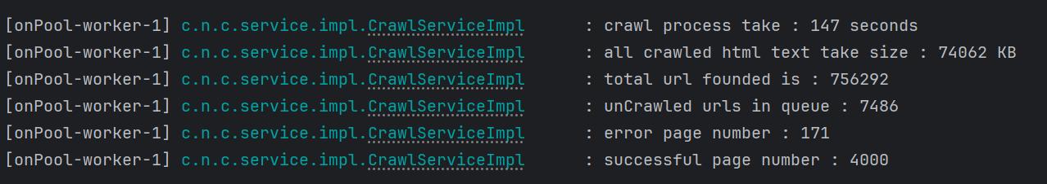
Crawling outputs
Result base on our limitation for crawler to crawl 4000 page successfully.

Slide 8
Key challenges
Depth : Consider depth for internal domain and external domain. For example we specified internal depth =4 and external =2 . Mean from root to url founded if url be internal and less than 4 it can be processed. Consider we moves to depth 3 if this url be internal we can extend it otherwise we skip it. It used for avoiding infinite loop
Performance : at first by using single thread its very slow . for that we used different approach.
1) async with specified platform thread. In this way we don’t block for io operation and increased performance a lot (it takes maybe 10 second for specific domain)
2) use virtual thread without limitation : it send very large connection to server. And server cant handle those request and we saw network bottleneck. And we encountered with lot of 429(too many request) and we encountered with lot of errors. the error rate in this method increased significantly. (in this approach it take 70 second but with lot of error rate)
3) we use previous approach with another component such as rate limit . We consider rate limit at crawler for control max concurrent connection can be created. (this is best approach I founded and take 140 second without network bottleneck

Slide 9
Thanks for attention
If you have any issue or any feedback you can contact me through: email-address
and you are access to source code at git hub address: search-engine-project
also if you like it please give it a star. And you want to contribute to that fork and submit a PR Request.

